Slide 1
Summary of the Steering Committee Meeting

Slide 2
Supercomputing
SC11: Seattle, Washington, USA
12 – 18 November 2011
Dinner on Wednesday night (16 November 2011)
Each person pays
Please contact Peter Arzberger

Slide 3
PRAGMA 22
Monash University will host it
During week of 16 – 20 April 2012
First day may be a development day

Slide 4
Comments on PRAGMA
“Experimenting” organization
We try, we share, we know what others are doing
Source of tools for others
Enable international collaborations
Make cloud easier for scientists to use
Family of researchers
Trust

Slide 5
Summary of Discussions
PRAGMA Cloud
Build on work demonstrated at this workshop
Engage networking
Address backup / duplication capacity
Develop images
Create training
Push boundaries of interoperability, data, …
Disaster Mitigation
Compelling area
How to engage?
What to focus on
Whom to involve

Slide 6
Ideas on the Table
Data explosion
Multitude of devices with sensors
Very important addition to “cloud” (millions of new data sources and sinks)
Android system
Important for disaster mitigation
More interaction between working groups
Application expedition
Conceptual framework for interacting with other communities: AsiaFlux, GLEON, Disaster mitigation

Slide 7
Thanks to the Organizers and Committee Members
Program Committee
Yusuke Tanimura (AIST), Kohei Ichikawa (Osaka), Chao Jin (Monash) and Seok Jong Yu (KISTI)
Chih-Wen Chang (NCHC), Supakit Prueksaaroon (NECTEC)
Kevin Dong (CNIC), Rommie Amaro (UCI/UCSD)
Secretariat
Yuko Oshimia (AIST)

Slide 8
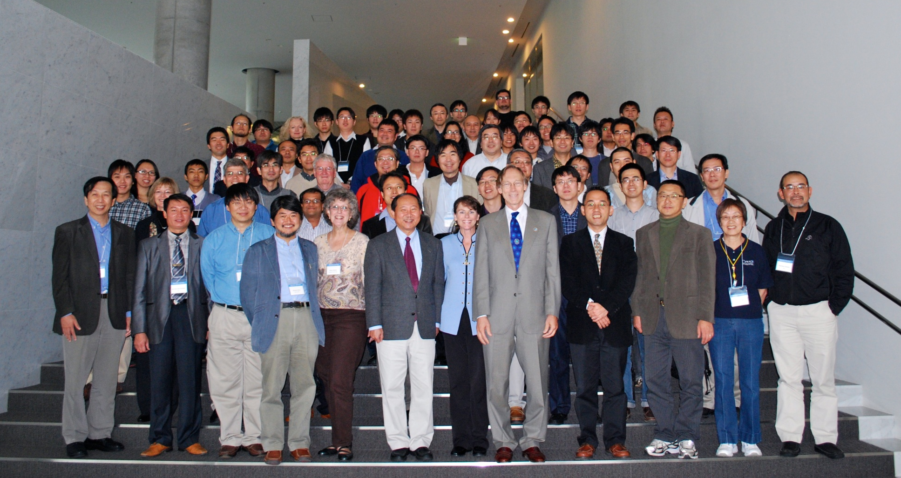
Thank You
Organizers, Sponsors, and
Participants

