Slide 1
e-AIRS Reporting and Issues Resource Working Group, PRAGMA 15
Jongbae Moon, Byungsang Kim, Kum Won Cho
Korea Institute of Science and Technology Information (KISTI)
2008. 10. 24.

Slide 2
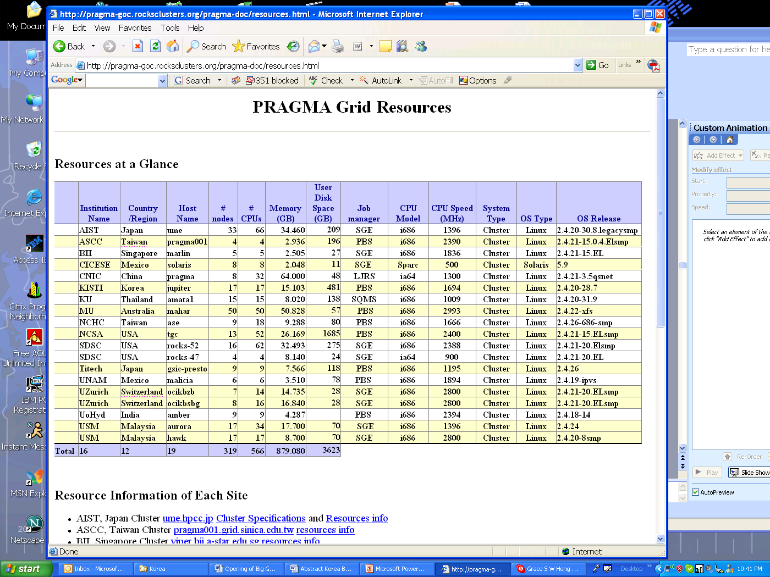





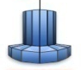
Resources
Cluster
Seoul, SNU
KREONET
Daejeon, KISTI
Sakura,AIST, Japan
Portal Server
Cluster
NCHC, Taiwan
Storage
Cluster
SDSC, USA
Cluster
DB Server
Cluster
UZH, Switzerland
UPRM, Puerto Rico
Cluster
Cluster
NCHC, Taiwan
Cluster

Slide 3
Statistics
How many resources in PRAGMA are used in e-AIRS?
Ver. 1
AIST( Japan), Sakura(Japan)
GT4 only
Ver. 2
Available 15 sites
So far, 300 CPUs
9 sites including AIST (Japan)
1 | AIST | fsvc001.asc.hpcc.jp | 128 | Y
2 | AIST | sakura.hpcc.jp | 34 | Y
3 | ASGC | pragma001.grid.sinica.edu.tw | 6 | GT2
4 | BU | pop.cs.binghamton.edu | 12 | GT2
5 | CNIC | pragma.sdg.ac.cn | 36 | Y
6 | CUHK | server1.itsc.cuhk.edu.hk | 4 | Y
7 | SDSC | rocks-52.sdsc.edu | 30 | GT2
8 | SDSC | rocks-153.sdsc.edu | 20 | GT2
9 | SDSC | rocks-96.sdsc.edu | 16 | GT2
10 | ThaiGrid | sunyata.thaigrid.or.th | 40 | Y
11 | MIMOS | nucleus.mygridusbio.net.my | 16 | Y
12 | USM | aurora.usmgrid.myren.net.my | 34 | GT2
13 | UZH | ocikbpra.unizh.ch | 20 | GT2
14 | UPRM | komolongma.ece.uprm.edu | 108 | Y
15 | IHPC | (sirius.ihpc.a-star.edu.sg | 76 | Y
 | TOT. |  | 492

Slide 4
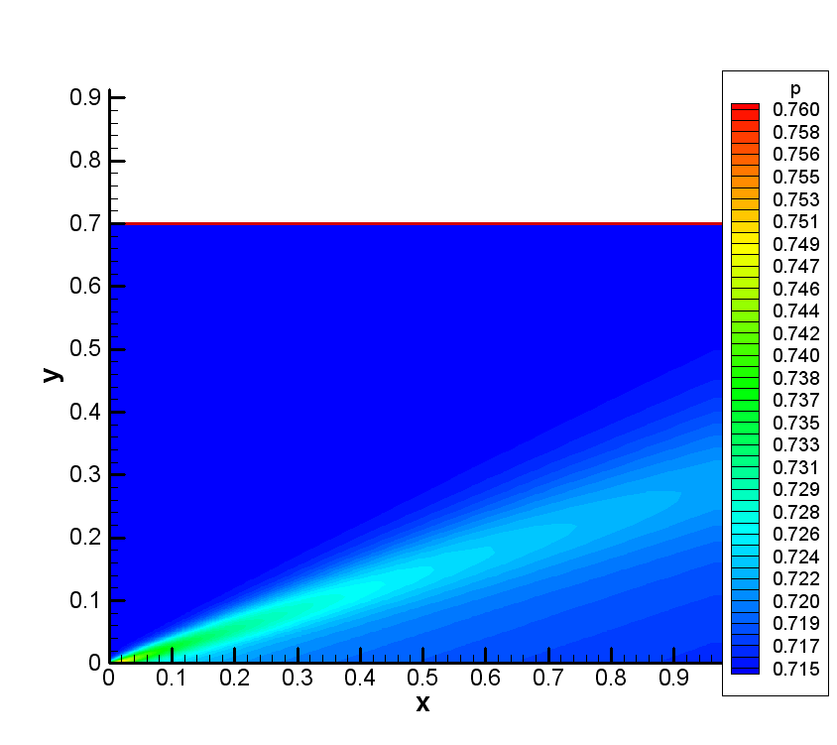
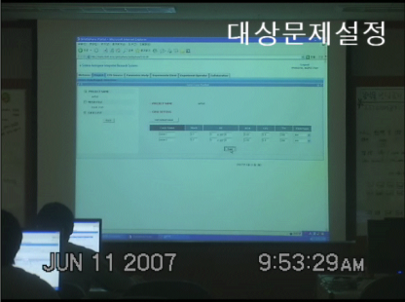
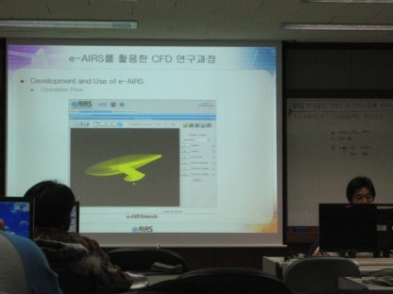
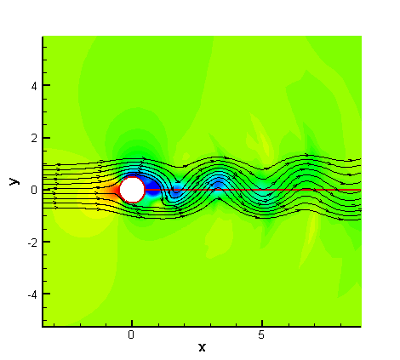
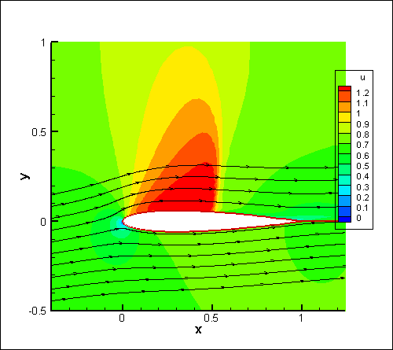
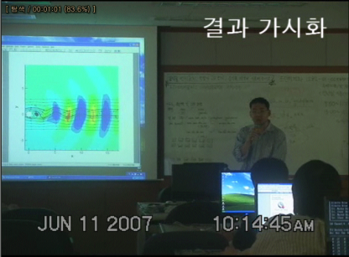
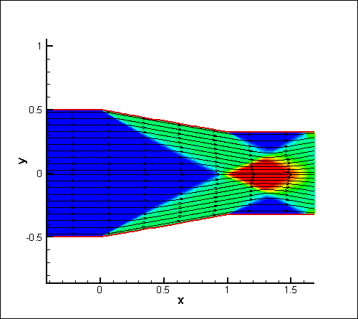
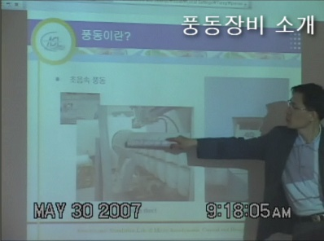
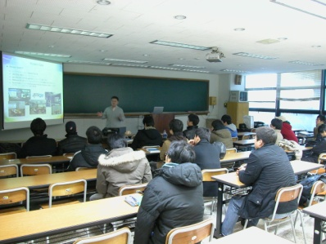
Education Service
Effectiveness of Education
Under and Graduate Student
Introduce Wind Tunnel Experiment, CFD using e-AIRS
Break away traditional text-based CFD lecture → Higher interesting in using e-AIRS at the class
Since 2007. utilizing at two universities classes,
More universities and classes in 2008.
No need to program solvers
Just click simulation button
=> Quick review of Fluid
CFD Lecture
Fluid Computation Result
Wind Tunnel Remote Lecture (Using AG)
Student can see the process of the Wind Tunnel Experiment via AGToolkit.

Slide 5
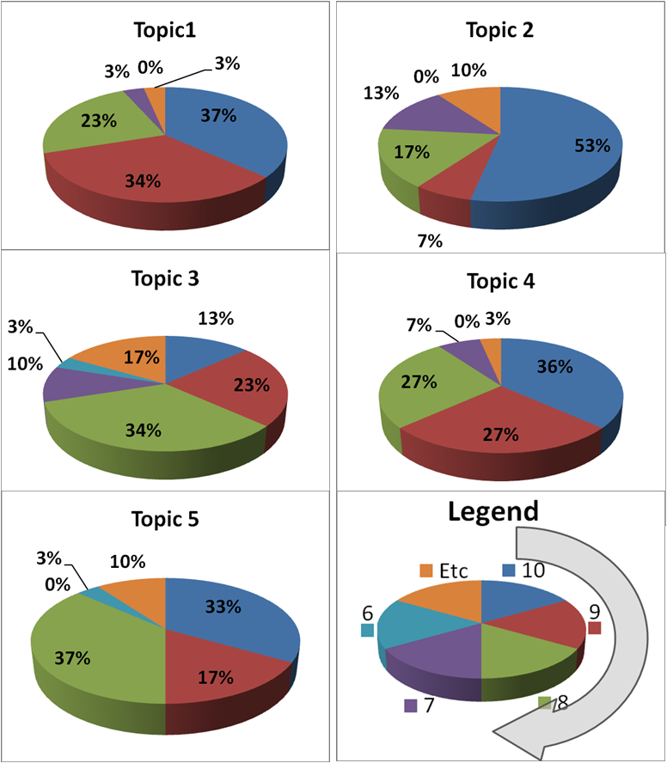
Survey Results
Topic
Increasing the understanding of the CFD simulation process
Convenience of using the portlet based web portal
Functionality and Convenience of the mesh generation
Functionality and Convenience of the CFD simulation
Functionality and Convenience of the Visualization
Topic | Average | Above 8
1 | 8.7 | 94%
2 | 8.4 | 87%
3 | 7.5 | 70%
4 | 8.6 | 90%
5 | 8.1 | 87%

Slide 6

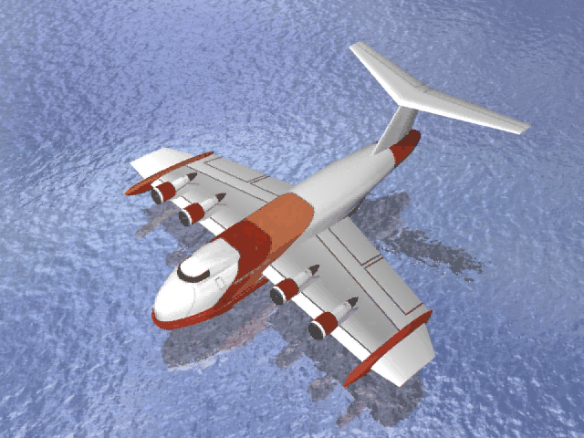

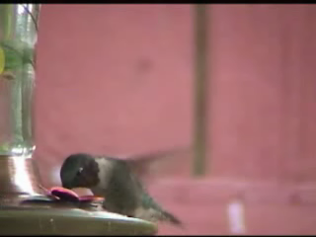
Current and Future Services
1. Cyber Education Service
2. Insect Flapping Simulation Service
3. WIG Craft Simulation Service
4. Black hole Simulation Service

Slide 7
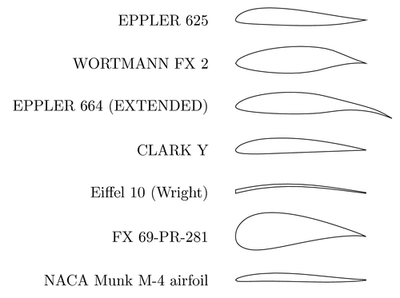
Case study
Busan University conducted a term project using e-AIRS.
5 meshes of NACA 4-digit series Airfoil (NACA 4012, 4112, 4212, 4312, 4412) Parametric Study
Parametric Study variable : Angle of Attack (AOA), Mach number
Freestream flow
direction
Freestream flow
direction
Angle of Attack = 0
Angle of Attack = 30
AOA 0~30, increase by 2 step => 16 Case
Freestream flow
Mach number=3.0
Freestream flow
Mach number=0.2
Angle of Attack = 30
Angle of Attack = 30
Mach number 0.2~3.0 increase by 0.2 => 15 Case
One student submit a job of at least 5*16*15=1,200 cases X 50 students = 60,000 JOBs

Slide 8
Computing resources needed for classes
Average Needs : 6 Univ. X 30 Students X (200~400Case) X 20 min./Case
= 720,000~1,440,000min
= 12,000 hours~24,000 hours
24 hour X 7 days = 168 Hours Under 24h 7days 100% full running condition, Needs CPU : 70 ~ 140 CPUs
Max Needs (at the class) : 1 Univ. X 30 students X (100~200Case) X 20min/Case = 60,000 ~ 120,000min = 1,000hours ~ 2,000hours
We need 167 ~ 330 CPUs
Under 100% running during 6 Hour class,
To solve 3 Dimensional Problem
More CPU time

Slide 9
Need More Resources
There are many resources in PRAGMA (over 1,000 CPUs)
However, there are some problems
Grid authentication problem
Gridmap file typos
"/C=KR/O=KISTI/O=GRID/O=KISTI/CN=48690174 Jongbae Moon". eairs
No CA file update
Network problem
SSH access denied
gsi-ssh may be a alternatives

Slide 10
Global Scheduler or Resource Broker
e-AIRS resource broker
At the classes, students are submitting jobs at the same time
Causing bad situations to some sites
Static information
SCMSweb + GridWay is a candidate.
“Sugree” can help me
Need to install Gridway to all sites of PRAGMA
Developing a Global Scheduler
SCMSweb based?

Slide 11
Authentication Problem
e-AIRS is being used by many students
It is very difficult to register them to GRID
VOMS is mandatory for e-AIRS
PRAGMA VOMS is a good solution
Student has own portal account
However, one account and Sharing a GridProxy
Issue Short-term User Certificate by PRAGMA CA?

Slide 12
Thank you for your attentions!

