Slide 1
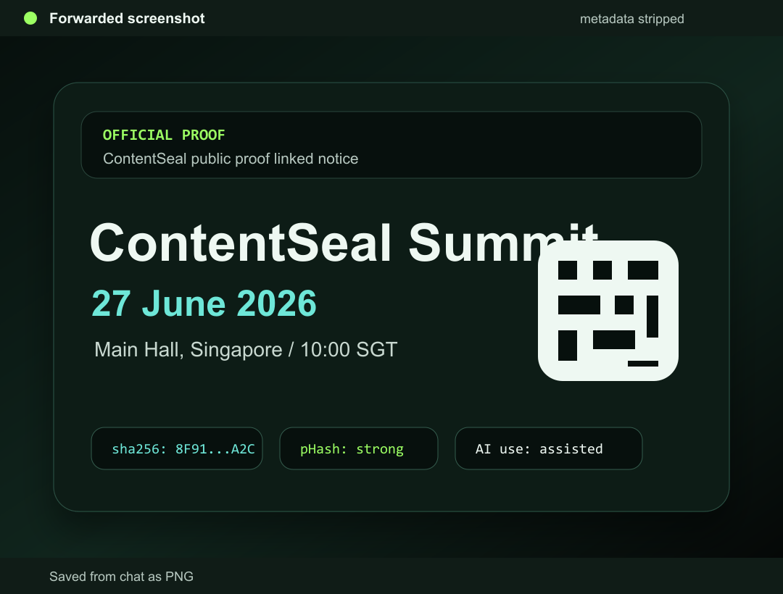
Challenge Statement
01
A2: AUTHENTICITY IN A SYNTHETIC WORLD
ContentSeal
Recover trusted sources after screenshots break provenance.
Recover the source after metadata is gone.
Pan Ting-Yu & Lee Ming Xuan

Slide 2
Target User & Use Case
02
Who exactly is this for?
A specific first ICP, not a broad audience.
First target user
Use case moment
Struggle
Student clubs, event teams, and small publishers who issue public posters or notices.
A viewer receives a screenshot or reposted image in chat or social media before resharing.
They cannot tell whether the image points back to an accountable source.

Slide 3
Pain Point & Bottleneck
03
The pain is uncertainty. The bottleneck is lost context.
A screenshot can look official while source signals are missing.
Pain point
Core bottleneck
Users see a screenshot but cannot tell who issued it, whether it changed, or if it is current.
The original metadata and platform context disappear during screenshot, crop, compression, and reposting.

Slide 4
Current Alternative
04
What users do today does not solve the bottleneck
Current checks are manual, slow, and often impossible after metadata loss.
Reverse image search misses private or newly created event content.
Asking the sender depends on trust in the same broken chain.
Net result
AI detectors may flag style, but not recover accountability.
No accountable source recovered.
Metadata viewers fail when screenshots strip metadata.

Slide 5
Solution & Value Proposition
05
Seal the source before it spreads. Recover it after context breaks.
One-line output: We help viewers recover accountable source evidence from damaged image copies.
What improves
Why it fits A2
Why lightweight
Viewers can move from uncertainty to a recovered proof page or a clear unknown state.
Trust is tied to source recovery, human accountability, and synthetic-media context.
The receipt uses hashes, visual fingerprints, and public proof context, not heavy enterprise setup.

Slide 6
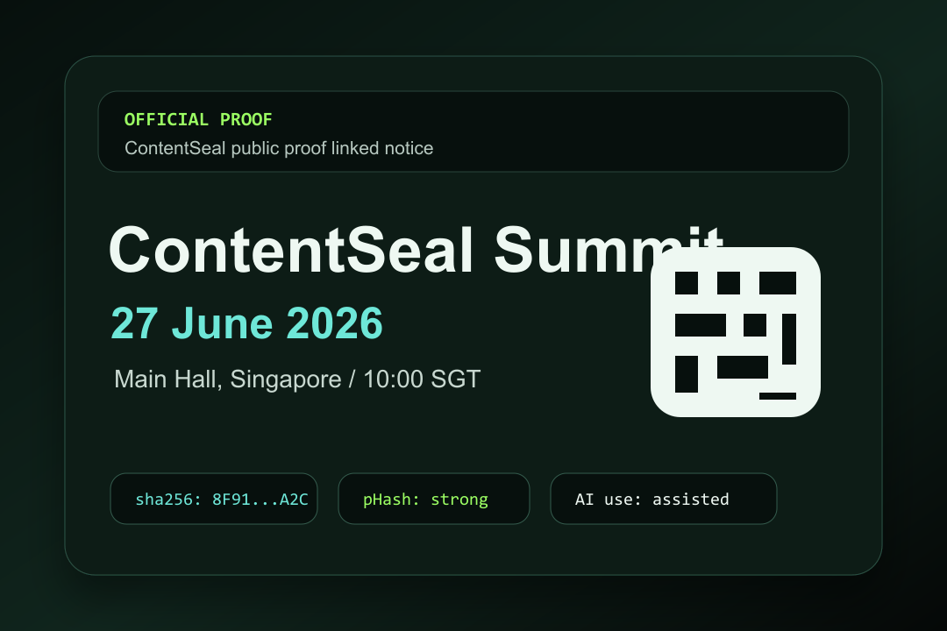
How It Works
06
Show the product flow
Seal source -> recover screenshot -> open proof -> warn limits.
Open Proof Page
Guardrails
issuer • AI usage • source • expiry • status
changed copy warning
unknown stays unknown
1. Seal original
2. Recover screenshot
3. Check proof
4. Warn limits

Slide 7
AI Leverage & Technical Execution
07
AI Evidence Layer: explain trust without pretending certainty
Not a black-box fake verdict. It turns provenance signals into user-facing evidence.
Source recovery
Human accountability
AI context
Change risk
Exact hash and pHash variants recover originals, screenshots, crops, and reposts.
The recovered proof page shows issuer, trust level, source URL, expiry, and status.
Declared AI usage plus optional C2PA, watermark, classifier, and OCR signals.
Separates verified original, screenshot recovery, changed copy, conflict, and unknown.

Slide 8
Traction & Validation
08
Working prototype, tested against the key edge cases
We validated the product logic against exact, screenshot, edited, and unknown images.
Live Vercel prototype with Firebase-backed persistence.
Judge-ready checks
Regression tests for real cropped screenshot recovery and changed-copy risk.
Fixture checks cover original, screenshot/repost, edited copy, and unknown image.
works live
clear user
clear bottleneck
clear value
Next validation: interviews with clubs, event teams, and small publishers.

Slide 9
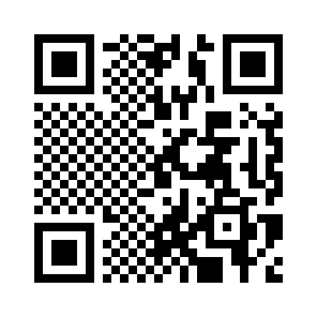
Close
09
LIVE SITE
ContentSeal
Try it
We help viewers who receive screenshots recover accountable source evidence, so they can verify before resharing.
contentseal.vercel.app
github.com/mx1204/ContentSeal
Scan live site

