Slide 1

Heart Disease
Muhammad Faraz Akram

Slide 2
Introduction
Dataset
Data source
Reason
Expectation
Heart Diseases
CDC Official Website
To find which Age, Gender, Race is more at risk of getting Heart Disease
To run classification models on the Dataset at hand

Slide 3
Cleaning of the Dataset
Missing Values
Target Values
Unneeded Columns
Plan of Action
Unique Values
Fixing Outliers

Slide 4
Cleaning Examples
“Data Value Footnote” had 81.66% missing values
Target values were Topics (Heart Diseases)
Unneeded Columns (Data source)
Topics had 6 unique values
Break out and Break out Category had 17 unique values combined

Slide 5
Feature Engineering
Diseases
Dummying up Target Variable
(6 Types of Heart Conditions)
Categories
Dummying up Categories
(Age, Race, Gender,..)
Binary Data
Converting Columns into Binary Data

Slide 6
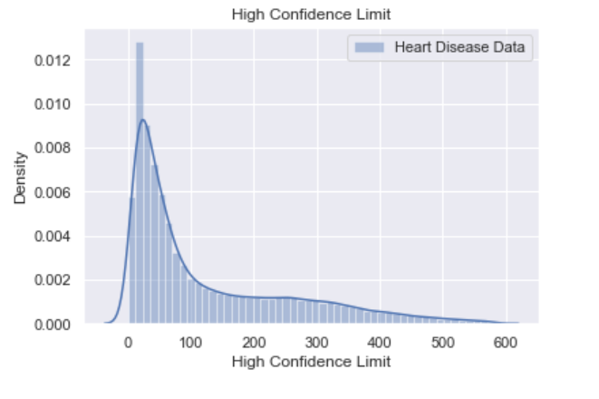
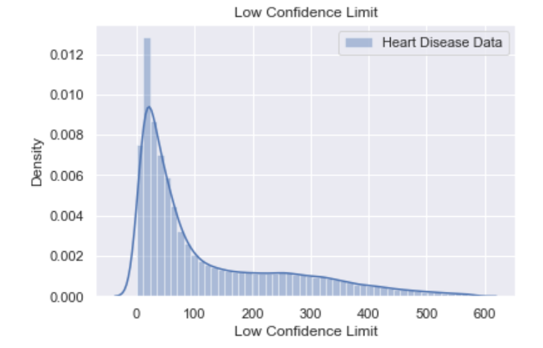
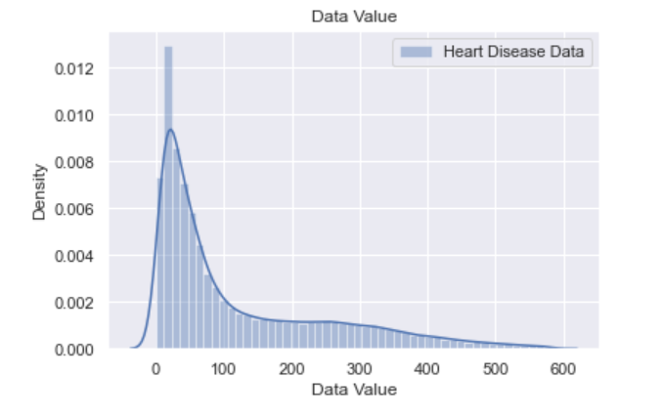
Distribution

Slide 7
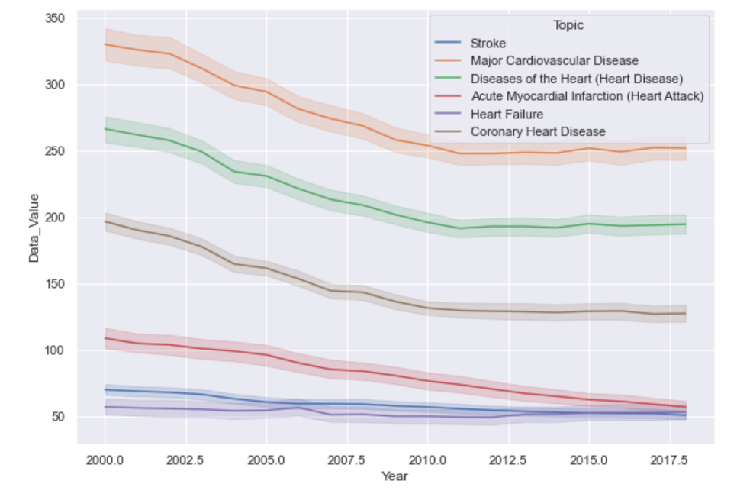
Lineplot for Data Value and Years
Data Value is the Point Estimate rate per 100,000

Slide 8
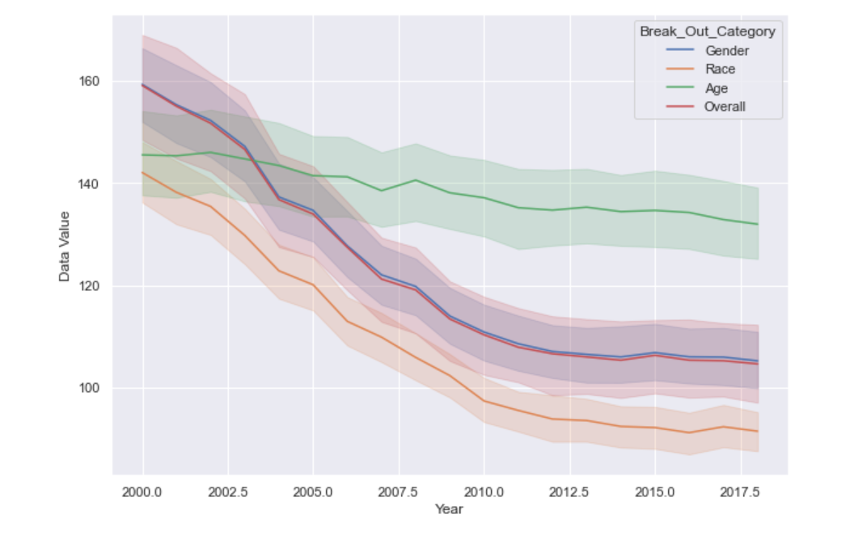
Lineplot for Data Value and Year

Slide 9

Types of Heart Condition
Stroke
Cardiovascular Disease
Heart Attack
Heart Failure
Coronary Heart Disease
Other Heart Diseases

Slide 10
Modeling
One Vs Rest Classification
Random Forest Classification
Extra Tree Classification
Multiclassification Model used for more than two classes. (6 diseases)
Using it to predict One Disease at a time (Binary Data)
Using it to predict One Disease at a time (Binary Data)

Slide 11
One Vs Rest Classification
Six Diseases
Model was overfit
Test score is approximate 69%
Train score is 77%
Baseline Accuracy = 63.2%

Slide 12

Classification Models for Diseases Random Forest Classification
Disease | Train Score | Test Scores | Overfit
Stroke | 86 % | 81 % | Yes
Cardiovascular Disease | 95 % | 93 % | No
Coronary Heart Disease | 95 % | 94 % | No
Heart Attack | 89 % | 88 % | No
Heart Failure | 92 % | 91 % | No
Other Heart Disease | 93 % | 90 % | No

Slide 13
Classification Models for Diseases Extra Tree Classification
Diseases | Train Score | Test Score | Overfit
Stroke | 84 % | 80 % | Yes
Cardiovascular Disease | 94 % | 93 % | No
Coronary Heart Disease | 94 % | 93 % | No
Heart Attack | 89 % | 88 % | No
Heart Failure | 90.5 % | 90.2 % | No
Other Heart Diseases | 91 % | 89 % | No

Slide 14
Confusion Matrix
In this Confusion Matrix, we can better explain the outcome
True negatives means that we correctly predicted the people who don't have Heart Disease
True positives means that we correctly predicted the people who have Heart Disease
False positives means that we incorrectly predicted the people who have Heart Disease(who don't have Heart Disease)
False negatives means that we incorrectly predicted the people who don't have Heart Disease(who have Heart Disease)

Slide 15
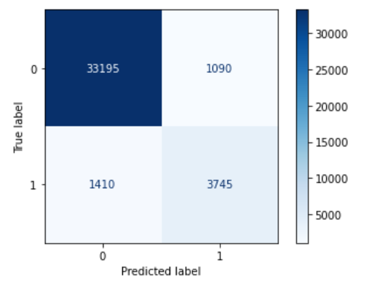
Confusion Matrix for Cardiovascular Disease
Better able to predict True Negatives
Will be helpful in specifying the people with no Heart Conditions
Will be able to make better Healthcare plans for the members

Slide 16
Conclusion
Values related to Stoke 62%
One Vs Rest Classification was Overfit
Models worked well
Success in True Negatives

Slide 17

Thank You for Listening

