Slide 1
CSBP483 Mobile Web Content and Development
UI Design – Layouts & Menus
Dr. Mamoun Adel Awad
Lecture Video: https://www.youtube.com/watch?v=a-6_BKyUmWI

Slide 2
Outline
Layout Definition
LinearLayout
Relative Layout
Constraint Layout:
GridLayout
GridView & ListView
Dialog Layout
TableLayout
Menus
Notes:
https://www.sitepoint.com/know-your-layouts-in-android/

Slide 3
Program Learning Outcomes
Upon the successful completion of the course, students should be able to:
Design mobile User Interface (views, layout, controls, etc.)
Explain the key technological principles and methods for delivering and maintaining mobile applications
Apply Model-View-View-Model (MVVM) design principle and its variants
Develop a complete project/application for smart-phones and tablets.

Slide 4
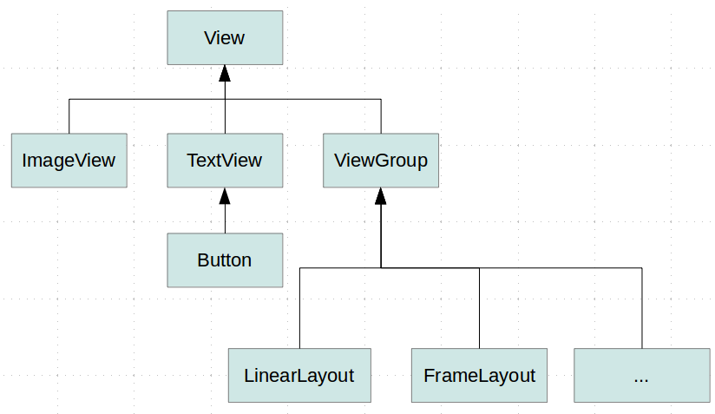
Layouts
View is a basic UI building block and occupies a rectangular area on the screen
A ViewGroup is a special base class/view that can contain other views (called children.)
Layouts:
a subclasses of ViewGroup class
defines the visual structure for an Android user interface

Slide 5
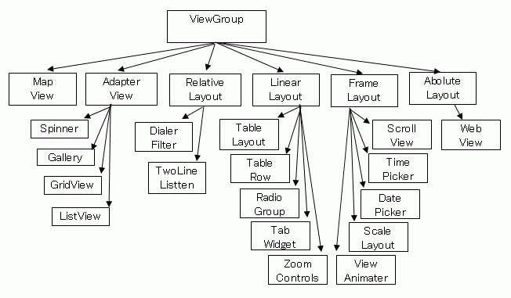
Layouts

Slide 6
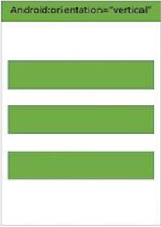
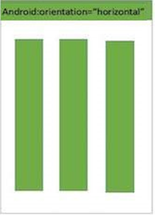
Linearlayout
A layout that arranges other views either horizontally in a single column or vertically in a single row.
android:orientation: to specify whether child views are displayed in a row or column.
android:gravity: To control how linear layout aligns all the views it contains
android:layout_weight: to specify how linear layout divides remaining space amongst the views it contains.
LinearLayout.LayoutParams : to set on a child view to affect its position and size in the containing linear layout.

Slide 7
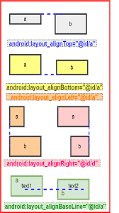
Relative Layout
RelativeLayout is a view group that displays child views in relative positions.
The position of each view can be specified as relative to sibling elements (such as to the left-of or below another view) or in positions relative to the parent RelativeLayout area (such as aligned to the bottom, left or center).
For better performance, use Constraint Layout instead.

Slide 8
Constraint Layout
A ConstraintLayout is a ViewGroup which allows you to position and size widgets in a flexible way.
Available as a support library that you can use on Android systems starting with API level 9 (Gingerbread).
There are various of constraints we can use:
Relative positioning | Centering positioning
Margins | Visibility behavior
Circular positioning | Dimension constraints
Chains | Virtual Helpers objects
Optimizer
Notes:
https://developer.android.com/reference/androidx/constraintlayout/widget/ConstraintLayout
Centering positioning and bias
it deals with "impossible" constraints, the constraints act like opposite forces pulling the widget apart equally
Bias The default when encountering such opposite constraints is to center the widget; but you can tweak the positioning to favor one side over another using the bias attributes:
layout_constraintHorizontal_bias
layout_constraintVertical_bias
Circular positioning (Added in 1.1)
You can constrain a widget center relative to another widget center, at an angle and a distance. This allows you to position a widget on a circle (see Fig. 6). The following attributes can be used:

Slide 9
Constraints
Relative Positioning:
Allows position a given widget relative to another one
Centering positioning and bias
"impossible" constraints, the constraints act like opposite forces pulling the widget apart equally
Bias: favor one axis over the other.
Circular positioning (Added in 1.1)
angle and a distance constraints allowing position a widget on a circle. (e.g., Circle, radius, angle)
Visibility behavior
View.GONE is considered in layout computation
Dimension Constraints
can define minimum and maximum of the constraint layout
Chains
provide group-like behavior in a single axis
https://developer.android.com/reference/androidx/constraintlayout/widget/ConstraintLayout
Notes:
The dimension of the widgets can be specified by setting the android:layout_width and android:layout_height attributes in 3 different ways:
Using a specific dimension (either a literal value such as 123dp or a Dimension reference)
Using WRAP_CONTENT, which will ask the widget to compute its own size
Using 0dp, which is the equivalent of "MATCH_CONSTRAINT“
Match-Parient is not recommended.

Slide 10
Constraint Layout - Relative Positioning
Relative positioning is one of the basic building block of creating layouts in ConstraintLayout.
Those constraints allow you to position a given widget relative to another one.
You can constrain a widget on the horizontal and vertical axis:
Horizontal Axis: left, right, start and end sides
Vertical Axis: top, bottom sides and text baseline
Tutorial on Learning Constraints using Android Studio Editor :
https://developer.android.com/training/constraint-layout/
https://developer.android.com/develop/ui/views/layout/constraint-layout

Slide 11
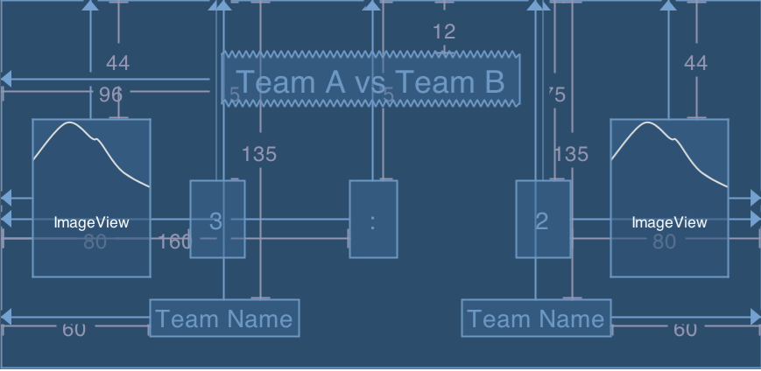
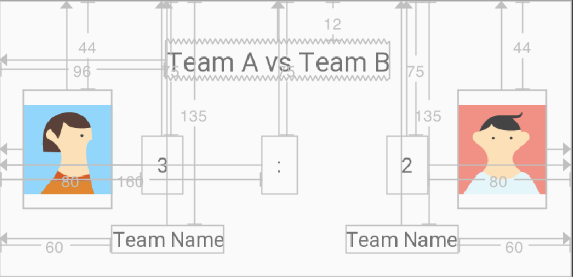
Constraint Layout
(Blueprint)

Slide 12
Relative Positioning
T
T
<Button android:id="@+id/buttonA" ... />
<Button android:id="@+id/buttonB"
layout_constraintLeft_toRightOf="@+id/buttonA"
/>
L
A
R
L
B
R
B
B
A | B
B
Left-side of buttonB is-connected-to right-side of buttonA
<Button android:id="@+id/buttonA"
layout_constraintLeft_toRightOf="@+id/buttonB"
/>
<Button android:id="@+id/buttonB"
…
/>
T
T
L
A
R
L
B
R
B
B
B
B
A
Left-side of buttonA is-connected-to right-side of buttonB

Slide 13
List of Available Constraints (Relative Positioning)
layout_constraintLeft_toLeftOf | layout_constraintBottom_toTopOf
layout_constraintLeft_toRightOf | layout_constraintBottom_toBottomOf
layout_constraintRight_toLeftOf | layout_constraintBaseline_toBaselineOf
layout_constraintRight_toRightOf | layout_constraintStart_toEndOf
layout_constraintTop_toTopOf | layout_constraintStart_toStartOf
layout_constraintTop_toBottomOf | layout_constraintEnd_toStartOf
 | layout_constraintEnd_toEndOf
They all take a reference id to another widget, or the parent (which will reference the parent container, i.e. the ConstraintLayout):
<Button android:id="@+id/buttonB" ...
app:layout_constraintLeft_toLeftOf="parent" />

Slide 14
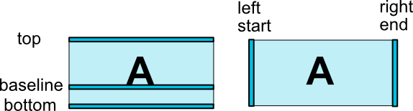
Relative Positioning

Slide 15
Example: align TextView: Hello relative to parent
No constraints (Same as top-top).
Right-Right=‘parent’
Bottom-bottom=‘parent’
Bottom-bottom=‘parent’, right-right=‘parent
Top-top=parent, bottom-bottom=‘parent
Top-top=parent, bottom-bottom=‘parent, right-right=‘parent’
Top-top=‘parent’, bottom-bottom=‘parent’ , Right-right = ‘parent’, left-left=‘parent’
You do it.
You do it
Hello¹
Hello⁹
Hello²
Hello⁵
Hello⁷
Hello⁶
Hello³
Hello⁸
Hello⁴
You can apply android:layout_marginXXXX=“..dp” to adjust the location.
Notes:
marginLeft is effective if it has constraint_Left.

Slide 16
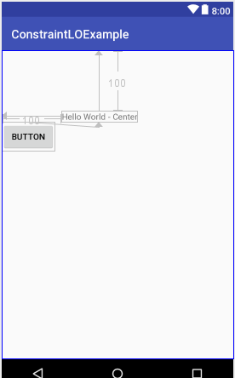
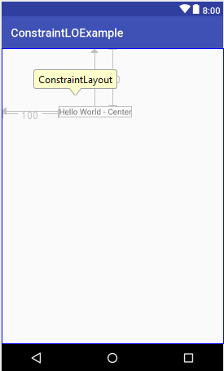
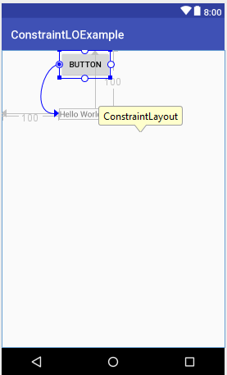
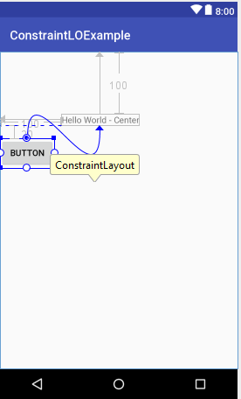
Constraint Layout Example (1)
<TextView android:id=“id/tv_1” android:layout_width="wrap_content" android:layout_height="wrap_content" android:text="Hello World" app:layout_constraintTop_toTopOf="parent" app:layout_constraintLeft_toLeftOf="parent" android:layout_marginTop="100dp" android:layout_marginLeft="100dp" />
<Button android:id="@+id/button" android:layout_width="wrap_content" android:layout_height="wrap_content" android:text="Button" app:layout_constraintTop_toBottomOf="@id/tv_1“
android:layout_marginTop==“20dp” />
<Button android:id="@+id/button" android:layout_width="wrap_content" android:layout_height="wrap_content" android:text="Button" app:layout_constraintStart_toStartOf="@id/tv_1" />
<Button android:id="@+id/button" android:layout_width="wrap_content" android:layout_height="wrap_content" android:text="Button" app:layout_constraintTop_toBottomOf="@id/tv_1“ />

Slide 17
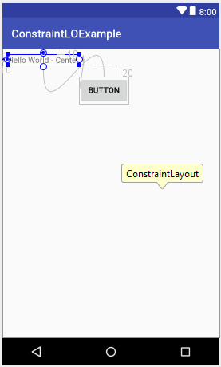
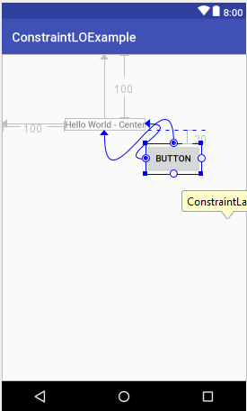
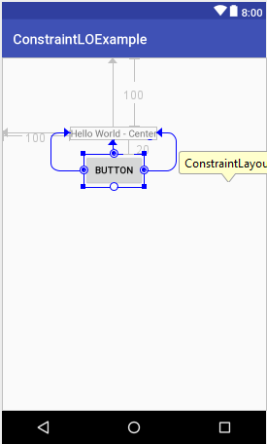
Constraint Layout Example (2 )
Q. Edit the XML to align the button.
<TextView android:id=“id/tv_1” android:layout_width="wrap_content" android:layout_height="wrap_content" android:text="Hello" app:layout_constraintTop_toTopOf="parent" app:layout_constraintLeft_toLeftOf="parent" android:layout_marginTop="100dp" android:layout_marginLeft="100dp" />
<TextView android:id=“id/tv_1” android:layout_width="wrap_content" android:layout_height="wrap_content" android:text="Hello" app:layout_constraintTop_toTopOf="parent" app:layout_constraintLeft_toLeftOf="parent" android:layout_marginTop="10dp" android:layout_marginLeft=“10dp" />
<Button android:id="@+id/button" android:layout_width="wrap_content" android:layout_height="wrap_content" android:text="Button" app:layout_constraintTop_toBottomOf="@id/tv_1" android:layout_marginTop="20dp" app:layout_constraintLeft_toLeftOf="@id/tv_1" app:layout_constraintRight_toRightOf="@id/tv_1" />
<Button android:id="@+id/button" android:layout_width="wrap_content" android:layout_height="wrap_content" android:text="Button" app:layout_constraintTop_toBottomOf="@id/tv_1" android:layout_marginTop="20dp" app:layout_constraintLeft_toRightOf="@id/tv_1" />
<Button android:id="@+id/button" android:layout_width="wrap_content" android:layout_height="wrap_content" android:text="Button" app:layout_constraintTop_toBottomOf="@id/tv_1“
android:layout_marginTop==“20dp” />

Slide 18
Constraint Layout Example (2 )
Q. Edit the XML to align the button.
What if we edit this textview???
<TextView android:id=“id/tv_1” android:layout_width="wrap_content" android:layout_height="wrap_content" android:text="Hello" app:layout_constraintTop_toTopOf="parent" app:layout_constraintLeft_toLeftOf="parent" android:layout_marginTop="10dp" android:layout_marginLeft=“10dp" />
<TextView android:id=“id/tv_1” android:layout_width="wrap_content" android:layout_height="wrap_content" android:text="Hello" app:layout_constraintTop_toTopOf="parent" app:layout_constraintLeft_toLeftOf="parent" android:layout_marginTop="100dp" android:layout_marginLeft="100dp" />
How to align the button??
How to align the button??
<Button android:id="@+id/button" android:layout_width="wrap_content" android:layout_height="wrap_content" android:text="Button" app:layout_constraintTop_toBottomOf="@id/tv_1" android:layout_marginTop="20dp" app:layout_constraintLeft_toRightOf="@id/tv_1" />
<Button android:id="@+id/button" android:layout_width="wrap_content" android:layout_height="wrap_content" android:text="Button" app:layout_constraintTop_toBottomOf="@id/tv_1" android:layout_marginTop="20dp" app:layout_constraintLeft_toLeftOf="@id/tv_1" app:layout_constraintRight_toRightOf="@id/tv_1" />
<Button android:id="@+id/button" android:layout_width="wrap_content" android:layout_height="wrap_content" android:text="Button" app:layout_constraintTop_toBottomOf="@id/tv_1“
android:layout_marginTop==“20dp” />

Slide 19

Overlapping
If two views overlap, then the later view in the xml will be placed at the top of the earlier view.
50 dp
50 dp
<TextView android:layout_width="match_parent" android:layout_height="40dp" android:background="@color/colorPrimary" app:layout_constraintTop_toTopOf="parent" android:layout_marginTop="120dp" /> <ImageView android:id="@+id/pic_iv4" android:layout_width="150dp" android:layout_height="120dp" android:src="@drawable/pic_1" app:layout_constraintRight_toRightOf="parent" app:layout_constraintLeft_toLeftOf="parent" app:layout_constraintTop_toTopOf="parent" android:layout_marginTop="50dp" />
What will happen if you reverse the order of the textview and image view?

Slide 20
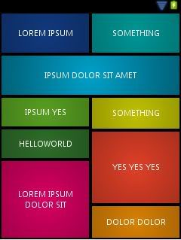
GridLayout
A layout that places its children in a rectangular grid.
The grid is composed of a set of infinitely thin lines that separate the viewing area into cells.
A grid with N columns has N + 1 grid indices that run from 0 through N inclusive.
Regardless of how GridLayout is configured, grid index 0 is fixed to the leading edge of the container and grid index N is fixed to its trailing edge (after padding is taken into account).
Attributes:
columnCount: set number of columns
column/rowSpan: to span more than one columns/rows.
Layout_gravity: fill_horizontal/fill_vertical to occupy whole row/column
Notes:
The grid is composed of a set of infinitely thin lines that separate the viewing area into cells. Throughout the API, grid lines are referenced by grid indices. A grid with N columns has N + 1 grid indices that run from 0 through N inclusive. Regardless of how GridLayout is configured, grid index 0 is fixed to the leading edge of the container and grid index N is fixed to its trailing edge (after padding is taken into account).

Slide 21
CSBP483 Mobile Web Content and Development
GridView & ListView & Menus
Dr. Mamoun Adel Awad

Slide 22
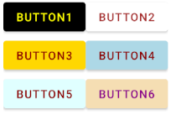
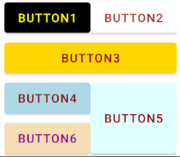
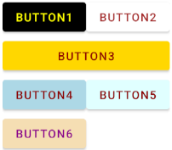
GridLayout Example (XML)
<Button android:layout_width="wrap_content" android:layout_height="wrap_content" android:text="Button1"/> <Button android:layout_width="wrap_content" android:layout_height="wrap_content" android:text="Button2"/> <Button android:layout_width="wrap_content" android:layout_height="wrap_content“
android:layout_columnSpan="2"
android:layout_gravity="fill_horizontal" android:text="Button3"/> <Button android:layout_width="wrap_content" android:layout_height="wrap_content" android:text="Button4" /> <Button android:layout_width="wrap_content" android:layout_height="wrap_content" android:text="Button5"/> <Button android:layout_width="wrap_content" android:layout_height="wrap_content" android:text="Button6" /> </GridLayout>
<Button android:layout_width="wrap_content" android:layout_height="wrap_content" android:text="Button1"/> <Button android:layout_width="wrap_content" android:layout_height="wrap_content" android:text="Button2"/> <Button android:layout_width="wrap_content" android:layout_height="wrap_content“
android:layout_columnSpan="2"
android:layout_gravity="fill_horizontal" android:text="Button3"/> <Button android:layout_width="wrap_content" android:layout_height="wrap_content" android:text="Button4" /> <Button android:layout_width="wrap_content" android:layout_height="wrap_content“
android:layout_rowSpan="2"
android:layout_gravity="fill_vertical” android:text="Button5"/> <Button android:layout_width="wrap_content" android:layout_height="wrap_content" android:text="Button6" /> </GridLayout>
<Button android:layout_width="wrap_content" android:layout_height="wrap_content" android:text="Button1"/> <Button android:layout_width="wrap_content" android:layout_height="wrap_content" android:text="Button2"/> <Button android:layout_width="wrap_content" android:layout_height="wrap_content" android:text="Button3"/> <Button android:layout_width="wrap_content" android:layout_height="wrap_content" android:text="Button4" /> <Button android:layout_width="wrap_content" android:layout_height="wrap_content" android:text="Button5"/> <Button android:layout_width="wrap_content" android:layout_height="wrap_content" android:text="Button6" /> </GridLayout>
<GridLayout android:id="@+id/gridLayout" android:layout_width=“wrap_content" android:layout_height="wrap_content" android:layout_gravity="center" android:columnCount=“2" >
Notes:
<GridLayout android:id="@+id/test_gv" android:layout_width="wrap_content" android:layout_height="wrap_content" app:layout_constraintTop_toBottomOf="@id/button_fb" app:layout_constraintLeft_toLeftOf="parent" app:layout_constraintRight_toRightOf="parent" android:columnCount="2" > <Button android:layout_width="wrap_content" android:layout_height="wrap_content" android:textColor="@color/Yellow" android:backgroundTint="@color/black" android:text="Button1"/> <Button android:layout_width="wrap_content" android:layout_height="wrap_content" android:textColor="@color/Brown" android:backgroundTint="@color/white" android:text="Button2"/> <Button android:layout_width="wrap_content" android:layout_height="wrap_content" android:textColor="@color/DarkRed" android:backgroundTint="@color/Gold" android:layout_columnSpan="2" android:layout_gravity="fill_horizontal" android:text="Button3"/> <Button android:layout_width="wrap_content" android:layout_height="wrap_content" android:textColor="@color/DarkRed" android:backgroundTint="@color/LightBlue" android:text="Button4" /> <Button android:layout_width="wrap_content" android:layout_height="wrap_content" android:textColor="@color/DarkRed" android:backgroundTint="@color/LightCyan" android:layout_rowSpan="2" android:layout_gravity="fill_vertical" android:text="Button5"/> <Button android:layout_width="wrap_content" android:layout_height="wrap_content" android:textColor="@color/DarkMagenta" android:backgroundTint="@color/Wheat" android:text="Button6" /> </GridLayout>

Slide 23
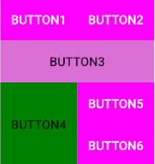

GridLayout Example
<GridLayout android:id="@+id/test_gv" android:layout_width=“wrap_content" android:layout_height="wrap_content" android:layout_gravity="center" android:columnCount=“2" />
if(i==2){ b.setBackgroundColor(getColor(R.color.AliceBlue)); b.setBackgroundColor(getColor(R.color.Orchid)); layoutParams.columnSpec = GridLayout.spec(0, 2,
GridLayout.FILL); }else if(i==3) { b.setBackgroundColor(getColor(R.color.Azure)); b.setBackgroundColor(getColor(R.color.Green)); layoutParams.rowSpec = GridLayout.spec(0, 2,
GridLayout.FILL); }else{ b.setTextColor(getColor(R.color.White)); b.setBackgroundColor(getColor(R.color.Magenta)); } b.setLayoutParams(layoutParams); b.setText("Button" + (i+1)); layout.addView(b); } }
public void setGridLayout(){ GridLayout layout = findViewById(R.id.test_gv); for(int i=0;i<6;i++) { Button b = new Button(this); b.setOnClickListener(new View.OnClickListener() { @Override public void onClick(View view) { //add your action on clicking this button }}); GridLayout.LayoutParams layoutParams =
new GridLayout.LayoutParams(); //set the button layout and background… }
Kotlin
Notes:
///////////////////////Kotlin //////////////////////
package com.example.mycsbp483app.ui import android.os.Bundle import android.widget.Button import android.widget.GridLayout import android.widget.Toast import androidx.activity.enableEdgeToEdge import androidx.appcompat.app.AppCompatActivity import androidx.core.view.ViewCompat import androidx.core.view.WindowInsetsCompat import com.example.mycsbp483app.R class LayoutDemoActivity : AppCompatActivity() { override fun onCreate(savedInstanceState: Bundle?) { super.onCreate(savedInstanceState) enableEdgeToEdge() setContentView(R.layout.activity_layout_demo) ViewCompat.setOnApplyWindowInsetsListener(findViewById(R.id.main)) { v, insets -> val systemBars = insets.getInsets(WindowInsetsCompat.Type.systemBars()) v.setPadding(systemBars.left, systemBars.top, systemBars.right, systemBars.bottom) insets } setGridLayout() } fun setGridLayout() { val layout = findViewById<GridLayout>(R.id.test_gv) for (i in 0..5) { val b = Button(this); b.text = String.format("Button %d", i + 1) b.setOnClickListener { Toast.makeText( this, "Button:" + b.text.toString() + " was clicked..", Toast.LENGTH_SHORT ).show() } val param = GridLayout.LayoutParams(); when(i){ 2 -> { b.setBackgroundColor(getColor(R.color.AliceBlue)); b.setBackgroundColor(getColor(R.color.Orchid)); param.columnSpec = GridLayout.spec(0, 2,GridLayout.FILL); } 3 ->{ b.setBackgroundColor(getColor(R.color.Azure)); b.setBackgroundColor(getColor(R.color.Green)); param.rowSpec = GridLayout.spec(0, 2, GridLayout.FILL); }else->{ b.setTextColor(getColor(R.color.White)); b.setBackgroundColor(getColor(R.color.Magenta)); } } b.setLayoutParams(param); layout.addView(b); } } }
////////////// Java ///////////////////////////////
public void setGridLayout(){ GridLayout layout = findViewById(R.id.test_gv); for(int i=0;i<6;i++) { Button b = new Button(this); b.setOnClickListener(new View.OnClickListener() { @Override public void onClick(View view) { //add your action on clicking this button } }); GridLayout.LayoutParams layoutParams = new GridLayout.LayoutParams(); if(i==2){ b.setBackgroundColor(getColor(R.color.AliceBlue)); b.setBackgroundColor(getColor(R.color.Orchid)); layoutParams.columnSpec = GridLayout.spec(0, 2, GridLayout.FILL); }else if(i==3) { b.setBackgroundColor(getColor(R.color.Azure)); b.setBackgroundColor(getColor(R.color.Green)); layoutParams.rowSpec = GridLayout.spec(0, 2, GridLayout.FILL); }else{ b.setTextColor(getColor(R.color.White)); b.setBackgroundColor(getColor(R.color.Magenta)); } b.setLayoutParams(layoutParams); b.setText("Button" + (i+1)); layout.addView(b); } }

Slide 24


GridView vs. ListView
GridView is a ViewGroup that displays items in a two-dimensional, scrollable grid. The grid items are automatically inserted to the layout using an Adapter object.
GridView
ListView: is a one column GridView and it displays a vertically-scrollable collection of views, where each view is positioned immediately below the previous view in the list.
ListView

Slide 25
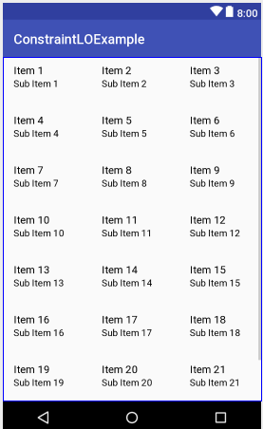
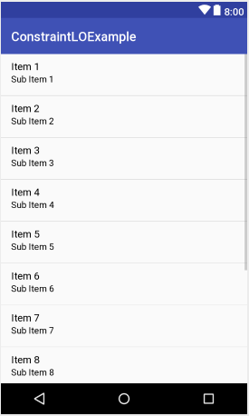
GridView & ListView
<GridView android:id="@+id/gridview" android:layout_width="match_parent" android:layout_height="match_parent" android:columnWidth="90dp" android:numColumns="auto_fit" android:verticalSpacing="10dp" android:horizontalSpacing="10dp" android:stretchMode="columnWidth" android:gravity="center" />
<ListView android:id="@+id/list_view" android:layout_width="match_parent" android:layout_height="match_parent" android:entries=“@array/cities” />
Setting the listview from array resource.

Slide 26
GridView vs. ListView
GridView
ListView
2D grid, Multi-columns
Scrollable
Data source is set in the code
Attributes:
numColumn to set number of columns (or set auto_fit)
Horizontal/Vertical spacing
Stretching
Column width
On column GridView
Scrollable
Data source is set in Java & XML
Attributes:
Entries to set the source
Notes:
ListView
=======
One column GridView
Displays a vertically-scrollable collection of views, where each view is positioned immediately below the previous view in the list.
To enable scrollable: you must have layout_height = “XXdp”
Wrap content might not work.
GridView:
========
Items are places in a 2D grid.
numColumns: sets number of columns (or set auto_fit)
We an add items/views according to the sequence. (row by row).
No “entries” attribute to set source of items in the xml

Slide 27
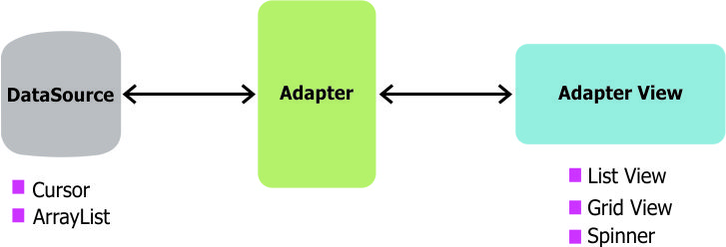
GridView/ListView Design

Slide 28
Setting the Adapter from resource.
<string-array name=“cities"> <item>Amman</item> <item>Baghdad</item> <item>Cairo</item> <item>Kuwait </item> <item>Abu Dhabi</item> /string-array>
Data Source
String[] arr = getResources().getStringArray(R.array.cities);
ArrayAdapter<String> adapter = new ArrayAdapter<>(
this,android.R.layout.simple_list_item_1,arr);
Adapter
GridView gv = (GridView) findViewById(R.id.lv_test);
gv.setAdapter(adapter);
GridView/ListView
gv.setOnItemClickListener(new AdapterView.OnItemClickListener() { public void onItemClick(AdapterView<?> adapterView,
View view, int position, long rowId) { // view: the gridview item that was clicked (TextView)
// position: item position // item text: arr[position] or lv.getAdapter().getItem(position).toString() // item text: ((TextView)view).getText().toString()
// rowId: The row id of the item that was clicked. }});}
Kotlin
Notes:
//Kotlin:
//Data source
val cities = resources.getStringArray(R.array.cities)
//Adpater
val adapter = ArrayAdapter<String>(this,
android.R.layout.simple_list_item_1,cities)
//GridView
val gv = findViewById<GridView>(R.id.test2_gv)
gv.adapter = adapter
gv.setOnItemClickListener{
groupView, view, position,row ->
//do what ever you want
}

Slide 29
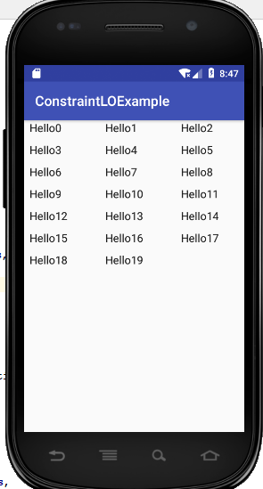
Setting the Adapter Manually
Layout XML
<GridView …
android:id=“@+id/gridview”
other details… />
Data Source
Adapter
ArrayAdapter<String> adapter = new ArrayAdapter<>(
this,android.R.layout.simple_list_item_1);
for(int i=0;i<20;i++){ adapter.add(“Hello" + i);}
GridView gv = (GridView) findViewById(R.id.gridview);
gv.setAdapter(adapter);
GridView/ListView
gv.setOnItemClickListener(
(parent, view, int position, long rowId) ->{
TextView tv = (TextView) view;
Toast.makeText ( this,
tv.getText().toString(),
Toast.LENGTH_SHORT)
.show(); }
);
Kotlin
Notes:
//Kotlin:
//Data source
val adapter = ArrayAdapter<String>(this, android.R.layout.simple_list_item_1)
for(i in 0..20) adapter.add("Hello $i") //List view val lv = findViewById<ListView>(R.id.lv) lv.adapter = adapter lv.setOnItemClickListener{ groupView, view, position,row -> val tv = view as TextView Toast.makeText(this,"${tv.text} was clicked" , Toast.LENGTH_SHORT).show() }

Slide 30
Setting the Adapter with Notification
List<String> cities = new ArrayList();
cities.add("Amman“); cities.add("Abu Dhabi“);
/// add more cities
Data Source
ArrayAdapter<String> adapter = new ArrayAdapter<>(
this,
android.R.layout.simple_list_item_1,cities);
Adapter
GridView gv = (GridView) findViewById(R.id.lv_test);
gv.setAdapter(adapter);
gv.setOnItemClickListener(
(parent, view, position, rowID) ->{
TextView tv = (TextView) view;
String text = tv.getText().toString();
if(text.equals(“Amman”)){
cities.add(“Zarqa”);
adapter.notifyDataSetChanged();
}
});
GridView/ListView
Kotlin
Notes:
//Kotlin:
Example: populate a gridview from a list,
when the user clicks on the girdview item same city is added to the list; adapter is notified; gridview is updates.
/////////////////////
val cities = mutableListOf<String>("Amman","Abu Dhabi","Jerusalem","Dubai","Kuwait") val colors = mutableListOf<Int>(R.color.White,R.color.Blue,R.color.Beige,R.color.YellowGreen) val rand = Random(123) fun setGridView(){ val gv = findViewById<GridView>(R.id.test2_gv) val adapter = ArrayAdapter<String>(this,android.R.layout.simple_list_item_1,cities) gv.adapter = adapter gv.setOnItemClickListener{ _, view,position,row -> Log.i("MyApp","done...") val v = view as TextView v.setBackgroundColor(getColor(colors[rand.nextInt(colors.size)])) cities.add(v.text.toString()) adapter.notifyDataSetChanged() }

Slide 31

Build Layout from Adapter
When the content for your layout is dynamic or not pre-determined, you can use a layout that subclasses AdapterView to populate the layout with views at runtime.
The Adapter behaves as a middleman between the data source and the AdapterView layout—the Adapter retrieves the data (from a source such as an array or a database query) and converts each entry into a view that can be added into the AdapterView layout.
Common layouts backed by an adapter include: LisView and GridView
ListView
GridView

Slide 32
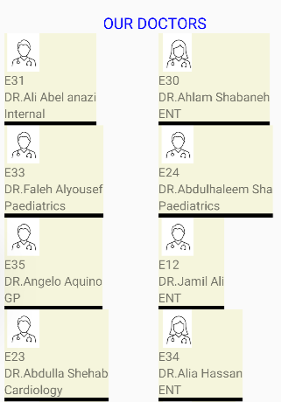
Customized GridView (ListView)
Why?
customized grids (GridView) or list (ListView)
How?
create your own adapter by extending BaseAdapter (or ArrayAdapter) class.
ListView
GridView

Slide 33

Customized GridView – Step 1
UI Design for the GridView item
In the res>>layout folder, create a layout xml file for the GridView item
Doctor
Name ID Specialty Gender
<LinearLayout … >
<ImageView id=“doc_iv” ..>
<TextView id=“doc_id_tv” ..>
<TextView id=“doc_name_tv ..>
….
</LinearLayout>
Notes:
<?xml version="1.0" encoding="utf-8"?> <LinearLayout xmlns:android="http://schemas.android.com/apk/res/android" android:id="@+id/root_id" android:layout_margin="10dp" android:layout_width="wrap_content" android:layout_height="wrap_content" android:orientation="vertical" android:background="@color/Beige" > <ImageView android:id="@+id/doc_iv" android:layout_width="50dp" android:layout_height="50dp" android:src="@drawable/doctor_male" /> <TextView android:id="@+id/doc_id_tv" android:layout_width="wrap_content" android:layout_height="wrap_content" android:text="ID: E2" android:textSize="16sp" /> <TextView android:id="@+id/doc_name_tv" android:layout_width="wrap_content" android:layout_height="wrap_content" android:text="Dr. Salim" android:textSize="16sp" /> <TextView android:id="@+id/specialty_tv" android:layout_width="wrap_content" android:layout_height="wrap_content" android:text="Specialty: ENT" android:textSize="16sp" /> <View android:layout_width="match_parent" android:layout_height="5dp" android:background="@color/black" /> </LinearLayout>

Slide 34
Customized GridView (Step2 & 3)
Data Source:
Customized Adapter
Grid/List View
GridView gv = findViewById(… )
gv.setAdapter( adapter);
Doctor
Name ID Specialty Gender
List<Doctor> doctors = SomeManager.getInstance().
getAllDoctors();
DoctorAdapter adapter =
new DoctorAdapter( this, doctors);
Notes:
<?xml version="1.0" encoding="utf-8"?> <LinearLayout xmlns:android="http://schemas.android.com/apk/res/android" android:id="@+id/root_id" android:layout_margin="10dp" android:layout_width="wrap_content" android:layout_height="wrap_content" android:orientation="vertical" android:background="@color/Beige" > <ImageView android:id="@+id/doc_iv" android:layout_width="50dp" android:layout_height="50dp" android:src="@drawable/doctor_male" /> <TextView android:id="@+id/doc_id_tv" android:layout_width="wrap_content" android:layout_height="wrap_content" android:text="ID: E2" android:textSize="16sp" /> <TextView android:id="@+id/doc_name_tv" android:layout_width="wrap_content" android:layout_height="wrap_content" android:text="Dr. Salim" android:textSize="16sp" /> <TextView android:id="@+id/specialty_tv" android:layout_width="wrap_content" android:layout_height="wrap_content" android:text="Specialty: ENT" android:textSize="16sp" /> <View android:layout_width="match_parent" android:layout_height="5dp" android:background="@color/black" /> </LinearLayout>

Slide 35
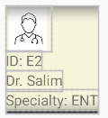
BaseAdapter (Doctor Adapter)
We can create our own adapter by extending the BaseAdapter.
public class DoctorAdapter extends BaseAdapter { private Context mContext;
private List<Doctor> items; public DoctorAdapter(Context c, List<Doctor> items) { mContext = c; this.items = items } @Override public int getCount() { return items.size(); } @Override public Object getItem(int position) { return items.get(position); } @Override public long getItemId(int position) { return position; }
@Override public View getView(int position, View convertView, ViewGroup parent){
//inflat XML and set views with doctor properties.
//set next slide
}
My_layout
Doctor
Name ID Specialty Gender
Kotlin
Notes:
//Kotlin
========
package com.example.mycsbp483app; import android.content.Context; import android.view.LayoutInflater; import android.view.View; import android.view.ViewGroup; import android.widget.BaseAdapter; import android.widget.TextView; import java.util.List; public class DoctorAdapter2 extends BaseAdapter { private List<Doctor> items; private Context context; public DoctorAdapter2(Context context, List<Doctor> items){ this.context = context; this.items = items; } @Override public int getCount(){ return items.size();} @Override public long getItemId(int position){ return position;} @Override public Doctor getItem(int position){ return items.get(position);} @Override public View getView(int position, View view, ViewGroup parent){ if(view == null){ LayoutInflater inflter = (LayoutInflater.from(context)); view = inflter.inflate(R.layout.doctor_list_item, null); } Doctor doctor = items.get(position); //set up doctor fields in the view. TextView nameTV = view.findViewById(R.id.doc_name_tv); nameTV.setText(doctor.getName()); //set other views return view; } }

Slide 36
BaseAdapter
We can create our own adapter by extending the BaseAdapter.
Doctor
Name ID Specialty
public class DoctorAdapter extends BaseAdapter { private Context mContext;
private List<Doctor> items; …
@Override public View getView(int position, View convertView,
ViewGroup parent){
if(view == null){
LayoutInflater inflter = (LayoutInflater.from(context));
view = inflter.inflate(R.layout.my_layout, null);
}
Doctor doctor = items.get(position);
TextView nameTV = view.findViewById(R.id.doc_name_tv);
nameTV.setText(doctor.getName());
//set other views
return view;
}
}
my_layout
Set item content from layout
Set doctor fields from doctor object
Return the view
Notes:
<?xml version="1.0" encoding="utf-8"?> <LinearLayout xmlns:android="http://schemas.android.com/apk/res/android" android:id="@+id/root_id" android:layout_margin="10dp" android:layout_width="wrap_content" android:layout_height="wrap_content" android:orientation="vertical" android:background="@color/Beige" > <ImageView android:id="@+id/doc_iv" android:layout_width="50dp" android:layout_height="50dp" android:src="@drawable/doctor_male" /> <TextView android:id="@+id/doc_id_tv" android:layout_width="wrap_content" android:layout_height="wrap_content" android:text="ID: E2" android:textSize="16sp" /> <TextView android:id="@+id/doc_name_tv" android:layout_width="wrap_content" android:layout_height="wrap_content" android:text="Dr. Salim" android:textSize="16sp" /> <TextView android:id="@+id/specialty_tv" android:layout_width="wrap_content" android:layout_height="wrap_content" android:text="Specialty: ENT" android:textSize="16sp" /> <View android:layout_width="match_parent" android:layout_height="5dp" android:background="@color/black" /> </LinearLayout>

Slide 37
Exercise 1
Add an list view in an activity such that the data source of the list view is an object of type ArrayList
While running, clicking on the items in the list view result of the following:
If the item is UAE then Abu Dhabi is added to the list view
If the item is KSA then Riyadh is added to the list view
If the item is Abu Dhabi or Riyadh then it will be removed from the list view.

Slide 38
Exercise - Solution
ListView listview = findViewById(..)
List<String> items = new ArrayList<>( Arrays.asList("UAE","KSA","Kuwait"));
ArrayAdapter<String> adapter = new ArrayAdapter<>(
this, android.R.layout.simple_list_item_1,items); listview.setAdapter( adapter );
Handling the Selection/Clicking of the ListView items
listview.setOnItemClickListener(
(parent, view, position, rowID) ->{
TextView tv = (TextView) view;
String text = tv.getText().toString();
if(text.equals("UAE") && !items.contains("Abu Dhabi")){
items.add("Abu Dhabi");
}else if(text.equals("KSA") && !items.contains("Riyadh")){
items.add("Riyadh");
}else if(text.equals("Riyadh") || text.equals("Abu Dhabi")){
items.remove(text);
}
adapter.notifyDataSetChanged();
}
); }
Kotlin
Notes:
List<String> items = Stream.of("UAE","KSA","Kuwait").
collect(Collectors.toList());
//Kotlin
========
fun setLV() { val listview = findViewById<ListView>(R.id.lv) val items = arrayListOf("UAE", "KSA", "Kuwait") val adapter = ArrayAdapter(this, android.R.layout.simple_list_item_1, items) listview.adapter = adapter listview.setOnItemClickListener { _, view, _, _ -> val tv = view as TextView val text = tv.text.toString() if (text == "UAE" && !items.contains("Abu Dhabi")) { items.add("Abu Dhabi") } else if (text == "KSA" && !items.contains("Riyadh")) { items.add("Riyadh") } else if (text == "Riyadh" || text == "Abu Dhabi") { items.remove(text) } adapter.notifyDataSetChanged(); } }

Slide 39
Exercise 2 - Customized ListView Item
You can define your own ListView Item layout to include more information that represents objects, such as textview, image view, etc.
(1) Design List view Item
(2) Extend Array Adapter or BaseAdapter
Res>> Layout>> New >> XML Layout
(3) Set the List View

Slide 40
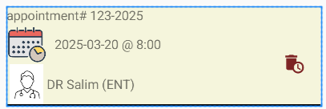
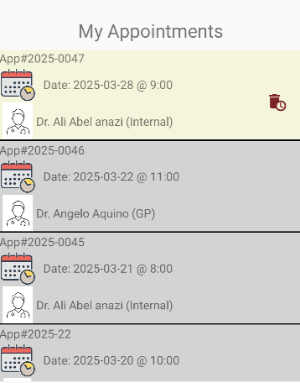
(1) Customized ListView Item Layout
Design the ListView Item layout:
Res>> Layout>> New >> XML Layout
Define an xml layout, (listview_item1)
<?xml version="1.0" encoding="utf-8"?> <LinearLayout …. android:orientation="vertical" > <TextView android:id="@+id/doctor_tv“
….. /> …
<TextView android:id="@+id/datetime_tv“
….. />
… </LinearLayout>
Appointment
ID Doctor Date Time
Notes:
<?xml version="1.0" encoding="utf-8"?> <LinearLayout xmlns:android="http://schemas.android.com/apk/res/android" android:id="@+id/root_id" android:layout_margin="10dp" android:layout_width="match_parent" android:layout_height="wrap_content" android:orientation="vertical" android:background="@color/Beige" > <TextView android:id="@+id/a_id" android:layout_width="wrap_content" android:layout_height="wrap_content" android:text="appointment# 123-2025" android:textSize="16sp" android:layout_marginEnd="30dp" /> <LinearLayout android:layout_width="match_parent" android:layout_height="wrap_content" android:orientation="horizontal" android:gravity="center" > <LinearLayout android:layout_width="wrap_content" android:layout_height="wrap_content" android:orientation="vertical" > <LinearLayout android:layout_width="wrap_content" android:layout_height="50dp" android:orientation="horizontal" android:gravity="center" > <ImageView android:layout_width="50dp" android:layout_height="50dp" android:src="@drawable/date_time"/> <TextView android:id="@+id/a_date_time" android:layout_width="wrap_content" android:layout_height="wrap_content" android:text="2025-03-20 @ 8:00" android:textSize="16sp" android:layout_marginStart="10dp" /> </LinearLayout> <LinearLayout android:layout_width="wrap_content" android:layout_height="50dp" android:orientation="horizontal" android:gravity="center" > <ImageView android:id="@+id/doc_iv" android:layout_width="50dp" android:layout_height="50dp" android:src="@drawable/doctor_male" /> <TextView android:id="@+id/a_doc" android:layout_width="wrap_content" android:layout_height="wrap_content" android:text="DR Salim (ENT)" android:textSize="16sp" android:gravity="end" /> </LinearLayout> </LinearLayout> <LinearLayout android:layout_width="match_parent" android:layout_height="wrap_content" android:gravity="right|center" android:layout_marginEnd="20dp" > <ImageView android:id="@+id/cancel_iv" android:layout_width="25dp" android:layout_height="25dp" android:src="@drawable/delete_icon" /> </LinearLayout> </LinearLayout> <View android:layout_width="match_parent" android:layout_height="2dp" android:background="@color/black" /> </LinearLayout>

Slide 41

(2) Define Adapter
class AppointmentAdapter extends ArrayAdapter<Appointment> { Appointment[] arr; Context context; public AppointmentAdapter(Context context,Appointment[] arr){ super(context,0,arr); this.context = context; this.arr = arr; } @Override public int getCount() {return arr.length; }
@Override public Appointment getItem(int i) {return arr[i]; }
@Override public long getItemId(int position){ return position;} @Override public View getView(int i, View view, ViewGroup viewGroup) { if (view == null) {
LayoutInflater inflter = (LayoutInflater.from(context)); view = (View) inflater.inflate(R.layout.listview_item1, null); } TextView doctor_tv = (TextView)view.findViewById(R.id.doctor_tv); TextView datetime_tv =(TextView)view.findViewById(R.id.datetime_tv); datetime_tv.setText(arr[i].date “@” + arr[i].time); return view; } }
Extend the Array Adapter
Setup the content and context
Inflat the list item
Setup the layout values
Must return the view object
Kotlin
Notes:
package ae.ac.uaeu.storagetoyapplication; import android.content.Context; import android.view.LayoutInflater; import android.view.View; import android.view.ViewGroup; import android.widget.ArrayAdapter; import android.widget.BaseAdapter; import android.widget.TextView; import java.util.List; public class AppointmentAdapter extends BaseAdapter{ Appointment[] arr; TextView doctor_tv,date_tv,time_tv; Context context; public AppointmentAdapter(Context context,Appointment[] arr){ this.context = context; this.arr = arr; } public AppointmentAdapter(Context context, List<Appointment> arr){ this.context = context; this.arr = arr.toArray(new Appointment[0]); } @Override public int getCount() { return arr.length; } @Override public Object getItem(int i) { return arr[i]; } @Override public long getItemId(int i) { return 0; } @Override public View getView(int i, View view, ViewGroup viewGroup) { if (view == null) { LayoutInflater inflater = (LayoutInflater) context.getSystemService(Context.LAYOUT_INFLATER_SERVICE); view = (View) inflater.inflate(R.layout.listview_item1, null); } doctor_tv = (TextView)view.findViewById(R.id.doctor_tv); date_tv =(TextView)view.findViewById(R.id.date_tv); time_tv =(TextView) view.findViewById(R.id.time_tv); doctor_tv.setText("Doctor ID:" + arr[i].doctor); date_tv.setText("Date:" + arr[i].date); time_tv.setText("At:" + arr[i].time); return view; } } class AppointmentAdapter2 extends ArrayAdapter<Appointment> { Appointment[] arr; Context context; public AppointmentAdapter2(Context context,Appointment[] arr){ super(context,0,arr); this.context = context; this.arr = arr; } public AppointmentAdapter2(Context context, List<Appointment> arr){ this(context,arr.toArray(new Appointment[0])); } @Override public Appointment getItem(int i) { return arr[i]; } @Override public View getView(int i, View view, ViewGroup viewGroup) { if (view == null) { LayoutInflater inflater = (LayoutInflater) context.getSystemService(Context.LAYOUT_INFLATER_SERVICE); view = (View) inflater.inflate(R.layout.listview_item1, null); } TextView doctor_tv = (TextView)view.findViewById(R.id.doctor_tv); TextView date_tv =(TextView)view.findViewById(R.id.date_tv); TextView time_tv =(TextView) view.findViewById(R.id.time_tv); doctor_tv.setText("Doctor ID:" + arr[i].doctor); date_tv.setText("Date:" + arr[i].date); time_tv.setText("At:" + arr[i].time); return view; } }
//Kotlin
class AppointmentAdapter(context: Context,items:MutableList<Appointment>) : BaseAdapter() { private val context: Context private val items: MutableList<Appointment> override fun getCount(): Int { return items.size //returns total of items in the list } override fun getItem(position: Int): Any { return items[position] } override fun getItemId(position: Int): Long { return position.toLong() } override fun getView(position: Int, convertView: View?, parent: ViewGroup?): View? { var convertView: View? = convertView if (convertView == null) { convertView = LayoutInflater.from(context) .inflate(R.layout.appointment_list_item, parent, false) } val currentItem = getItem(position) as Appointment //set the appointment id val aId = convertView?.findViewById<TextView>(R.id.a_id) aId?.text = String.format("App#%s",currentItem.appointmentId) //set the doctor val doctor = KDoctorMgr.instance.getDoctor(currentItem.doctorId) val docTv = convertView?.findViewById<TextView>(R.id.a_doc) docTv?.text = String.format("Dr. %s (%s)",doctor?.name, doctor?.specialty) val giv = convertView?.findViewById<ImageView>(R.id.doc_iv) if(doctor?.gender?.lowercase() == "f") giv?.setImageResource(R.drawable.doctor_female) val time_tv = convertView?.findViewById<TextView>(R.id.a_date_time) time_tv?.text = String.format("Date: %s @ %s ", currentItem.date, currentItem.slot) //set listener for cancel appointment... val cancel = convertView?.findViewById<ImageView>(R.id.cancel_iv) if(!currentItem.isPast()) { cancel?.setOnClickListener { val dialog = KAppUtil.makeDialog( context, "Cancel Appointment", "You're about to cancel your appointment. Are you sure" ) val okButton = dialog.findViewById<Button>(R.id.ok_bt) okButton.setOnClickListener { KAppointmentMgr.instance.cancelAppointment(currentItem.appointmentId) //update the view list.. Log.i("MyApp","size before:" + items.size) val index = items.indexOf(currentItem) Log.i("MyApp", "Index of appointment:$index") //items.drop(index) items.removeAt(index) Log.i("MyApp","size after removing :" + items.size) notifyDataSetChanged() dialog.dismiss() } dialog.show() } }else { cancel?.visibility = View.INVISIBLE val root = convertView?.findViewById<LinearLayout>(R.id.root_id) root?.setBackgroundColor(context.resources.getColor(R.color.LightGrey,null)) } return convertView } init { this.context = context this.items = items } }

Slide 42
(3) Set the ListView
View the result of searching students by name in a view list.
<ListView android:id="@+id/res_lst" android:layout_width="match_parent" android:layout_height="250dp"> </ListView>
Appointment[] result = Manager.getAppointments(…);
ListView lv = (ListView) findViewById(R.id.res_lst); AppointmentAdapter arrayAdapter =
new AppointmentAdapter(this,result); lv.setAdapter(arrayAdapter);
lv.setOnItemClickListener(
new AdapterView.OnItemClickListener() { public void onItemClick(AdapterView<?> parent,
View v,int position, long id) {
//write your code here. }});

Slide 43

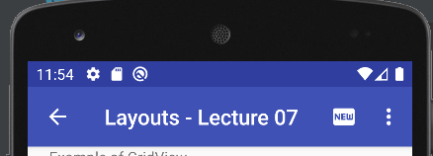
Show/Hide Action Bar
To Hide the Action Bar
Dynamically: getSupportActionBar().hide();
Or in the AppTheme: res>>values>style, Set the App theme to AppCompat.Light.NoActionBar"
To show the Actin Bar:
getSupportActionBar().show();
Or in the AppTheme: set the App theme to AppCompat.Light.DarkActionBar

Slide 44
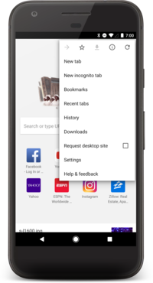
Menus in Action Bar
Menus are a common user interface component in many types of applications.
To provide a familiar and consistent user experience, you should use the Menu APIs to present user actions and other options in your activities.
Three fundamental types of menus:
Option Menus and app bar
Context menu and contextual action mode
Popup menu
Notes:
https://developer.android.com/guide/topics/ui/menus

Slide 45


Menus Definition
Android provides a standard XML format to define menu items.
You should define a menu and all its items in an XML menu resource.
You can then inflate the menu resource (load it as a Menu object) in your activity or fragment
Using a menu resource is a good practice for a few reasons:
It's easier to visualize the menu structure in XML.
It separates the content for the menu from your application's behavioral code.
It allows you to create alternative menu configurations for different platform versions, screen sizes, and other configurations by leveraging the app resources framework.
Application bar
Overflow menu

Slide 46
Menus Definition
To define the menu, create an XML file inside your project's res/menu/ directory and build the menu with the following elements:
<menu> | defines a Menu, which is a container for menu items. A <menu> element must be the root node for the file and can hold one or more <item> and <group> elements.
<item> | Creates a MenuItem, which represents a single item in a menu. This element may contain a nested <menu> element in order to create a submenu.
<group> | An optional, invisible container for <item> elements. It allows you to categorize menu items so they share properties such as active state and visibility. For more information, see the section about Creating Menu Groups.

Slide 47
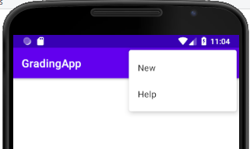
Menu example
<?xml version="1.0" encoding="utf-8"?> <menu xmlns:android="http://schemas.android.com/apk/res/android" xmlns:app="http://schemas.android.com/apk/res-auto" android:id="@+id/main_menu" > <item android:id="@+id/new_game" android:icon="@drawable/ic_new_game" android:title=“New" app:showAsAction="ifRoom" /> <item android:id="@+id/help" android:icon="@drawable/ic_help_24" android:title= "Help" /> </menu>
Application bar
Overflow menu
The <item> element supports several attributes you can use to define an item's appearance and behavior.
The menu items in the above menu include the following main attributes :
id | A resource ID that's unique to the item, which allows the application to recognize the item when the user selects it.
icon | A reference to a drawable to use as the item's icon.
title | A reference to a string to use as the item's title
showAsAction | Specifies when and how this item should appear as an action item in the app bar
Notes:
Note: icons do not show up in the items.
android:showAsAction=["ifRoom" | "never" | "withText" | "always" | "collapseActionView"]

Slide 48
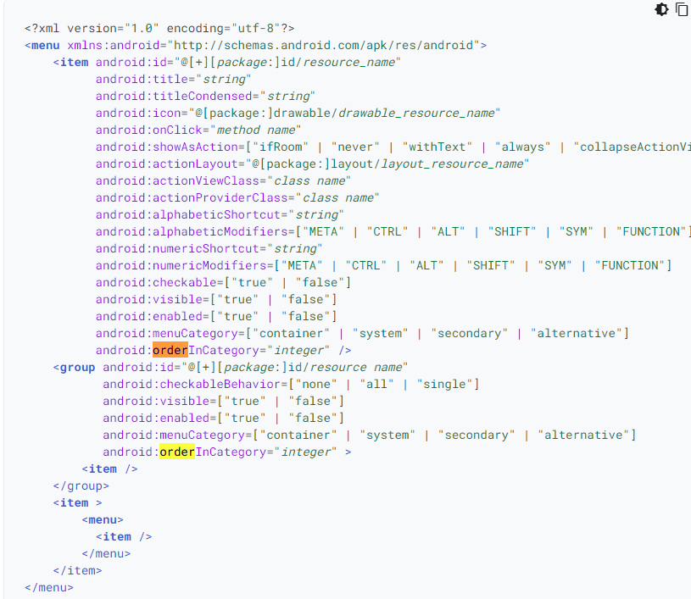
Menu Resources
Attributes of Menu Item:
Title
Icon
Onclick
orderInCategory Attribute:
The order of "importance" of the item, within a group.
visible
Boolean. "true" if the item is visible by default.
enabled
Boolean. "true" if the item is enabled by default
…..
https://developer.android.com/guide/topics/resources/menu-resource

Slide 49
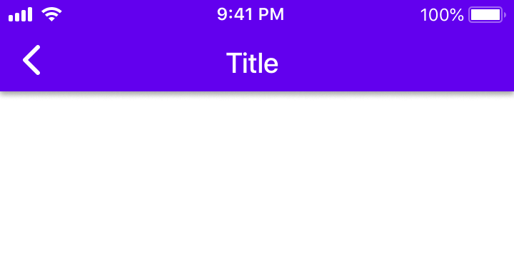
ShowAsAction Attribute
Value | Description
ifRoom | Only place this item in the app bar if there is room for it. If there is not room for all the items marked "ifRoom", the items with the lowest orderInCategory values are displayed as actions, and the remaining items are displayed in the overflow menu.
withText | Also include the title text (defined by android:title) with the action item. You can include this value along with one of the others as a flag set, by separating them with a pipe.
never | Never place this item in the app bar. Instead, list the item in the app bar's overflow menu.
always | Always place this item in the app bar. Avoid using this unless it's critical that the item always appear in the action bar. Setting multiple items to always appear as action items can result in them overlapping with other UI in the app bar.
collapseActionView | The action view associated with this action item (as declared by android:actionLayout or android:actionViewClass) is collapsible. Introduced in API Level 14.
Application bar
Overflow menu

Slide 50
Sub menus
Item can include <menu> tag to create submenu.
<item android:id="@+id/file" android:title="File" > <!-- "file" submenu --> <menu> <item android:id="@+id/create_new" android:title="New File" /> <item android:id="@+id/open" android:title="Open" /> </menu> </item>
Main menu
submenu
Notes:
<?xml version="1.0" encoding="utf-8"?> <menu xmlns:android="http://schemas.android.com/apk/res/android" xmlns:app="http://schemas.android.com/apk/res-auto" android:id="@+id/main_menu" > <item android:id="@+id/new_game" android:icon="@drawable/ic_new_game" android:title="@string/new_game" android:showAsAction="ifRoom" /> <item android:id="@+id/help" android:icon="@drawable/ic_help_24" android:title="@string/help" /> <item android:id="@+id/about" android:title="About Us" /> <item android:id="@+id/settings" android:title="Settings" /> <item android:id="@+id/file" android:title="File" > <!-- "file" submenu --> <menu> <item android:id="@+id/create_new" android:title="New File" /> <item android:id="@+id/open" android:title="Open" /> </menu> </item> </menu>

Slide 51
MenuInflater
To inflate the menu resource, override the onCreateOptionsMenu method:
@Override public boolean onCreateOptionsMenu(Menu menu){ getMenuInflater().inflate(R.menu.menu1,menu); return true; }
Instantiates a layout XML file into its corresponding View objects
Menu xml definition
Res> menu> menu1.xml
Kotlin
Notes:
Kotlin:
override fun onCreateOptionsMenu(menu: Menu?): Boolean {
menuInflater.inflate(R.menu.main_menu,menu)
return true;
}

Slide 52
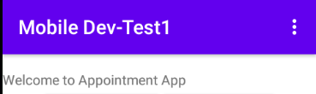
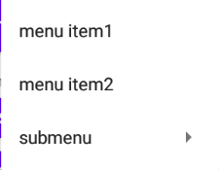
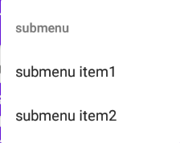
Example
res>>menu>>Menu1.xml
<?xml version="1.0" encoding="utf-8"?> <menu xmlns:android="http://schemas.android.com/apk/res/android" xmlns:app="http://schemas.android.com/apk/res-auto" android:id="@+id/main_menu"> <item android:id="@+id/mi_1" android:title="menu item1"/> <item android:id="@+id/mi_2" android:title="menu item2"/> <item android:title="submenu" android:id="@+id/submenu"> <menu> <item android:id="@+id/sm_1" android:title="submenu item1"/> <item android:id="@+id/sm_2" android:title="submenu item2"/> </menu> </item> </menu>
@Override public boolean onCreateOptionsMenu(Menu menu){ getMenuInflater().inflate(R.menu.menu1,menu); return true; }

Slide 53
Menu Item Handler
Override the onOptionsItemSelected method:
Public boolean onOptionsItemSelected(MenuItem item) { int id = item.getItemId(); if (id == R.id.mi_1) { startActivity( new Intent(this, SOME_ACTIVITY.class)); return true; }else if(id == R.id.mi_2){ …} //add code to handle other menu items. return super.onOptionsItemSelected(item); }
Kotlin
Notes:
Kotlin:
====
override fun onOptionsItemSelected(item: MenuItem): Boolean { val id = item.itemId when(id){ R.id.contact -> Log.i("MyApp","contacts was chosen...") R.id.new_game -> Log.i("MyApp","New Game was chosen...") R.id.twitter -> Log.i("MyApp","Twitter was chosen...") R.id.facebook -> Log.i("MyApp","Facebook was chosen...") } return super.onOptionsItemSelected(item) }

Slide 54

Adding Back Button
Step1:
In the MainActivity - onCreate method enable the home/menu as follows.
Step2: add a handler in case you want to add extra steps
@Override protected void onCreate(Bundle savedInstanceState) { super.onCreate(savedInstanceState); setContentView(R.layout.activity_main); getSupportActionBar().setDisplayHomeAsUpEnabled(true);}
@Override public boolean onSupportNavigateUp(){ //Replace your Back Handler finish(); //just destroy the activity for now return true; }
Kotlin
Notes:
Kotlin:
//back button is included in the onOptionItemSelected method with id: android.R.id.home:
override fun onOptionsItemSelected(item: MenuItem): Boolean { val id = item.itemId when(id){ R.id.contact -> Log.i("MyApp","contacts was chosen...") R.id.new_game -> Log.i("MyApp","New Game was chosen...") R.id.twitter -> Log.i("MyApp","Twitter was chosen...") R.id.facebook -> Log.i("MyApp","Facebook was chosen...") android.R.id.home-> { Log.i("MyApp", "back button was tapped...xxx") finish() } }

Slide 55
Creating a floating context menu

Slide 56
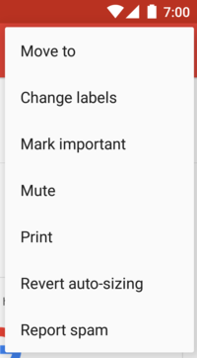
Popup Menu
A popup menu displays a list of items in a vertical list that's anchored to the view that invoked the menu.
To define popup menu:
Define a menu layout (menu1.xml)
In the view handler, create PopupMenu object and set it up.
Button/view handler (onclick)
public void showMenu(View view) { PopupMenu menu = new PopupMenu(this,view); getMenuInflater().
inflate(R.menu.menu1,menu.getMenu()); menu.setOnMenuItem …
menu.show(); }
Handlers for clicking menu items
menu.setOnMenuItemClickListener(
new PopupMenu.OnMenuItemClickListener() { @Override public boolean onMenuItemClick(MenuItem menuItem) { int id = menuItem.getItemId(); if(id == R.id.mi_1){ /* write your code here */ } return false; } });
Kotlin
Notes:
Kotlin:
//////////////////
val cal = findViewById<ImageView>(R.id.cal) cal.setOnClickListener{ v -> val pmenu = PopupMenu(this,v); menuInflater.inflate(R.menu.cal_menu, pmenu.menu); pmenu.setOnMenuItemClickListener{ menu_item -> when(menu_item.itemId){ R.id.cal_item1-> Log.i("My App","item 1 was tapped...") R.id.cal_item2-> Log.i("My App","item 2 was tapped...") } return@setOnMenuItemClickListener true } menu.show(); }
//////////////////////////////////////////////////////

Slide 57
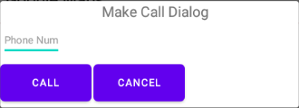
Dialog Layout
A dialog is a small window that prompts the user to make a decision or enter additional information.
A dialog does not fill the screen and is normally used for modal events that require users to take an action before they can proceed.
Dialog can have an xml layout attached to it.

Slide 58
Dialog - Setting
Res>>layout>Dialog_layout1.xml
<?xml version="1.0" encoding="utf-8"?> <LinearLayout android:layout_width="300dp" android:orientation="vertical" android:layout_height="match_parent"> <TextView …/> <EditText …/> <LinearLayout android:layout_width="match_parent" android:layout_height="wrap_content" android:orientation="horizontal"> <Button android:id="@+id/call_bt" android:text="Call" /> <Button android:id="@+id/cancel_bt" android:text="Cancel" /> </LinearLayout> </LinearLayout>
Handler to set/view the dialog
Create the dialog and set the layout
public void startDialog(){ final Dialog dialog = new Dialog(this); dialog.setContentView(R.layout.dialog_layout1); Button call = dialog.findViewById(R.id.call_bt); call.setOnClickListener(new View.OnClickListener() { public void onClick(View view) { String phone =
((EditText)dialog.findViewById(R.id.phone_et)).
getText().toString(); Uri number = Uri.parse(“tel:”+ phone); Intent callIntent = new Intent(Intent.ACTION_DIAL, number); startActivity(callIntent); }}); Button cancel = dialog.findViewById(R.id.cancel_bt); cancel.setOnClickListener(new View.OnClickListener() { public void onClick(View view) { dialog.dismiss(); } }); dialog.setTitle("Making Call"); dialog.show(); }
Set handler to the button in the dialog
Setting a handler for cancel
Kotlin
Notes:
//Kotlin:
======
fun startDialog(context:Context, title:String, msg:String) : Dialog { val dialog = Dialog(context) dialog.setTitle(title) dialog.setContentView(R.layout.dialog_layout1) val call = dialog.findViewById<Button>(R.id.call_bt)
call.setOnClickListener{
val phone = dialog.findViewById<EditText>(R.id….)
val num = Uri.parse(“tel:” + phone.text.toString())
startActivity( Intent( Intent.ACTION_DIAL, num) )
} val cancel_bt = dialog.findViewById<Button>(R.id.cancel_bt) cancel_bt.setOnClickListener { dialog.dismiss() } return dialog }
/////////////////////// Layout for the dialog
<?xml version="1.0" encoding="utf-8"?> <LinearLayout xmlns:android="http://schemas.android.com/apk/res/android" android:layout_width="300dp" android:orientation="vertical" android:layout_height="match_parent"> <TextView android:layout_width="wrap_content" android:layout_height="wrap_content" android:text="Make Call Dialog" android:layout_gravity="center_horizontal" /> <Space android:layout_width="match_parent" android:layout_height="1dp" /> <EditText android:id="@+id/phone_et" android:layout_width="wrap_content" android:layout_height="wrap_content" android:textSize="10sp" android:hint="Phone Num" /> <LinearLayout android:layout_width="match_parent" android:layout_height="wrap_content" android:orientation="horizontal"> <Button android:id="@+id/call_bt" android:layout_width="wrap_content" android:layout_height="wrap_content" android:textSize="10sp" android:text="Call" /> <Space android:layout_width="2dp" android:layout_height="5dp"/> <Button android:id="@+id/cancel_bt" android:layout_width="wrap_content" android:layout_height="wrap_content" android:textSize="10sp" android:text="Cancel" /> </LinearLayout> </LinearLayout>

Slide 59
References
GridLayout from Android Developers
https://developer.android.com/guide/topics/ui/menus#java
https://guides.codepath.com/android/Using-an-ArrayAdapter-with-ListView

