Slide 1
NVIDIA Stock Price Prediction using LSTM
Manoj Bala 700754021

Slide 2
Contents
Title
Group Member Information
Role / Responsibilities and Contributions in project
Motivation
Objectives
Related Work
Problem Statement
Proposed Solution
Result / Simulations
References

Slide 3

Roles / Responsibilities and Contributions
Group Member / Individual
1
Manoj Bala
Roles / Responsibilities
2
Business Analyst
NVIDIA’s Stock price prediction requirements
Data Engineer
Data collection, cleaning, exploratory data analysis, visualizations
Data Scientist
Model Building, Data Visualizations
Documentation
Contributions
3
Project Proposal
Data Collection – Yahoo Finance (API)
Data Cleaning
Data Preprocessing
Model Creation
Fitting
Predictions
Visualizations
Project Report
Project Presentation

Slide 4
Motivation
NVIDIA meteoric stock price growth as a GPU maker revolutionizing AI domain
1
Increasing interest in the predictive power of Neural Networks & Deep Learning in finance domain.
2
NVIDIA critical role in tech and AI fields makes its stock a focal point for investors.
3
The need for more accurate, data-driven investment decisions.
4

Slide 5
Objectives
To predict the stock price of NVIDIA Corporation using LSTM.
To analyze historical stock data for pattern identification.
To improve investment decisions through accurate forecasting.

Slide 6
Related Work
Machine learning in stock price prediction.
Previous studies using LSTM for financial forecasting.
Gaps in current research and how this project aims to fill them.

Slide 7
Problem Statement
Traditional models struggle to capture the complexity and volatility of stock prices.
Lack of accurate prediction models for Nvidia’s stock, considering its growth and market volatility.
This project aims to develop a predictive model that can predict Nvidia’s future stock price based on its historical data.
This project leverages Neural Networks & Deep Learning technique like LSTM to construct model, fit data and make predictions.

Slide 8
Proposed Solution
Predict Nvidia’s stock using Neural Networks & Deep Learning technique like LSTM (Long Short Term Memory) neural network.
Data collected from Yahoo Finance (via API) is cleaned and preprocessed (scaled).
LSTM model is built, fit and used to make predictions

Slide 9
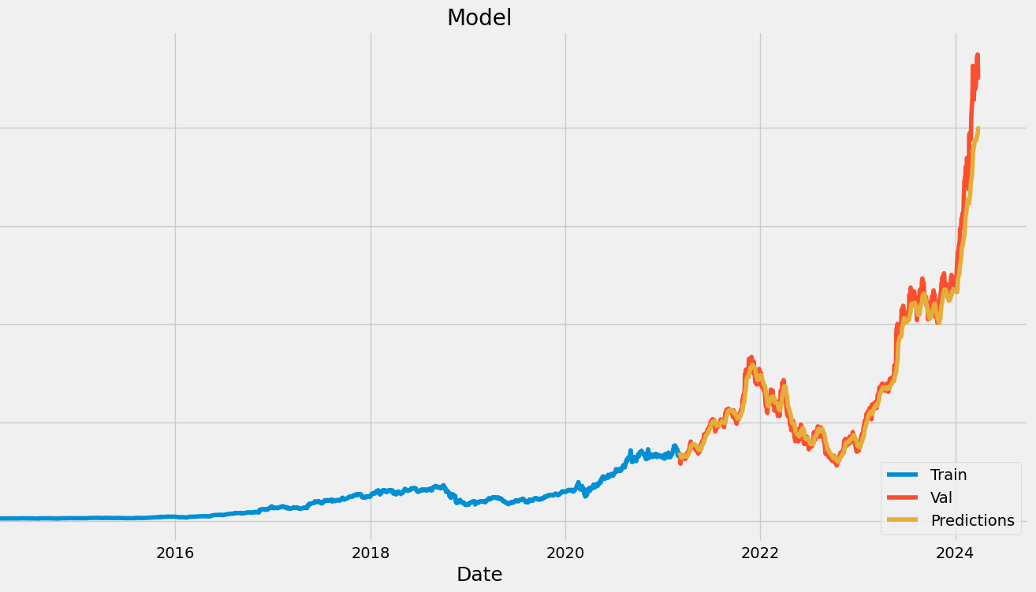
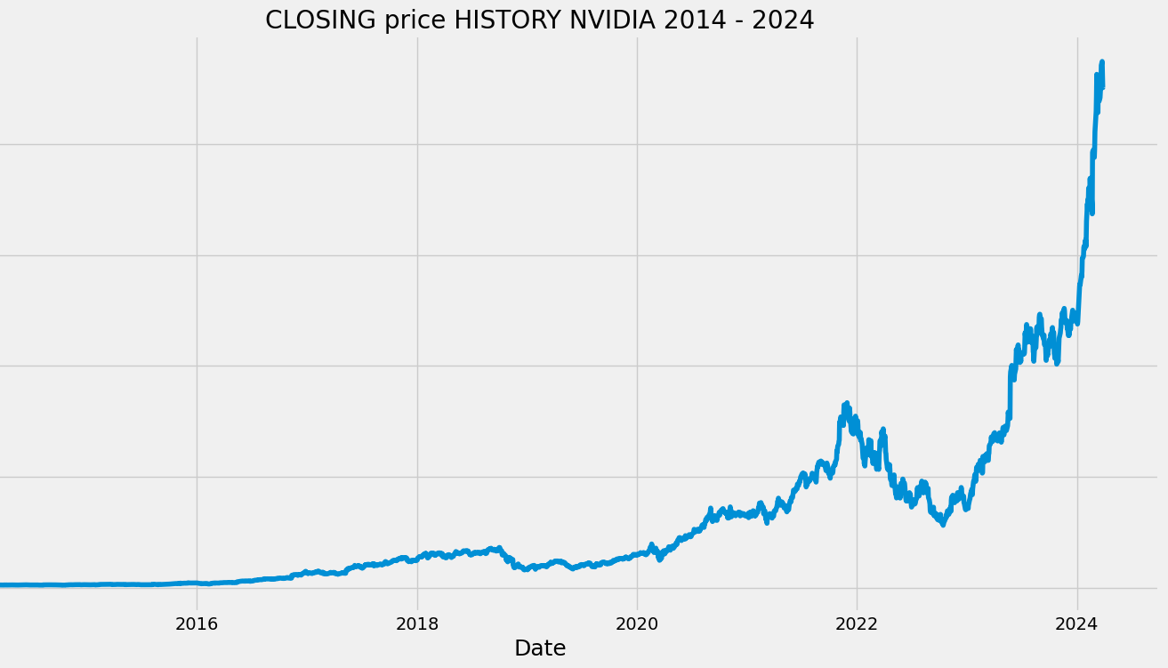
Result / Simulations
Model accuracy and comparison with baseline models.
Model’s predictive capabilities over different time frames.
Insights and patterns identified through the model's predictions.

Slide 10
References
https://colah.github.io/posts/2015-08-Understanding-LSTMs/
https://www.geeksforgeeks.org/deep-learning-introduction-to-long-short-term-memory/
https://www.analyticsvidhya.com/blog/2017/12/fundamentals-of-deep-learning-introduction-to-lstm/
https://finance.yahoo.com/quote/NVDA/history
https://pypi.org/project/yfinance/
https://pypi.org/project/keras/
https://keras.io/api/layers/recurrent_layers/lstm/

