Slide 1



DEPARTMENT OF COMPUTER SCIENCE AND ENGINEERING
AI VIRTUAL MOUSE
USING HAND GESTURES
BATCH NO : 09
BATCH YEAR : 2020-2024
GUIDED BY : Asst Prof S.N MOHAMED IRFAN
M.H.MOGDOOM KHAN SAHIB - 110120104022
A.MOHAMED BASITH ALI - 110120104024
A.S.MOHAMED MUBEEN - 110120104028
K.MOHAMED RIYASATH - 110120104038

Slide 2
ABSTRACT
This system enables users to perform mouse actions through hand movements, eliminating the need for traditional input devices.
The system begins with the detection of hand gestures, leveraging hand landmark estimation algorithms to accurately locate and track the user's hand in real-time.
The system can be integrated with various hardware devices, such as cameras or sensors, and can accommodate different operating systems and software applications.

Slide 3
INTRODUCTION
The computer mouse is a device that detects two-dimensional movements, allowing users to navigate the graphical user interface (GUI) on a computer.
A virtual human-computer interaction device, using a camera or other image capturing devices, could be an alternative to touch screens.
Moreover, the advantage of reducing physical strain and promoting ergonomic comfort.
By eliminating the need for physical mouse movements or keyboard typing.
This not only minimizes the risk of repetitive strain injuries but also provides a more intuitive and immersive computing experience.

Slide 4
OBJECTIVE
The objective of the AI Virtual Mouse project is to develop a reliable and user-friendly system that enables users to control the mouse cursor on a computer screen using hand gestures or body movements, eliminating the need for a physical mouse or touchpad. This project aims to achieve accurate gesture recognition, translating the user's intentions into corresponding cursor movements..
To accomplish these goals, the AI Virtual Mouse project will focus on developing advanced AI models and algorithms for gesture recognition and cursor control. The system will be optimized for real-time performance, minimizing latency and delivering a smooth and responsive user experience..

Slide 5
EXISTING SYSTEM
The existing system consists of the generic mouse and trackpad system of monitor controlling and the non-availability of a hand gesture system.
The existing virtual mouse control system consists of the simple mouse.
The basic mouse operation like could perform mouse pointer control, left click, right click, drag etc. The further use of the hand recognition is not been made use of.

Slide 6
PROPOSING SYSTEM
Using our project we could make use of the laptop or web-cam and by recognizing the hand gesture we could control mouse and perform basic operations like mouse pointer controlling, select and deselect using left click
The project done is a “Zero Cost” hand recognition system for laptops, which uses simple algorithms to determine the hand, hand movements and by assigning an action for each movement.

Slide 7
HARDWARE SOFTWARE REQUIREMENT REQUIREMENT
Processor : Intel Core2Duo / AMD 3000series
Main Memory : 4GB RAM DDR3
Hard Disk : 120GB
Display : Any Monitor
Camera : Webcam 720p 24fps
Visual Studio code / PyCharm - Python (version 3.7 or above) -- Programming language.
Package requirement :
NumPy (version 1.19.2) -- For frame collection in an array
Pyautogui (Version - 0.9.53) -- For controlling the Mouse Movement and click
opencv-python (Version - 4.5.3.56) -- For object Detection, Image and Video Processing
Mediapipe (Version - 0.8.6.2) -- For Hand and Object Tracking

Slide 8
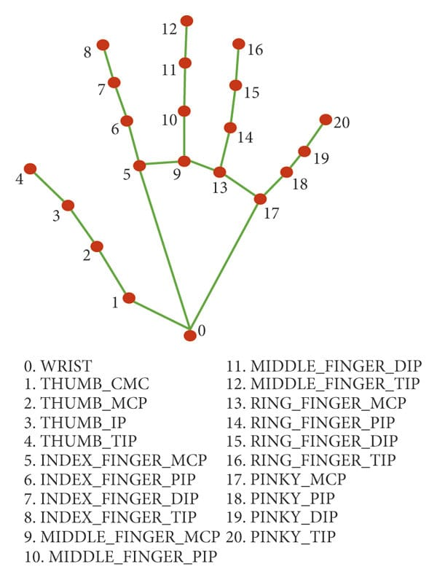
HAND DETECTION
Hand detection is a fundamental component of the AI virtual mouse using hand gestures system
Skin Color-based Detection
Background Subtraction
Once the hand regions are detected, employ techniques such as object tracking algorithms to track the hand across frames, ensuring smooth and continuous hand detection.

Slide 9
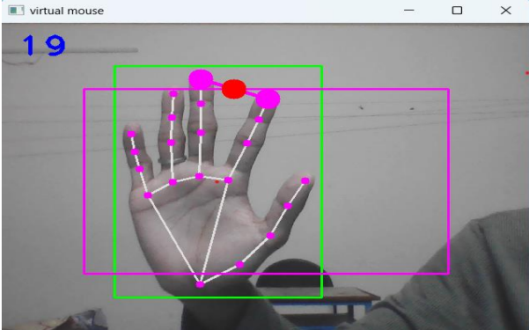
HAND LANDMARK ESTIMATION
Hand landmark estimation involves estimating the positions of essential landmarks or key points on the hand, such as fingertips, palm, and the base of the hand.
Optical Flow: Optical flow algorithms can track the movement of hand key points across consecutive frames, estimating their positions in each frame based on the flow of pixel intensities.
Use the chosen hand landmark estimation technique to predict or estimate the positions of hand landmarks.

Slide 10
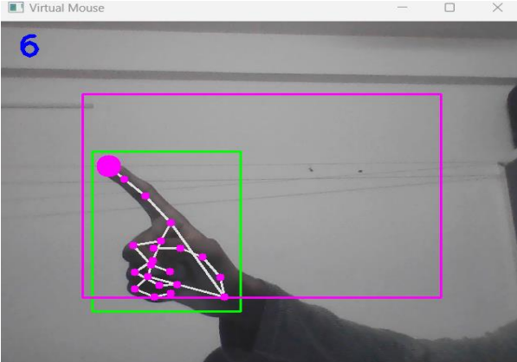
GESTURE RECOGNITION
Mapping between recognized gestures and mouse actions enables precise control of the virtual mouse
Gesture recognition technology promotes a more natural and immersive user interface, eliminating the need for traditional input devices such as keyboards or controllers
This not only simplifies the interaction process but also opens up new possibilities for individuals with physical disabilities or limitations, empowering them to engage with technology in a more inclusive and intuitive manner.

Slide 11
GESTURE MAPPING
Gesture mapping is the process of associating recognized hand gestures with specific mouse actions in the AI virtual mouse system.
Once a gesture is recognized through gesture recognition, it needs to be mapped to the appropriate mouse action to control the virtual mouse effectively.
Map the recognized gestures to their corresponding mouse actions based on the defined mapping scheme
For example, if the recognized gesture corresponds to cursor movement, calculate the displacement of the cursor based on the direction and magnitude of the hand movement.

Slide 12
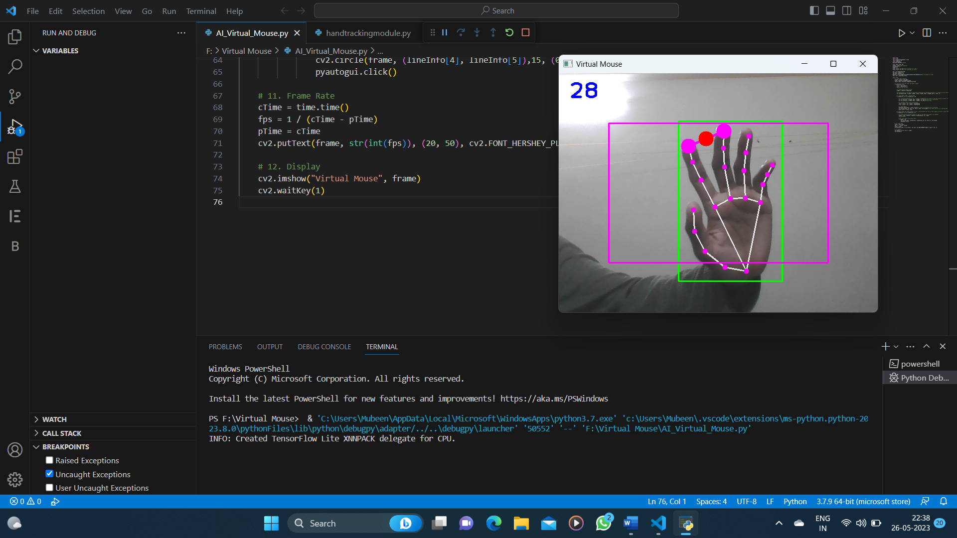
OUTPUT

Slide 13
FUTURE ENHANCEMENTS
The future enhancements for an AI virtual mouse using hand gestures can involve advancements in technology, improved user experience, and expanded functionality Develop more advanced algorithms and machine learning models to improve the accuracy and robustness of gesture recognition.
This can involve incorporating deep learning techniques, leveraging larger and diverse training datasets, and refining the feature extraction process. Explore real-time adaptation and personalization of gesture recognition models to adapt to individual user preferences and varying hand shapes and sizes.

Slide 14
CONCLUSION
In conclusion, an AI virtual mouse using hand gestures offers a novel and intuitive way for users to interact with computers and digital devices. This system enables users to control a virtual mouse using hand movements through the detection of hand gestures, the system accurately identifies and tracks the user's hand movements in real-time. It maps these gestures to specific mouse actions, such as cursor movement, clicking, scrolling etc.

Slide 15
REFERENCE
1) Banerjee, A., Ghosh, A., Bharadwaj, K., & Saikia, H. (2014). Mouse control using a camera based on colour detection. arXiv preprint arXiv:1403.4722.
2) Park, H. (2008). A method for controlling mouse movement using a realtime camera. Brown University, Providence, RI, USA, Department of computer science.

Slide 16
THANK YOU

