Slide 1
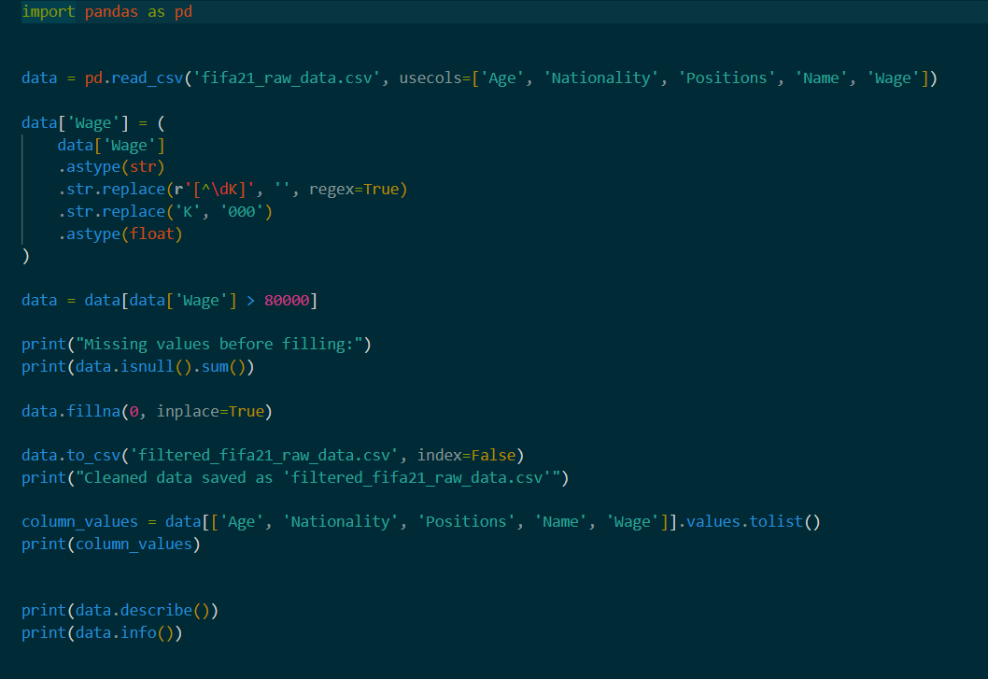

Spotify Data Analysis and Machine Learning Regression Study
Haya Darwish
Josh Belisario
Conor Cleary

Slide 2
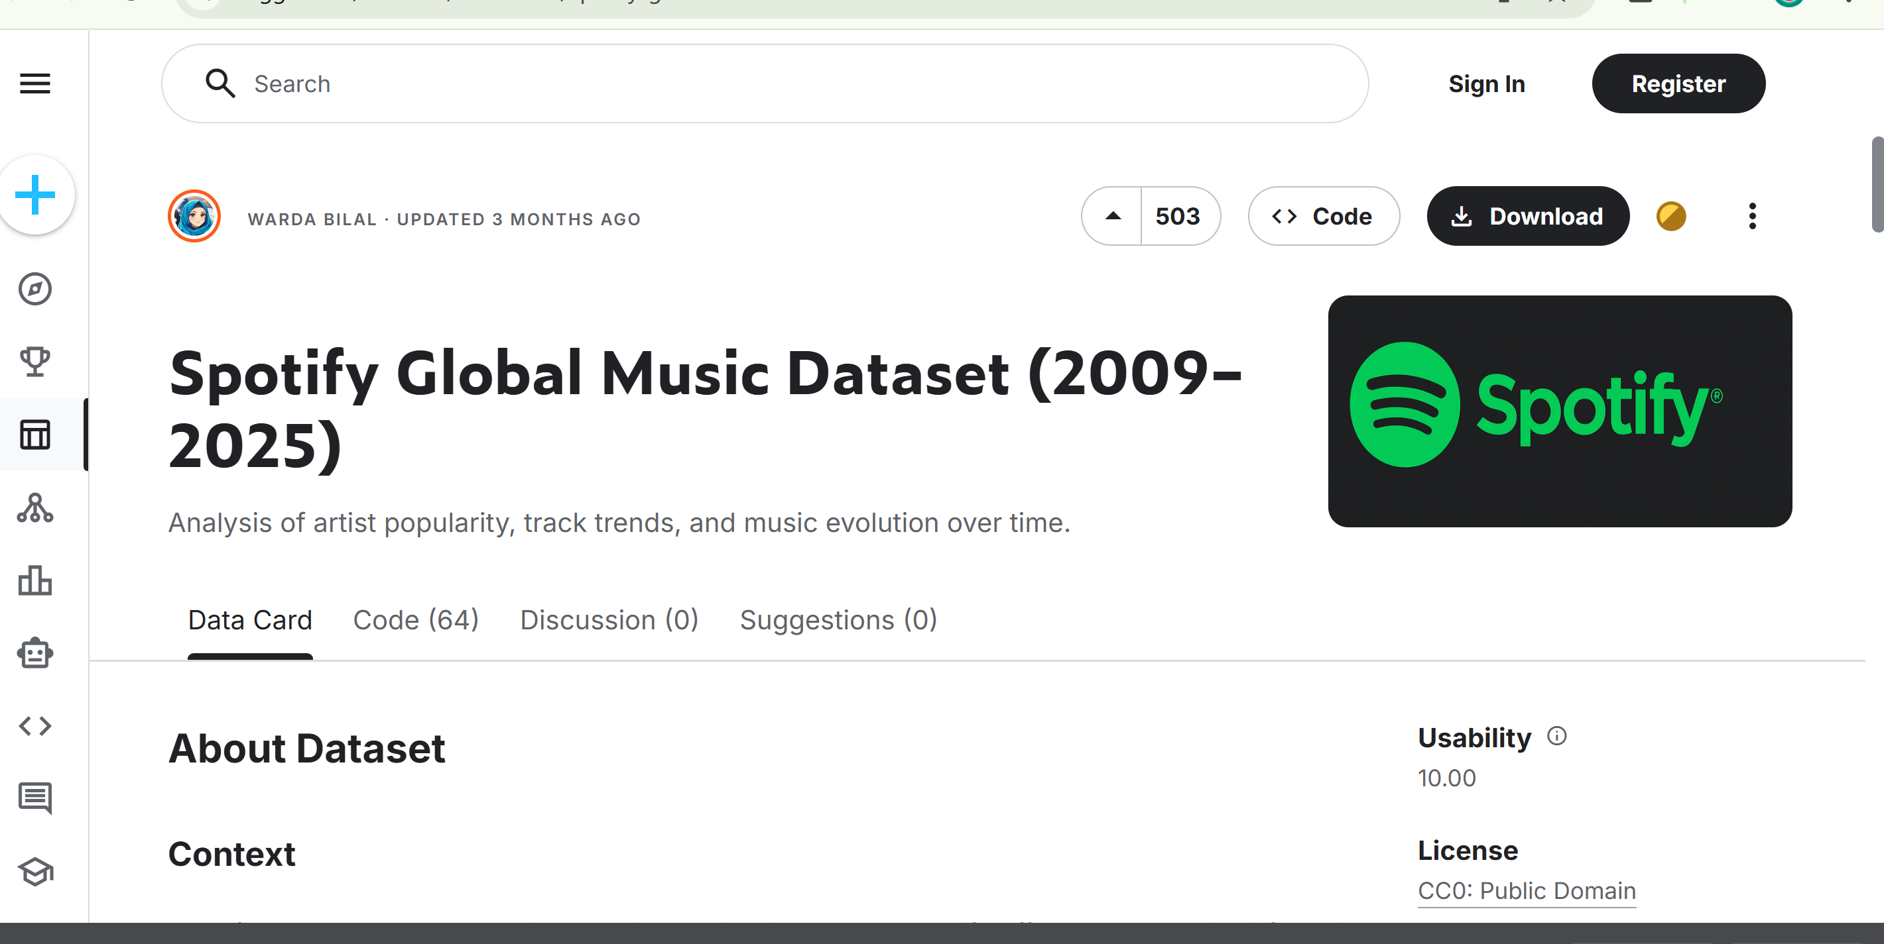
Data Selection
Data Source is Kaggle

Slide 3
Dataset Overview
The Dataset consists of 3 main variables which are numeric variables:
track_popularity
artist_followers
album_total

Slide 4
Data Filtering
Python was used to clean the data
Handle empty values
Minimize the raws

Slide 5
Dataset Statistics
Basic statistics have been applied to the data
Variable | Mean | Median | Mode | Min | Max | Standard Deviation
Track_popularity | 68.82925546 | 69 | 71 | 50 | 99 | 9.765489542
Artist_followers | 38377632.49 | 18208465 | 145396321 | 502300 | 145542136 | 43655014.98
Album_total | 15.8005788 | 15 | 12 | 4 | 137 | 43655014.98

Slide 6
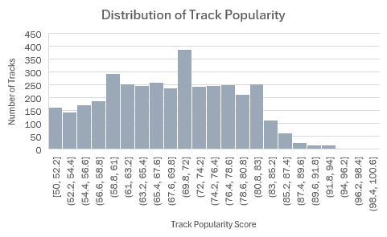
Visual Graphs
Most tracks fall into the mid-popularity range, with fewer extremely popular songs

Slide 7
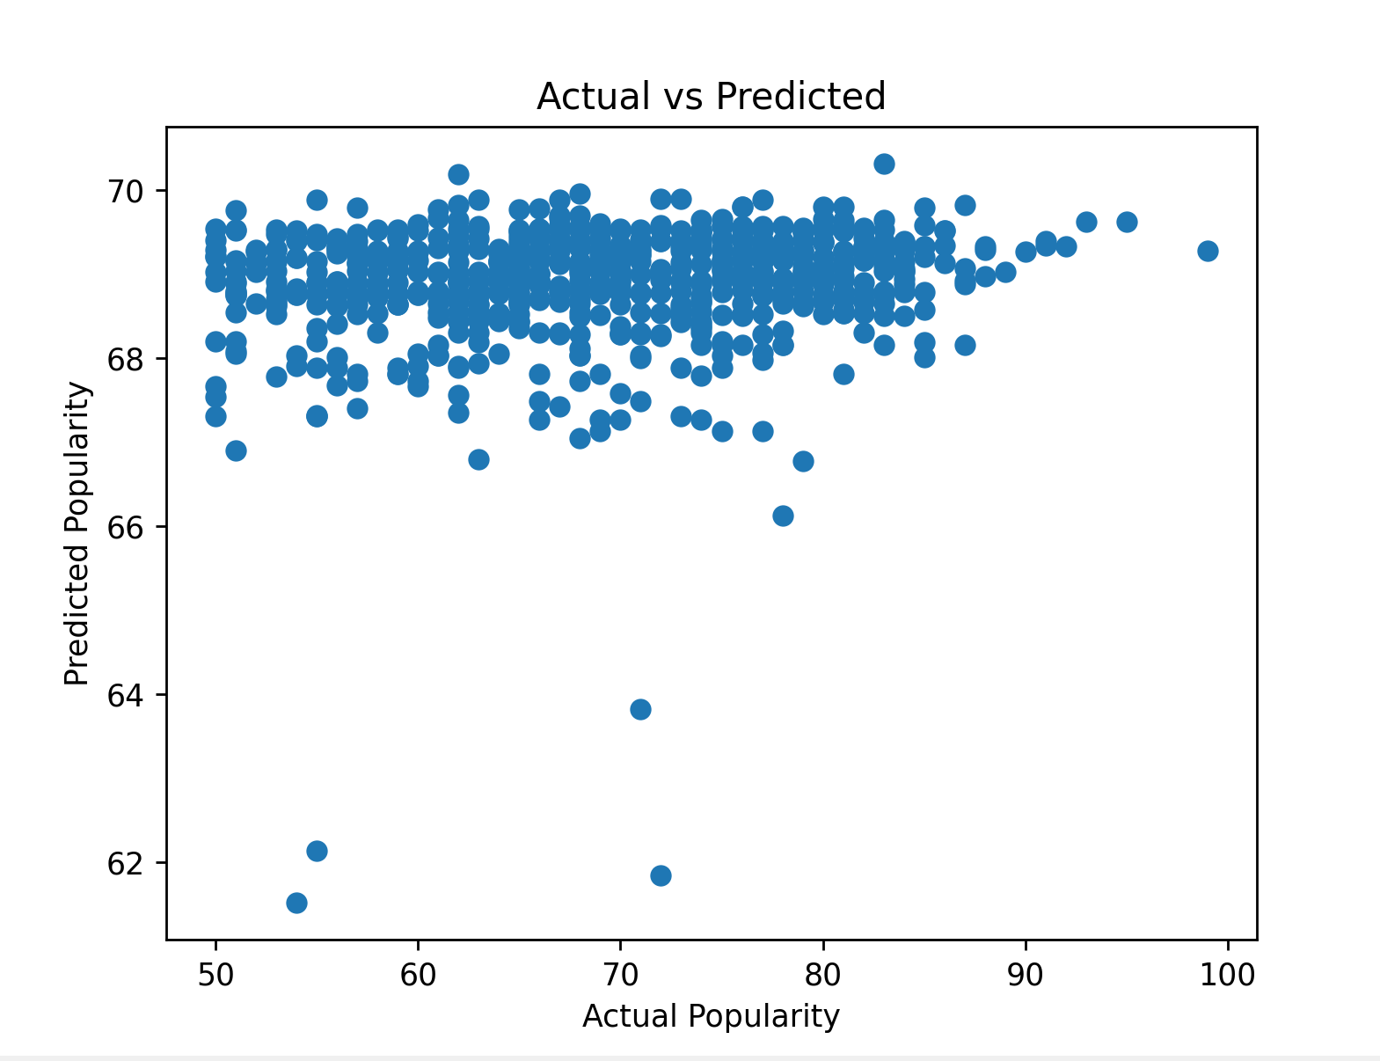
Machine Learning
A linear regression model was used to predict track popularity
Features used: artist followers and album track count

Slide 8
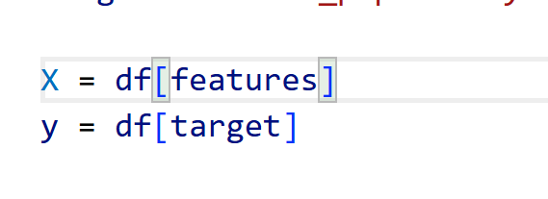
Machine Learning Analysis
Data was split into training and testing sets (80/20)
Model evaluated using R², MAE, and
Results showed limited predictive power due to missing real-world factors

Slide 9
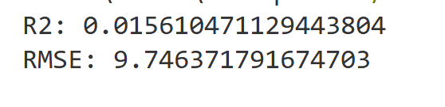
Machine Learning Analysis
The results show that the model achieves R^s score of ≈0.0156, and RMSE of ≈ 9.75 popularity points.
• RMSE of ~9.75 reflects noticeable prediction error
• This could be because track popularity depends on more complex real-world factors

Slide 10

Github
This Photo by Unknown Author is licensed under CC BY-SA
https://github.com/mxc1911/CA2.git

