Slide 1
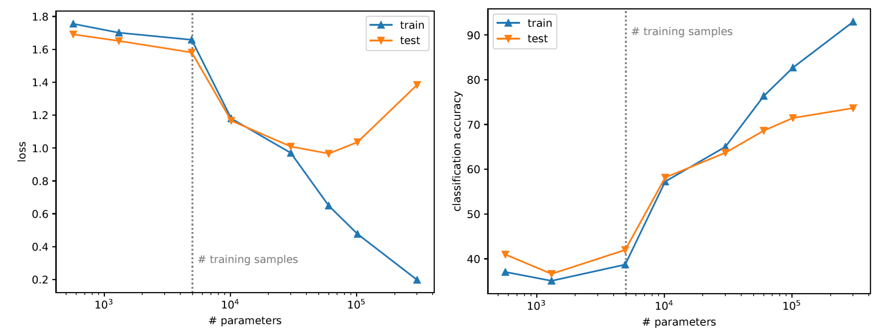
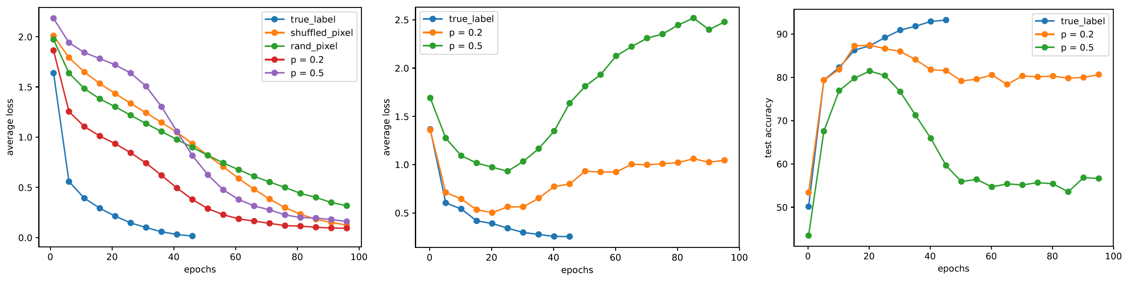
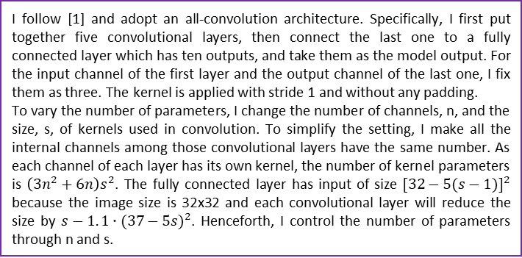
MATH 6380O Project 2: Great Challenges of Reproducible Training of CNNs
Wang Qicheng, Department of Mathmatics, HKUST
qwangch@connect.ust.hk
1. Introduction
3. Exp 1 Results
5. Exp 2 Results
The numbers of parameters in deep neural networks are often far more than the training samples. However, unlike traditional statistical learning, it seems that deep learning does not exhibit overfitting. To get a better understanding of this phenomena, I re-implement some experiments in [1, 2]. In the first experiment (section 2), I apply some modifications to the CIFAR-10 dataset and then train ResNet-18 to fit these datasets. In the second experiment (section 4), I train CNN on CIFAR-10 classification problem. I increase the number of parameters gradually and record the related loss and classification accuracy.
Fig 1 shows the learning curves of the ResNet-18 model on the CIFAR-10 dataset under various settings. Due to the limit of time, I only train each model 100 epochs. I observe that the training loss will always decay to zero. Since the loss of true labels decays to zero very fast, I only train the model 50 epochs in this case. I also tried to train the random labels (i.e. p = 1), but the loss decreases very slow so I do not plot the curve here.
Fig 2 and 3 are the test loss and test accuracy of corrupted labels, respectively. Note that the loss and accuracy are computed on the true labels test set. Fig 2 shows that for p = 0:2 and p = 0:5, the model has exhibited overfitting. I observe that the test accuracy firstly increase, then decrease and finally become steady.
Fig 4 and 5 show that the loss value is severely overfitted. When the number of parameters exceeds that of training samples, the training loss quickly drops but the test loss grows in a reverse direction. This conforms with the traditional wisdom that over-parameterized models tend to overfit. However, the test accuracy doesn’t show such trend. It keeps going up with the training accuracy, indicating that the model is still well better with overmany parameters.
Fig4: Test loss Fig5: Test accuracy
6. Analysis & Conclusion
2. Exp 1: Capacity of neural network
Exp 1: The results of the first experiment show that deep neural networks can fit CIFAR-10 very well, even when I modify the dataset by random noises. The convergence time will increase steadily as I increase the noise level. My explanation for this phenomenon is that CNNs have sufficient capacity to ’memorize’ the entire training set. When a random transform is applied to the data, it is likely to make the landscape of the loss more complicated. So the optimization algorithm will need more time to converge, but, due to the capacity of CNNs, the global minimum is still zero.
Exp 2: The second experiment shows that as the number of parameters increases, the model will gradually overfit the data, which conforms with traditional machine learning. But the question is why accuracy does not overfit? I think there are two possible reasons: The non-overfitting is a property of deep neural networks which I do not understand yet. Or it is caused by special structure of CIFAR-10. However, base on my experiments, I can not assert whether this phenomenon is caused by the dataset or the network.
To test the capacity of deep neural network, I use ResNet-18 to fit the standard and modified CIFAR-10 datasets. As in [2], I run my experiments with the following modifications of the labels and input images:
True labels: the original dataset without modification.
Partially corrupted labels: independently with probability p, the label of each image is
corrupted as a uniform random class.
Shuffled pixels: a random permutation of the pixels is chosen and then the same permutation is applied to all the images in both training and test set.
Random pixels: a different random permutation is applied to each image independently.
Fig1: Train loss Fig2: Test loss Fig3: Test accuracy
4. Exp 2: Non-overfitting puzzle
I follow [1] and adopt an all-convolution architecture. Specifically, I first put together five convolutional layers, then connect the last one to a fully connected layer which has ten outputs, and take them as the model output. For the input channel of the first layer and the output channel of the last one, I fix them as three. The kernel is applied with stride 1 and without any padding.
To vary the number of parameters, I change the number of channels, n, and the size, s, of kernels used in convolution. To simplify the setting, I make all the internal channels among those convolutional layers have the same number. As each channel of each layer has its own kernel, the number of kernel parameters is $\left(3n^{2}+6n\right)s^{2}$. The fully connected layer has input of size ${[32−5(s−1)]}^{2}$ because the image size is 32x32 and each convolutional layer will reduce the size by $s−1. 1∙{(37−5s)}^{2}$. Henceforth, I control the number of parameters through n and s.
7. References
[1] T. Poggio, K. Kawaguchi, Q. Liao, B. Miranda, L. Rosasco, X. Boix, J. Hidary, and H. Mhaskar. Theory of deep learning iii: the non-overfitting puzzle. Technical report, CBMM memo 073, 2018.
[2] C. Zhang, S. Bengio, M. Hardt, B. Recht, and O. Vinyals. Understanding deep learning requiresrethinking generalization. arXiv:1611.03530, 2016.

