Slide 1
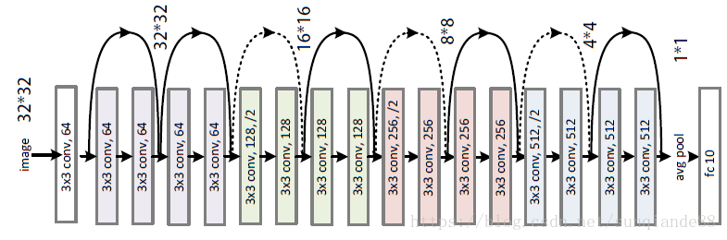
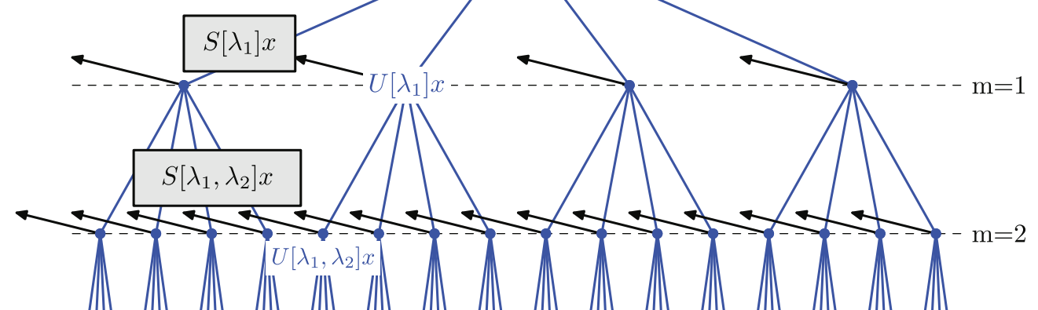
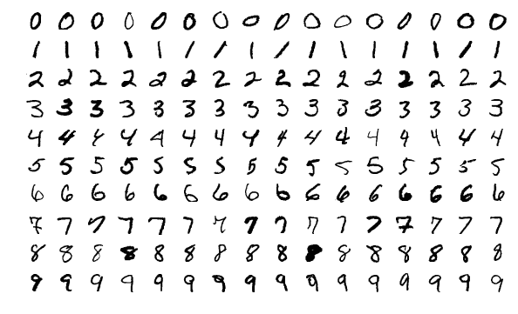
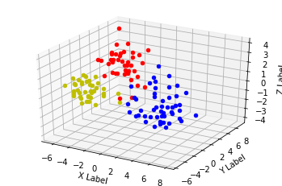
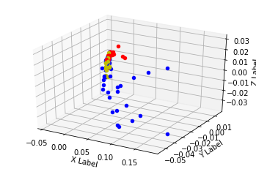
MATH 6380O: Project 1
Wang Qicheng, Department of Mathmatics, HKUST
qwangch@connect.ust.hk
Abstract
Methods
Discussion
In this project, I first extract the features of the MNIST dataset using ResNet-18, by deleting the last fully-connected layer. To get an intuitive understanding of the network, I visualized the features. Then I trained an SVM as a classifier on the extracted features to predict the labels of the test data. The same procedures applied to the ScatNet as well.
The results show the ResNet-18+SVM combination achieved a relatively high accuracy of 94.76%, while the ScatNet+SVM combination reached only 76.39% accuracy.
Then to improve the results, I updated the latter combination by replacing SVM with a small CNN with 3x3 convs based on VGG and saw a much better result (98.14%).
Feature Extraction
ScatNet: Wavelet scattering network (Scat Net) computes a translation invariant image representation. In this project, I use 2-layer Scat Net. The ScatNet code was adapted from the Kymatio. [3]
ResNet-18: It’s a residual learning framework with 18 layers. We do the same operation as that in scattering net and the weights of this pre-trained model was trained on ImageNet. The ResNet-18 code was adapted from Pytorch library. In this project I deleted the last fully-connected layer to get a feature extractor.
Classification
First we used SVM to train classifiers on the features extracted above. The SVM was trained based on the train data. The code was from SKlearn. Then to improve the performance of ScatNet, I replaced the SVM classifier with a small VGG-based CNN classifier as demonstrated in the Kymatio package.
Visualization
We perform PCA on the extracted features, preserve the first 3 dimensions and visualize in a 3D space. Fig.4 shows the visualization results. To keep concise, only “0”, “7” and “8” classes are shown and each class contains 50 randomly chosen points.
From the visualization of the ScatNet features, we can see that the ScatNet itself does not group the data. That’s probably the reason why the ScatNet + SVM combination does not work well. However the outputs of the ScatNet is ready to
Even a very small CNN attached to the ScatNet can produce promising results. Generally the ScatNet is not followed by a classical classifier like SVM. It is usually followed by a MLP or a small CNN like VGG in this case.
Conclusions
As a practice of neural network, this project aims to use pre-trained neural networks, i.e. ResNet-18 and scattering net respectively, to predict the labels of the test data in a popular machine learning dataset, MNIST.
For this purpose, I First extracted the features of train data in the dataset, visualized the featrues and employed a SVM classifier to predict the test data.
The results show ResNet-18 outperformed ScatNet. So I replaced the SVM with a small VGG net as researchers usually do. That greatly improved the performance.
Introduction
Fig 2. ResNet-18 Structure.
Fig 3. Scattering Network Structure.
The project is based on the MNIST dataset. The MNIST dataset is a large database of handwritten digits that is commonly used for training various image processing systems.[1][2]
It contains 60,000 training images and 10,000 testing images.[4] The images in the dataset are greyscale images and of size 28x28 pixel. Some sample images are shown in Fig.1.
Results
From the visualization results we see the ResNet-18 indeed classified the images well (“0” in red, “4” in blue and “8” in yellow), but the features derived from ScatNet do not group together. That’s probably because 3 dimensions are not sufficient to demonstrate the groups of the points.
The results of the project was listed in Table 1. Generally the ResNet-18+SVM outperformed ScatNet SVM. However after replacing the SVM with the small CNN classifier the results improved dramatically. The implementation is included in the Kymatio package as an example.
References
"Support vector machines speed pattern recognition - Vision Systems Design". Vision Systems Design. Retrieved 17 August 2013.
Gangaputra, Sachin. "Handwritten digit database". Retrieved 17 August 2013.
Andreux M., Angles T., Exarchakis G., Leonarduzzi R., Rochette G., Thiry L., Zarka J., Mallat S., Andén J., Belilovsky E., Bruna J., Lostanlen V., Hirn M. J., Oyallon E., Zhang S., Cella C., Eickenberg M. (2019). Kymatio: Scattering Transforms in Python. arXiv preprint arXiv:1812.11214.
Kussul, Ernst; Tatiana Baidyk (2004). "Improved method of handwritten digit recognition tested on MNIST database". Image and Vision Computing. 22 (12): 971–981.
Network | Classifier | accuracy
ResNet-18 + SVM | SVM | 94.76%
ScatNet + SVM | SVM | 76.39%
ScatNet + CNN | CNN | 98.14%
Figure 1. sample of MNIST dataset.
Acknowledgements
Table 1. Accuracy
Fig 4. Visualization of ResNet-18 features (left) and ScatNet (right)
Acknowledgements text goes here.

