Slide 1
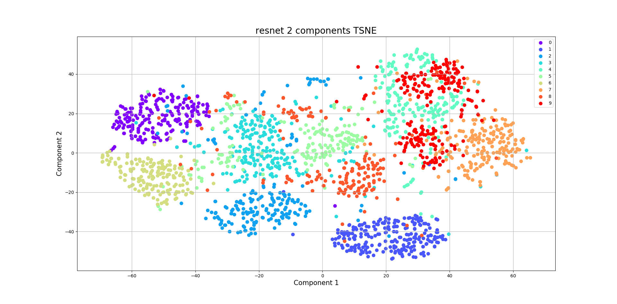
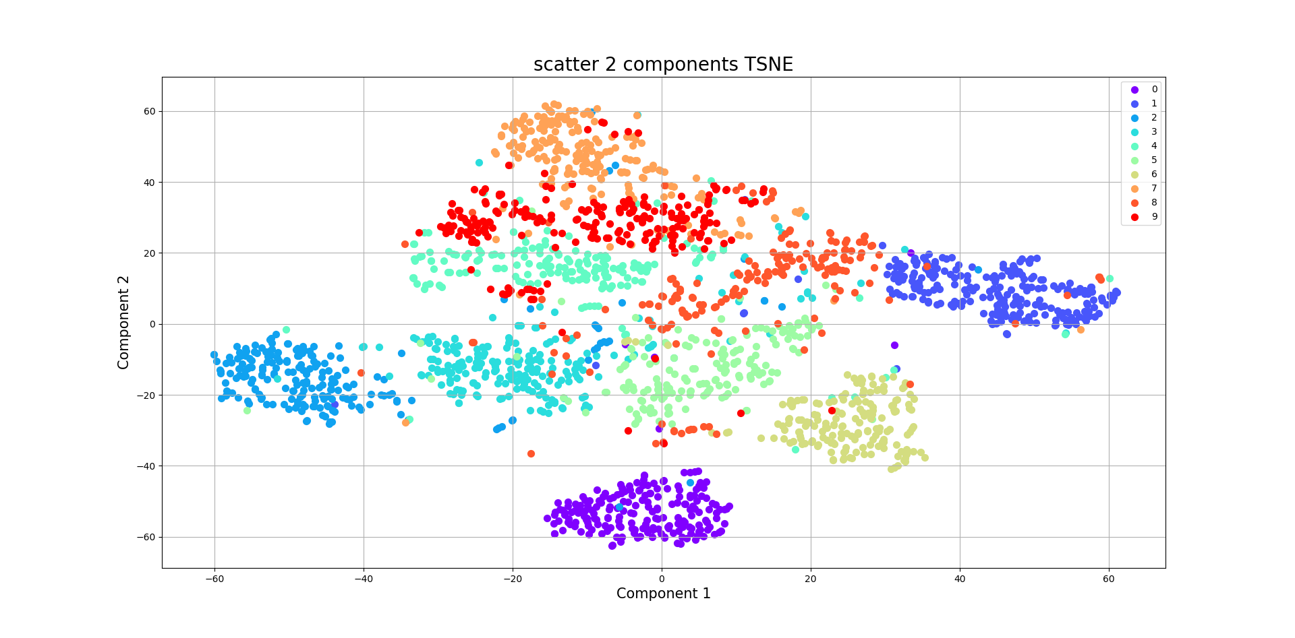

MATH 6380O Mini-Project 1: Feature Extraction and Transfer Learning
Chenyang Lei, Yazhou Xing, Yue Wu, and Xie Jiaxin {cleiaa, yxingag, ywudg, jxieax}@connect.ust.hk
Department of Computer Science and Engineering, HKUST
1. Introduction
For ResNet-18, we use the pretrained model on ImageNet to extract the feature of each sample image. We use the feature map just before the final fully connected layer in ResNet-18.
The following images show the visualizations of these features.
resnet is a more well-designed and complex network than scatter net, the feature map extracted by resnet can better describe the images. Result of using features is better since features contain more information than raw images.
t-SNE visualization We use t-SNE to visualize feature extracted from the above two networks. In detailed, we randomly sample 2000 points from training set and use t-SNE to reduce their feature vector to 2 components. From the figure on the left, we can see most of the points belonging to the same category are gathered. Classical unsupervised learning methods with good feature also work well in classification.
As the rapid growing of deep learning, neural network based learning algorithms have held the dominant position in machine learning community. In this project, we conducted several experiments to analyze the influence of different feature extraction methods and classifiers to the classification accuracy. To analyze the quality of extracted features, we visualize the features using PCA. Based on that, we performed a complete analysis for the obtained results. Finally, we fine tune the ResNet-18 to achieve the highest classification accuracy over 99.0%.
6. Conclusion
In this project, we have shown the powerful ability of CNN based methods to do classification task. By the comparative classification experiments of traditional SVM and ResNet-18 on MNIST dataset, we come to the conclusion that CNN based methods benefit a lot from the powerful feature extraction ability. Thus, using the feature extracted by ResNet-18, we could achieve better accuracy even using traditional classifiers. The visualization by PCA also confirm the conclusion. Based on this finding, tasks which highly rely on the quality of feature extraction now have the space to be rethinking and explored.
2. Mnist Dataset
t-SNE results of ResNet
t-SNE results of ScatNet
MNIST dataset of 60,000 training images and 10,000 test
Images. The resolution of each image is 28*28. It contains handwritten digits from 0 to 9. The shape, thickness and rotation of the same digit are different from each other.
4. Classification results on MNIST Dataset
Comparisons between SVM and ResNet-18
This table shows the accuracy of SVM and ResNet-18, using different extracted features.
7. References
He, Kaiming, et al. "Deep residual learning for image recognition." Proceedings of the IEEE conference on computer vision and pattern recognition. 2016.
Bruna, Joan, and Stéphane Mallat. "Invariant scattering convolution networks." IEEE transactions on pattern analysis and machine intelligence 35.8 (2013): 1872-1886.
Two samples in mnist
5. Analysis
3. Method
Result analysis between finetune resnet network and SVM classification
The result of finetune resnet network on mnist dataset is better than using SVM taking features as input. It is because finetune resnet is an end-to-end strategy, loss between prediction and target will help the network find best parameters. While using SVM algorithm taking the features of pretrained model, which may have different data distribution than mnist dataset.
Result analysis between SVM-raw image, SVM-scatter net, SVM-resnet
The result of SVM-resnet is better than SVM-scatter net, it’s because
8. Contribution
Feature Extraction
We use scattering net and ResNet to extract the features of images.
For scattering net, we set the number of dilations as 3, the length of scattering network as 2 and 6 rotations..
Feature extraction of Scattering Net and ResNet
Chenyang Lei, Yazhou Xing
Visualization of features
Jiaxin Xie
Classification
Yue Wu

