Slide 1
SGX / CAS – Use Case
Background:
Messages are lost intermittently in production incoming messages are not archived.
No end to end environment for development work.
During project development messages are not flowing into back office system (BOS) due to schema changes.
Complex flows in place between SGX, AAC , DClear (Dion)

Slide 2
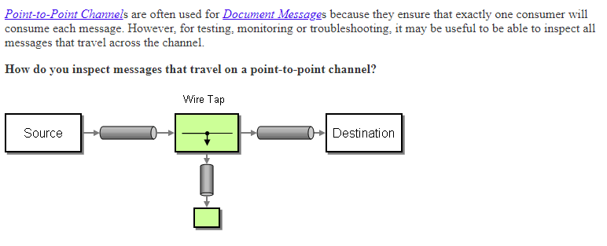
Wire Tap
When to use:
Publish Subscriber is not available ie. Point to Point.
Use Cases:
SGX BOS messages are lost !!! , audit trail.
Cycle testing when an end to end environment may not be available.
Separation of concerns, remove burden for applications to archive and housekeep incoming messages.

Slide 3
PIP Use Case
Background:
Manual process to enter data into MICs .
Data typically come from spreadsheet.
There are multiple file types that need to be processed.
Once data has been validated trigger a job in MICs
When job is processed notification is to be sent to requestor.
Solution needs to be scalable, additional file types can be added reusing similar routing and process flows.

Slide 4
Multiple Recipients
Not all channels want to be point to point.
Here a recipient list router is used to send to a predetermined set of endpoints

Slide 5
Cash Management – Use Case
Background:
Cash positions are maintained via spreadsheet.
Consolidated reports sent to head office via email.
Report pack consisting of 12 reports including charts.
Intraday reports is sent to treasury for daily reconciliation.
Replace the use of spreadsheet with a secure application.
Timeframe/ Budget is tight.

Slide 6
Multiple Recipients
Not all channels want to be point to point.
Here a recipient list router is used to send to a predetermined set of endpoints

Slide 7
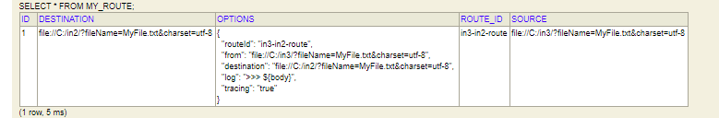

Slide 8
