Slide 1
Life Sciences Collaborative Access Team (LS-CAT) @ APS: Path to MxCuBE
Joseph S Brunzelle
j-brunzelle@northwestern.edu

Slide 2
21ID-D
P4-40
WB Shutter
Kohzu HLD-8NE
Monochromator
Si 111 or 220 crystals
Power-Limiting Aperture
Fixed Aperture
KB Bimorph Mirrors
Side-Bounce Single Laue Diamond 111 Crystal Monochromators
Fixed Aperture
21ID F-G
Power-Limiting Aperture
Be Lenses
Be Lenses
P8-50 Shutter
P8-50 Shutter

Slide 3
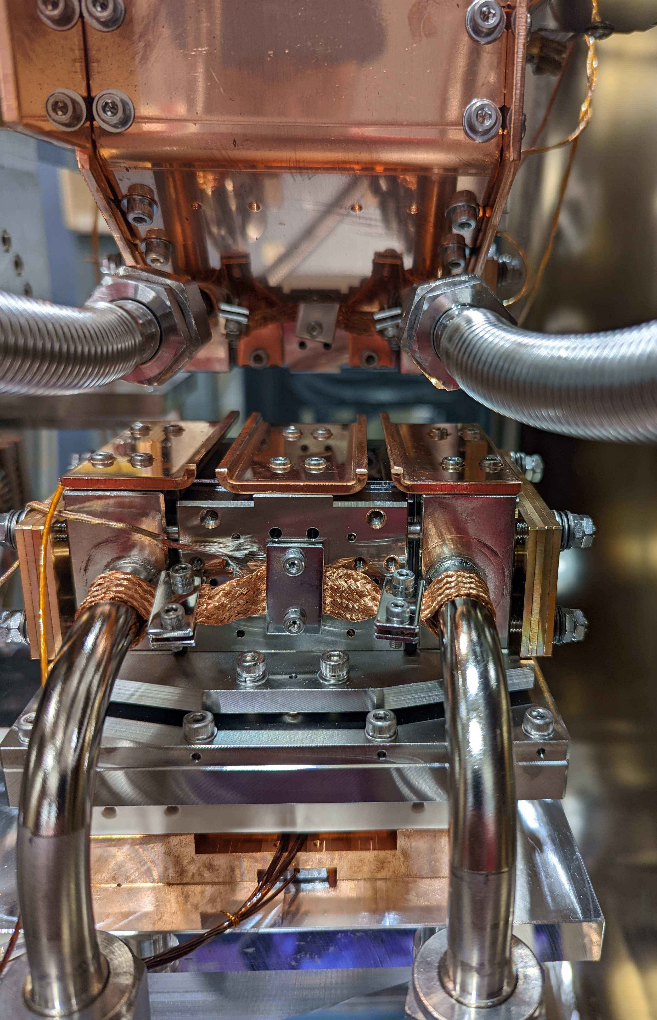
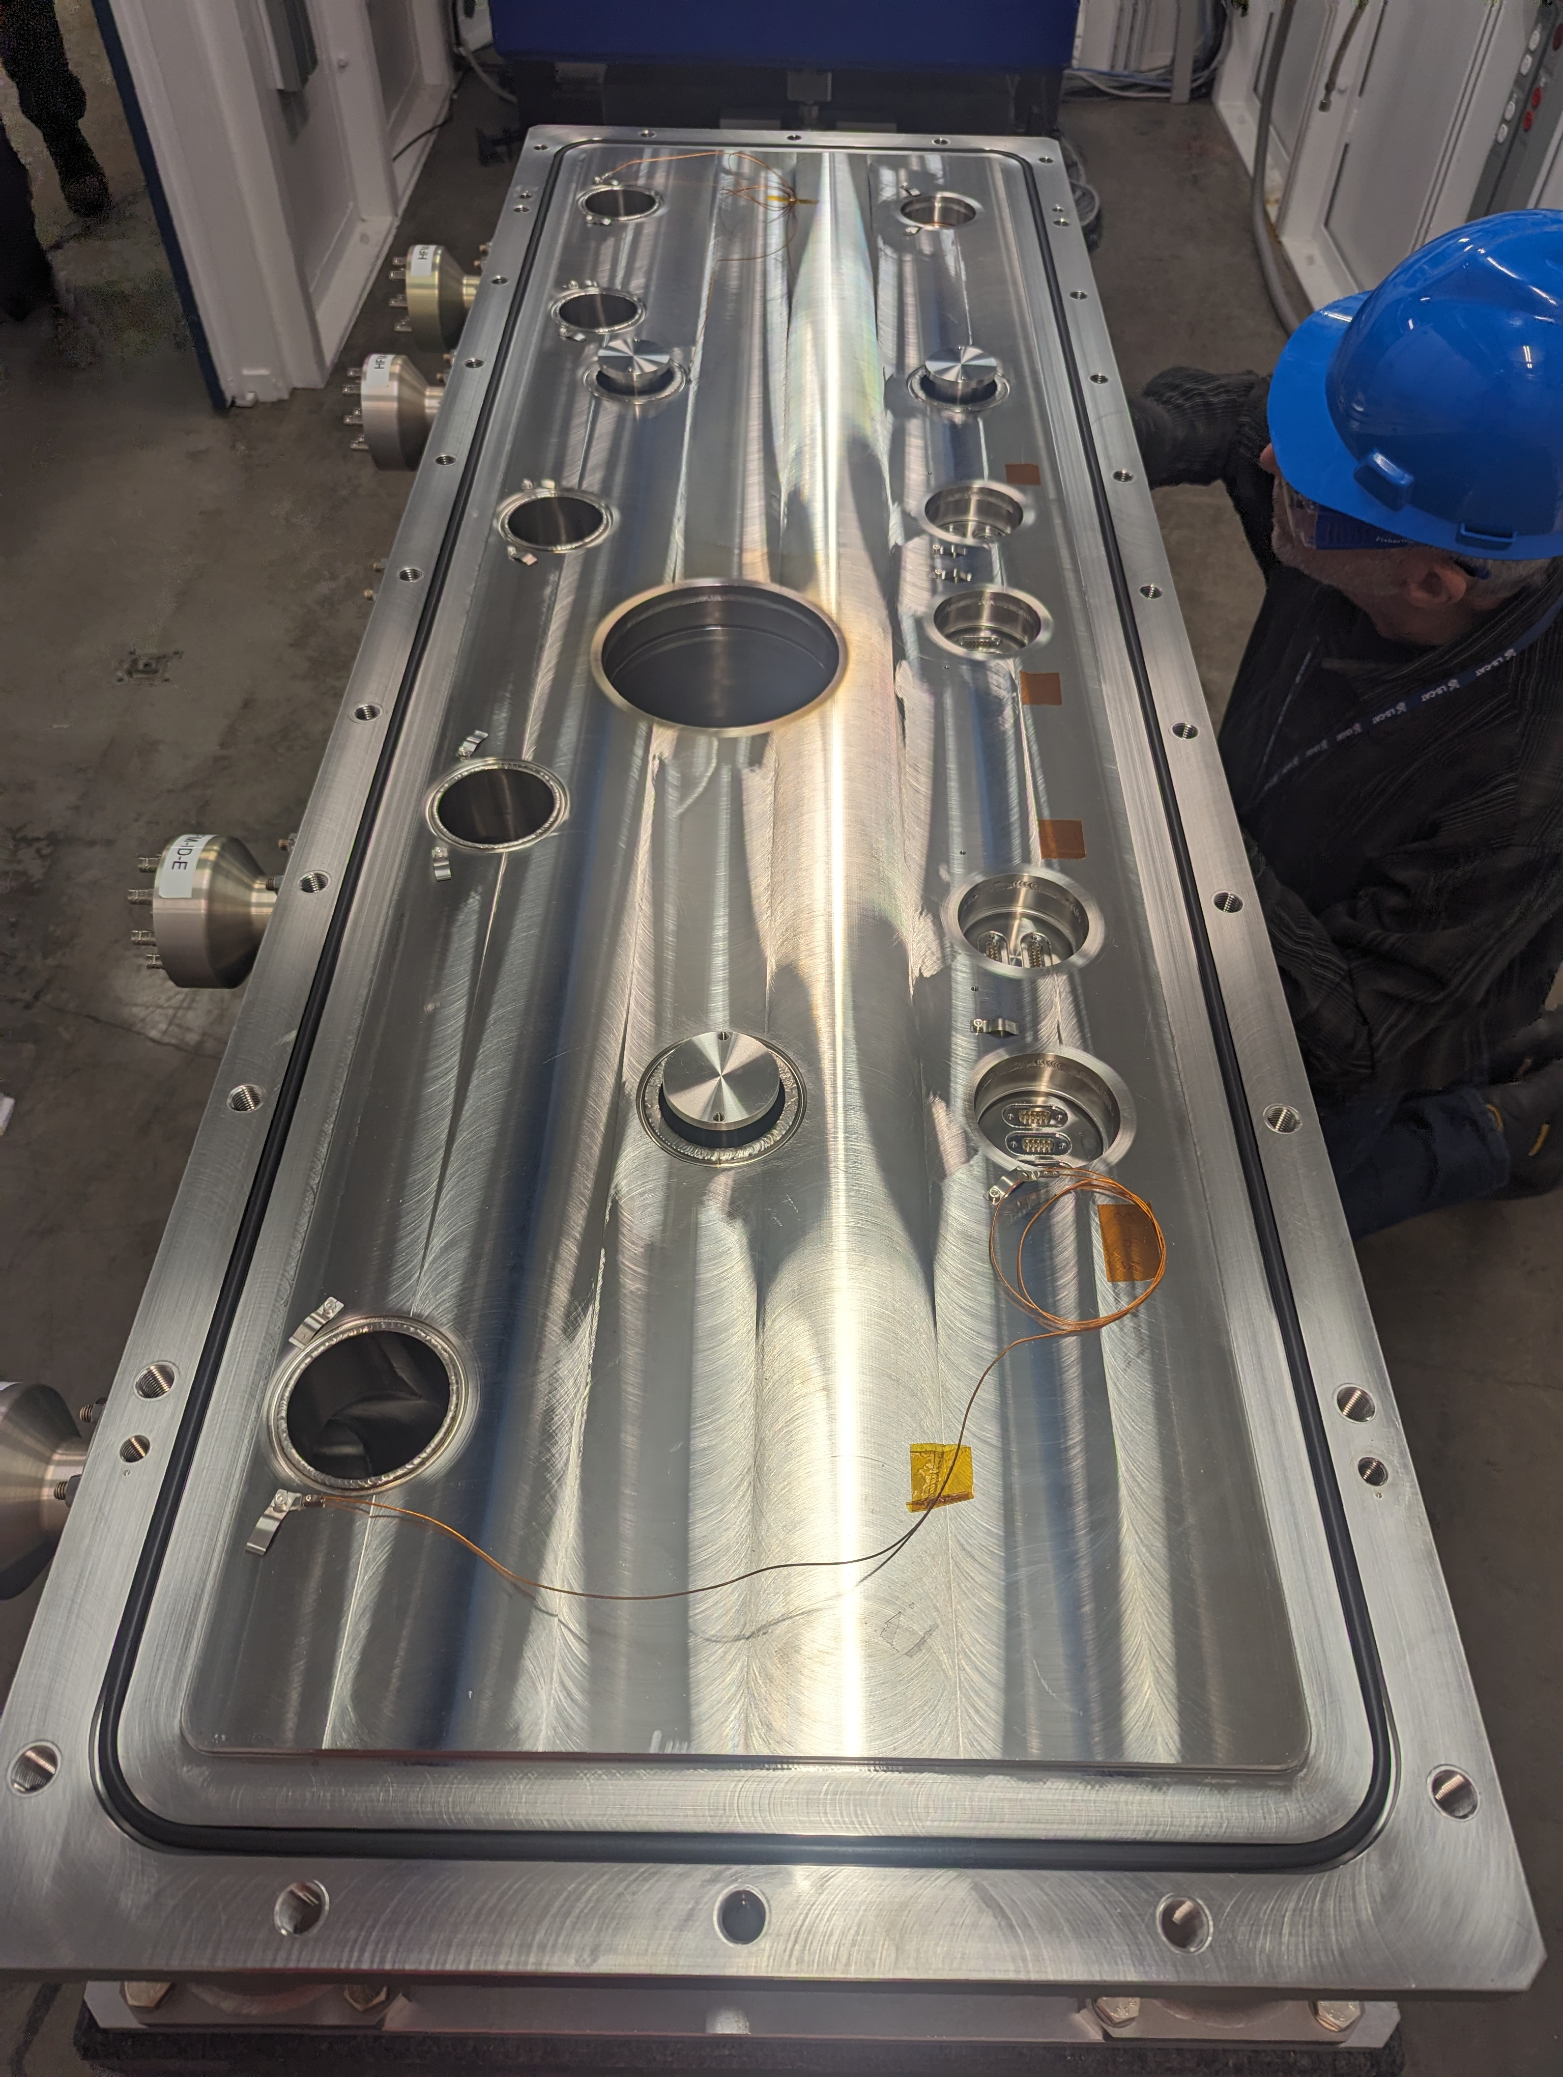
Upgraded Kohzu Mono
Upgraded KB Bimorph Mirror System
Went from direct to indirect cooling
Added crystal shielding
Mirror holders – increase stability
Replaced positioners & encoders

Slide 4
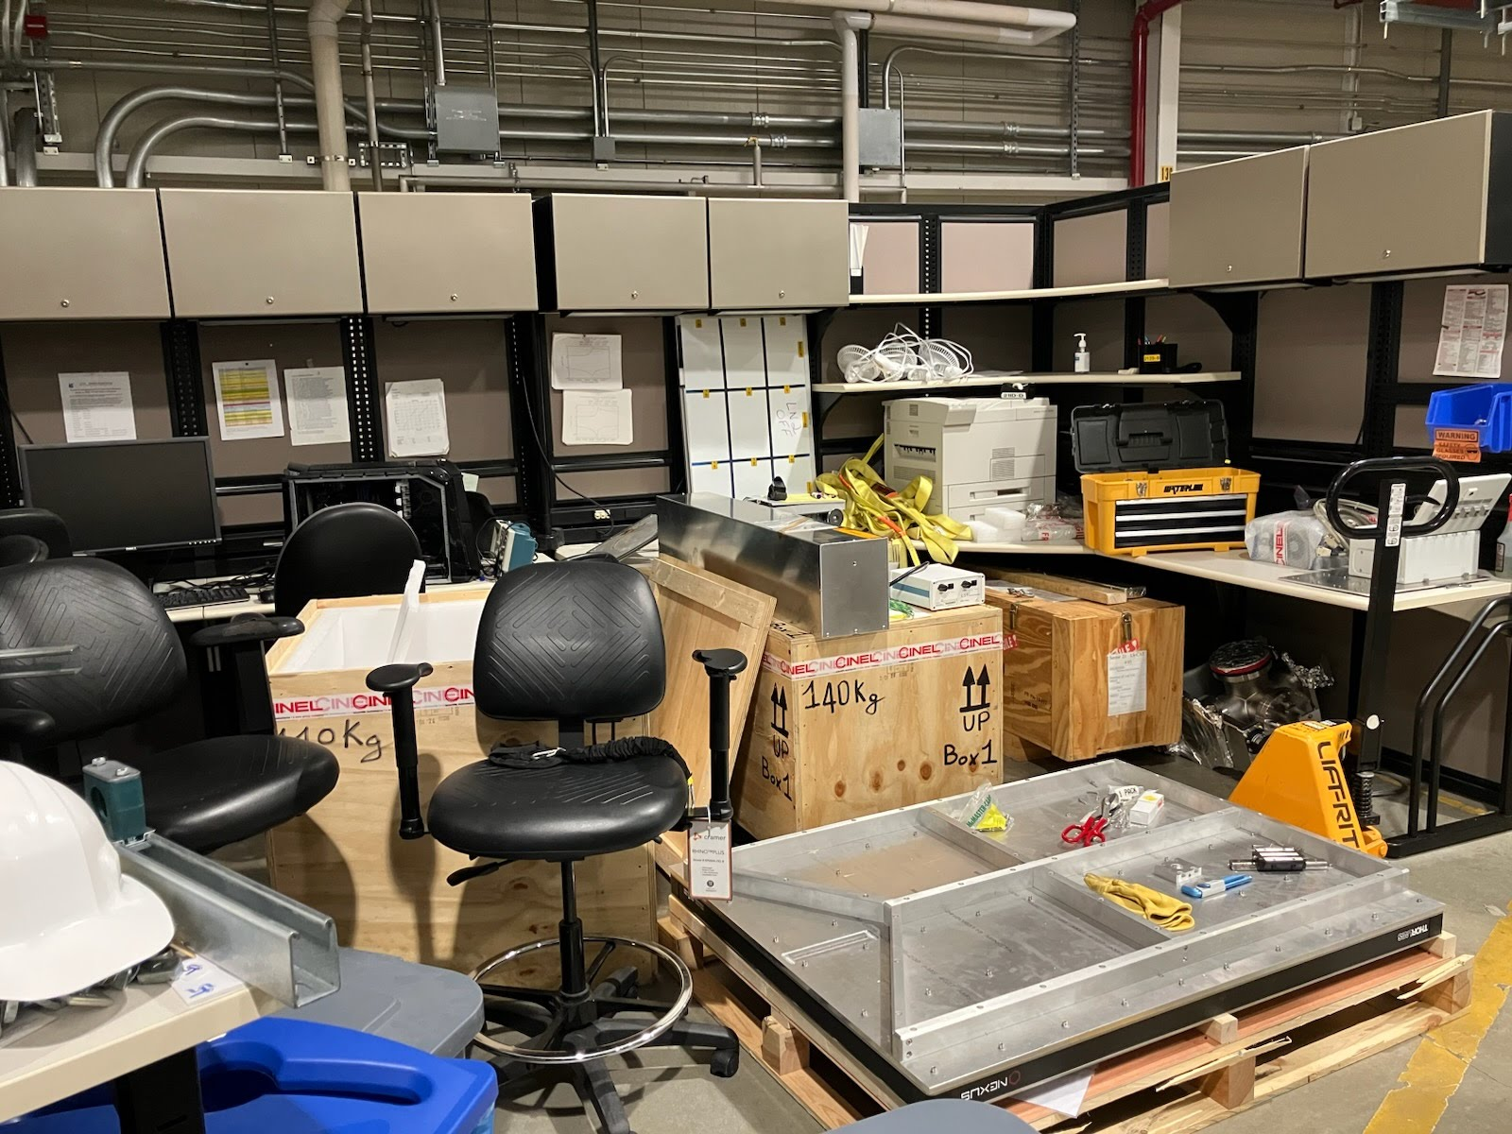
End Station Stagging Area

Slide 5
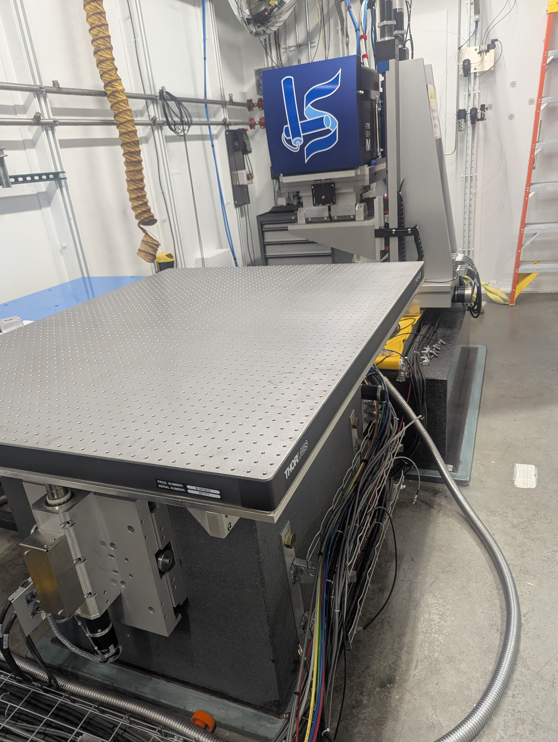

Slide 6
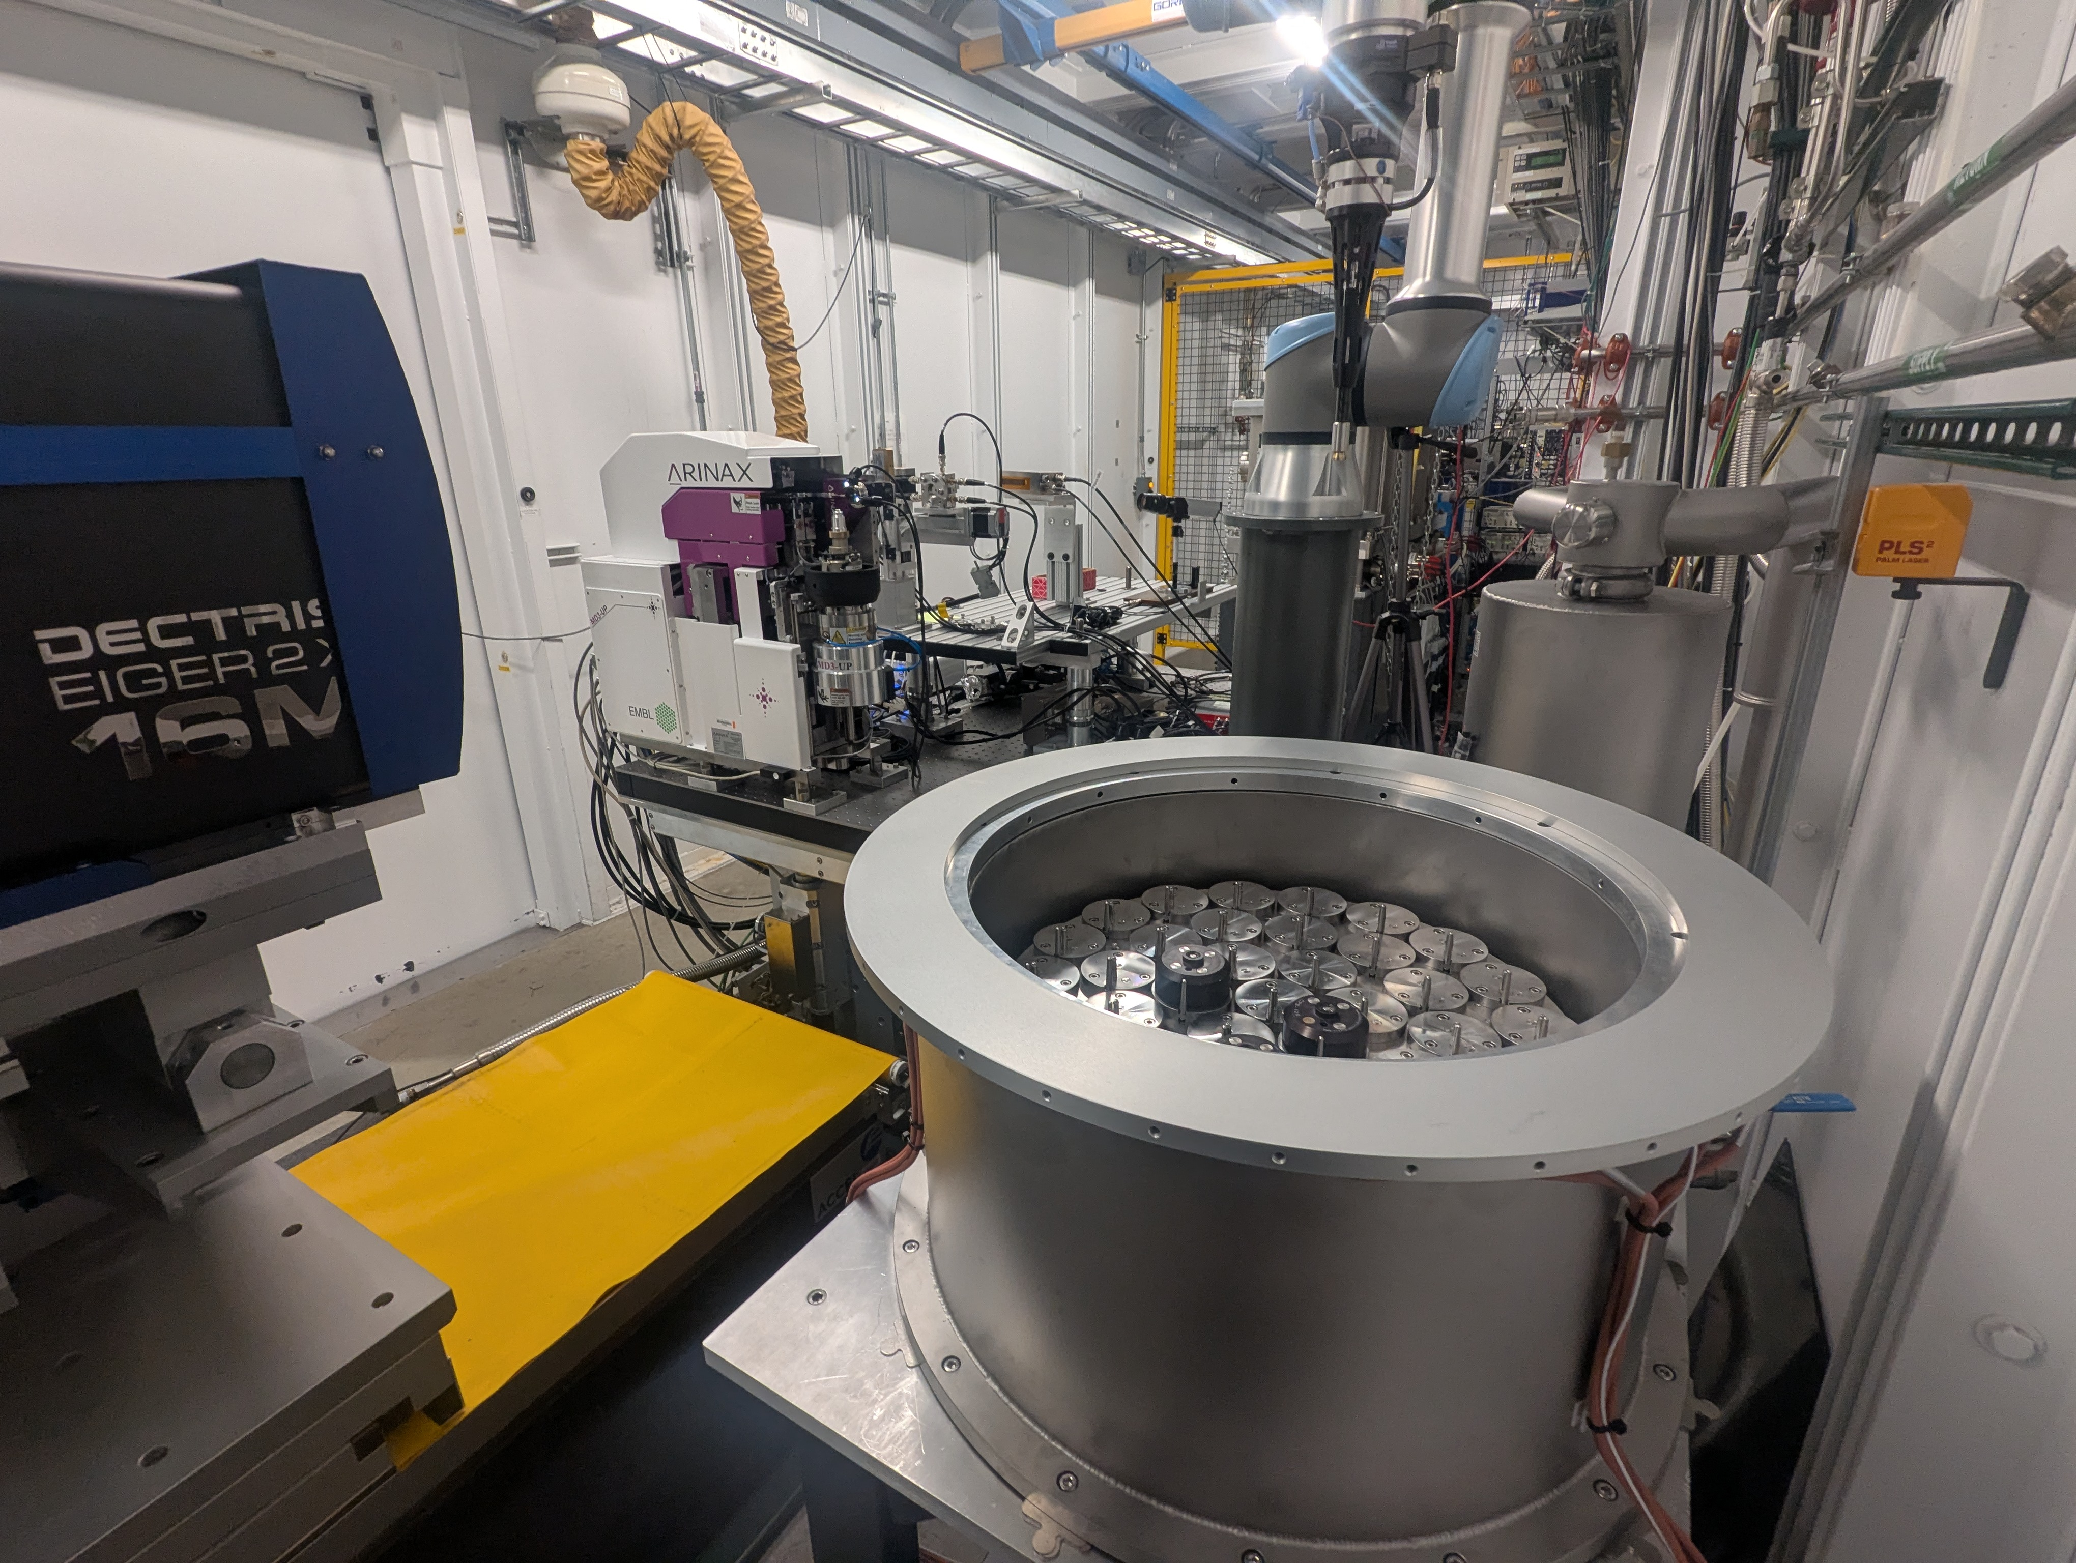
End Station Assembly
Installed MD3-up
Process of installing & programing sample changer
Commissioning BPMs
Commissioning KB Bimorph Mirrors

Slide 7
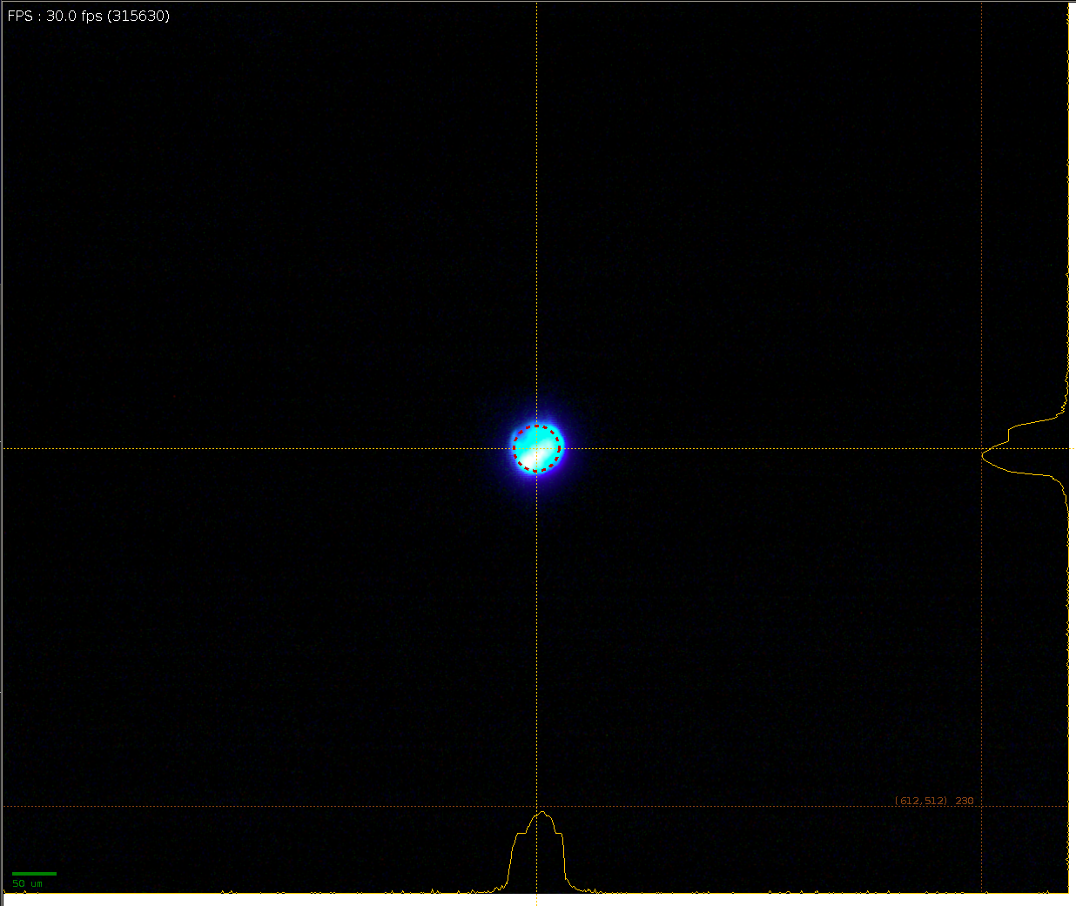
Finally Beam at the Sample
Now it’s time to install and integrate MXcuBE
Start simple and then build up

