Slide 1

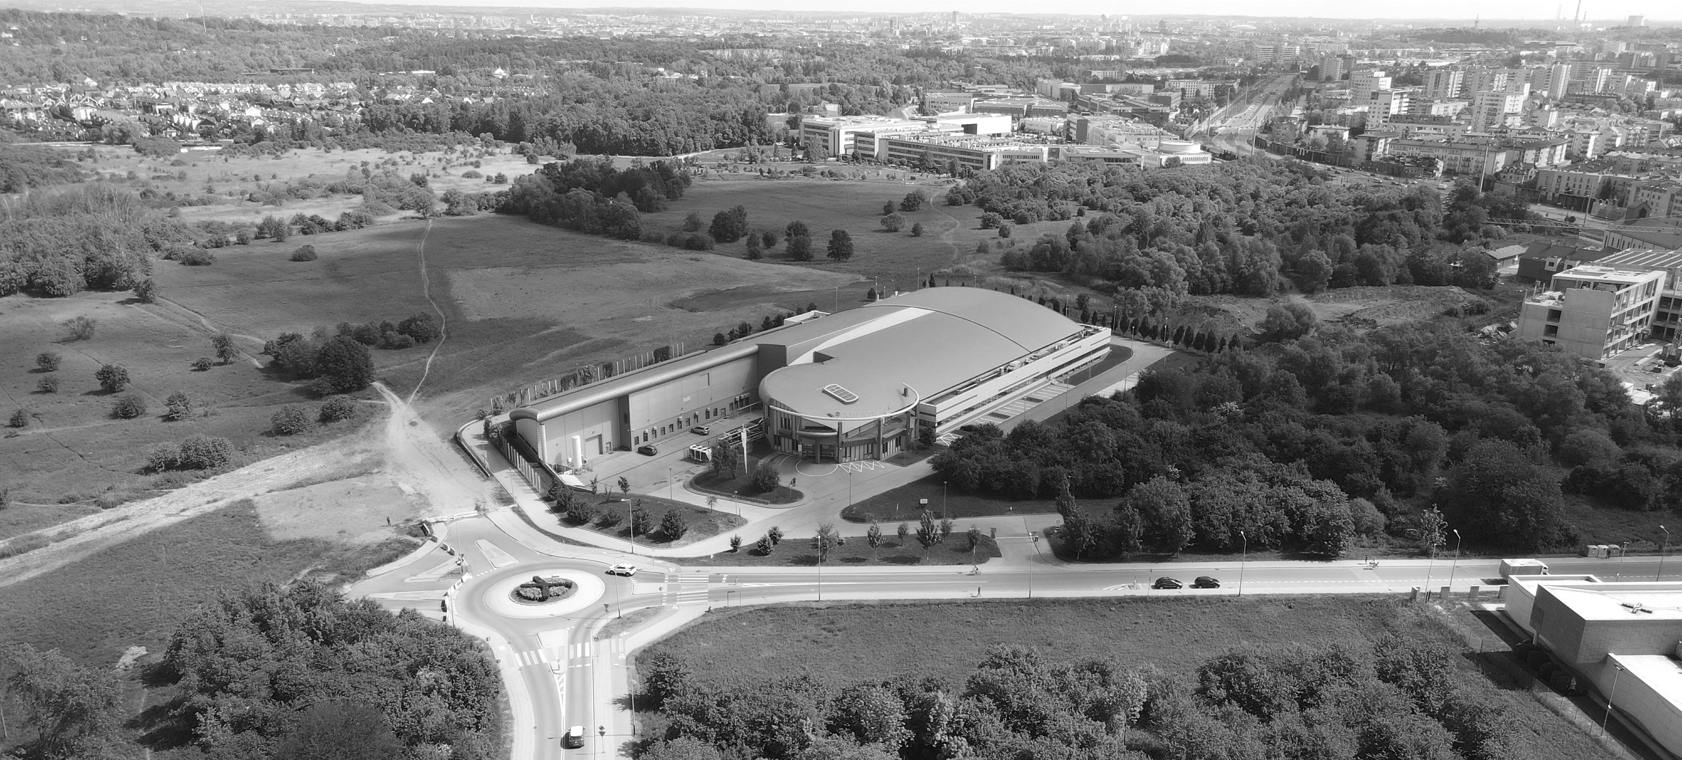

Current status of ARYA Macromolecular Crystallography beamline at SOLARIS NSRC
Michał Gucwa & Joanna Sławek
Notes:
Hello everyone. Today I will present the current status of the ARYA beamline at the SOLARIS synchrotron.

Slide 2
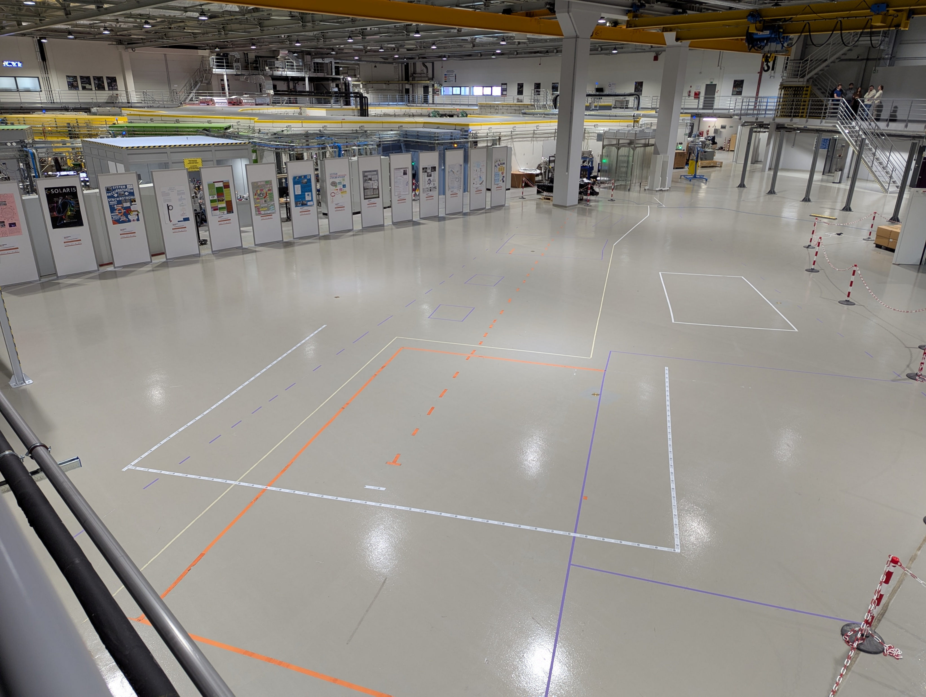
SOLCRYS project
2023
MEN infrastructure grants for MX (II stage) and SAXS
2024
Preparation for tenders for I and II stage of the project
2025
Tenders, Infrastructure project
2026
Installation of endstation
2027
Installation of optics, integration, comissioning
14 Nov 2025
D Liberda, M Hermes, P Koziol, N Stone, TP Wrobel, Journal of Biophotonics, 8, 2020
Notes:
The ARYA beamline is currently in the construction phase. Right now, we are working on the infrastructure project and preparing all necessary tenders. Our planned completion date is the end of 2027. Thus, the delivery and installation of equipment will take place over the next two years. Here you can see a recent photo of the beamline site. After that, the beamline will look like this.

Slide 3
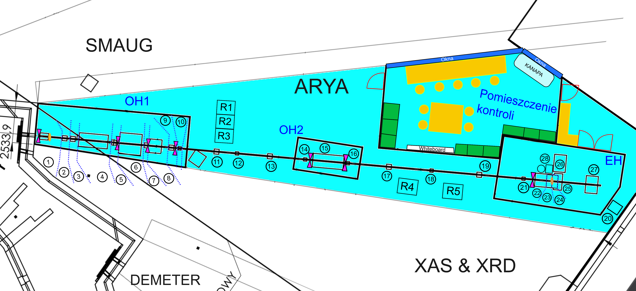
Progress on the ARYA Beamline Infrastructure
Controll Room
D Liberda, M Hermes, P Koziol, N Stone, TP Wrobel, Journal of Biophotonics, 8, 2020
Notes:
This is our most recent infrastructure layout. It includes:
Two optical hutches,
A tandem system with mirrors,
A tandem monochromator, enabling two operational modes: high resolution and high flux,
And the endstation, equipped with a detector and sample changer. Next to it, there will be a convenient control room — and yes, it will include a comfortable sofa for those long nights of data collection.

Slide 4
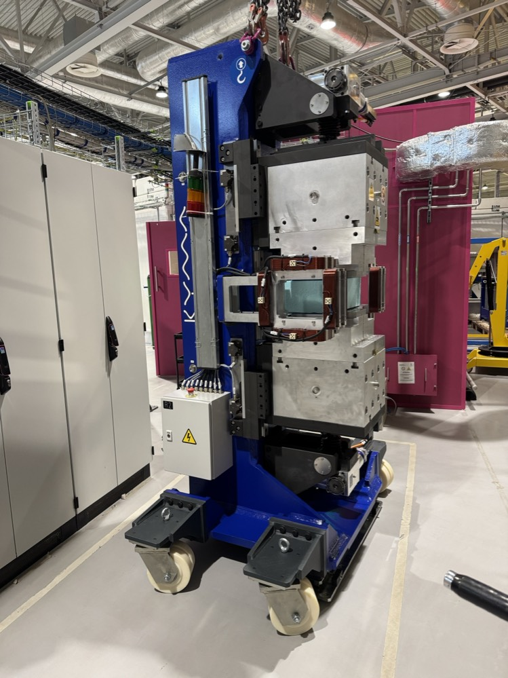
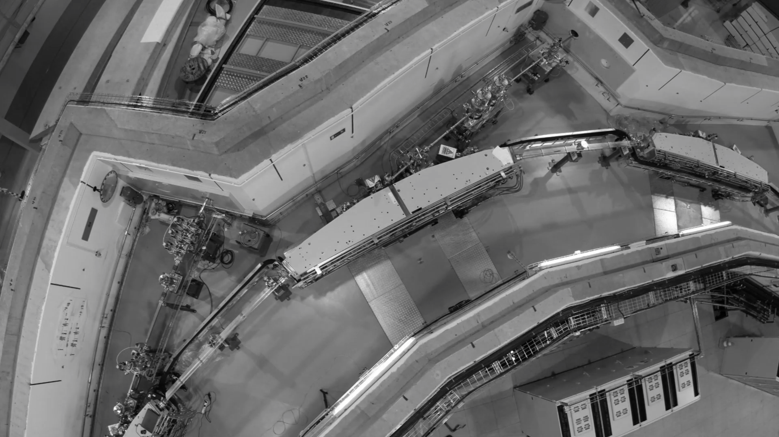
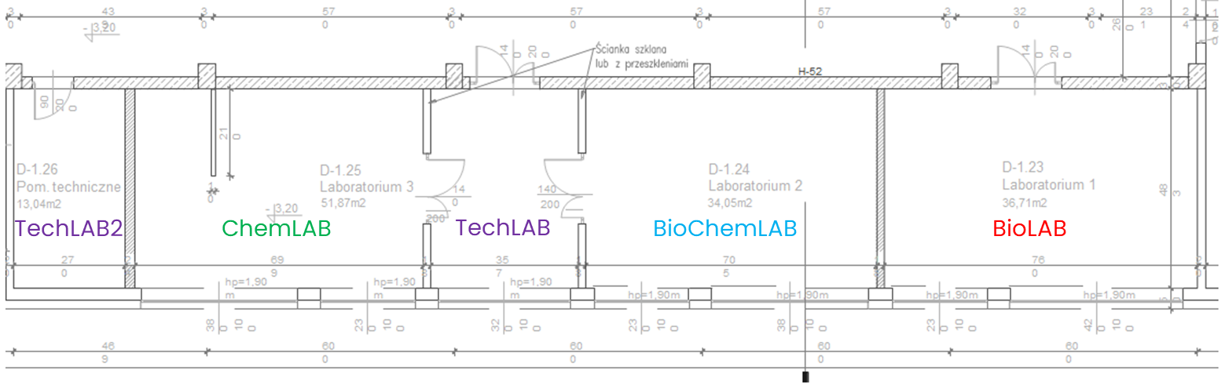
Progress on the ARYA Beamline Infrastructure
Object | Status
3T Wiggler | On site
Straight section | FDR
Front End | Kick-Off meeting
Optics | Tender
Sample Changer | Tender
Diffractometer | Tender
Detector | Soon Tender
Cryostream | Soon Tender
Hutches & Controll Room | Soon Tender
Labs | On site
D Liberda, M Hermes, P Koziol, N Stone, TP Wrobel, Journal of Biophotonics, 8, 2020
Notes:
Here is the current status of our equipment:
The wiggler is already on site.
For the straight section, we are after the Final Design Review.
For the front end, we recently had the kickoff meeting with the company.
Tenders are currently in progress for optics, the sample changer, and the diffractometer.
Soon, tenders for the detector, cryostream, and hutches will also be published. Additionally, the furniture and basic equipment for the laboratories have arrived and will become operational next year.

Slide 5
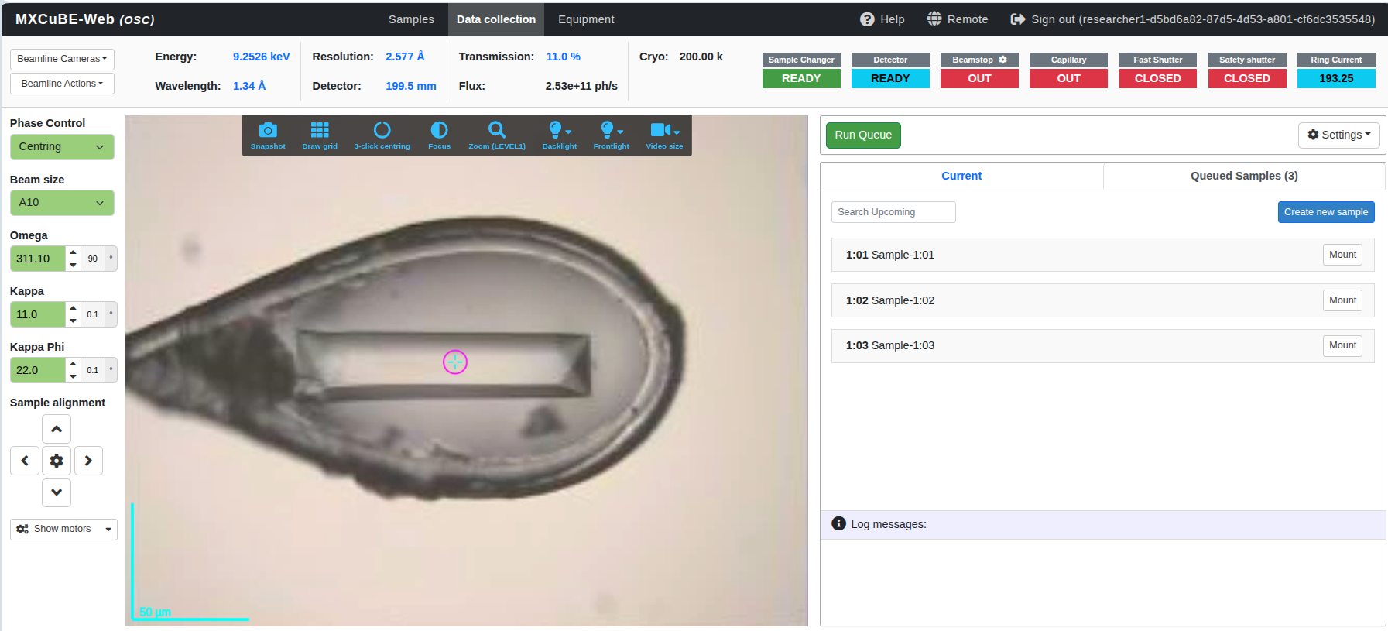
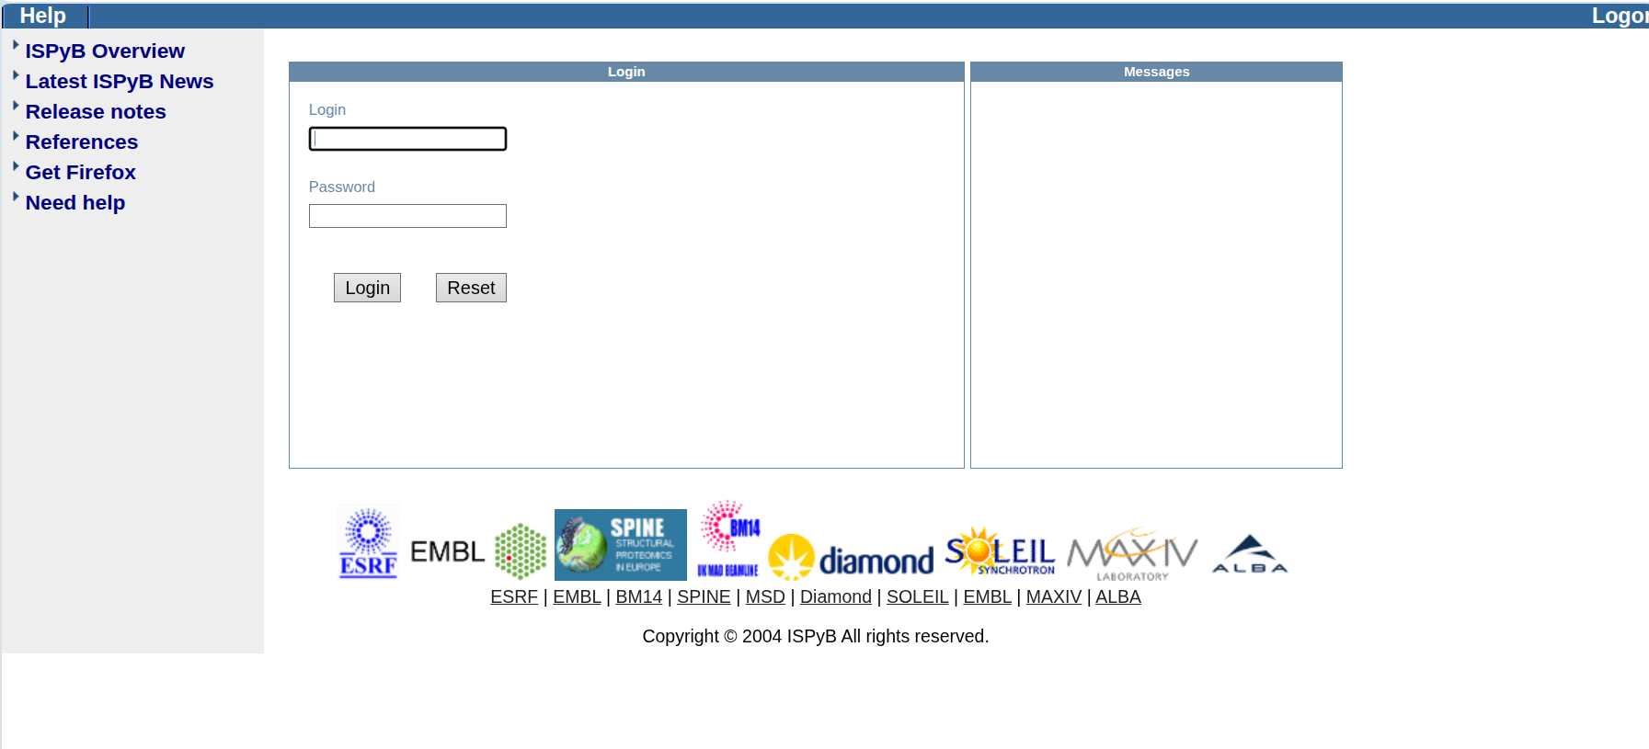
Progress on the ARYA Beamline Software
Makefile
Gitlab
Docker Compose
MXCuBE Backend (web+core)
MXCuBE Frontend (web)
LDAP - development
REDIS
ISPyB
MariaDB
D Liberda, M Hermes, P Koziol, N Stone, TP Wrobel, Journal of Biophotonics, 8, 2020
Notes:
Regarding MXCuBE, ARYA will be the first MX beamline at SOLARIS, so we are building our MXCuBE and ISPyB environment completely from scratch. To facilitate collaboration with our IT and software teams, we created a GitLab project containing all components:
the MXCuBE backend (mxcubewebbackend and mxcubecore),
the frontend,
the LDAP setup with mock users for authentication development,
Redis, ISPyB, and MariaDB.
All applications are easy to install and run thanks to Dockerfiles and docker-compose. With simple make build and make run commands, anyone in SOLARIS can launch the full environment, which helps us clearly demonstrate what we want to implement on the beamline.

Slide 6
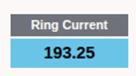
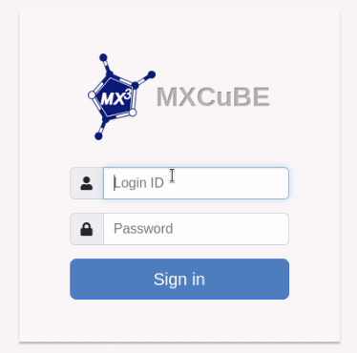
Progress on the ARYA Beamline Software - MXCuBE
mxcubecore/HardwareObjects/SOLARIS
MachineInfoArya.py (ring teamscurrent, time to injection)
ISPyBClinetArya.py (just authentication by LDAP)
mxcubeweb/Arya_config
beamline.yaml
D Liberda, M Hermes, P Koziol, N Stone, TP Wrobel, Journal of Biophotonics, 8, 2020
Notes:
We are still new to MXCuBE and learning step by step, but thanks to the support of many people, we have already made significant progress in integrating MXCuBE and ISPyB at SOLARIS. We would like to thank everyone who has helped us so far. Thank you for your attention.

Slide 7
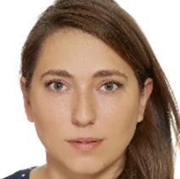
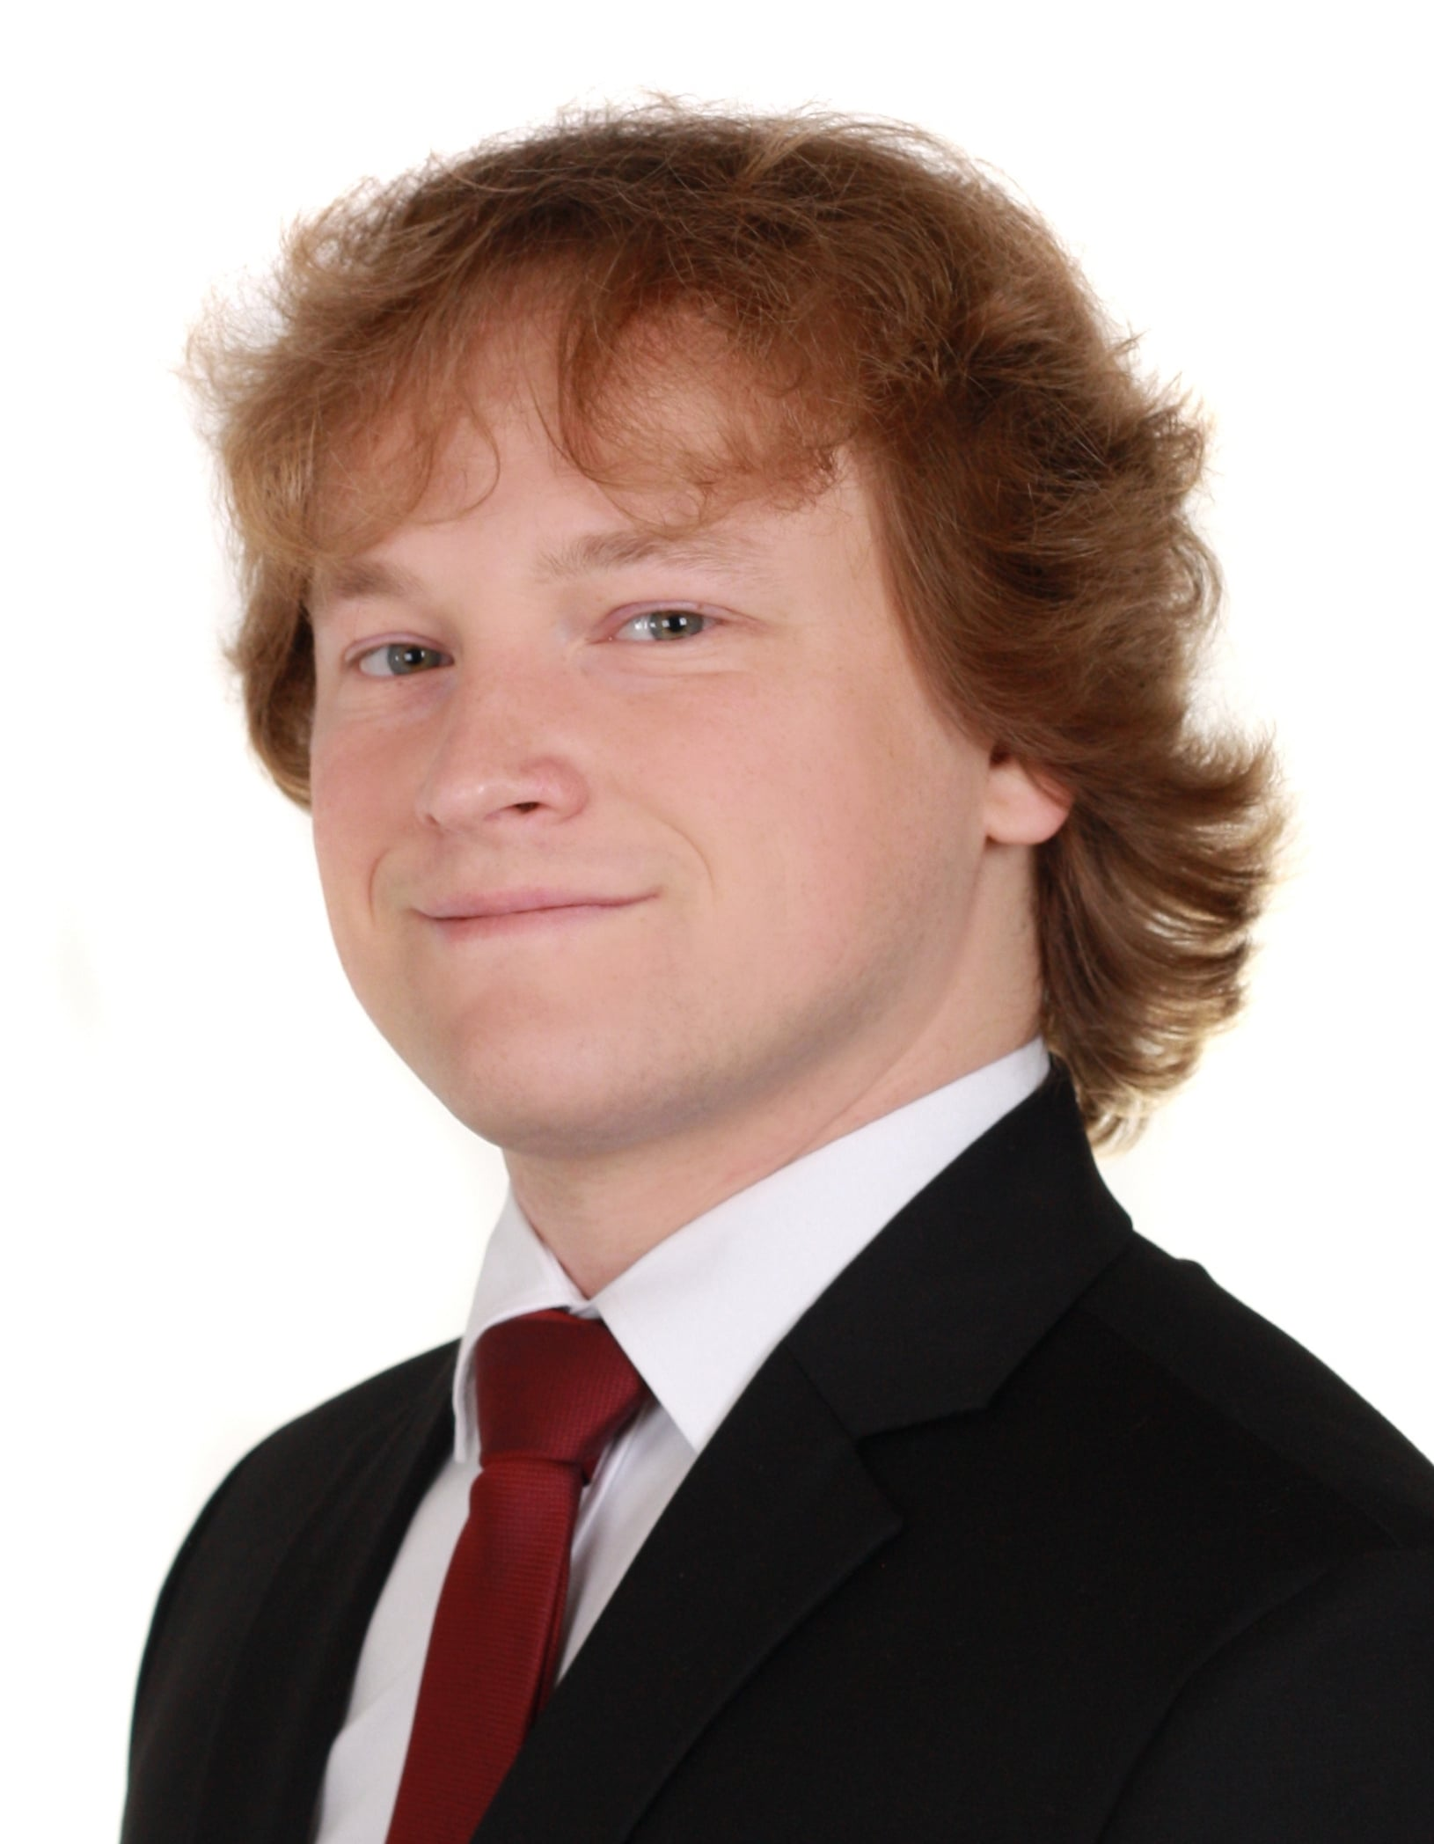
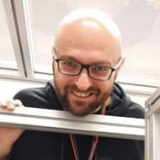
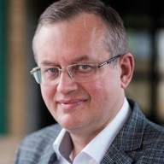

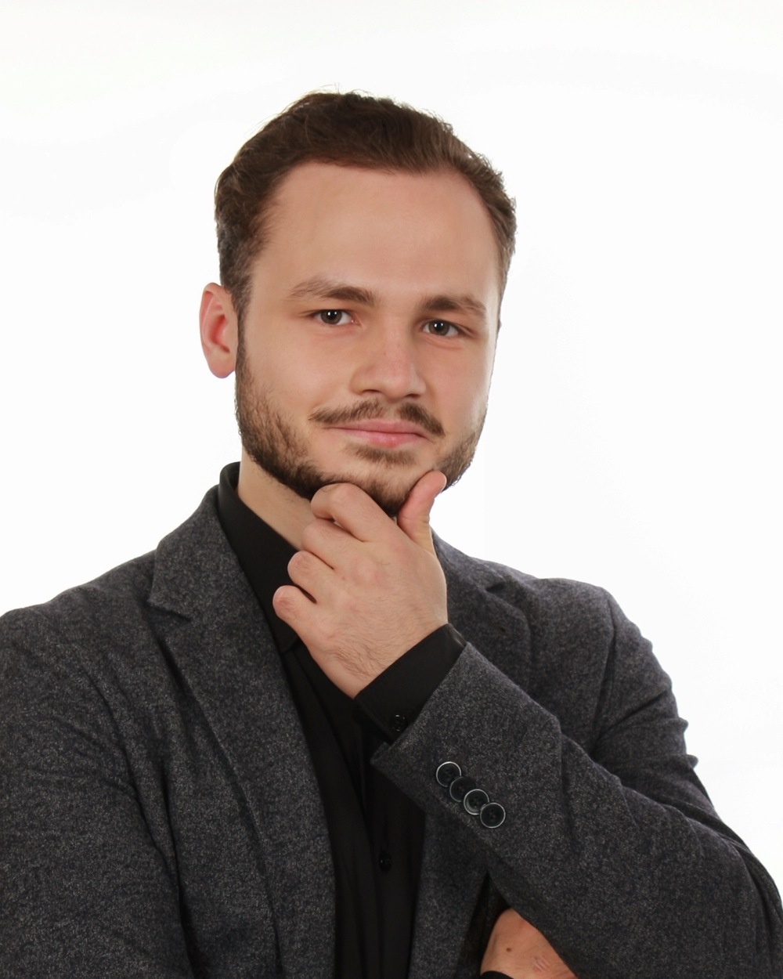
TEAM
Acknowledgments
Joanna Sławek ARYA beamline supervisor
Many thanks to:
Marcus Oscarsson (ESRF)
Yan Walesch (ESRF)
Lais Pessine Do Carmo (ESS)
Marc Armenter Hierro (ALBA)
Martin Savko (SOLEIL)
Guilherme De Freitas (DLS)
And all MXCuBE/ISPyB community
Michał Gucwa
ARYA beamline scientist
CONSULTANTS
Tomasz Kołodziej ARYA beamline consultant
Maciej Kozak ARYA beamline consultant
PhD STUDENTS
Agnieszka Klonecka PhD student
Jan Konopka PhD student
D Liberda, M Hermes, P Koziol, N Stone, TP Wrobel, Journal of Biophotonics, 8, 2020
Notes:
We are new to MXCube and we are in the proces of lerning it, but thanks to many people we did progres in inmplementation of mxcube and ispyb in solaris. We want to thanks… Thank you for your attention.

