Slide 1

Automating Scientific Reproducibility Pipelines
Camilla Buhl Larsen, Ph.D. - Scientific Solution Architect
camilla.larsen@dectris.com
www.dectris.com

Slide 2
Agenda
1
Reproducibility in Science
Why it matters and common approaches
2
Versioned Software Environments and Analysis in the Cloud
Introducing features of the platform
3
The XDS Reproducibility Project: Example of a Reproducibility Pipeline
Validating the behaviour of XDS at each release
4
Q&A

Slide 3
Reproducibility in Science
www.dectris.com

Slide 4
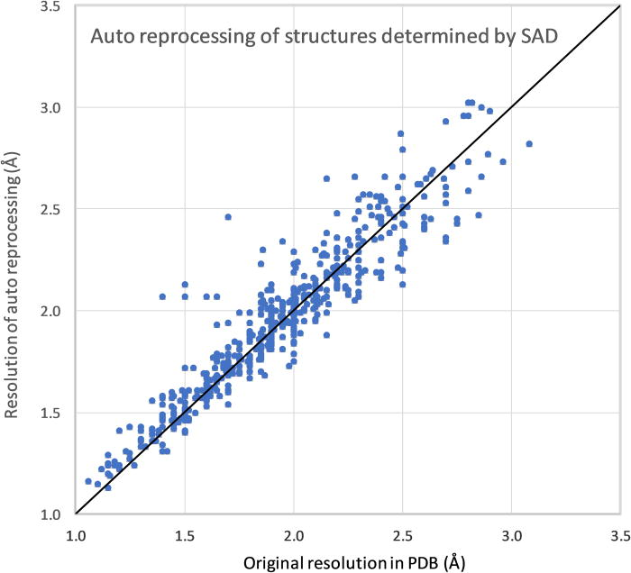
Why Reproducibility Matters
Ensures scientific credibility and trust
Enables independent verification of results
Facilitates cumulative knowledge building
Required by funding agencies and many journals
Particularly critical in cases where analyses depend on complex software stacks
Marek Grabowski, Marcin Cymborowski, Przemyslaw J. Porebski, Tomasz Osinski, Ivan G. Shabalin, David R. Cooper, Wladek Minor; The Integrated Resource for Reproducibility in Macromolecular Crystallography: Experiences of the first four years. Struct. Dyn. 1 November 2019; 6 (6): 064301. https://doi.org/10.1063/1.5128672

Slide 5
Typical Causes of Irreproducible Analyses
Evolving software versions
Missing documentation or metadata
Manual, undocumented analysis steps
Differences in computational environments
Hardware-dependent behaviours (performance, floating-point differences, GPUs vs CPUs, etc.)

Slide 6
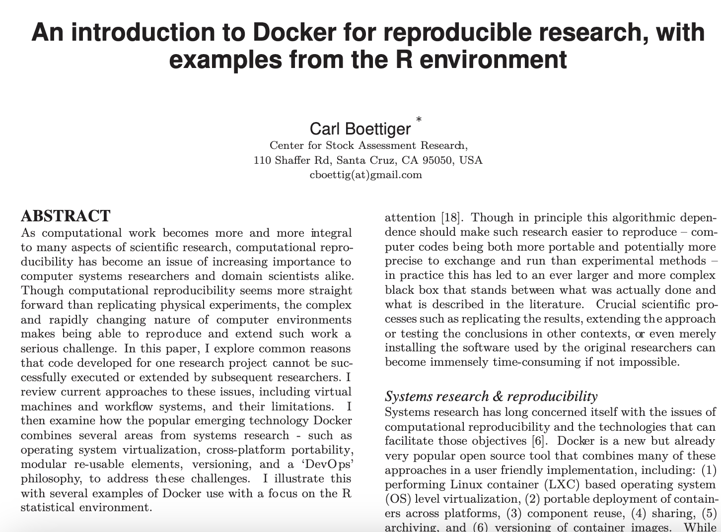

Typical Causes of Irreproducible Analyses
“Technological solutions such as workflow software, virtual machines, continuous integration services, and best practices from software development would address many of the issues frequently frustrating reproducibility.
However, researchers face significant barriers to entry in learning these tools and approaches which are not part of their typical curriculum, or lack incentives commensurate with the effort required”

Slide 7
Versioned Software Environments and Analysis in the Cloud
www.dectris.com

Slide 8









DECTRIS CLOUD Engine
Environments
Isolated Software containers
versioned
Interactive
Sessions
soon!
Automated
Jobs
Notes:
The DECTRIS CLOUD engine is fundamented in the existence of Environments:
which are isolated software containers, ready to use or custom built, and versioned which serve as basis to 2 types of computation tasks:
interactive sessions: Virtual machines or jupyter notebooks
or automated jobs: which are bash scripts that orchestrate tools

Slide 9

DECTRIS CLOUD Engine
Compute
Environments
Elastic
Performance
Isolated Software containers
per task
versioned
Interactive
Sessions
soon!
Automated
Jobs
Notes:
for each time you run a compute task, you can select the hardware needed at that moment,

Slide 10
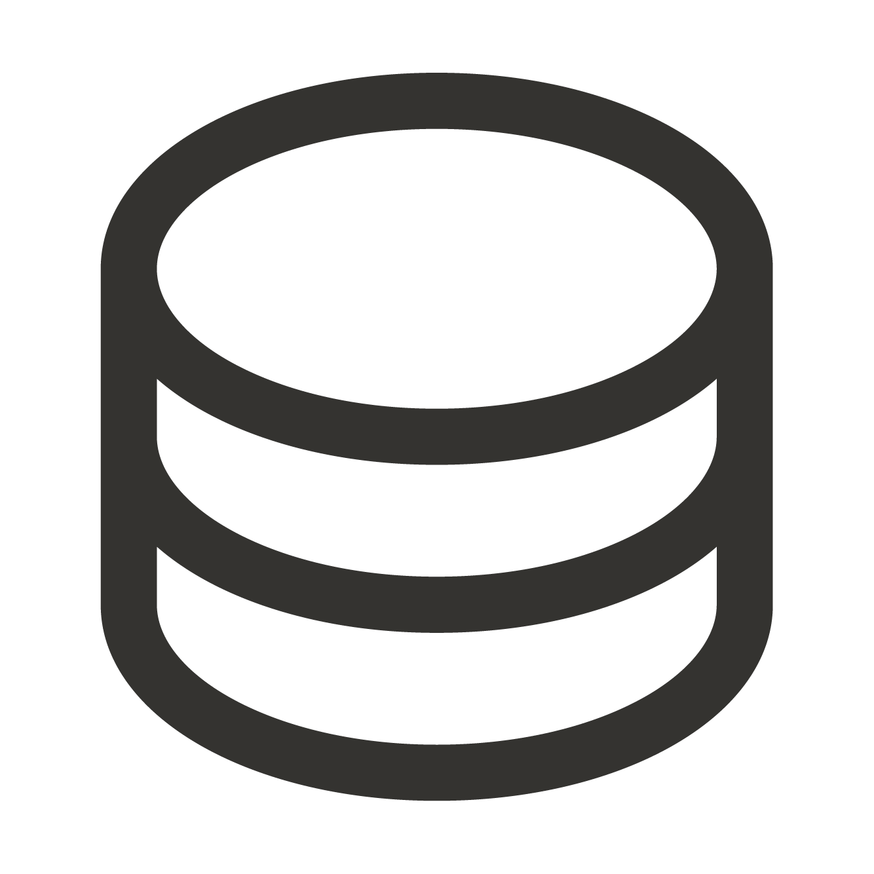
DECTRIS CLOUD Engine
Compute
Environments
Data
Elastic
Performance
Isolated Software containers
Elastic
Storage
per task
versioned
shareable
Interactive
Sessions
soon!
Automated
Jobs
Notes:
and mount the data that you would like to operate on.
the modularization that you can see in this diagram is what enables the flexibility in the cloud - and the safety of working in isolated workspaces.

Slide 11
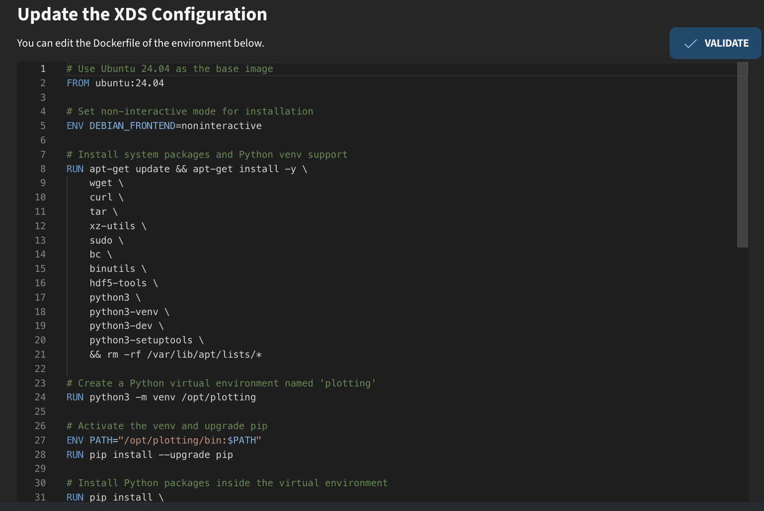
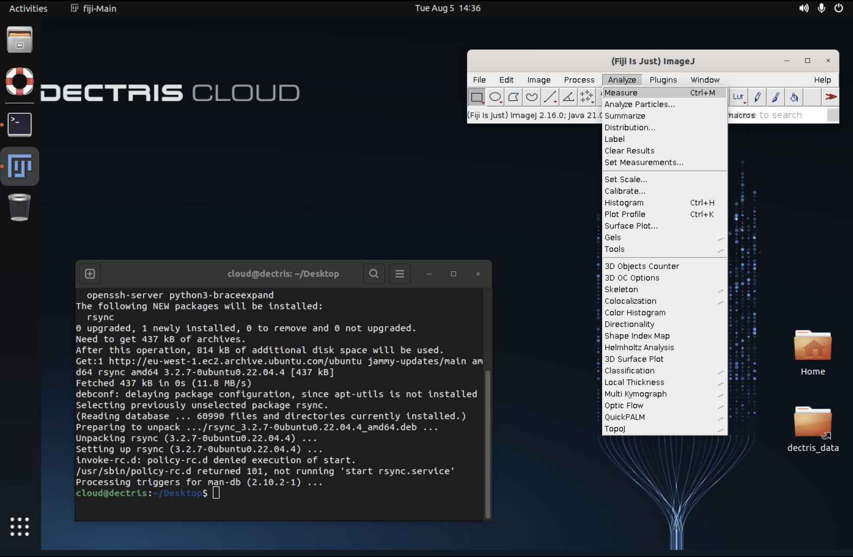
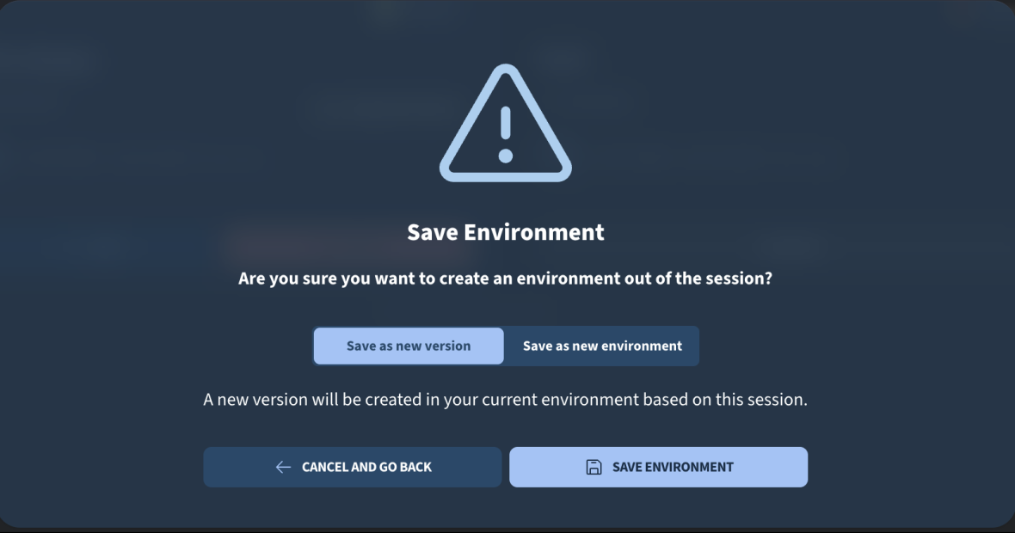
Definition of software containers (environments)
Method #1: Docker Script
Method #2: Save a snapshot of a virtual machine

Slide 12
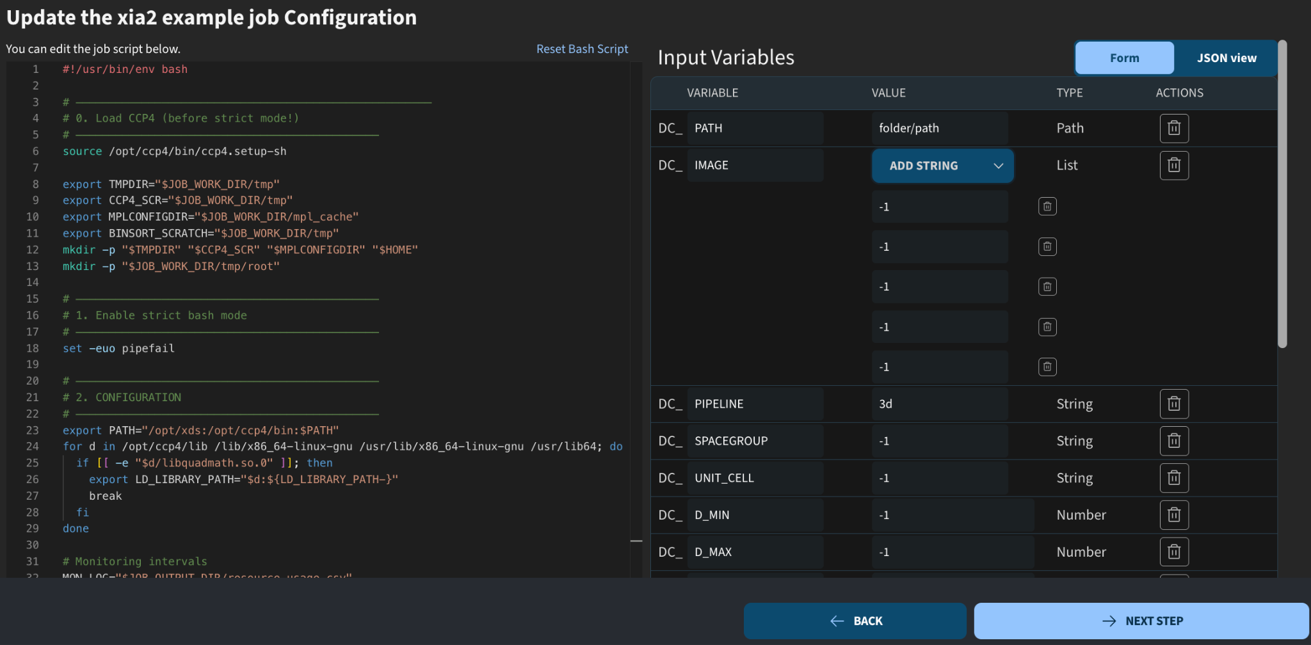
Definition of analysis jobs
Choose environment (available software)
Define configurable input parameters
Write bash script with analysis steps

Slide 13
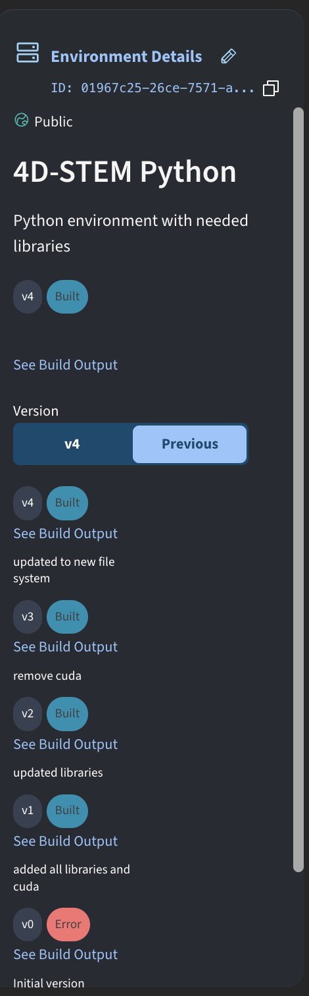
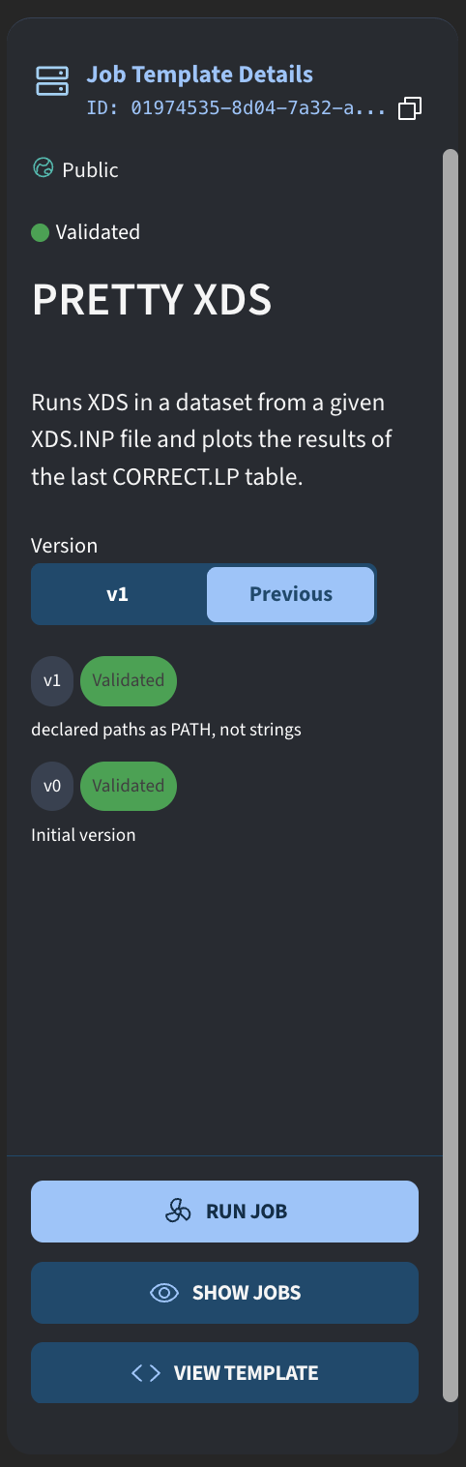
Versioning of jobs and environments
Jobs and environments can be edited by their creators
An edit results in a new version of either the job template or environment
Both old and new versions can still be used for analysis

Slide 14
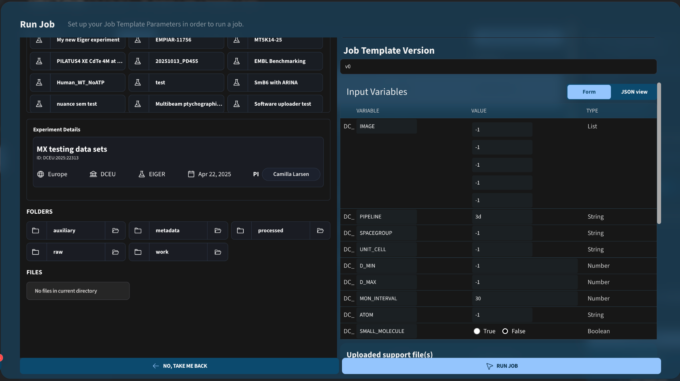
Job output and metadata
Users can trigger jobs through a GUI interface…

Slide 15
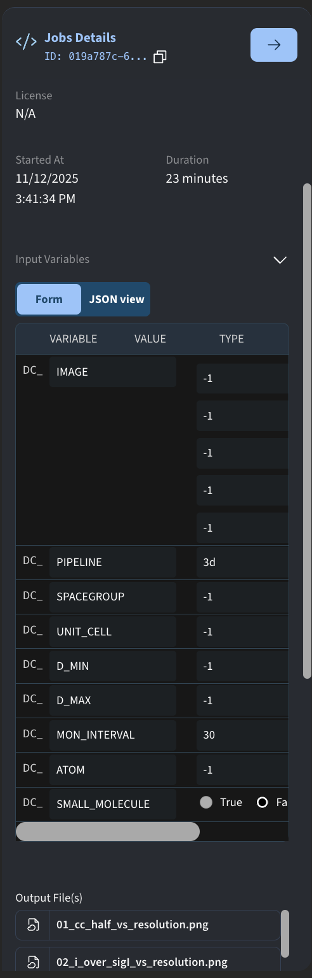
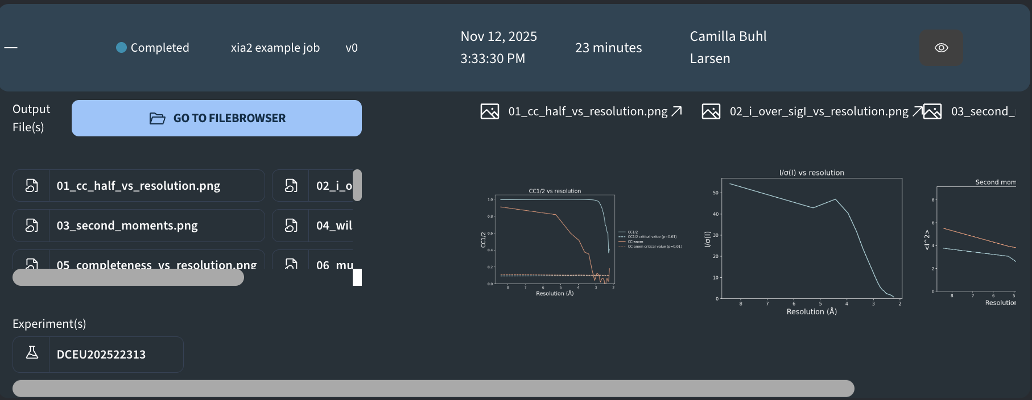
Job output and metadata
… resulting in an output that can be viewed in the jobs table:
Each job contains metadata, such as the exact input
parameters used to run the job

Slide 16
The XDS reproducibility project: Example of a reproducibility pipeline on
DECTRIS CLOUD
www.dectris.com

Slide 17
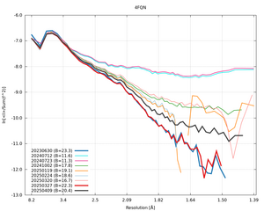
The XDS reproducibility project
Purpose
Enable automatic tracking and documentation of the behaviour of XDS across different versions and reference data sets
How
1)
Host containerized snapshots of different XDS versions in the cloud
3)
Example
Wilson intensity curves for one specific reference data set when running different versions of XDS on the same dataset.
From Global Phasing: https://www.globalphasing.com/autoproc/wiki/index.cgi?ComparisonProcessing202504#quick
Enable automatic processing pipeline that can be run when a new version of XDS or a new reference dataset is uploaded
2)
Host reference data sets in the cloud for anyone to use
Notes:
Notes on content DECTRIS CLOUD has been integrated into the PXIII beamline
Data from Pilatus4 detector is saved to the local SLS storage
Experiment users can enable data to be uploaded to DECTRIS CLOUD as well.
Data uploaded to the cloud can be shared with users, who can sign up for the platform for free (via email, orcid or google sign-up). Each experiment on the cloud is assigned a PI, who can invite additional collaborators to access the data.
Analysis workflows
Every time the collection of a dataset is finished, the control system of the beamline triggers an analysis job in the cloud via an API call.
In collaboration with the PXIII beamline staff, we have prepared a number of analysis workflows using XDS, CCP4 and autoPROC.
The beamline staff can configure the workflows to run on nodes with different performance types, dependent on their needs
Once the analysis job is finished, the results are viewable on the web app in the job output table (example on slide). The way the output is represented is fully customizable in the job definition. A natively integrated pdb viewer (mol*) also makes it possible to view and rotate the refined structures.
In addition to the automatically triggered jobs, it is also possible for the experiment users to trigger their own analysis workflows. For the duration of the experiment and a short time after, users can use compute resources provided by the lab’s DECTRIS CLOUD license. They can rerun the workflows or define and run their own on the data they have collected.

Slide 18






Project working group
A. Chari, MPI
G. Bourenkov, EMBL
G. Bricogne & C.Vonrhein, GPhL
W. Kabsch & K. Dietrichs, retired
Discussion topics
Implementation of validation framework
Quality measures to implement
Selection of reference datasets
Notes:
Notes on content DECTRIS CLOUD has been integrated into the PXIII beamline
Data from Pilatus4 detector is saved to the local SLS storage
Experiment users can enable data to be uploaded to DECTRIS CLOUD as well.
Data uploaded to the cloud can be shared with users, who can sign up for the platform for free (via email, orcid or google sign-up). Each experiment on the cloud is assigned a PI, who can invite additional collaborators to access the data.
Analysis workflows
Every time the collection of a dataset is finished, the control system of the beamline triggers an analysis job in the cloud via an API call.
In collaboration with the PXIII beamline staff, we have prepared a number of analysis workflows using XDS, CCP4 and autoPROC.
The beamline staff can configure the workflows to run on nodes with different performance types, dependent on their needs
Once the analysis job is finished, the results are viewable on the web app in the job output table (example on slide). The way the output is represented is fully customizable in the job definition. A natively integrated pdb viewer (mol*) also makes it possible to view and rotate the refined structures.
In addition to the automatically triggered jobs, it is also possible for the experiment users to trigger their own analysis workflows. For the duration of the experiment and a short time after, users can use compute resources provided by the lab’s DECTRIS CLOUD license. They can rerun the workflows or define and run their own on the data they have collected.

Slide 19
Pipeline organization
Script 1: Run a specific XDS version for a specific dataset in the cloud
Script 2: Orchestrate that script 1 is run for all combinations of available data sets and XDS versions
Script 3: Collect output from script 2 process and organize results in plots
Job template built with XDS vX.X
Reference data set #N
XDS output folder
Notes:
Notes on content DECTRIS CLOUD has been integrated into the PXIII beamline
Data from Pilatus4 detector is saved to the local SLS storage
Experiment users can enable data to be uploaded to DECTRIS CLOUD as well.
Data uploaded to the cloud can be shared with users, who can sign up for the platform for free (via email, orcid or google sign-up). Each experiment on the cloud is assigned a PI, who can invite additional collaborators to access the data.
Analysis workflows
Every time the collection of a dataset is finished, the control system of the beamline triggers an analysis job in the cloud via an API call.
In collaboration with the PXIII beamline staff, we have prepared a number of analysis workflows using XDS, CCP4 and autoPROC.
The beamline staff can configure the workflows to run on nodes with different performance types, dependent on their needs
Once the analysis job is finished, the results are viewable on the web app in the job output table (example on slide). The way the output is represented is fully customizable in the job definition. A natively integrated pdb viewer (mol*) also makes it possible to view and rotate the refined structures.
In addition to the automatically triggered jobs, it is also possible for the experiment users to trigger their own analysis workflows. For the duration of the experiment and a short time after, users can use compute resources provided by the lab’s DECTRIS CLOUD license. They can rerun the workflows or define and run their own on the data they have collected.

Slide 20
Pipeline organization
Script 1: Run a specific XDS version for a specific dataset in the cloud
Script 2: Orchestrate that script 1 is run for all combinations of available data sets and XDS versions
Script 3: Collect output from script 2 process and organize results in plots
Job template built with XDS vX.X
Reference data set #1
XDS output
XDS output
XDS output
XDS output
Job template built with XDS vX.Y
Reference data set #2
XDS output
XDS output
XDS output
XDS output
Job template built with XDS vX.Z
Reference data set #N
XDS output
Notes:
Notes on content DECTRIS CLOUD has been integrated into the PXIII beamline
Data from Pilatus4 detector is saved to the local SLS storage
Experiment users can enable data to be uploaded to DECTRIS CLOUD as well.
Data uploaded to the cloud can be shared with users, who can sign up for the platform for free (via email, orcid or google sign-up). Each experiment on the cloud is assigned a PI, who can invite additional collaborators to access the data.
Analysis workflows
Every time the collection of a dataset is finished, the control system of the beamline triggers an analysis job in the cloud via an API call.
In collaboration with the PXIII beamline staff, we have prepared a number of analysis workflows using XDS, CCP4 and autoPROC.
The beamline staff can configure the workflows to run on nodes with different performance types, dependent on their needs
Once the analysis job is finished, the results are viewable on the web app in the job output table (example on slide). The way the output is represented is fully customizable in the job definition. A natively integrated pdb viewer (mol*) also makes it possible to view and rotate the refined structures.
In addition to the automatically triggered jobs, it is also possible for the experiment users to trigger their own analysis workflows. For the duration of the experiment and a short time after, users can use compute resources provided by the lab’s DECTRIS CLOUD license. They can rerun the workflows or define and run their own on the data they have collected.

Slide 21
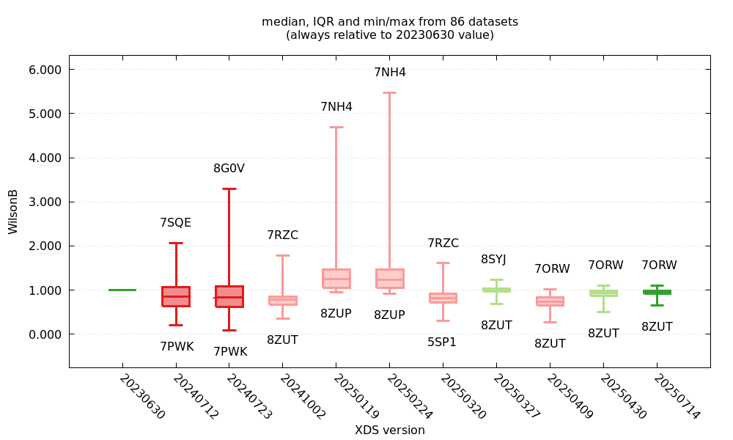
Pipeline organization
Script 1: Run a specific XDS version for a specific dataset in the cloud
Script 2: Orchestrate that script 1 is run for all combinations of available data sets and XDS versions
Script 3: Collect output from script 2 process and organize results in plots
*
XDS output
XDS output
XDS output
XDS output
XDS output
XDS output
XDS output
XDS output
XDS output
*Preliminary analysis performed by Clemens Vonrhein
Notes:
Notes on content DECTRIS CLOUD has been integrated into the PXIII beamline
Data from Pilatus4 detector is saved to the local SLS storage
Experiment users can enable data to be uploaded to DECTRIS CLOUD as well.
Data uploaded to the cloud can be shared with users, who can sign up for the platform for free (via email, orcid or google sign-up). Each experiment on the cloud is assigned a PI, who can invite additional collaborators to access the data.
Analysis workflows
Every time the collection of a dataset is finished, the control system of the beamline triggers an analysis job in the cloud via an API call.
In collaboration with the PXIII beamline staff, we have prepared a number of analysis workflows using XDS, CCP4 and autoPROC.
The beamline staff can configure the workflows to run on nodes with different performance types, dependent on their needs
Once the analysis job is finished, the results are viewable on the web app in the job output table (example on slide). The way the output is represented is fully customizable in the job definition. A natively integrated pdb viewer (mol*) also makes it possible to view and rotate the refined structures.
In addition to the automatically triggered jobs, it is also possible for the experiment users to trigger their own analysis workflows. For the duration of the experiment and a short time after, users can use compute resources provided by the lab’s DECTRIS CLOUD license. They can rerun the workflows or define and run their own on the data they have collected.

Slide 22
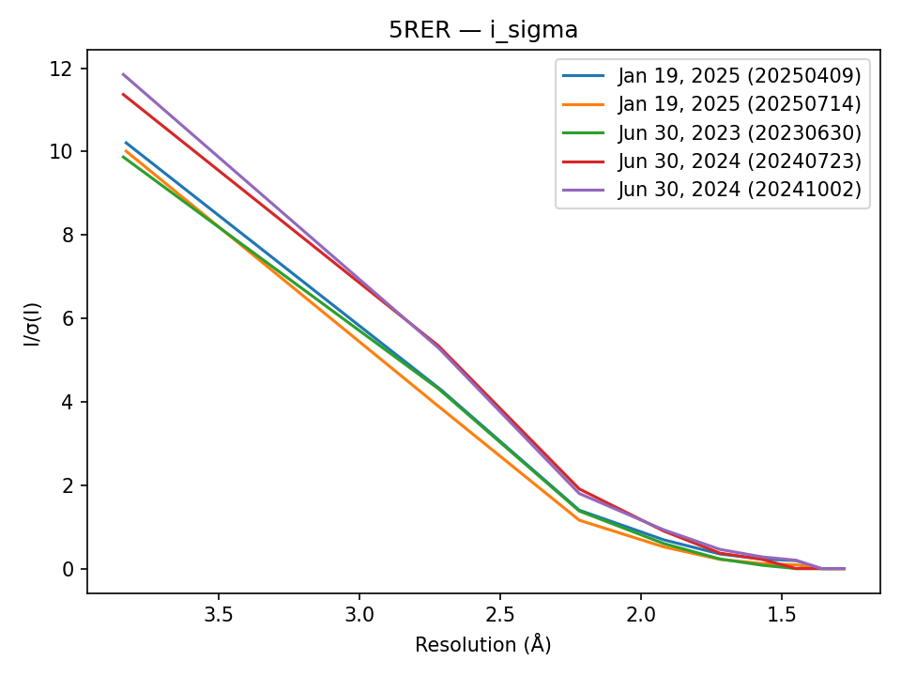
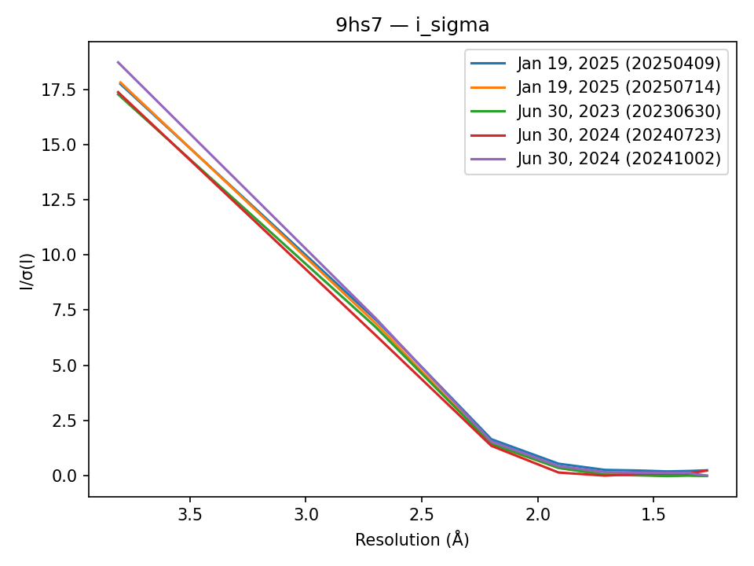
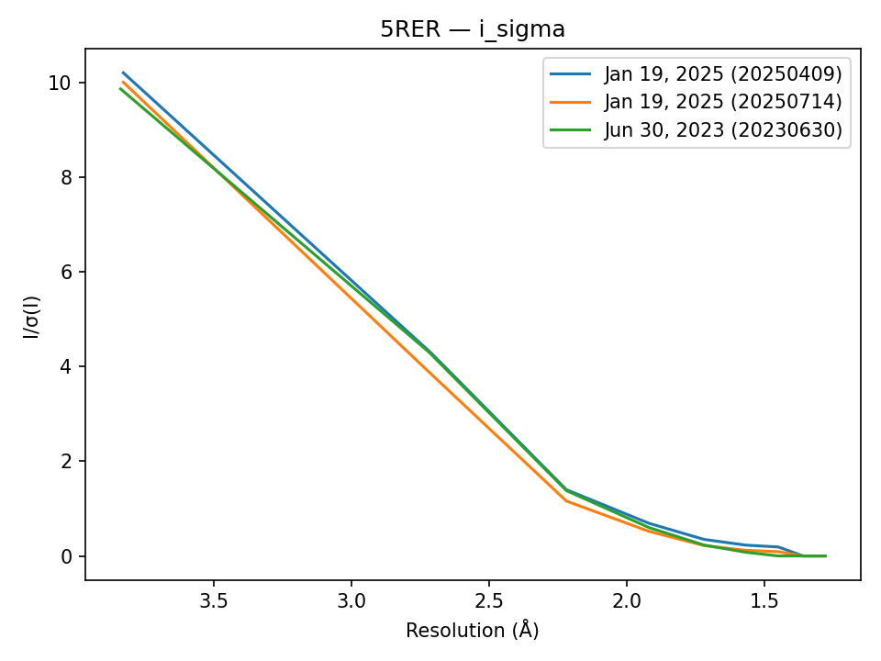
Quality measures to track XDS performance
#1 Comparisons between different XDS versions per dataset
Notes:
Notes on content DECTRIS CLOUD has been integrated into the PXIII beamline
Data from Pilatus4 detector is saved to the local SLS storage
Experiment users can enable data to be uploaded to DECTRIS CLOUD as well.
Data uploaded to the cloud can be shared with users, who can sign up for the platform for free (via email, orcid or google sign-up). Each experiment on the cloud is assigned a PI, who can invite additional collaborators to access the data.
Analysis workflows
Every time the collection of a dataset is finished, the control system of the beamline triggers an analysis job in the cloud via an API call.
In collaboration with the PXIII beamline staff, we have prepared a number of analysis workflows using XDS, CCP4 and autoPROC.
The beamline staff can configure the workflows to run on nodes with different performance types, dependent on their needs
Once the analysis job is finished, the results are viewable on the web app in the job output table (example on slide). The way the output is represented is fully customizable in the job definition. A natively integrated pdb viewer (mol*) also makes it possible to view and rotate the refined structures.
In addition to the automatically triggered jobs, it is also possible for the experiment users to trigger their own analysis workflows. For the duration of the experiment and a short time after, users can use compute resources provided by the lab’s DECTRIS CLOUD license. They can rerun the workflows or define and run their own on the data they have collected.

Slide 23
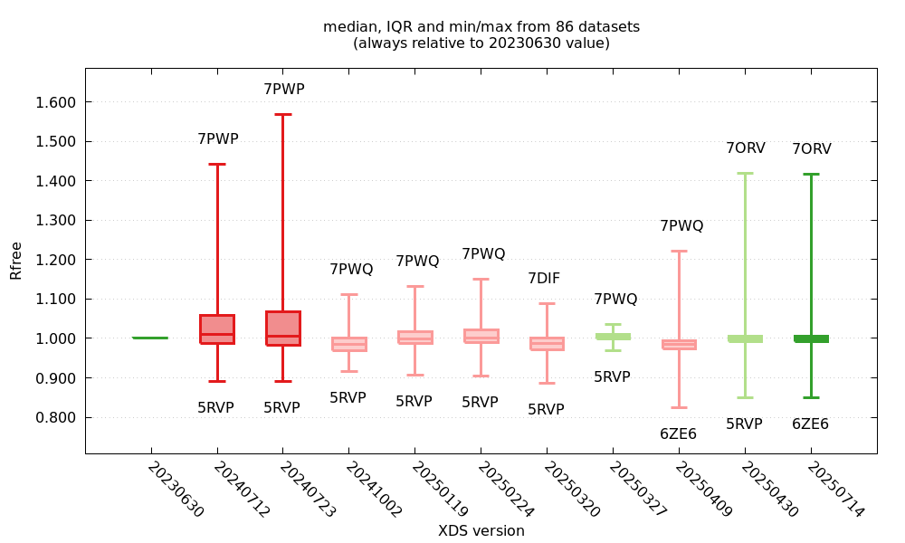
Quality measures to track XDS performance
#2 Statistics over many datasets per XDS version
*
*
*Preliminary analysis performed by Clemens Vonrhein
Notes:
Notes on content DECTRIS CLOUD has been integrated into the PXIII beamline
Data from Pilatus4 detector is saved to the local SLS storage
Experiment users can enable data to be uploaded to DECTRIS CLOUD as well.
Data uploaded to the cloud can be shared with users, who can sign up for the platform for free (via email, orcid or google sign-up). Each experiment on the cloud is assigned a PI, who can invite additional collaborators to access the data.
Analysis workflows
Every time the collection of a dataset is finished, the control system of the beamline triggers an analysis job in the cloud via an API call.
In collaboration with the PXIII beamline staff, we have prepared a number of analysis workflows using XDS, CCP4 and autoPROC.
The beamline staff can configure the workflows to run on nodes with different performance types, dependent on their needs
Once the analysis job is finished, the results are viewable on the web app in the job output table (example on slide). The way the output is represented is fully customizable in the job definition. A natively integrated pdb viewer (mol*) also makes it possible to view and rotate the refined structures.
In addition to the automatically triggered jobs, it is also possible for the experiment users to trigger their own analysis workflows. For the duration of the experiment and a short time after, users can use compute resources provided by the lab’s DECTRIS CLOUD license. They can rerun the workflows or define and run their own on the data they have collected.

Slide 24
Feedback / Contributions
Feedback is welcome, both on the XDS project as well as the general validation framework (can in future also be used for different programs)
For the XDS project, we welcome contributions of datasets (including XDS.INP)
Notes:
Notes on content DECTRIS CLOUD has been integrated into the PXIII beamline
Data from Pilatus4 detector is saved to the local SLS storage
Experiment users can enable data to be uploaded to DECTRIS CLOUD as well.
Data uploaded to the cloud can be shared with users, who can sign up for the platform for free (via email, orcid or google sign-up). Each experiment on the cloud is assigned a PI, who can invite additional collaborators to access the data.
Analysis workflows
Every time the collection of a dataset is finished, the control system of the beamline triggers an analysis job in the cloud via an API call.
In collaboration with the PXIII beamline staff, we have prepared a number of analysis workflows using XDS, CCP4 and autoPROC.
The beamline staff can configure the workflows to run on nodes with different performance types, dependent on their needs
Once the analysis job is finished, the results are viewable on the web app in the job output table (example on slide). The way the output is represented is fully customizable in the job definition. A natively integrated pdb viewer (mol*) also makes it possible to view and rotate the refined structures.
In addition to the automatically triggered jobs, it is also possible for the experiment users to trigger their own analysis workflows. For the duration of the experiment and a short time after, users can use compute resources provided by the lab’s DECTRIS CLOUD license. They can rerun the workflows or define and run their own on the data they have collected.

Slide 25
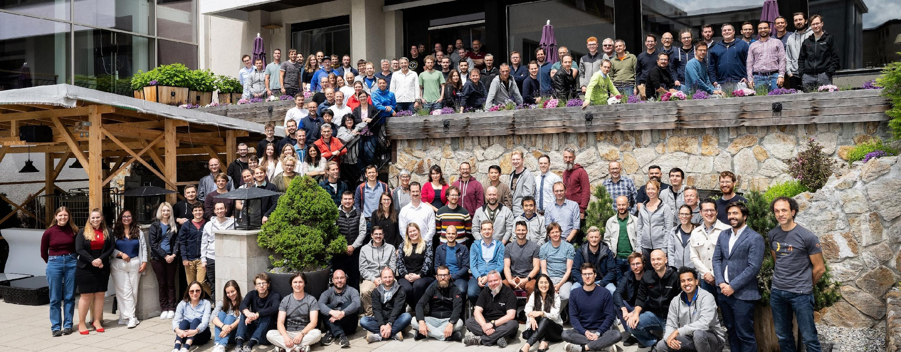
Thank you
DECTRIS Ltd.
5405 Baden-Dättwil
Switzerland
www.dectris.com

