Slide 1
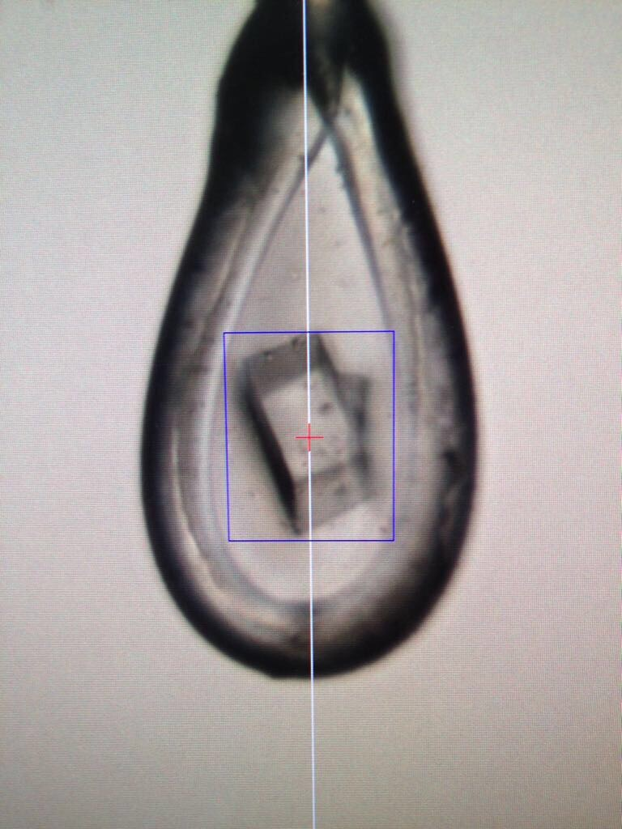

PURE PROTEINS.
Complexity of multi-synchrotron operations for a small CRO Christian Becke

Slide 2


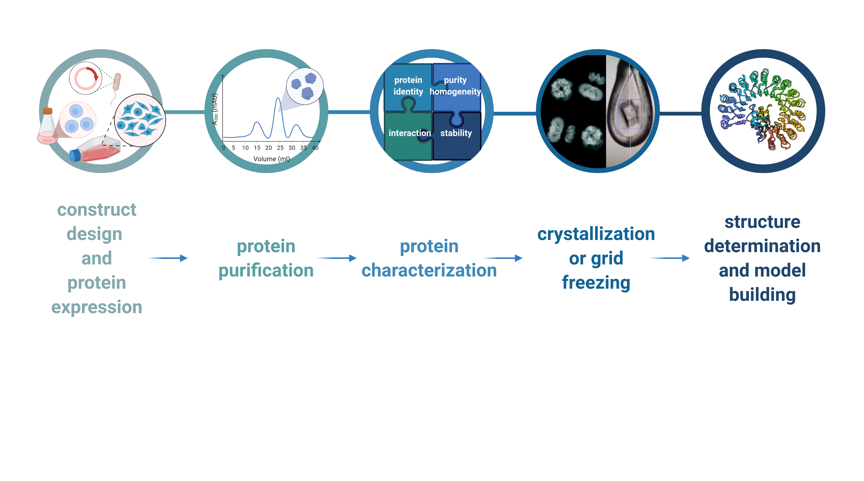
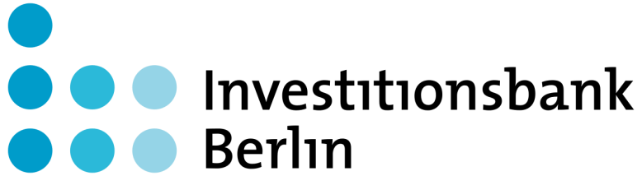

MOLOX
founded in June 2012
located on the campus of the Free University Berlin
no third party funding
currently 5 scientists full-time (of which 4 are structural biologists)
additional scientists employed on an hourly basis for peak demands
projects for pharmaceutical, chemical and biotech industry worldwide
partnerships with academic institutions and other leading CROs in the field
Christian Becke
<Foliennummer>

Slide 3
What we do
book beamtime at different synchrotrons and beamlines worldwide
aggregate samples produced in-house and by clients
organise sample shipment to the beamlines
provide sample information to beamline software (ISPyB, MxCUBE, …)
perform diffraction experiments (remotely or on site)
organize return shipments of pucks and dry-shippers
data reduction and analyses
organise data transfer (raw diffraction data and analysis results) to the client
Christian Becke
<Foliennummer>

Slide 4
What we do
book beamtime at different synchrotrons and beamlines worldwide
aggregate samples produced in-house and by clients
organise sample shipment to the beamlines
provide sample information to beamline software (ISPyB, MxCUBE, …)
perform diffraction experiments (remotely or on site)
organize return shipments of pucks and dry-shippers
data reduction and analyses
organise data transfer (raw diffraction data and analysis results) to the client
clients world-wide
> 1,000 h of beamtime with > 15,000 samples in 2025
Christian Becke
<Foliennummer>

Slide 5
Challenges
Heterogeneity across synchrotrons and beamlines
sample shipment
software
importing sample information into beamline software
remote access (VPNs, TeamViewer, ThinLinc, Guacamole, …)
beamline control (MXCuBE Qt, MXCuBE 3, developed in-house)
viewing diffraction images (ALBULA, Adxv, …)
automatic data reduction pipelines (EDNA, autoPROC, XDSAPP, …)
data access:
raw diffraction images
results from automatic data reduction pipelines (MTZ, logfiles, statistics, …)
crystal & diffraction image snapshots
Christian Becke
<Foliennummer>

Slide 6
Challenge: sample shipment
creating dewar labels in Exi, ISPyB, …
distribute labels to clients prior to shipment
idea: equip dewars with permanent UUID labels and use these instead?
Christian Becke
<Foliennummer>

Slide 7
Challenge: sample information
mainly done via CSV files
required columns in the CSV files differ from beamline to beamline
safety declarations
nice to have:
one-fits-all CSV format containing essential data only
API access to send sample information directly from client’s LIMS
Christian Becke
<Foliennummer>

Slide 8
Challenge: remote access
many different implementations of remote access to the beamlines
TeamViewer
Guacamole
VPN + ThinLinc
each with its own pros & cons
installing and configuring client software
support for multiple screens
copy/paste from local to remote and vice versa
Christian Becke
<Foliennummer>

Slide 9
Challenge: beamline software
MXCuBE Qt / MXCuBE3 / in-house tools
requirements:
easy way to pre-define file-/foldernames for each sample
easy way to move through a batch of samples: characterisation → maybe collect dataset → (auto-)mount next sample
each of the tools we have seen so far has its own strenghts and weaknesses
ALBULA / Adxv / in-house tools
real-time display of diffraction images
real-time display of DOZOR scores or similar
Christian Becke
<Foliennummer>

Slide 10
Challenge: data reduction pipelines
fast access to results
to decide which samples to collect
to catch issues with collected data
often only MTZ files and a selected set of logfiles are available
making it difficult to re-use existing results when data needs to be re-processed
unfortunately, it is often quicker to start from scratch
different pipelines & hardware with their own strenghts & weaknesses
easy to parse overview of key statistics of collected data (resolution limits, completeness, quality indicators) to allow quick decision making
Christian Becke
<Foliennummer>

Slide 11
Challenge: data access
user accounts for controlling (remote) sessions
user accounts for accessing data
in ISPyB/Exi/…
filesystem access
grant access to subsets of data produced during a shift to different users
session based access: open a new session for each client’s crystals
user based access: change user accounts for each client’s crystals
pre-define access rules along with other sample information?
protocols for data access: rsync, sftp, Globus, …
protocols with command line clients strongly preferred
Christian Becke
<Foliennummer>

Slide 12
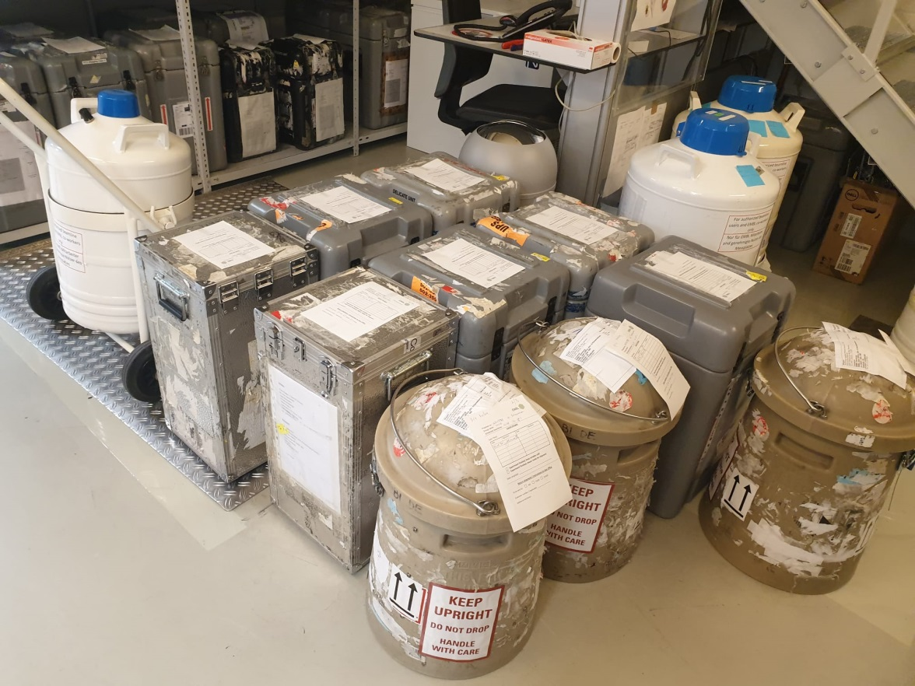
Thank you
Nirdosh Dadwal Holger von Moeller
Alexander Schendzielorz
Sophie Zimmermann
www.molox.de
service@molox.de
Christian Becke
<Foliennummer>

