Slide 1
Homebrewed Crystallographic Data Management in an Academic Setting
Marko Hyvönen
Department of Biochemistry
University of Cambridge
mh256@cam.ac.uk
https://hyvonen.bioc.cam.ac.uk

Slide 2
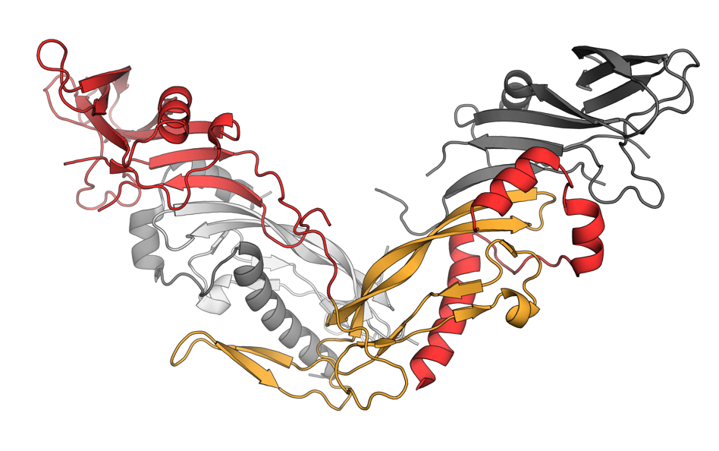
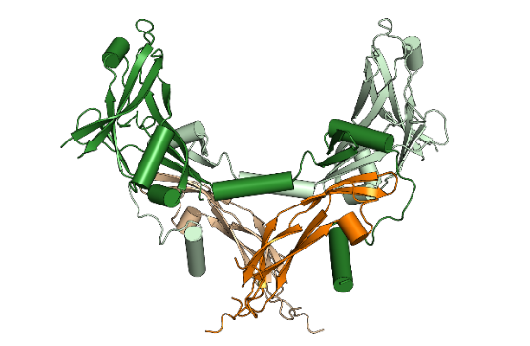
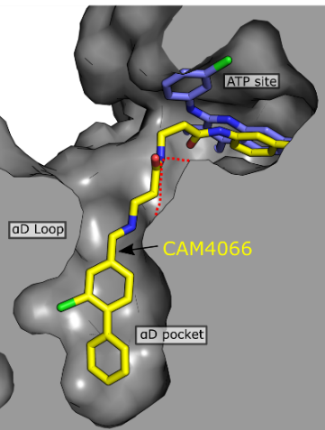
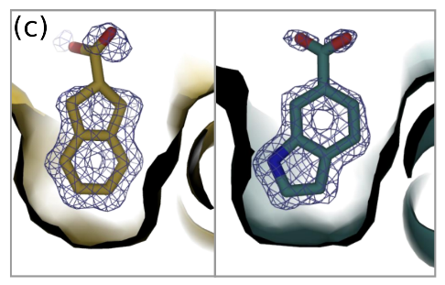
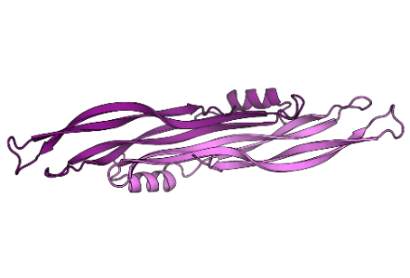

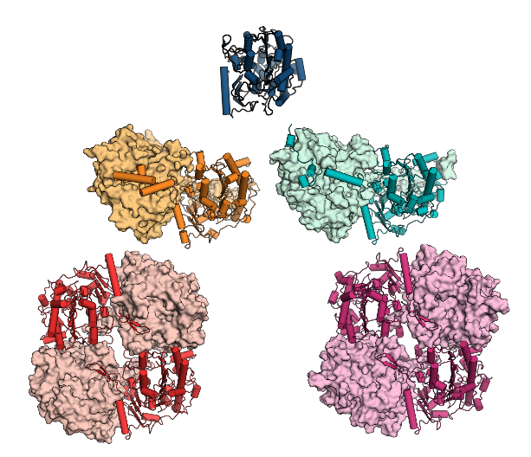
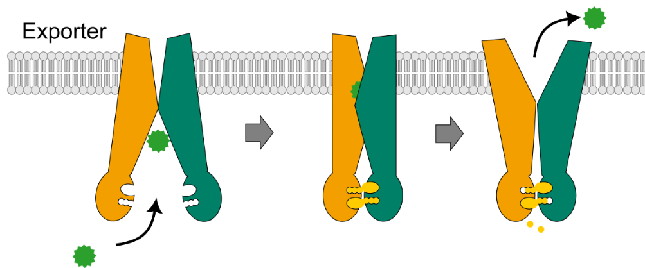

What do we do
Structure and function of TGF-β family growth factors
Fragment-based, structure-guided drug discovery
Structural enzymology (with Hollfelder lab)
Tackling antimicrobial resistance (in São Paulo)

Slide 3
Data sources
Previously
ESRF, Soleil, SLS, Diamond
Today: Diamond, Diamond, Diamond
BAG for MX
BAG for XChem
Future…
Diamond dark time

Slide 4
Resource for data management
No dedicated resource for hardware or for people
Investment when grants allow
keeping data in between the grants can be a challenge
Running NAS boxes to the ground
Plenty of praying
and missed heartbeats, waking up in cold sweat in the middle of the night
No data managers
hardly system managers
everything is a DIY job

Slide 5
Deposition to PDB is a major limiting factor
mmcif is not making it easier

Slide 6
The only command that I (as a PI) need
deposit AFF025_PKL1_01
Finds the latest refinement and related processing files based on the base name for the structure.
Defines the dataset and what is in it

Slide 7
The only command that I (as a PI) need
deposit AFF025_PKL1_01
Finds the latest refinement and related processing files based on the base name for the structure.
Defines which ligand is in the structure and allows retrieval of the relevant data
Defines protein in the crystallised sample and allows extraction of its details (e.g sequence)
Defines where the crystal came from, xtallisation conditions etc.

Slide 8
What I need that command for
Sharing data with collaborators
Especially chemists working on the project
Standardised data, in a format they are comfortable with
Also e-density maps (with pymol command file to read it all in)
PDB deposition
Incl Group Deposition of tens/hundreds of structures
Generating data for publications
“Table 1”
Generating ligand electron densities (for the supplement)

Slide 9
What else to know and keep track of
What has been sent to synchrotron
What has been collected
Outcome of those collections
Which results in the representative/best structure
To keep track of progress
To enable data purging
delete data that does not result in structure we keep
I do not need that and want to clean my disks

Slide 10
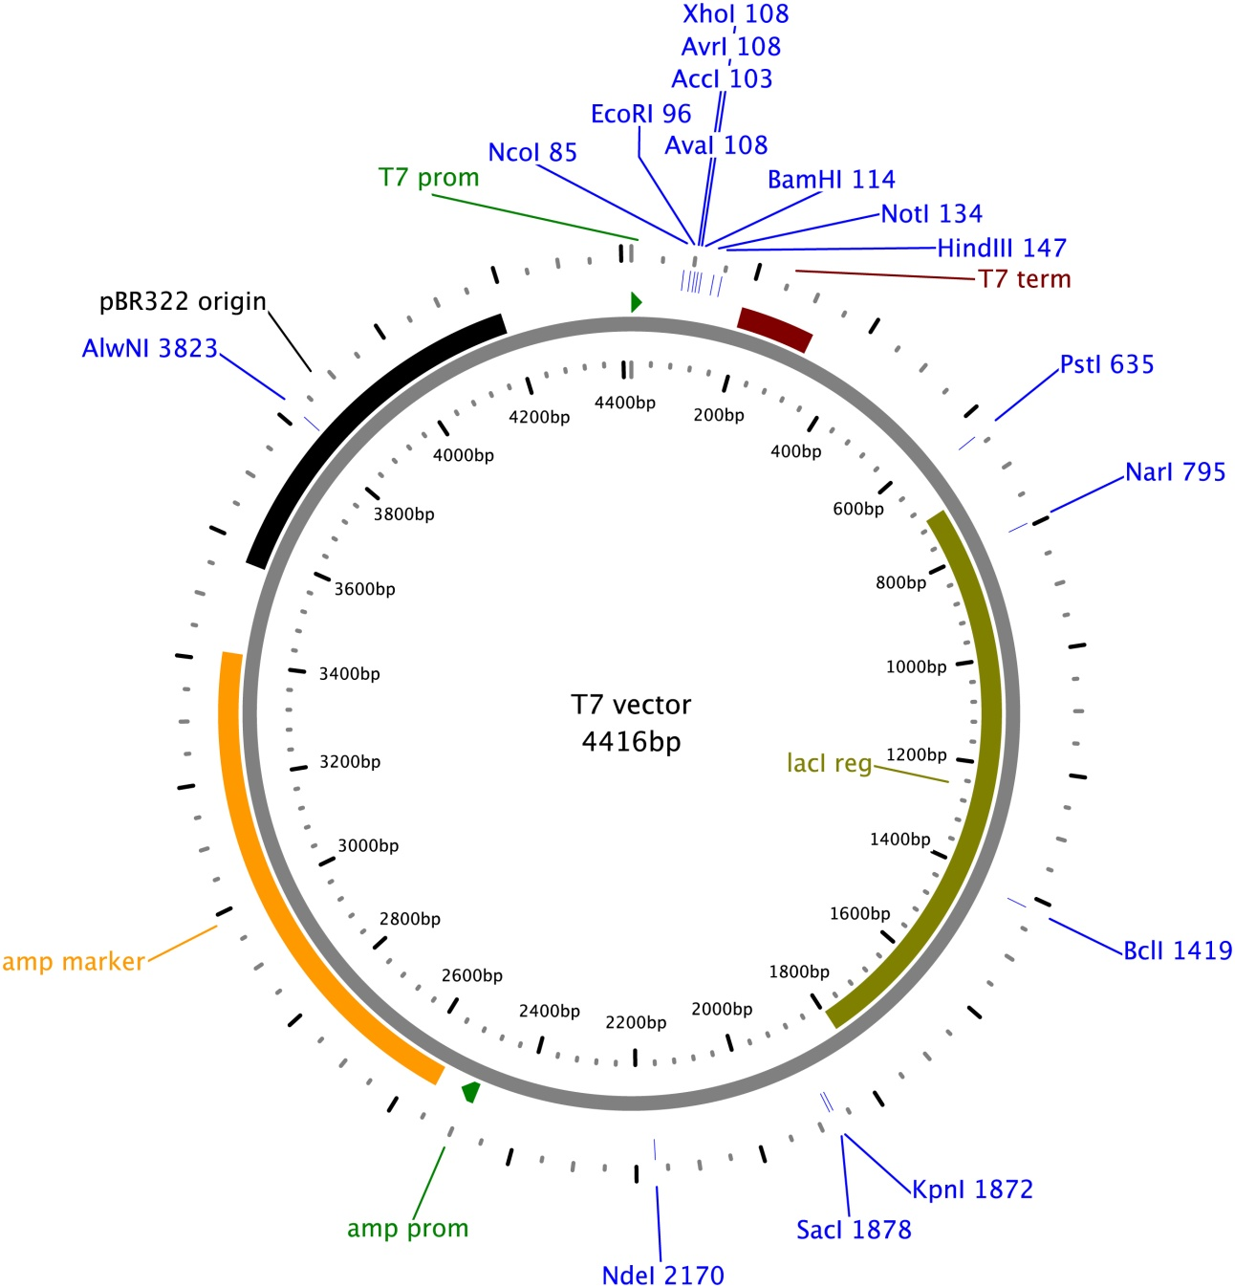
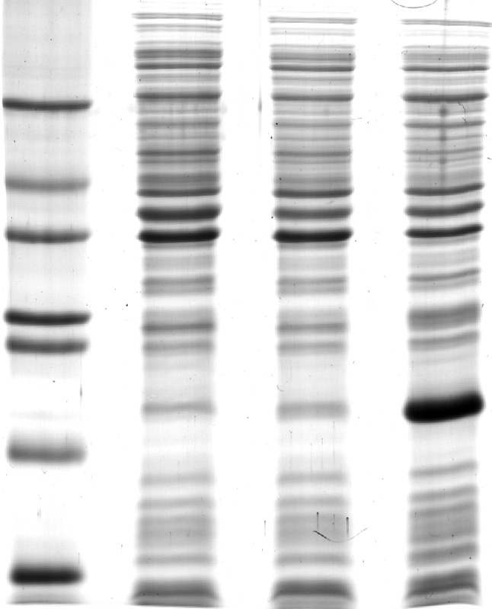
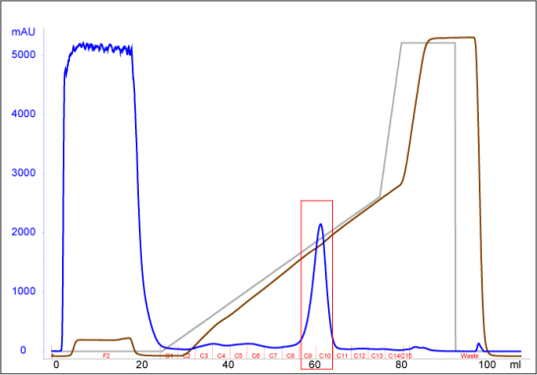
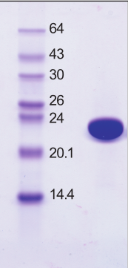
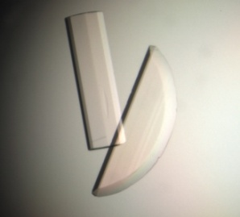
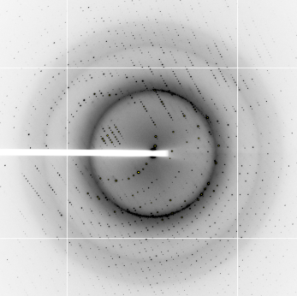
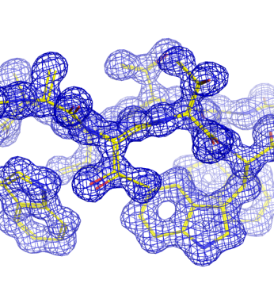
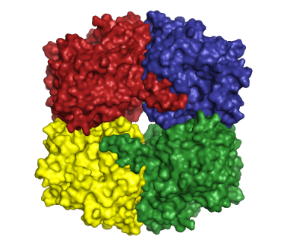

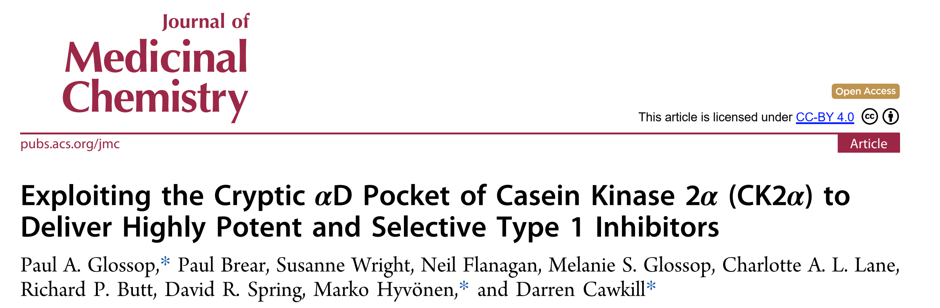
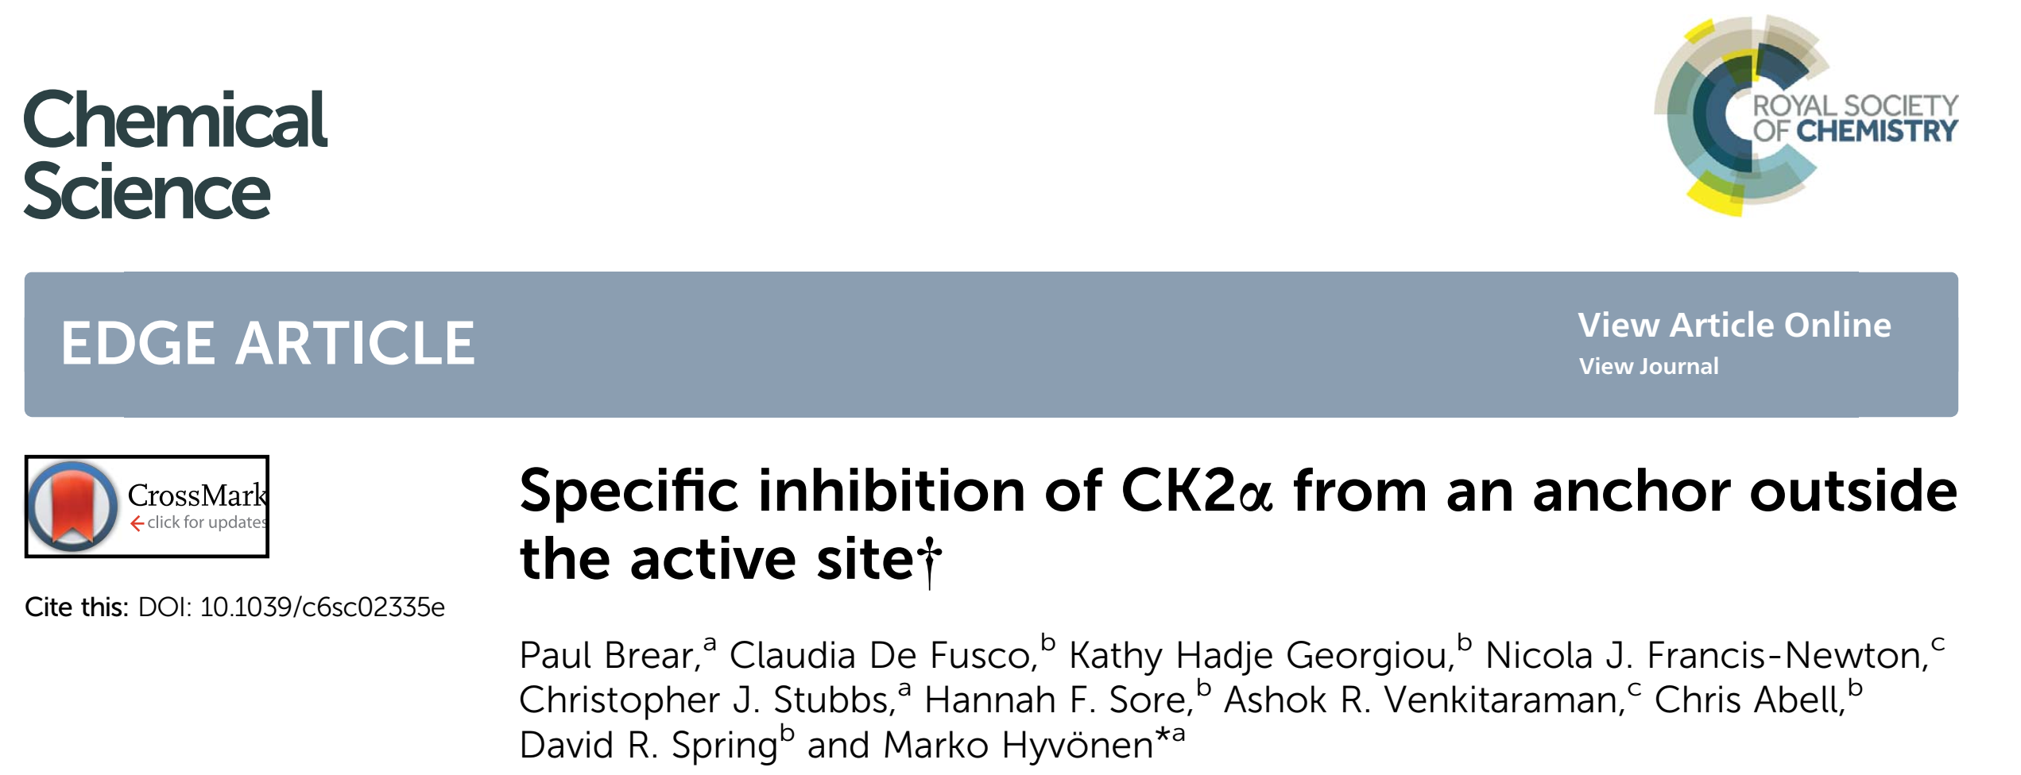

End-to-end (and back) traceability
Sequence
analysis
Expression
construct
Recombinant
expression
Protein
purification
Purified
protein
133 ATGGCCGCAGTGATTCTGGAGAGCATCTTTCTGAAGCGATCCCAA 177
1 M A A V I L E S I F L K R S Q 15
178 CAGAAAAAGAAAACATCACCTCTAAACTTCAAGAAGCGCCTGTTT 222
16 Q K K K T S P L N F K K R L F 30
223 CTCTTGACCGTGCACAAACTCTCCTACTATGAGTATGACTTTGAA 267
31 L L T V H K L S Y Y E Y D F E 45
268 CGTGGGAGAAGAGGCAGTAAGAAGGGTTCAATAGATGTTGAGAAG 312
46 R G R R G S K K G S I D V E K 60
313 ATCACTTGTGTTGAAACAGTGGTTCCTGAAAAAAATCCTCCTCCA 357
61 I T C V E T V V P E K N P P P 75
358 GAAAGACAGATTCCGAGAAGAGGTGAAGAGTCCAGTGAAATGGAG 402
76 E R Q I P R R G E E S S E M E 90
403 CAAATTTCAATCATTGAAAGGTTCCCTTATCCCTTCCAGGTTGTA 447
91 Q I S I I E R F P Y P F Q V V 105
448 TATGATGAAGGGCCTCTCTACGTCTTCTCCCCAACTGAAGAACTA 492
106 Y D E G P L Y V F S P T E E L 120
493 AGGAAGCGGTGGATTCACCAGCTCAAAAACGTAATCCGGTACAAC 537
121 R K R W I H Q L K N V I R Y N 135
538 AGTGATCTGGTTCAGAAATATCACCCTTGCTTCTGGATCGATGGG 582
136 S D L V Q K Y H P C F W I D G 150
583 CAGTATCTCTGCTGCTCTCAGACAGCCAAAAATGCTATGGGCTGC 627
151 Q Y L C C S Q T A K N A M G C 165
Data collection & processing
Structure determination
Crystallisation
The final structure
PDB
Publication

Slide 11
End-to-end (and back) traceability
Sequence
analysis
Expression
construct
Protein
purification
Purified protein
Crystallisation
Uniprot code & mutations
Name and sequence of the crystallised protein
Characterisation (oligomeric state, ligands)
Batch details
Protein concentration
Crystallisation condition(s)
Ligand details
Soaking and cryo-cooling
Data collection & processing
Structure determination
The final structure
PDB
Publication
Crystallisation condition(s)
Ligand details
Collection and Processing stats
MR models etc
Refinement stats
mmcifs
Table 1
Need to able to trace back from this to the start
(ideally)

Slide 12
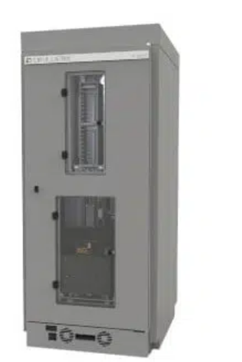
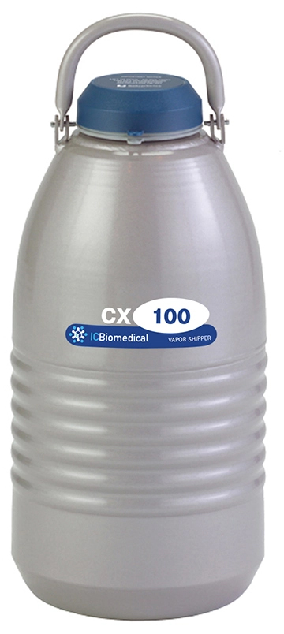
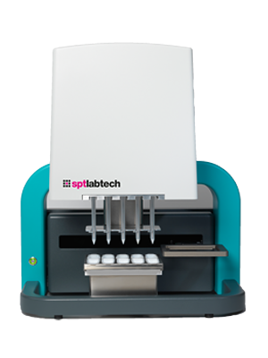
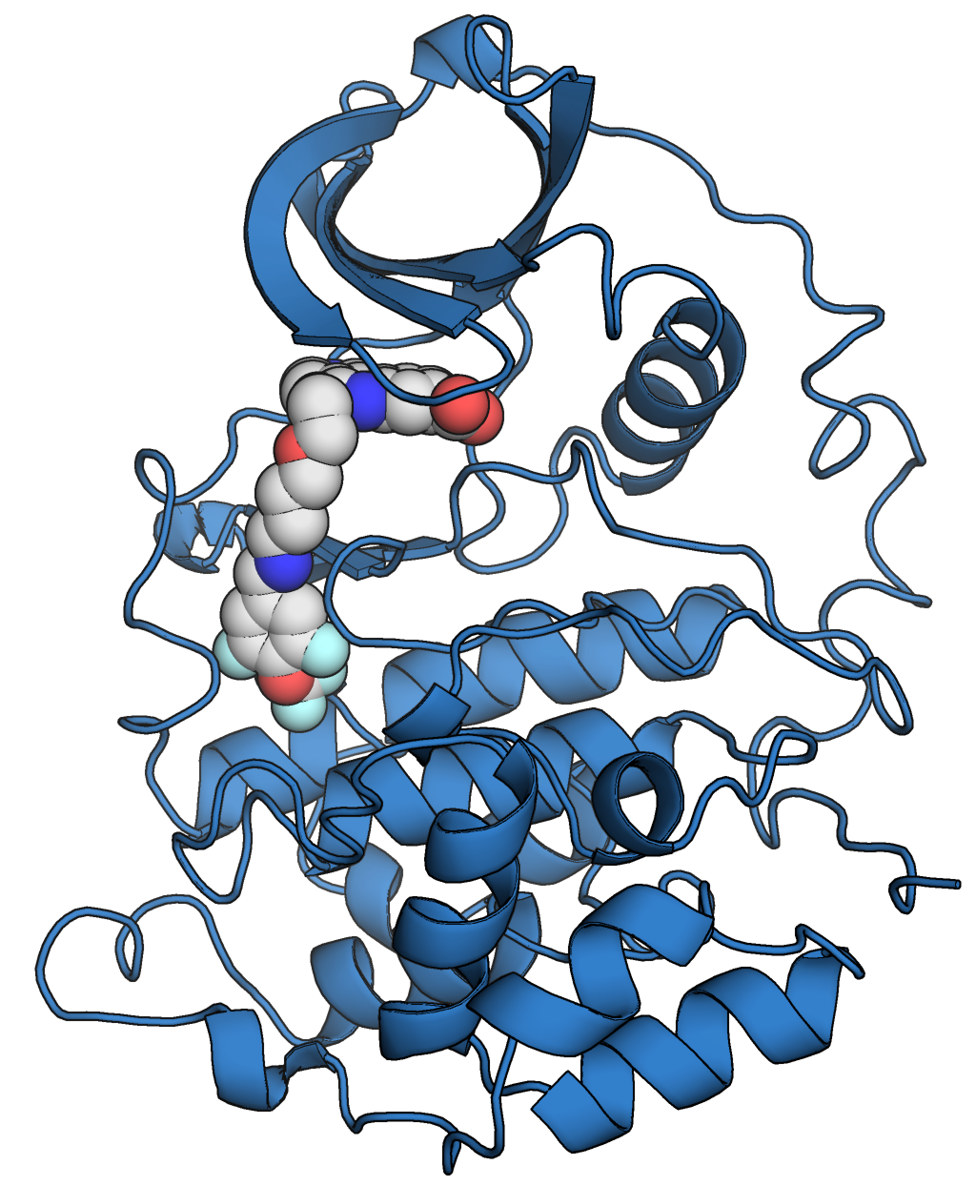
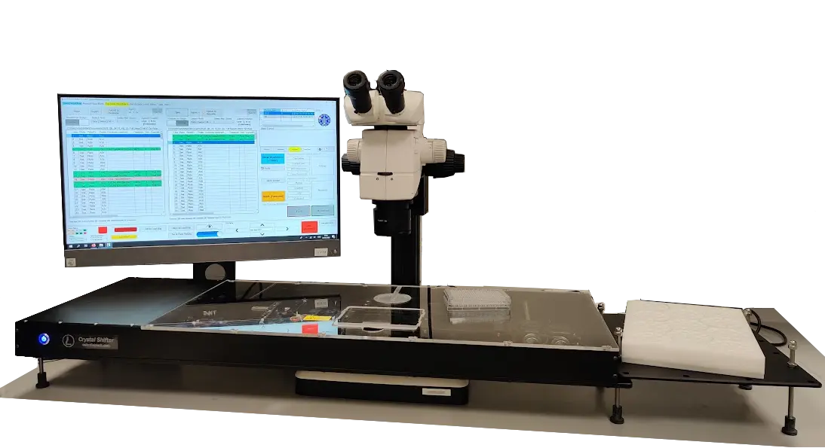
Workflow from crystals to data capture
Crystallisation plate compositions
Protein data
Crystallisation conditions
Crystal ID/Sample Name
incl ligand details
Shipment to synchrotron/ ISPyB
Structure determination

Slide 13
Strict file structure and strict naming policy
“Disasters” at the start of our FBDD projects
when every trip had samples called crystal1-crystal16…
Folders were filled with structures with identical names, e.g. refine.pdb
Solution:
Strict file naming standard to ensure unique name for all datasets
human readable and easily searchable.
No capacity to set up databases etc
scripts to ensure standardised file structure and naming
find ./ -name …
grep “cell parameters”

Slide 14
What we do with data
Originally home-written structure determination shell scripts
XDS, aimless, amore, refmac5, coot water placement, refmac5
Basic but FAST
Now with pipedream
starting from autoPROC or autoPROC/Staraniso data
Wrapper scripts to ensure file naming
and follow work progression in standardised way

Slide 15
Key identifiers
Especially for DD projects
Variable &
Focus of the work
Ligand
&
Protein
Constant, but necessary
Unique name
linked to a SMILES
“apo” if not ligand
Unique name linked to a sequence

Slide 16
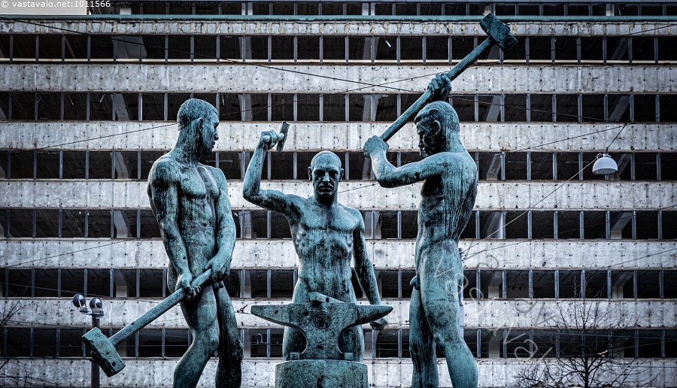
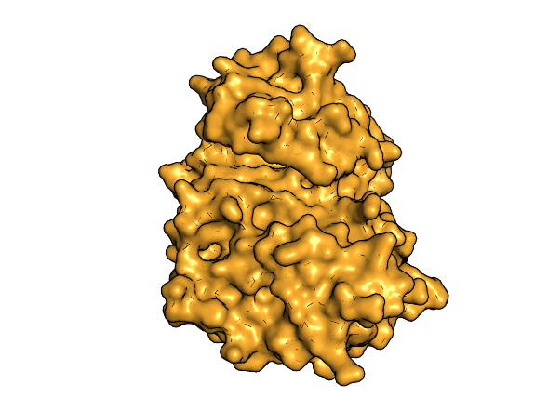
Three Blacksmiths, Helsinki
Enabling the target
AurAS
AurAL
AurASC
….
Fragment-based lead discovery
Biophysics
Crystallography/Cryo-EM

Slide 17
Nomenclature
PROJECT | General name of the project, usually the target: STING, PKL, CK2a
LIGAND | Ligand name as defined by the chemists, e.g. AFF025 “apo” for non-soaked structures.
ProtID | Short name for the particular protein construct, with unique sequence, e.g. PLK.01 Unique to crystal form with its own reference coordinates and mtz
x# | Running number for soaked crystals with a particular ligand and a particular protein.
RESN | Ligand residue name in coordinates. Last three digits from LIGAND e.g. AFF145 -> RESN = 145
DATASET | Unique dataset, LIGAND_ProtID_x#, e.g. AFF145_PKL.01_01 (= name in ISPyB)
SMILES | SMILES string for the ligand e.g. “OC1=CC2=C(C=C1O)C3=CC(O)=CC=C3C2=O”
VISIT | Synchrotron visit, e.g. mx25402-76
SYNC | Synchrotron, e.g. dls
BEAM | Beamline, e.g. i03

Slide 18
Workflow
Target
Target name (PKL)
Construct
Plasmid-target-construct number (pExp-NHis-PKL001)
Protein prep
Unique protein name (PKL001)
Crystallisation
YYYYMMDD_ProtID_screen (20220628_PKL001_JCSG)
Soaking & fishing
LIGAND_ProtID_x# (AFF025_PKL001_01)
Data collection
LIGAND_ProtID_x#_runNO (AFF025_PKL001_01_2)
Structure determination
DATASET_stage_# (AFF025_PKL001_01_refine_1)
Deposition
DATASET_deposit.??? (AFF025_PKL001_01_deposit)

Slide 19
Data flow
Data from Diamond to local server
Only processed data
diamond_copy /dls/i03/data/2022/mx25402-81/auto/PKL1 20220529
Server to workstation
data_copy /dls/i03/data/2022/mx25402-81/auto/PKL1 20220529
- transfer from NAS box to PROJECT/pipedream folder in a workstation
Ligand SMILES from a csv file
Structure determination
full_pipedream ON174 P12Did 1 174
- output in coot/ON174_P12Did_1_refine_0.[pdb|mtz]
Manual fixing in Coot
coot_menus2.pl 1
- output saved to coot/ON174_P12Did_1_refine_#_coot-0.pdb
Re-refinement
re-refine ON174 P12Did 1 1
- output coot/DATASET_refine_[pdb|mtz].???
Deposition to server
deposit_structure ON174 P12Did 1 3 174 A
- output to deposit/DATASET folder
Deposition to PDB
also via Group deposition

Slide 20
Data flow
Data from Diamond to local server
Only processed data
No renaming of files, DLS file structure (more or less)
Server to workstation
Files renamed as per sample name
Structure determination
Output something refine_0.pdb/mtz
Manual fixing in Coot
Automatic generation of “New structures” menu for coot
Re-refinement
Automatically pick the latest “fixed” model
Deposition to server
Collect all relevant files needed for deposition
Run also B-factor etc analysis, renumber residues
Deposition to PDB
Also via Groupdep

Slide 21
File name progression
ligand_protein_xtalNo_processing.mtz
Integrated data from Diamond
ligand_protein_xtalNo_refine_0.pdb/mtz
Initial structure determination
ligand_protein_xtalNo_refine_0-coot-0.pdb
Fixed coordinates after initial stage
ligand_protein_xtalNo_refine_1.pdb/mtz
Data after first manual refinement
ligand_protein_xtalNo_refine_1-coot-0.pdb/mtz
Fixed coordinates after first refinement
ligand_protein_xtalNo_refine_2.pdb/mtz
Data after later refinement
ligand_protein_xtalNo_deposit.pdb/mtz
Deposited data after last refinement

Slide 22
Local deposition files
Copied to local server
Refinement PDB and mmcif files of coordinates
Refinement mtz and mmcif files of structure factors
Deposition ready mmcif coordinates
“2FoFc” map of the final refinement with the ligand
“2FoFc” map of ligand site from last refinement without ligand
“FoFc” map of ligand site from last refinement without ligand
“Table 1” in csv format using makecrystTable3 script from mmcif
Processing log files (staraniso, aimless, XDS)
Processing “table 1” (staraniso.table1)
Original integrated, scaled cif file (if available)
Original integrated, scaled mtz file (staraniso_alldata-unique.mtz)
Ligand SMILES, PDB and cif files
PyMOL script for loading structure and maps automatically

Slide 23
Wishlist
Files stored already with sample names defined in ISPyB
Easier generation of standardised Table 1
sure, no standards: add all, easy to remove later
Notification of changes to file structure and naming
CSV file with all the data collections from a “trip”
Currently just manually from ISPyB
Capture other data needed/desired for deposition, e.g. synchrotron, beamline, date of collection, detector type, …
mmcif snippet to grab for deposition files

Slide 24
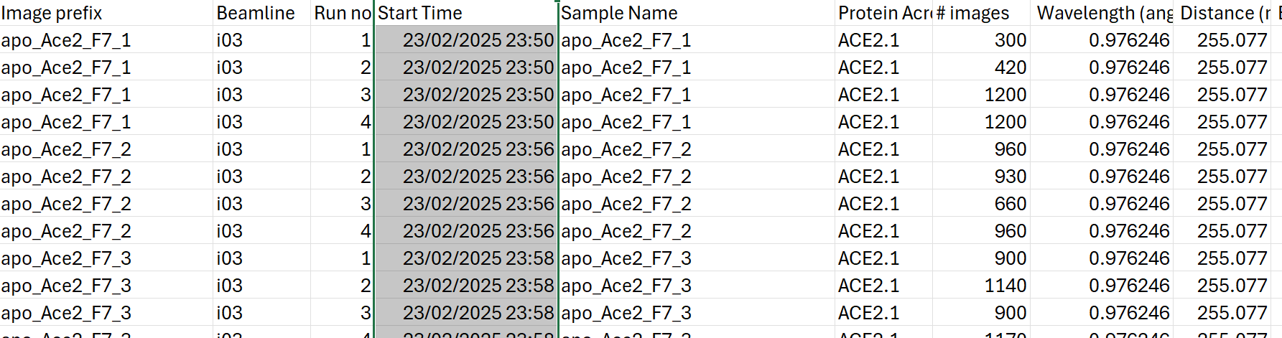
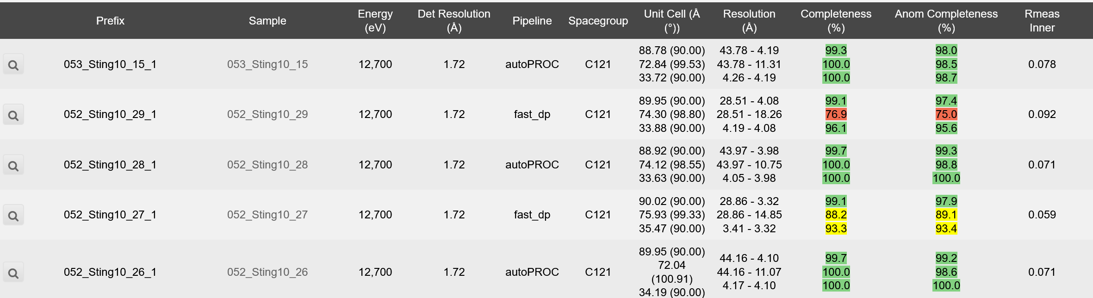
Collection csv vs. data processing summary

