Slide 1
MXCuBE | LIMS
Site Report: SSRF / NFPSS
Wenming Qin
National Facility for Protein Science in Shanghai (NFPSS)
Shanghai Synchrotron Radiation Facility (SSRF)
June 2026

Slide 2
Facility Overview

Slide 3
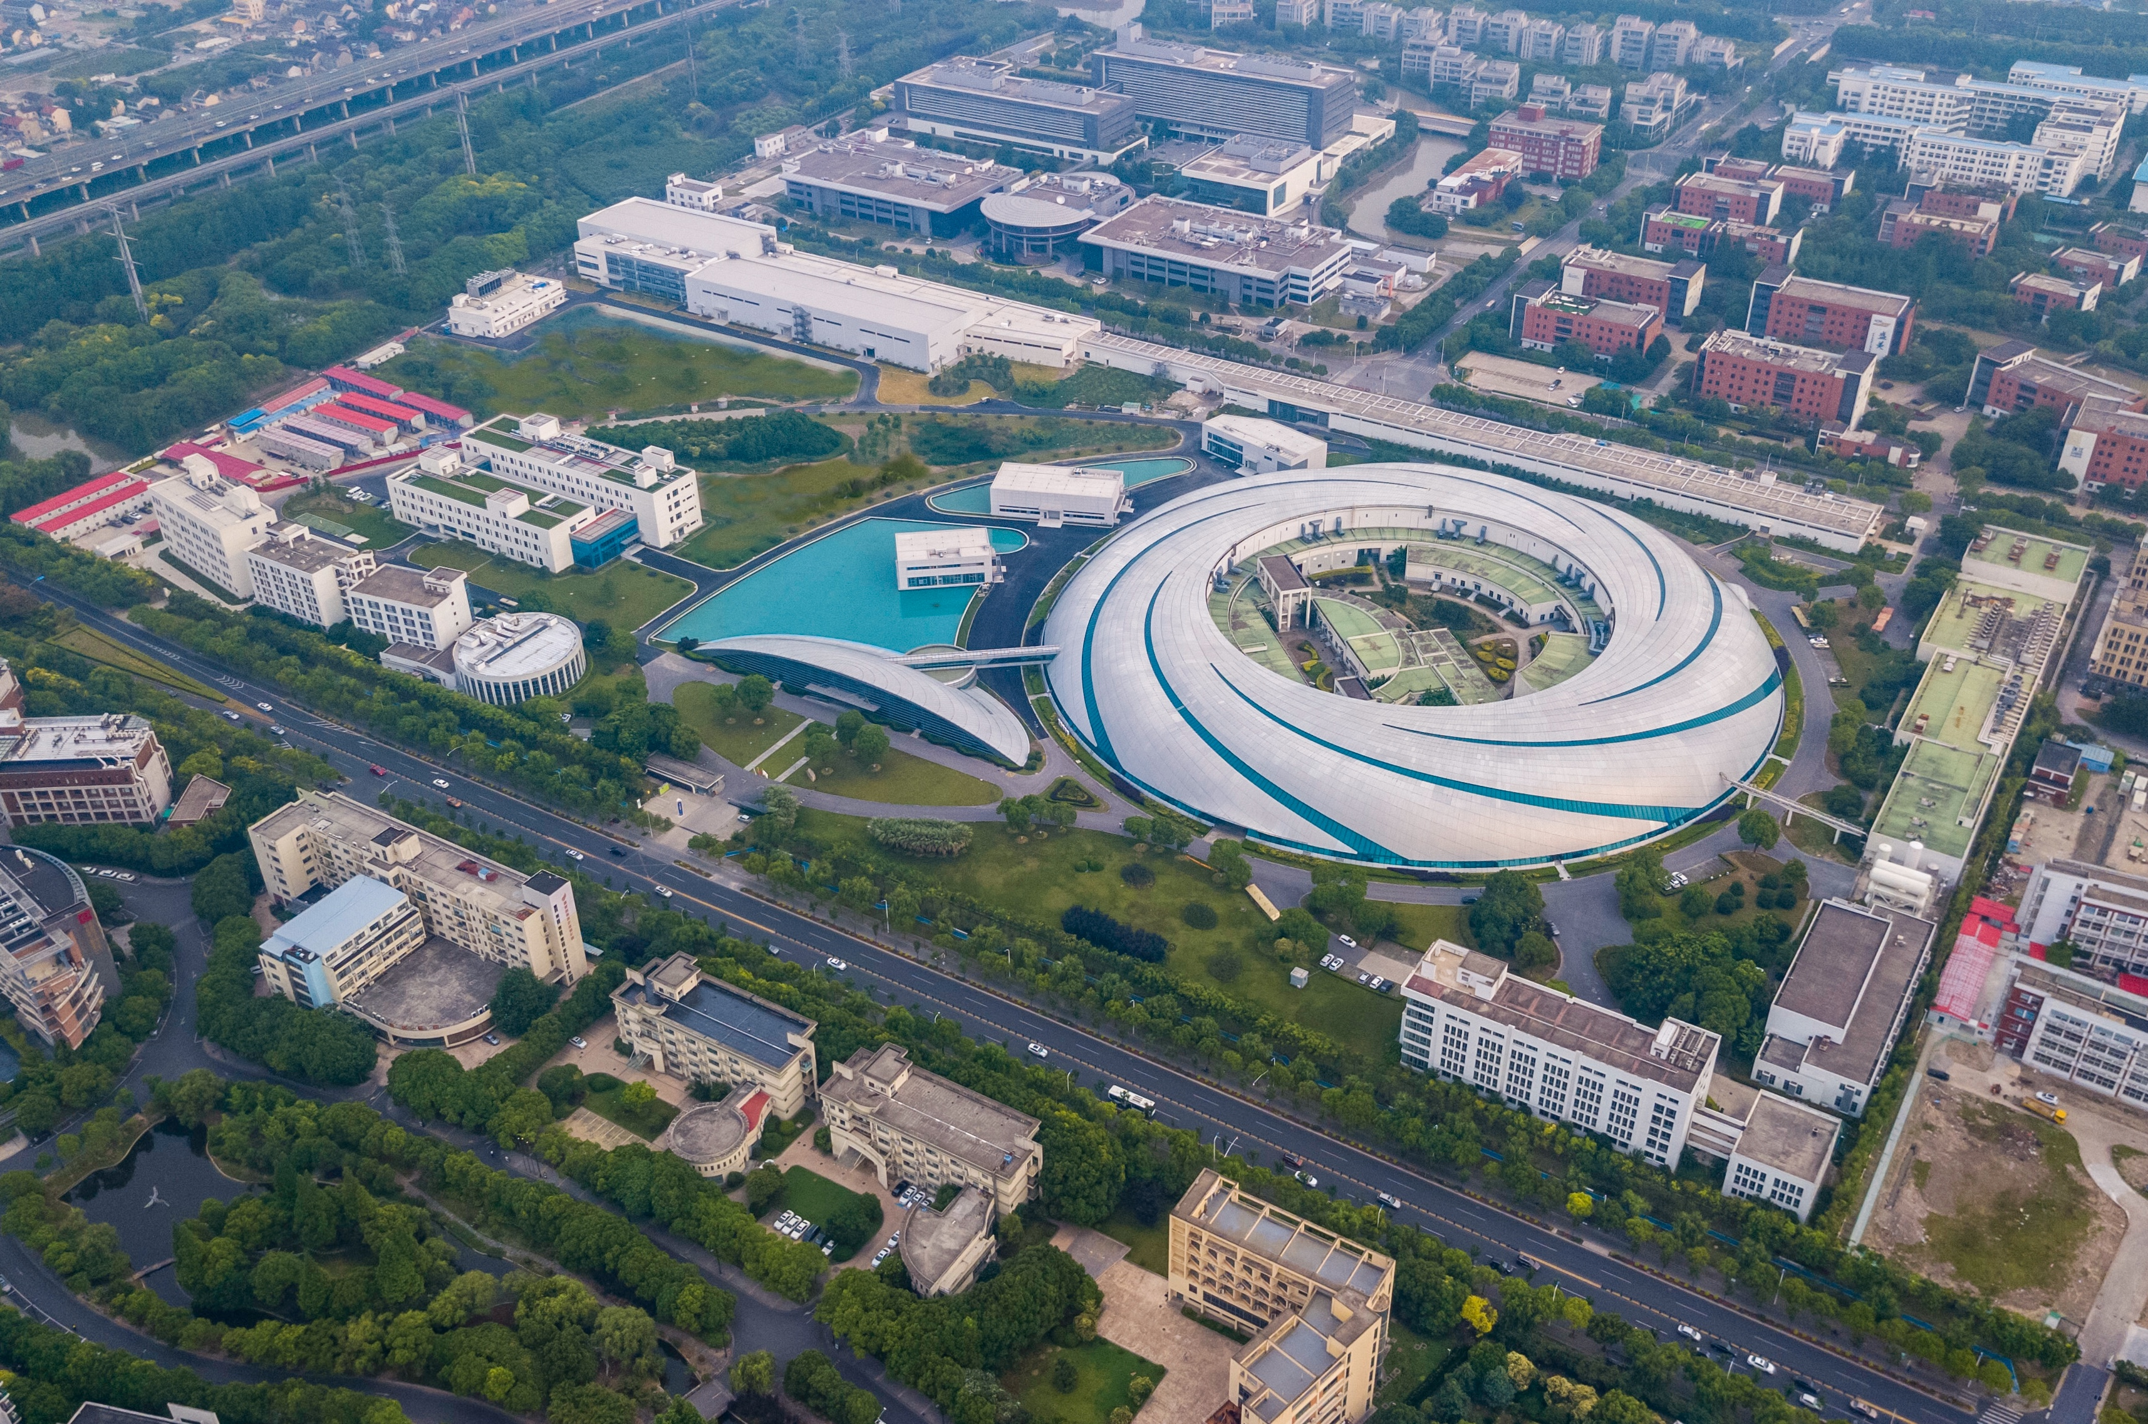
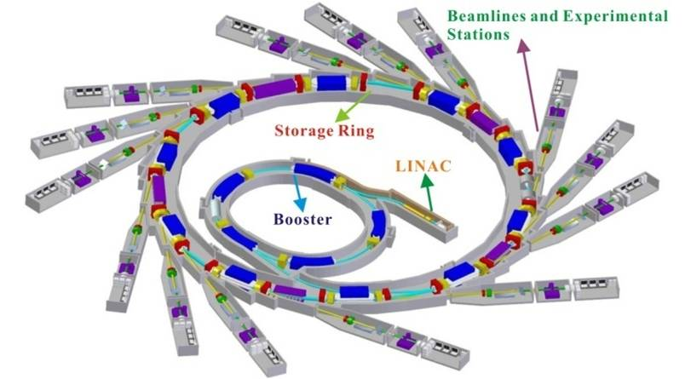
SSRF Storage Ring & Parameters
SSRF Ring Parameters
Electron Energy：3.5 GeV
Electron Current: 300 mA
Circumference: 432 m
Straight sections: 20
Hard X-ray Free Electron Laser
Soft X-ray Free Electron Laser
SSRF

Slide 4

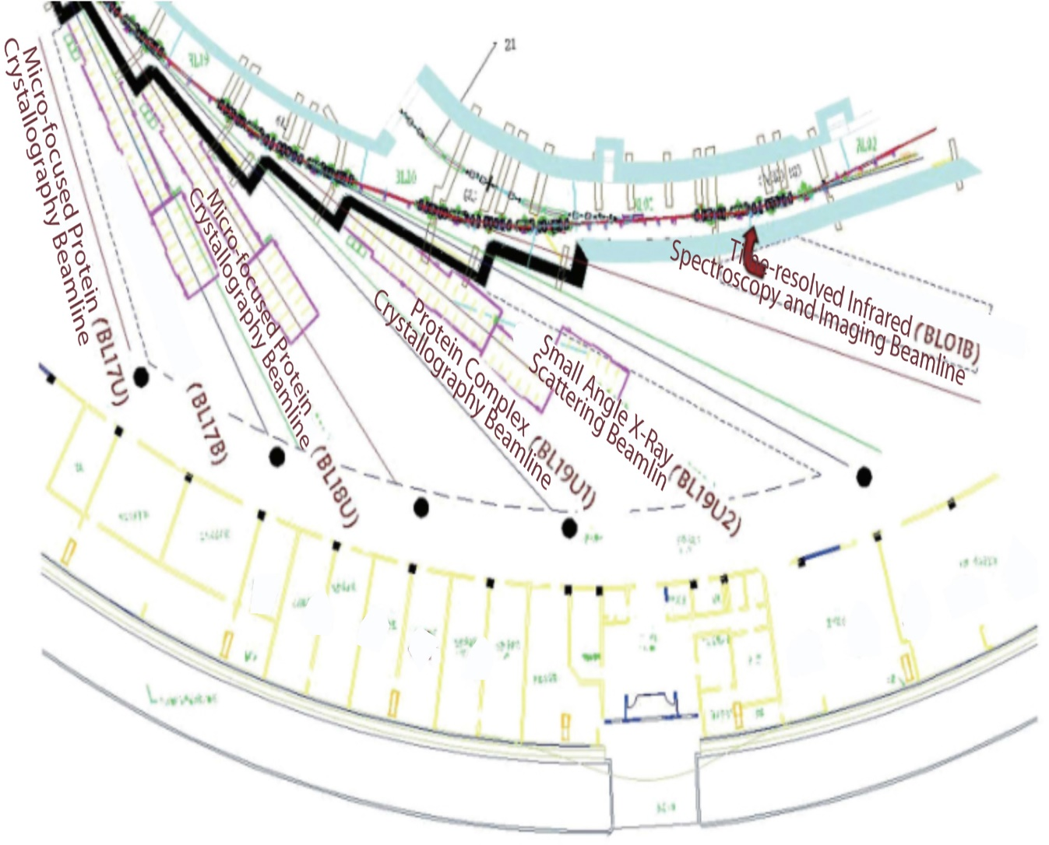
National Facility for Protein Science . Shanghai
NFPS passed the National Acceptance Review, and formally opened to the users in July 2015.
NFPS is composed of 9 technology systems with state-of-the-art instruments in its Haike Road Campus and 5 Beamlines within the Shanghai Synchrotron Radiation Facility.

Slide 5
MX Beamlines at SSRF
BL17B
6 MX Beamlines
BL18U1
NFPSS
MXCube
BL19U1
Shanghai Tech
BL17UM
BL02U1
SSRF
BL10U1

Slide 6
MXCuBE Status
Implementation & Hardware Control

Slide 7
System Versioning & Controls
Beamline | MXCuBE-Core Version | Control Interface | Hardware
BL17B | Version 2022.2.23 | Socket / EPICS/ Exporter | MD2，Pilatus 2M
BL18U1 | Version 2023.4.9 |  | Pilatus 6M, MD2，Rigaku sample changer
BL19U1 | Version 2023.4.9 |  | Pilatus 6M, MD2S，FLEX sample changer

Slide 8
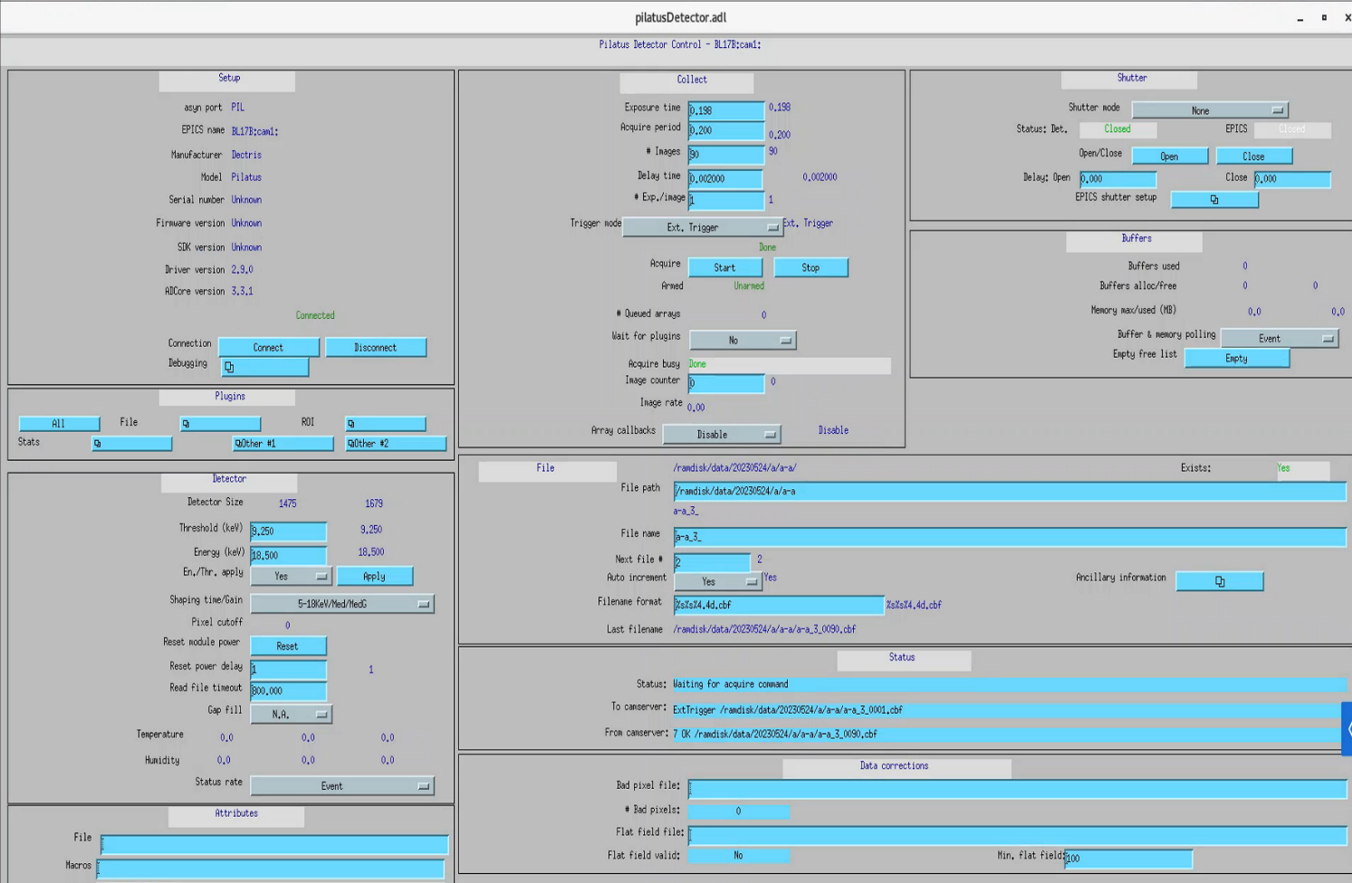
Hardware Interface Control System
Integrate Flex sample changer into MXCuBe by Exporter.
Integrate Pilatus 6M detector into MXCuBe by EPICS.
Integrate MD2S into MXCuBE by Exporter and Tango（camera）.
MXCuBE3
Exporter
Exporter and Tango
EPCIS
EPICS
FLEX Sample Changer
MD2S
Pilatus 6M Detector
Monochromator/Support table
Integrated Control Systems
Detector EPICS Control Interface

Slide 9
Developments since last meeting

Slide 10
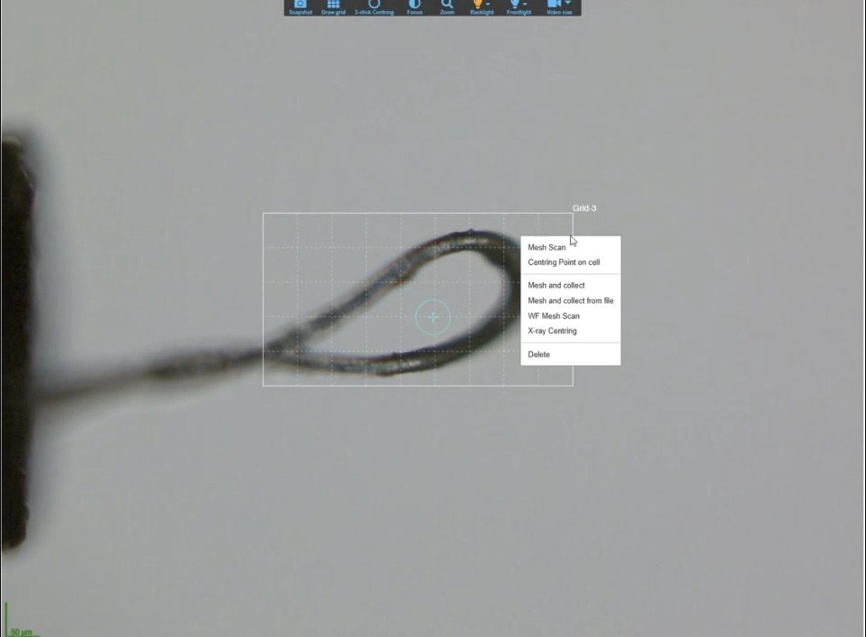
Raster scan feature configuration
Done:Currently, our raster scan executes correctly, and DOZOR successfully calculates the diffraction scores.
Issue: the web frontend isn't displaying these scores at all; the UI remains unchanged.
Question: where this breakdown usually happens—is it typically an issue with the script parsing and uploading DOZOR results to the ISPyB database, or is it a missing endpoint configuration on the web frontend?

Slide 11
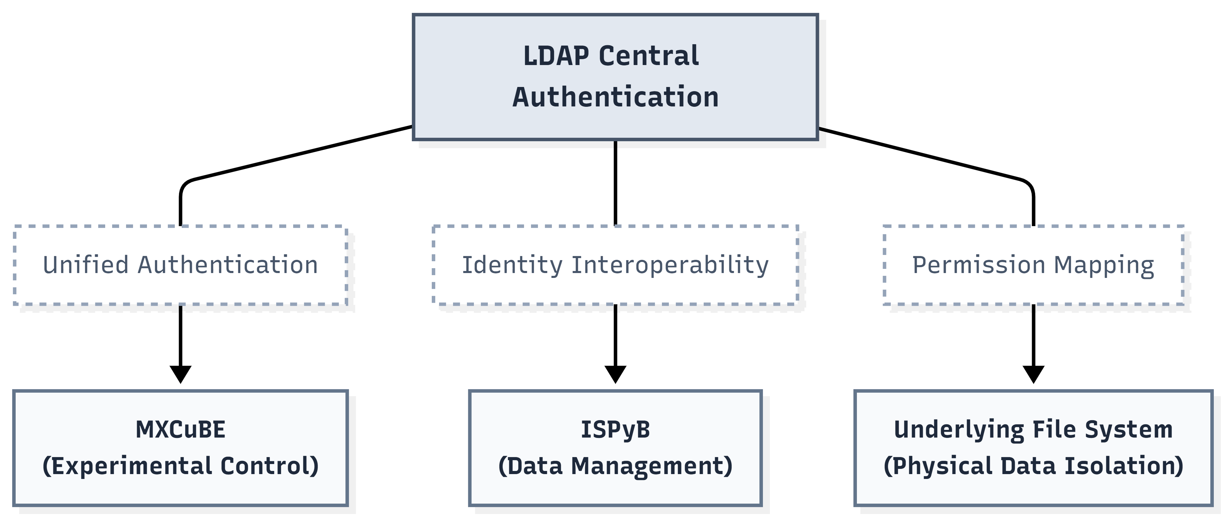
Cybersecurity & Data Isolation
Strict project-based accounts ensuring users only access their own diffraction data. Servers operate primarily on internal networks with regular secure backups.

Slide 12
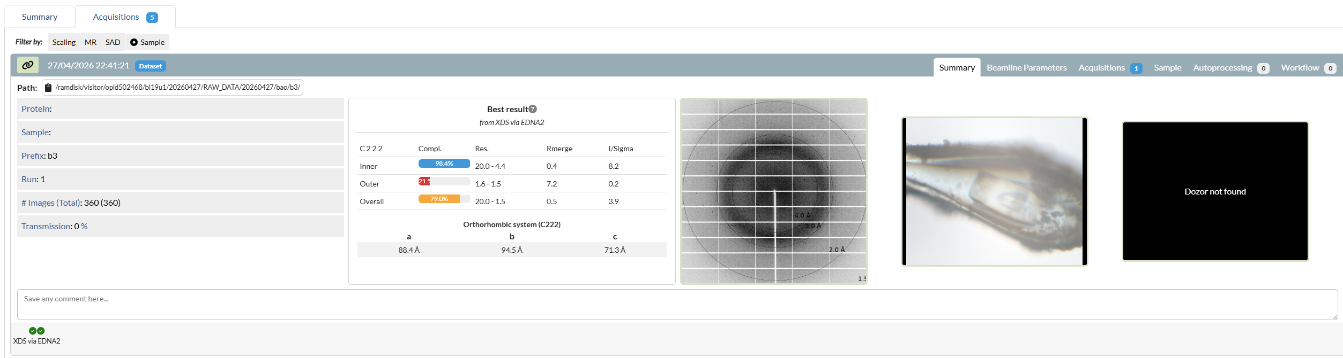
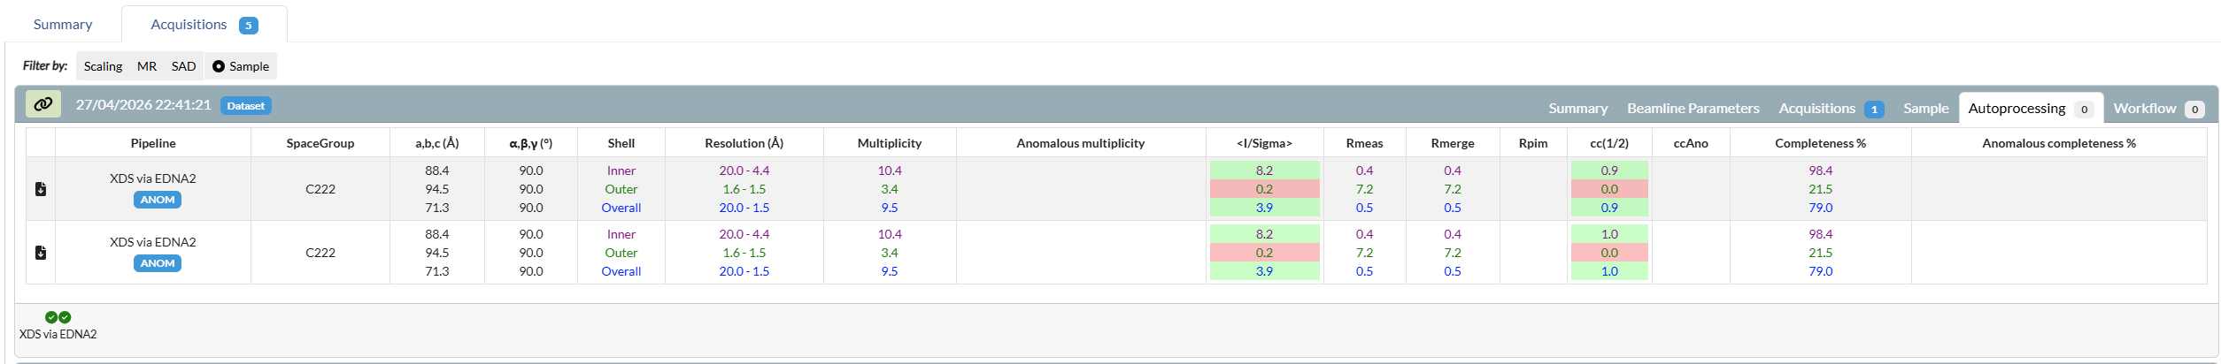
ISPyB and EDNA2 integration
ISPyB: Achieve deep synchronization between experimental data and samples, ensuring automated workflows for storage and retrieval.
EDNA2: Integrate an automated data analysis framework to enhance the accuracy of sample characterization and strategy calculation.

Slide 13
Plan the next work

Slide 14
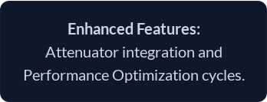
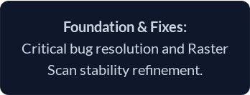
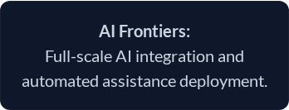
Impementaion Timeline
Q3 2026
2027&Beyond
Q4 2026

Slide 15
Thank you for your attention!
Acknowledgments:
Shanghai Sychrontron Radiation Facility
Mikel Eguiraun and Jie Nan from MAX IV
Letícia G. Capovilla from LNLS
Arinax, Dectris, Rigaku, Irelec
MXCube community.

