Slide 1
MXCuBE site report
Lai-Chin Wu, Bo-Yi Liao
NSRRC

Slide 2
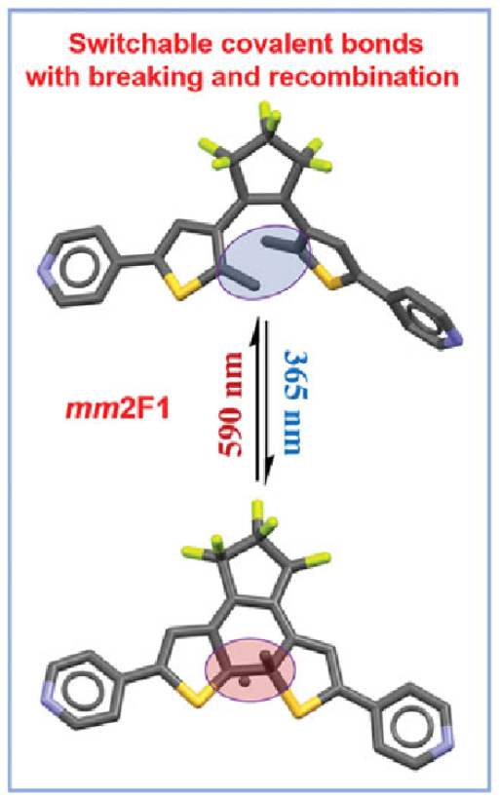
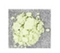
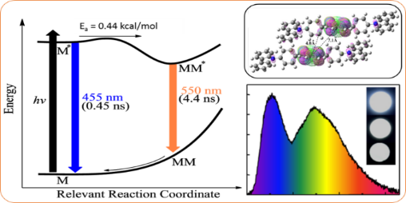
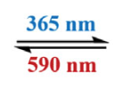
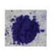
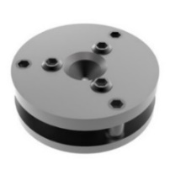
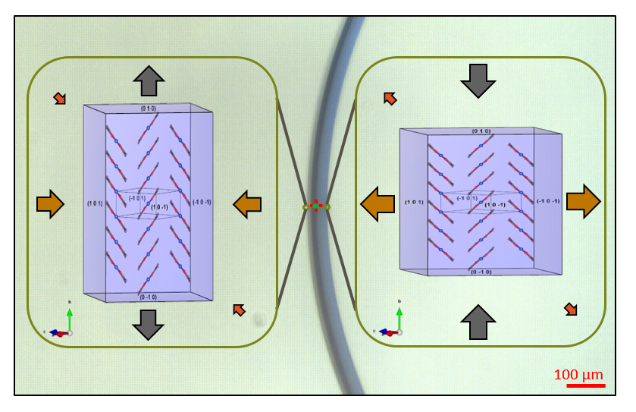
Brief beamlines summary
Scientific opportunity
15A μ-XRD
Pump-probe Laue Crystallography
Micro-crystal and Advanced Crystallography
High Pressure Crystallography, Geoscience
Charge Density Analysis Fundamental study
Photo-crystallography
Phys. Rev. Lett., 2023, 130, 176802
Metastable, intermediate structures of photochromism related materials
bond breaking and reformation process
J. Phys. Chem. A, 2011, 115, 13061
Chemical bond characterization,
Intra- and inter-molecular interactions
Phys. Rev. Lett., 2009, 103, 028301
Spin crossover
Photo-excitation
Photochromism
Static excited state structure
0.0 GPa
7.6 GPa
Phase transition
Pressure synthesis
New physical properties
Bending crystal structure mapping
Micro-crystals
Porous materials (micro, meso and macro)
Drug development
Chem. Commun., 2015, 51, 8868-8871
Nat. Chem, 2018, 10(1), 65-69

Slide 3
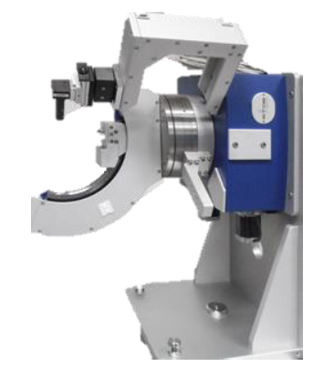
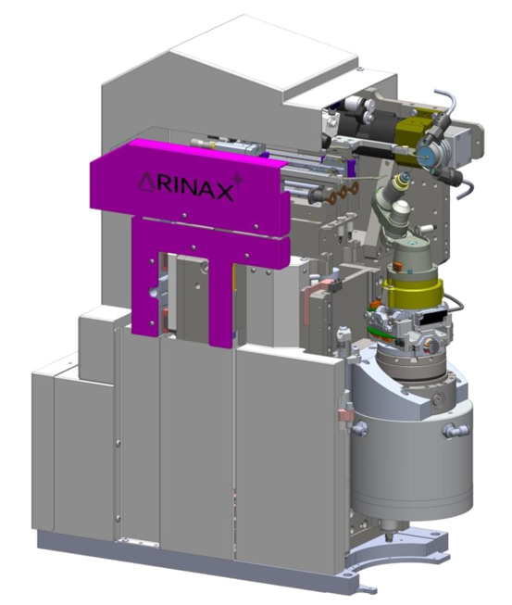
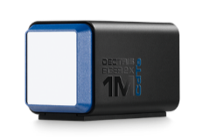
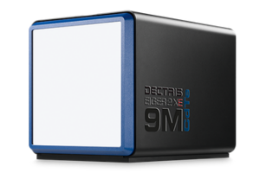
Brief beamlines summary
End-stations
15A1 2024-2 open to user 30 % beamtime
15A2 starts commissioning
15A1 Beam size (@37.5 m)
200 × 200 – 100 × 100 μm²
(define by slits)
STADIVARI
Eulerian Cradle type, horizontal design
Goniometer with robot and auto centering system
EIGER 2X CdTe 1M
Lager size crystal, high pressure
Robot auto sample mount/unmount
15A2 Beam size (@56 m)
70 × 70 – 10 × 10 μm²
(2 × 2 with aperture of MD3)
MD3-UP
High precision goniometer (SCO ~ 100 nm)
Vertical design
EIGER 2X CdTe 9M
Small size crystal, crystal structure mapping, pump-probe, high pressure
EIGER 2X CdTe 1M
EIGER 2X CdTe 9M
STADIVARI
MD3-UP

Slide 4
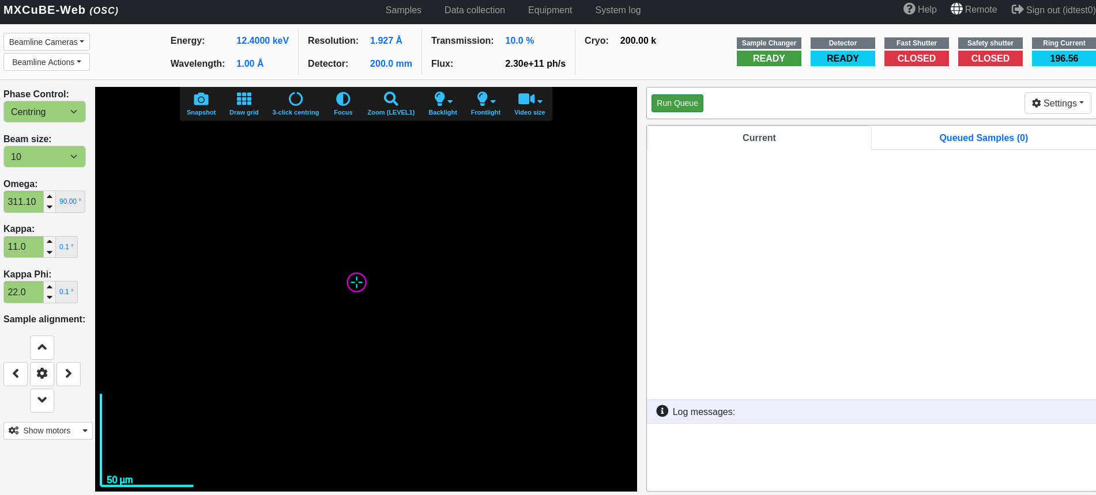
MXCuBE status
Version, mxcubecore
mxcubecore (1.90.0)
mxcubeweb (4.72.0)
Develop platform ready -->
Other deplopments
Ubuntu (20.04.4 LTS)
+ Anaconda
Python (3.10.14)

Slide 5
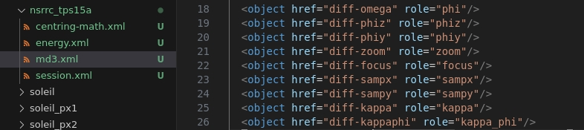
Developments since last meeting
MXCuBE:
MD3UP configuration
Omega
Phiz
Phiy
Sampx
Sampy
Kappa
Kappaphi
Settings are done but stuck at loading level. Try to check libs version.
Try EPICS connection
Make Beamline configuration
Beamline_config.yml

Slide 6
Plans for the next six months
MXCuBE:
Set up detector (Eiger) configuration
Add more EPICS Hardwares
User's experimental flow and new UI development

