Slide 1
Integration and deployment of GΦL workflows in MXCuBE
Rasmus Fogh Global Phasing Ltd, Cambridge, UK
Gleb Bourenkov EMBL Hamburg, DE
MXCuBE meeting, virtual Hamburg May 2021

Slide 2
Introduction – the problem
The GΦL Workflow and its capabilities
Deployment and tests
Workflow at P14 (Gleb Bourenkov)

Slide 3
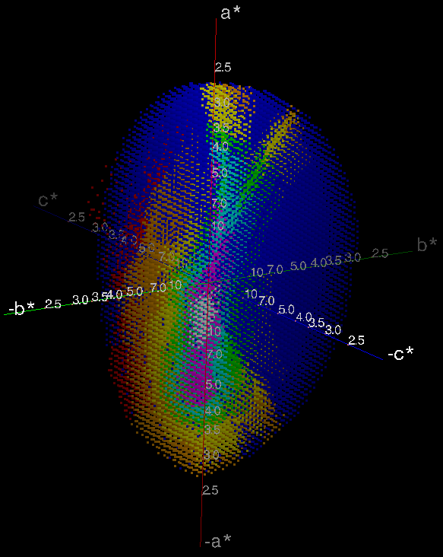
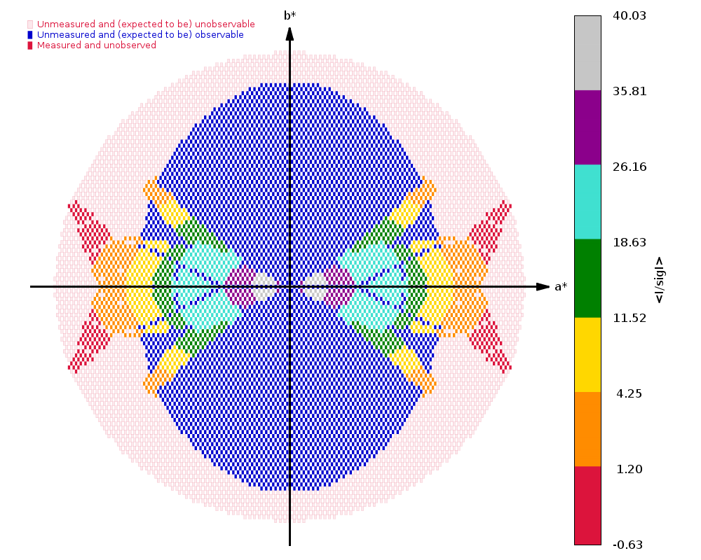
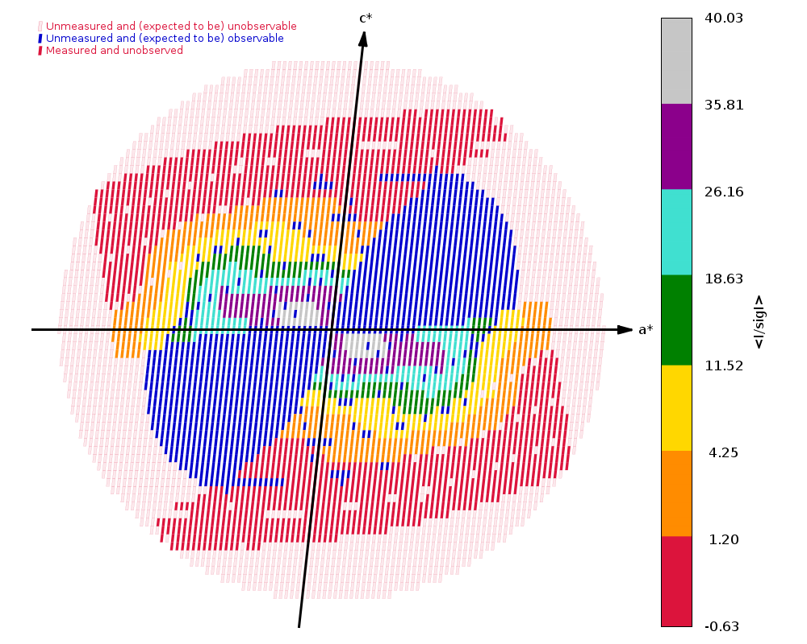
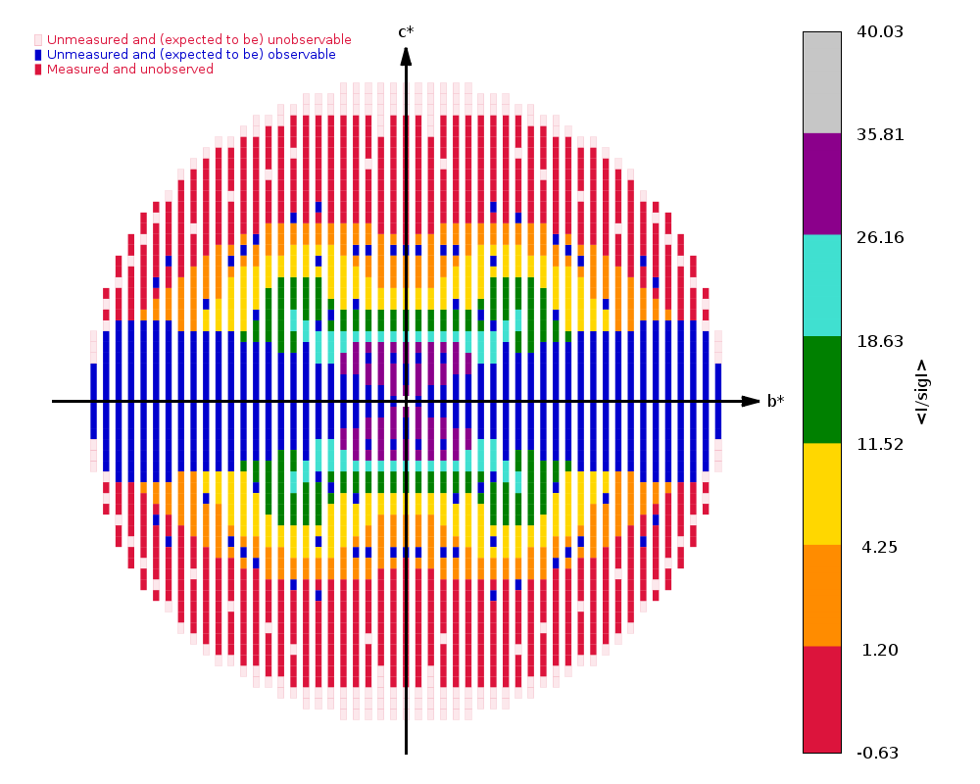
How bad can it get?
Pilatus6 3M detector - min 0.04s / image.
100s acquisition time (one centring took 235s)
Alternative strategy, collecting 400˚ in 4000 images: 200s acquisition at 50% transmission.
Blue = not measured but expected to be observable
Covid-related deposition (6W9C, 01/04/2020), C2, 2.7Å. 57% complete, 2.5 redundancy, (highest shell : 38%, 1.9) 2 sweeps, 70˚+ 30˚ (overlapping), 200 images 0.5˚,0.5s per image; high background, ca. 40 counts. 100% transmission; strong radiation damage.

Slide 4
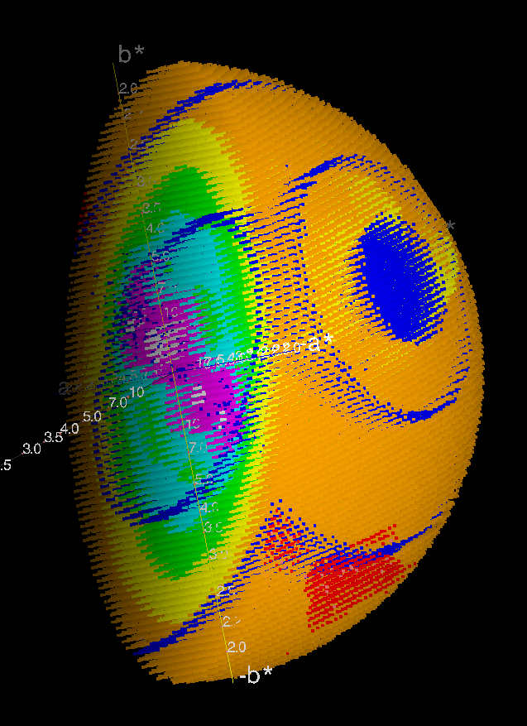
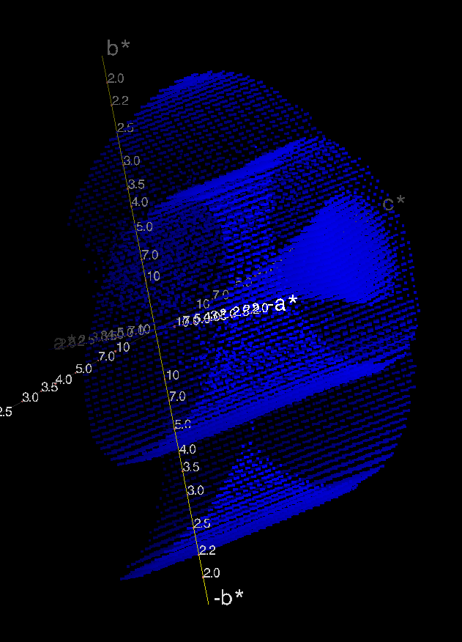
P1: Cusp and detector module gaps (4CY8)

Slide 5
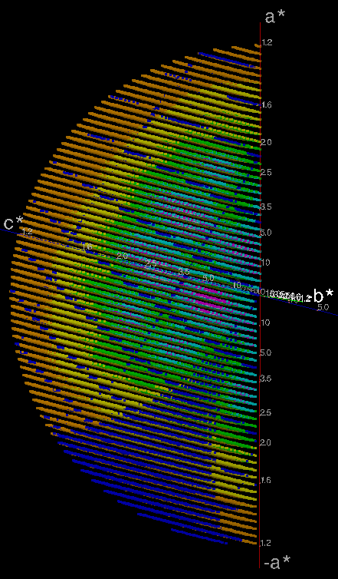
Unfortunate orientations
6R6F
P21
93% complete, redundancy 6
(highest shell: 90%, 6.1)
1.20Å resolution
Missing observations (blue) from module gaps and cusp

Slide 6
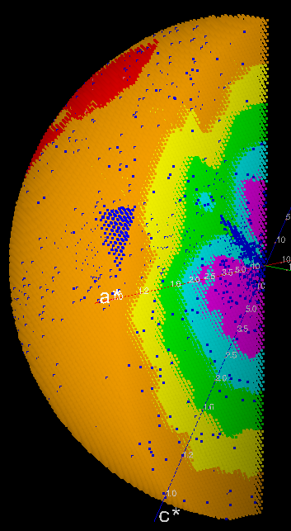
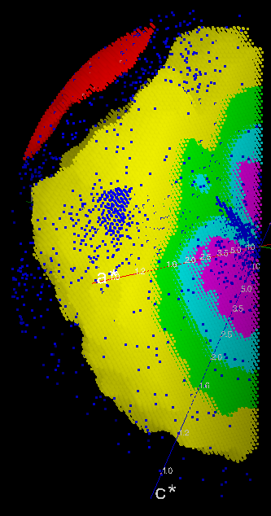
Cusp imprint in complete data
Reduced S/N ratio (I/σ) resulting from reduced redundancy caused by cusp in a high-quality data set.
4KXX, C2, 1.20Å. 99% complete, redundancy 3. (highest shell: 99%, 2.33)
Orange points removed

Slide 7
Introduction – the problem
The GΦL Workflow and its capabilities
Deployment and tests
Workflow at P14 (Gleb Bourenkov)

Slide 8
On-line strategy calculation and execution
Calculation of optimised multi-sweep acquisition strategies in real-time, from characterisation results
Workflow* includes characterisation, indexing, pre-centring, parameter setting, and data acquisition
Choice of strategies
Full, for high-quality data
OR quick, for fast-but-guaranteed complete data
Integrated into MXCuBE, with Qt4 interface components
* With acknowledgements to the EDNA precursors

Slide 9
Workflow capabilities
Goniostat calibration, subsequently used for automatic pre-centring when orientation changes
Native, MAD or SAD collection strategies
Adapted to resolution, symmetry, crystal orientation, and accessible (re)orientations on the available goniostat
Use full range of κ values while avoiding goniostat shadowing
Set default transmission*, depending on resolution
Uses pre-calculated radiation sensitivity values
Assumes B-factor increase of 1Å²/MGy
‘Top hat’: Based on mean flux density = flux / beam area
* With acknowledgements to the EDNA precursors

Slide 10
Strategy types
Native, full
Optimised for even distribution of redundancy
360-960°, 2-4 orientations, depending on symmetry
Native, quick or minimal
Optimised for speed and completeness (avoiding cusps)
180-360°, 1-2 orientations, includes characterisation
Phasing
Alignment of an even-order symmetry axis, or use of inverse beam, for clean Bijvoet pairs
SAD, 360-540°, up to 4 orientations
MAD, 180-360°, up to 3 orientations, wavelength interleaving

Slide 11
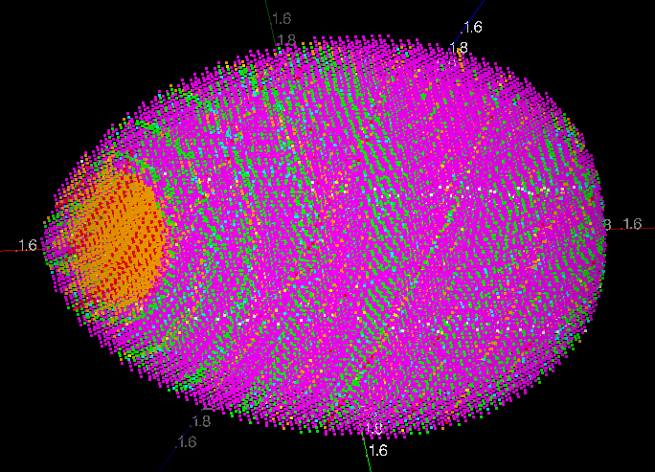
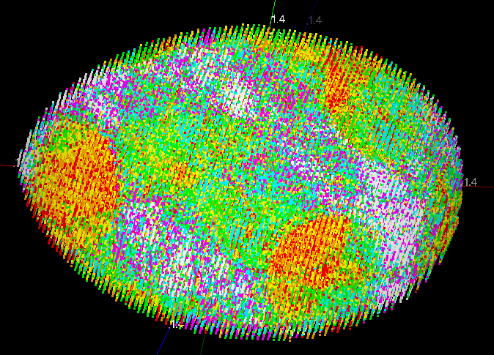
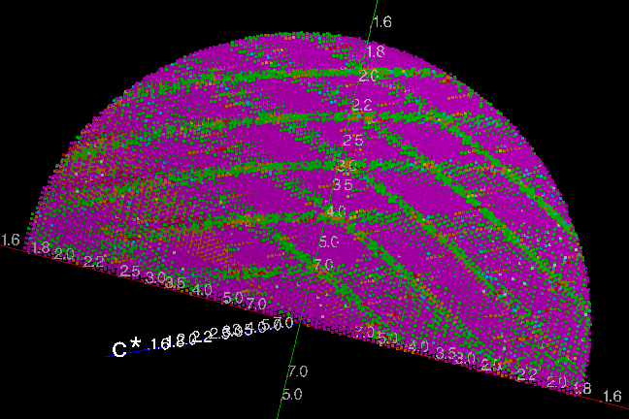
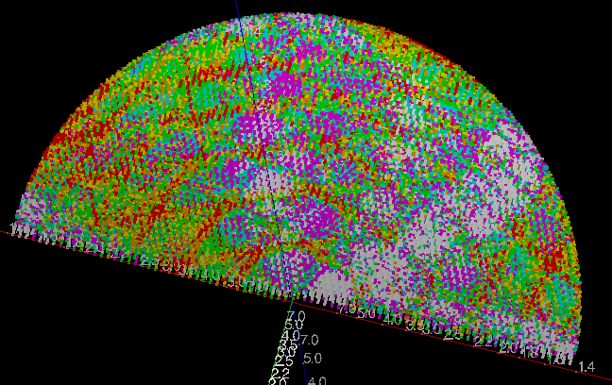
Monoclinic native - redundancy
Redundancy
Red 2 ^{…… aa}
Purple 8
Redundancy
Red 13 ^{…… aa}
White 19
Reflections for 1 * 360° strategy (left) v. 4 * 220° strategy (right)

Slide 12
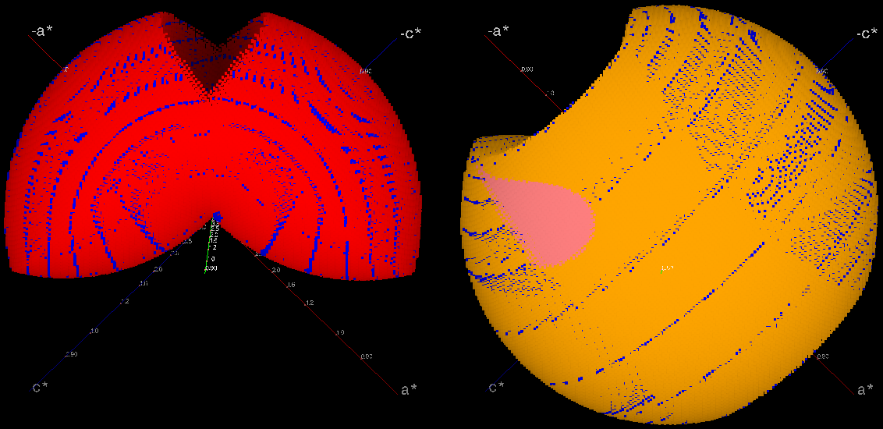
Orthorhombic phasing strategy
90° and 180 ° sweeps, aligned on different axes for mutual cusp-filling

Slide 13
Orthorhombic phasing strategy
Goniostat shadow
90° and 180 ° sweeps, aligned on different axes for mutual cusp-filling

Slide 14
Workflow integration with MXCuBE
MX
MXCuBE
GΦL HardwareObjects
Java
GΦL Controller
Message handling
Execution
GΦL Connection
Java
Python
GΦL Workflow Data persistence
Py4J Messages ABI objects
Function calls
ABI objects
Transcription
Fortran
Queue Model Objects
XDS
SimCal
StratCal
…
Data, formatting
MXCuBE Queue
Execution User interface
Generic I/O Popups
Parameter queries
Display and review

Slide 15
Workflow steps
Centre sample at arbitrary initial orientation
Characterisation
Acquire 5 * 1.2° wedges with 0.1° image width (configurable)
Short XDS run
Select indexing solution
Calculate strategy
Requires wavelength, resolution, crystal symmetry and crystal orientation
Present strategy to the user and confirm parameters
Generate and execute acquisition sequence
(Re)centre sample as needed after each reorientation
Automatically trigger (typically multi-sweep) data processing
Note: Designed strategies need at least one additional orientation

Slide 16
Introduction – the problem
The GΦL Workflow and its capabilities
Deployment and tests
Workflow at P14 (Gleb Bourenkov)

Slide 17




Where are we in terms of deployment?
Workflow installed on P14 at PETRA III and tested live by advanced users
Workflow installed on BL13 at ALBA under testing by beamline scientists
Preparing for installation at SOLEIL
Working with MASSIF 1 on integrating GΦL experimental workflow with MASSIF 1 EDNA automation workflow

Slide 18
Result of user feedback – P14
Improved usability of GΦL-specific user interface:
widget layout and behaviour
sequencing of parameter settings
Multi-trigger characterization on Eiger detectors:
each thin wedge would normally require re-arming the detector
with multi-triggering, multiple wedges are handled in a single operation
we hope to extend this to e.g. inverse beam and wavelength-interleaved data collection.

Slide 19
Extended user session on P14
28-hour non-stop user session on P14
Ashwin Chari and co-workers, with Gleb Bourenkov
No Global Phasing personnel involved, not even remotely
GΦL full native strategies used throughout
when WF was not successful, fall back to non-WF single-sweep acquisition
High resolution crystals, monoclinic, orthorhombic, and tetragonal space groups.

Slide 20
Sample success rate
Result | Samples loaded | <duration> (s) | Total time (s) | total time %
No data | 188 | 163.0 | 30640 | 25.9
Non-WF data | 4 | 601.0 | 2404 | 2.0
WF incomplete | 42 | 457.4 | 19213 | 16.2
WF success | 83 | 797.2 | 66168 | 55.9
Total sample loads: 317
No data: Sample did not diffract
Non-WF data: Only single-sweep data collected
WF incomplete: Resolution too low / no indexing solution / WF failure
WF success: WF data acquired (possibly after more than one try)

Slide 21
Workflow step timings
Median time required for individual steps
Load and centre | 128 s
Characterisation | 110 s
Acquire and process |  | 27 s
UI popups |  | 38 s
Calculations |  | 30 s
Stratcal | 4 s
Confirmation popup | 13 s
One extra centring | 47 s
One sweep | 43 s
Acquisition time for one sweep will vary with parameter settings

Slide 22
Estimated strategy timings
Centring count | Centring time (s) | Sweep count | Sweep time (s) | Total time (s) | Symmetries
+3 | 140 | 4 | 172 | 568 | P1, monoclinic
+3 | 140 | 3 | 129 | 524 | 222
+2 | 93 | 3 | 129 | 478 | Trigonal, tetragonal
+2 | 93 | 2 | 86 | 435 | 32, hexagonal
+1 | 47 | 2 | 86 | 389 (340) | 422, 622
0 / +1 | 0 / 47 | 2 | 90 | 345/392 | Quick (any symmetry)
0 / +1 | 0 / 47 | 1 | 43 | 298/345 | Minimal (any symmetry
Strategy time requirements, based on median duration for individual steps.
The centring count is in addition to the initial centring
Quick and minimal strategies use either one or two orientations, depending on the initial crystal orientation 340s for 422 is from later thaumatin tests (Gleb Bourenkov)

Slide 23
Acknowledgements
Global Phasing colleagues
Peter Keller
Rasmus Fogh
Wlodek Paciorek
Claus Flensburg
Clemens Vonrhein
Andrew Sharff
Ian Tickle
Gerard Bricogne
Diamond Light Source
Funding under Collaboration Agreement COL0044 re. I23
Armin Wagner
Kamel El Omari
EMBL-Hamburg / PETRA III
Gleb Bourenkov
Ivars Karpics
ALBA synchrotron
Roeland Boer
Jordi Andreu
Max Planck Institute, Göttingen
Ashwin Chari
EMBL-Grenoble
Josan Marquez
Irina Cornaciu
The MXCuBE Collaboration
The Global Phasing Consortium
Funding and much more

Slide 24
Introduction – the problem
The GΦL Workflow and its capabilities
Deployment and tests
Workflow at P14 (Gleb Bourenkov)

Slide 25
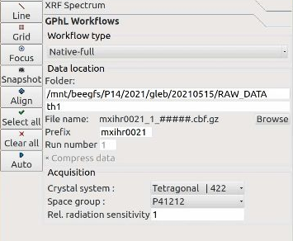
Start GΦL Workflow

Slide 26
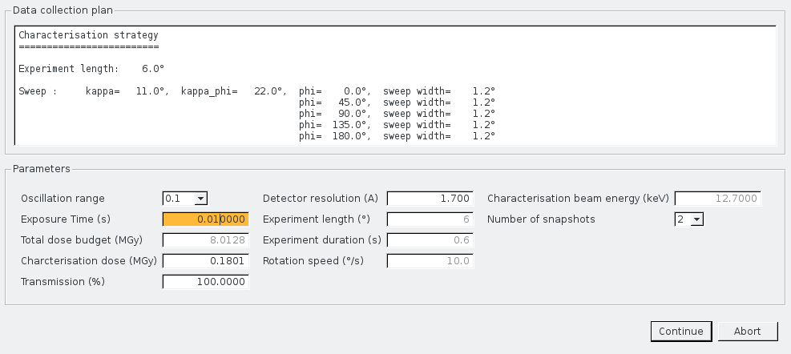
Confirm Characterisation

Slide 27
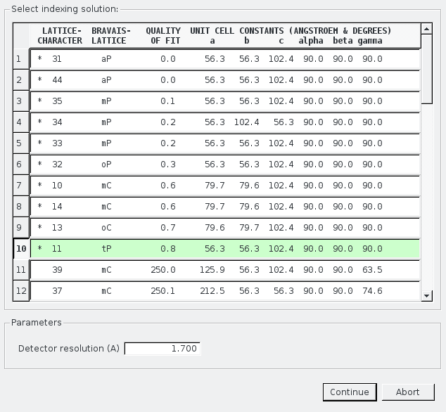
Indexing solution UI

Slide 28
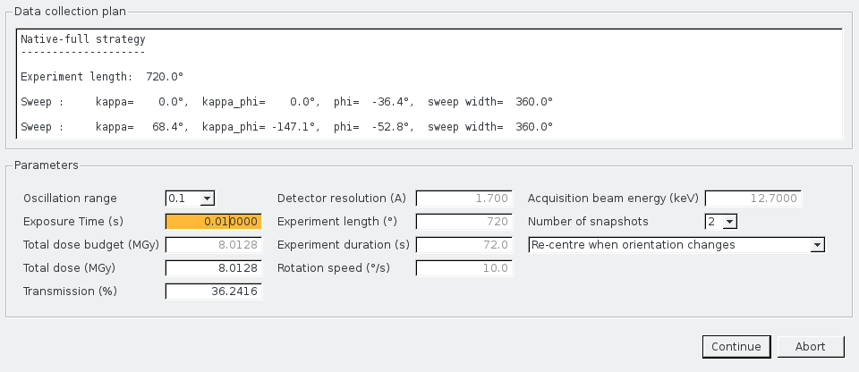
Confirm acquisition UI

