Slide 1
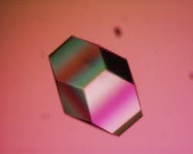
Current status of MxCuBE2 for
High-Energy Photon Source(HEPS)
Geng Zhi and Gao Zengqiang
MXCuBE/ISPyB Joint meeting, 2021

Slide 2
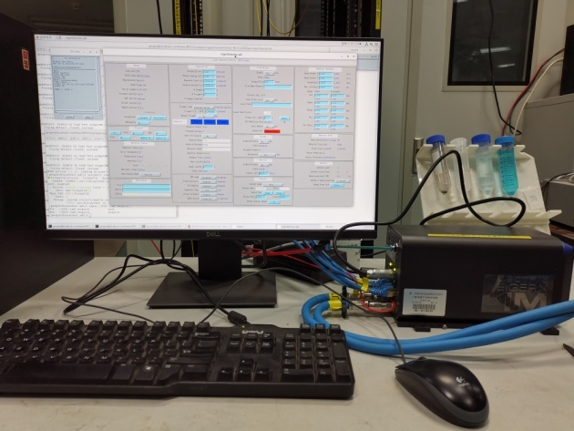
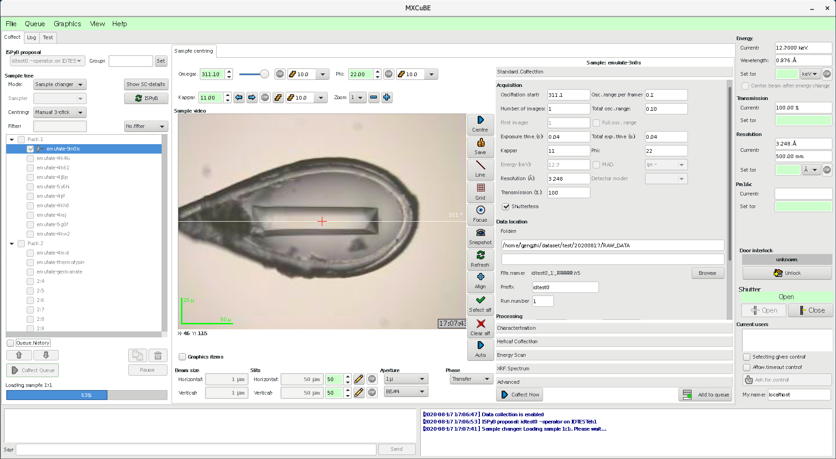
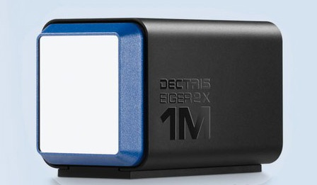
Integration of EIGER 1M into MxCuBE2
Install and debug device driver for EIGER in the framework of EPICS AreaDetector
1
2
4
3
Write Hardware Object codes for data collection
(HEPSCollect.py and HEPSEiger.py)
Configure XML files for the above two HWobjs
Startup MxCuBE and control EIGER detector
EPICS link for EIGER: https://github.com/areaDetector/ADEiger

Slide 3
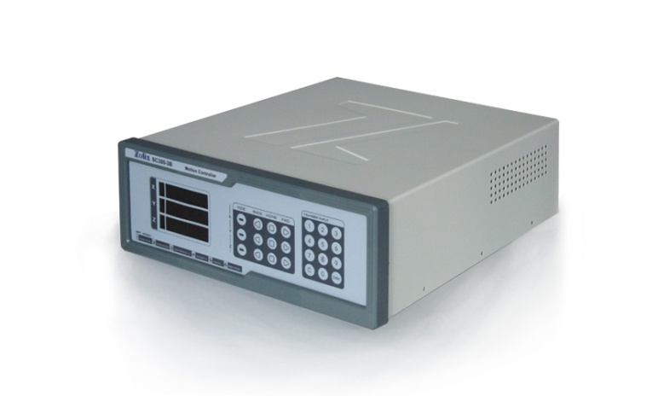
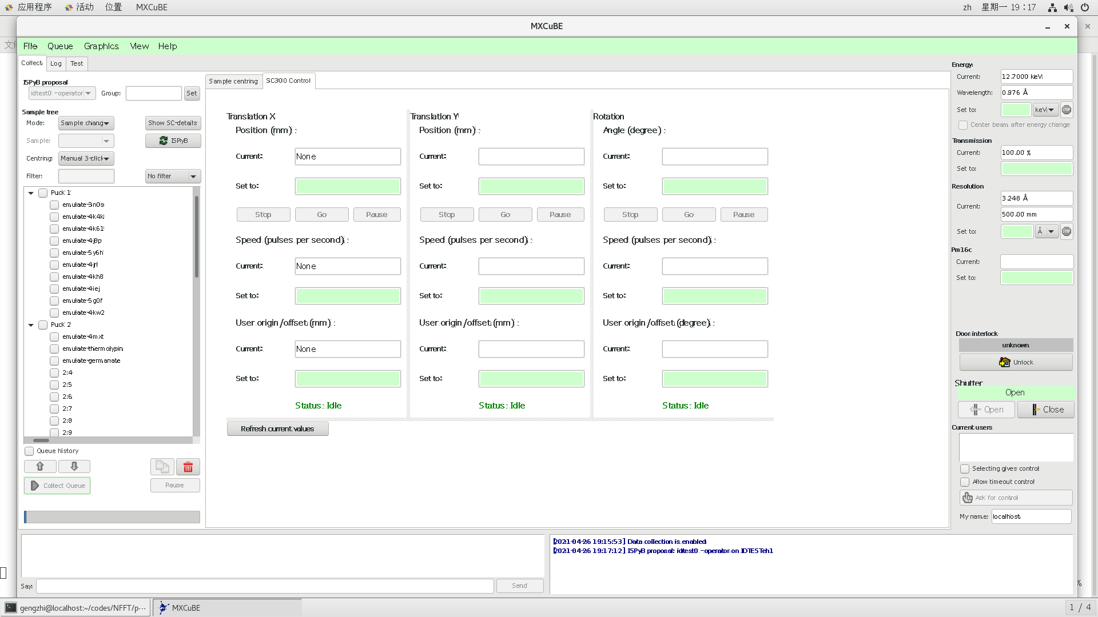
Integration of SC300 motor controller
A proof-of-concept trial: In order to align/move sample, motor controller is thus integrated
Install and debug device driver for SC300 motor controller
in the framework of EPICS Motor module
Design a new MxCuBE page
Program SC300Brick.py
Program SC300HWobj.py
Configure YML and XML
Setup and read motor position (trans or rot) in real-time
Pause, continue or stop motor movement
Setup motor acceleration or speed
Basic functions:

Slide 4
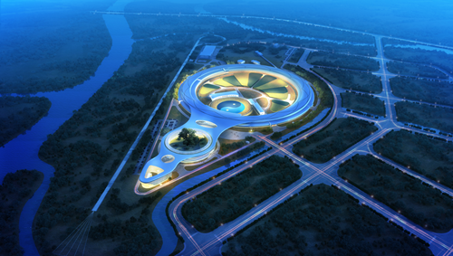
Discussions and Future plan
Test MxCuBE2 equipped with this new interface to align sample on BSRF
Make connection to our house-made AreaDetector through Socket communication
In the following years, more advanced station instrumentations will be integrated

Slide 5
Thank you for your attentions!

