Slide 1
MXCuBE Status Report
Isidro Crespo
Jordi Andreu
Roeland Boer

Slide 2
Staff changes
Changes in MX support groups
Jordi Andreu left the controls support group to work elsewhere
Currently no informatics support from ALBA, beamline team is now involved
Dani Sanchez and Dani Salvat, supporting ISpyB have also left ALBA
New head is Beatriz Lorenzo, support of ISpyB by Marc Armenter
A new section, Scientific Data Management, was formed
Headed by Nicolas Soler, beamline support from Emilio Centeno

Slide 3
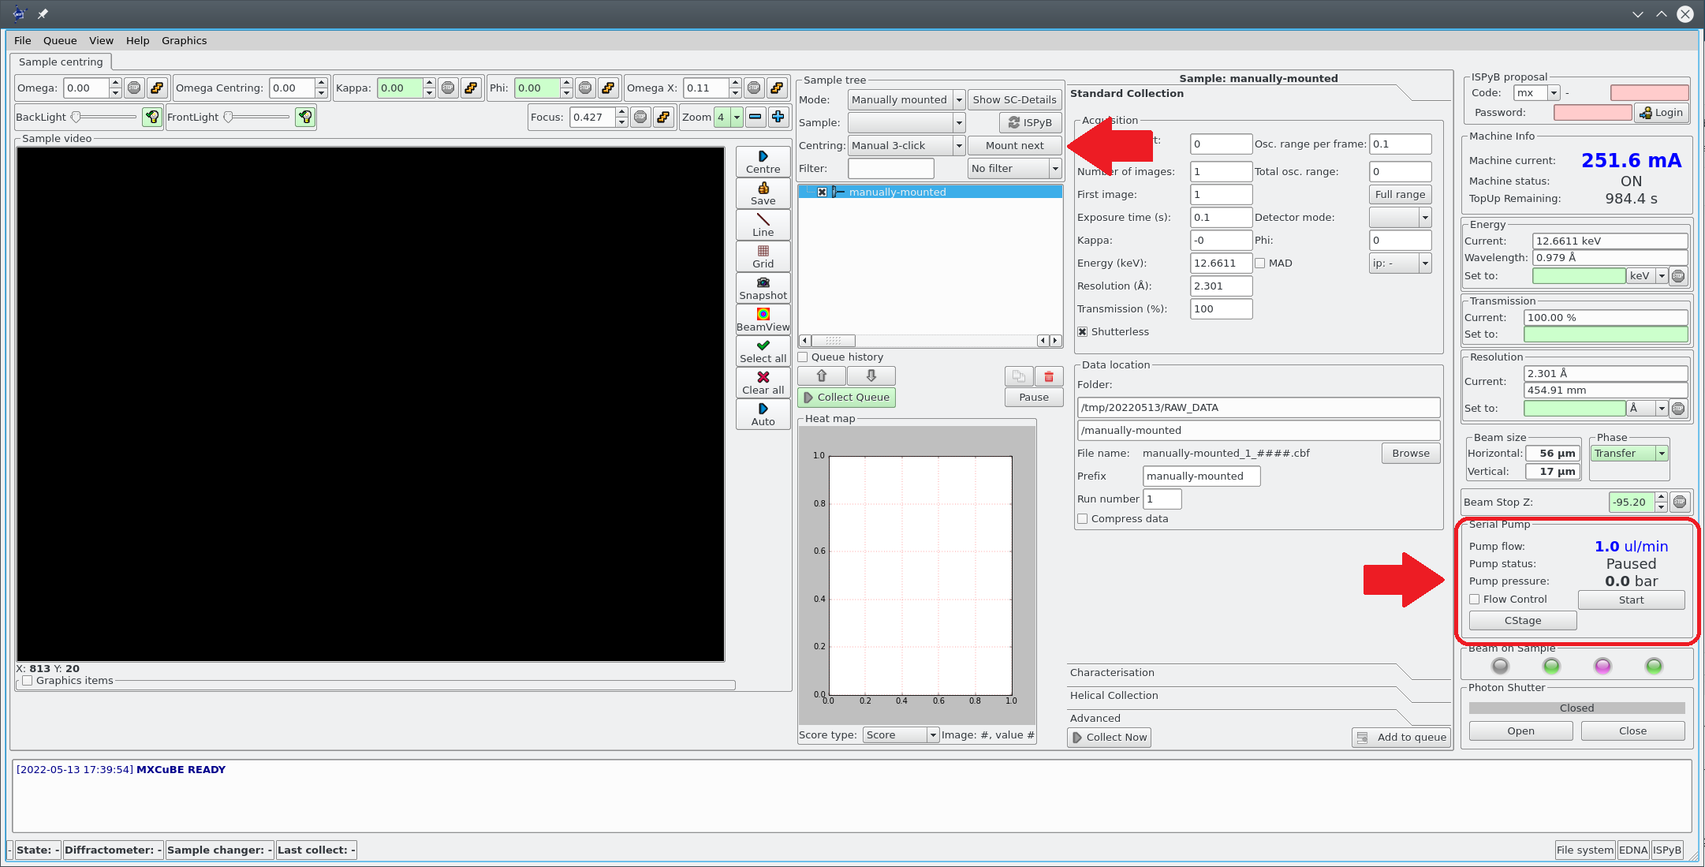
Current projects
Refactoring of MXCuBE
Currently running MXCuBE Qt4
User version expected in June, pending minor bug fixes before presentation to users
Addition of new features:
Pick function mounting using CATS double gripper
Implementation of XIA2 processing and Dimple
Pump control for jet extrusion for SSX
Small molecule processing
Change to MXCuBE3?
Beamline upgrades
New detector
Sample changer?

