Slide 1
ESRF Highlights
Nearly all beamlines running 2.1
      Five end stations, including the new ID30B MAD beamline
      Last two end stations to move in December.
New Hardware Objects
      Abstract MCA, AbstractXRFSpectrum
      RontecMCA, ESRFXRFSpectrum, ID30BXRFSpectrum
      MD2S full implementation
Workflows
      The new Beamline Expert System used on all the beamlines.
      Parameters taken from ISPyB diffraction plan ((Mxpress workflow).
ID23-2 beamline upgrade
      New diffractometer – SUNA or Vertical MD (from bottom).
Page <number>
7th MxCUBE Workshop, 30/11/2015, Barcelona Antonia BETEVA

Slide 2
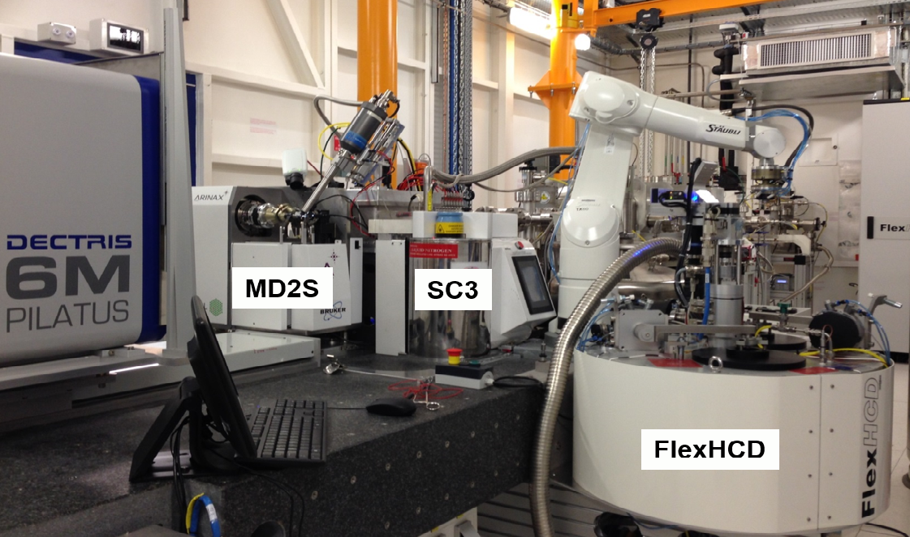
ESRF HighlightS: md2s
    New or adapted Hardware Objects – Exporter only
    Microdiff
    MD2Motor (based on AbstractMotor)
    Actuators, Beamstop, Capillary (based on MicrodiffInOut)
    SC synchronisation
    Procedures – Centrebeam, Quick Realign…(based on khoros)
Page <number>
7th MxCUBE Workshop, 30/11/2015, Barcelona Antonia BETEVA

Slide 3
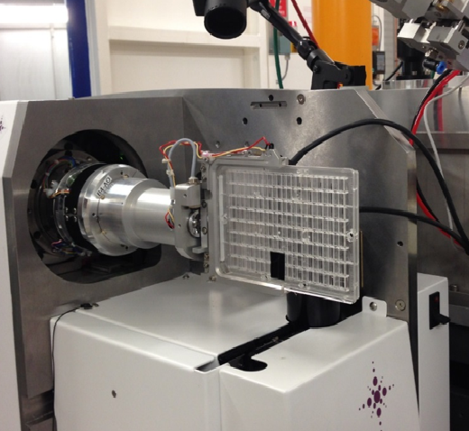
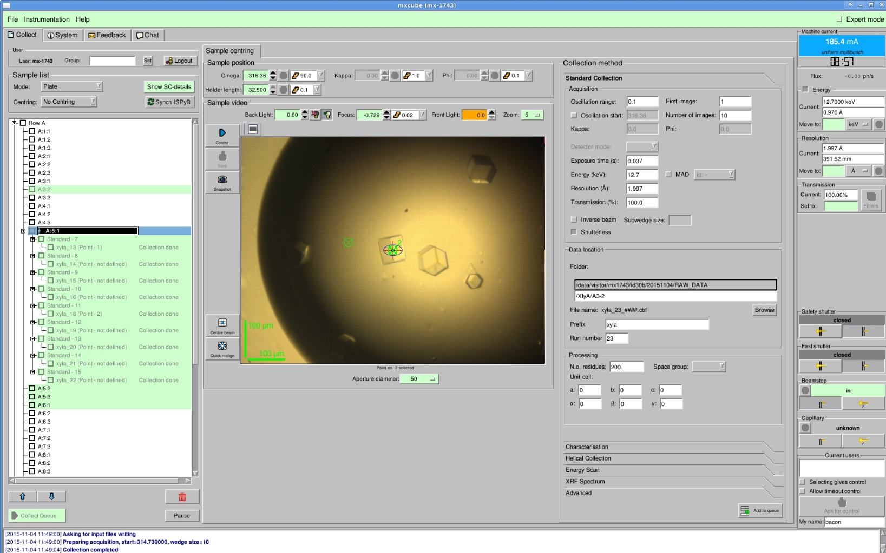
ESRF Highlights: New beamline opened – Plate gripper
      Adaptation of the EMBL Hamburg implementation
Page <number>
7th MxCUBE Workshop, 30/11/2015, Barcelona Antonia BETEVA

Slide 4
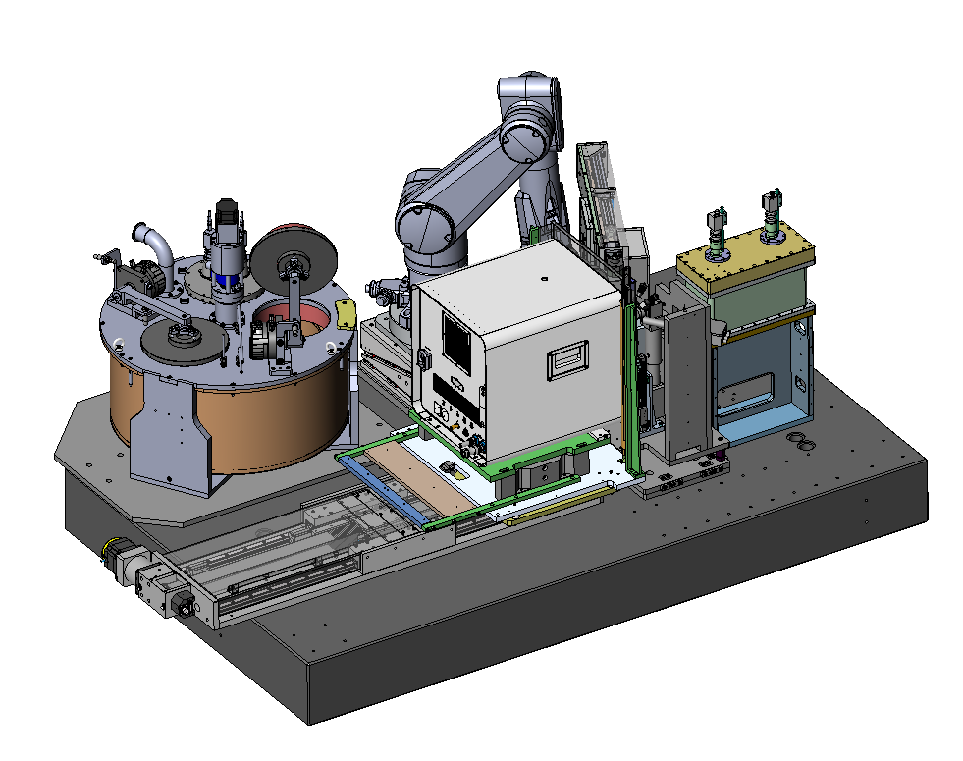
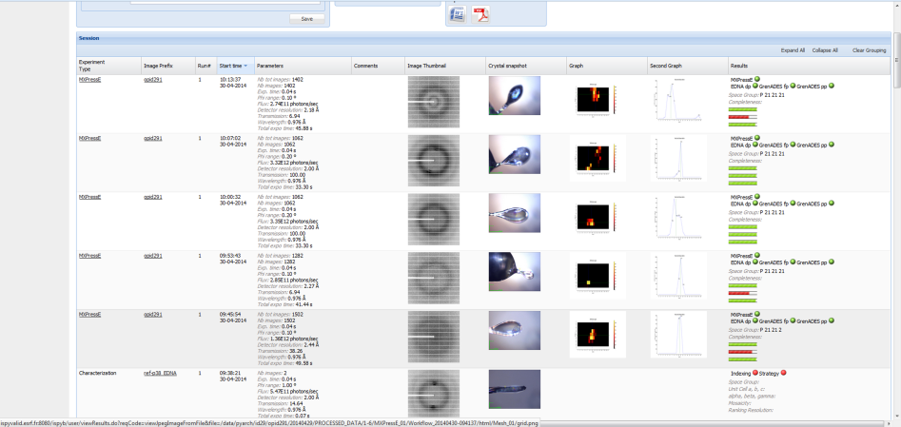
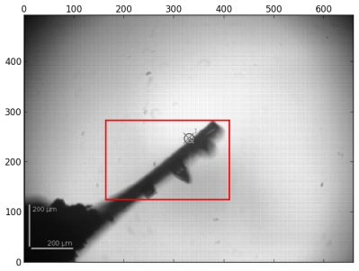
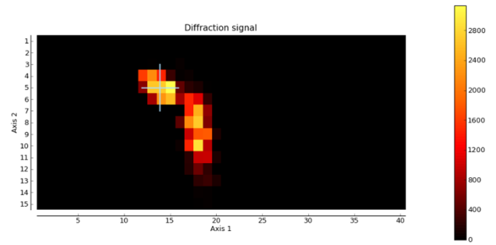
ESRF Highlights: workflows
Apertures tailor beam to 50 – 7 µm
ESRF Robodiff sample changer and high capacity dewar (240 samples)
PILATUS3 2M detector – data collection in ~30 seconds
Unique fully automatic beamline with no user presence - Workflows to fully automate sample characterisation and data collection
Flexible on-line scheduling
High intensity (3 x 10¹² ph/s), low divergent beam of 100 µm x 50 µm at Selenium edge (12.8 keV)
Optical centring and mapping area
Diffraction image analysis defines optimal volume
Results available via ISPyB database
14,110 samples processed since October 2014
480 to 150 samples processed in 24 h depending on level of characterisation required
Page <number>
7th MxCUBE Workshop, 30/11/2015, Barcelona Antonia BETEVA

Slide 5

ESRF Highlights
New logo
Page <number>
7th MxCUBE Workshop, 30/11/2015, Barcelona Antonia BETEVA

