Slide 1

HARDWARE OBJECTS
PERPETUUM MOBILE
Antonia BETEVA, ESRF

Slide 2

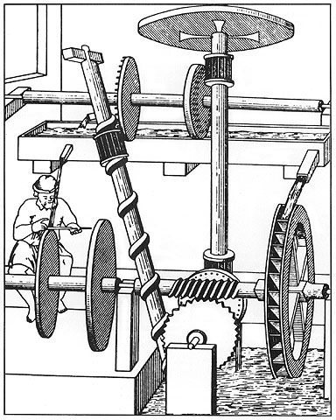
HARDWARE OBJECTS – PERPETUUM MOBILE

Slide 3

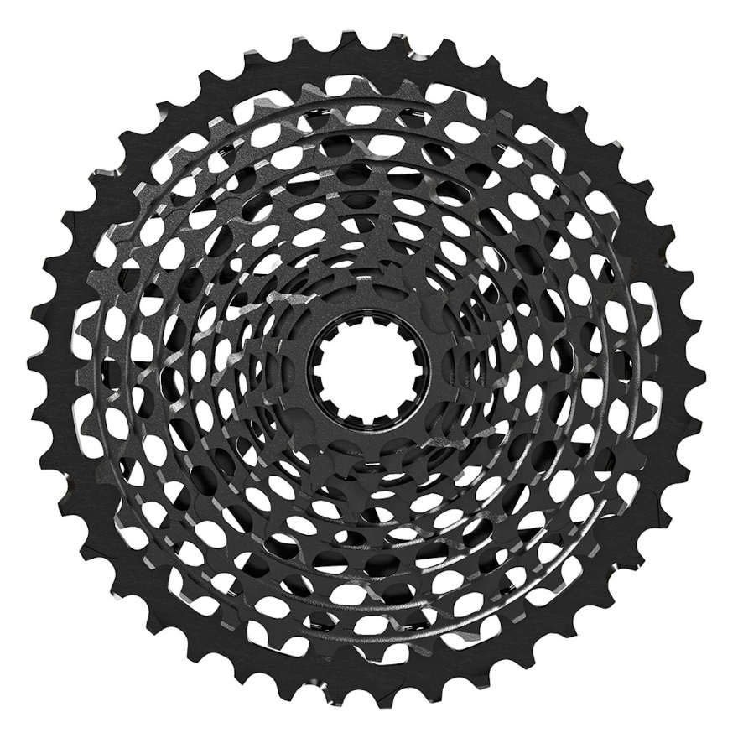

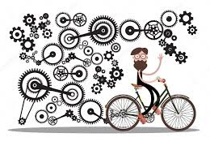
HARDWARE OBJECTS – PERPETUUM MOBILE
Using Hardware Objects

Slide 4
HARDWARE OBJECTS – PERPETUUM MOBILE
Using Hardware Objects
      Hardware Objects as abstraction of the hardware, SPEC as sequencer.
      The sequence in the Hardware Objects – shared knowledge, less portable.
      Generic/Abstract Hardware Objects – how many times refactored?
      New API – can support different sequencers
        Beamline
        Diffractometer
        Login
        LIMS
        Processing
        Sample Changer
        Sample Centring
        Workflows
      Queue – backbone of MXCuBE

Slide 5

HARDWARE OBJECTS – PERPETUUM MOBILE
Hardware Objects

