Slide 1

Johan Unge
MxCuBE Meeting
Grenoble, Sept 22 2010
MxCube @ MAX-lab

Slide 2
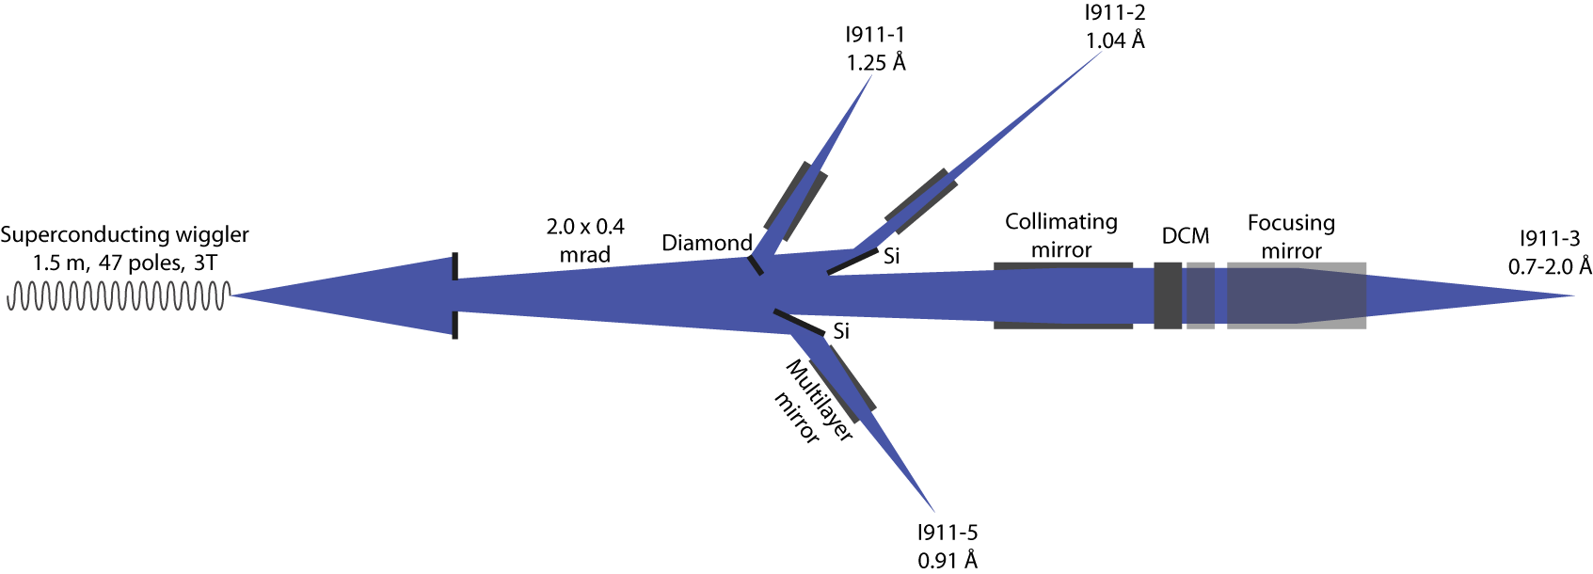
Beamline BLI911-3
Tunable wavelength, MD2, Minikappa, CATS
3 x 10¹¹ photons / s
SPEC, Tango
(MX beamlines BLI911-2, 5: MarCCD GUI)
BLI 911-3

Slide 3
Development version
RPM installation failed
  Took over an already changed version, unclear dependencies
Darren's SVN repo
  Clear structure!
Compiled Blissframework + all python libraries from source on RH5
  Hard restrictions in compatible version no.
  Fixing bug in source code

Slide 4
Local MxCuBE
Kept GUI as intact close as possible to ESRF version
Hardware Objects
Simplified or changed GUI
Added MAX-lab tab: Fluorescence tab
Some more adaptations needed: CATS, ...

Slide 5
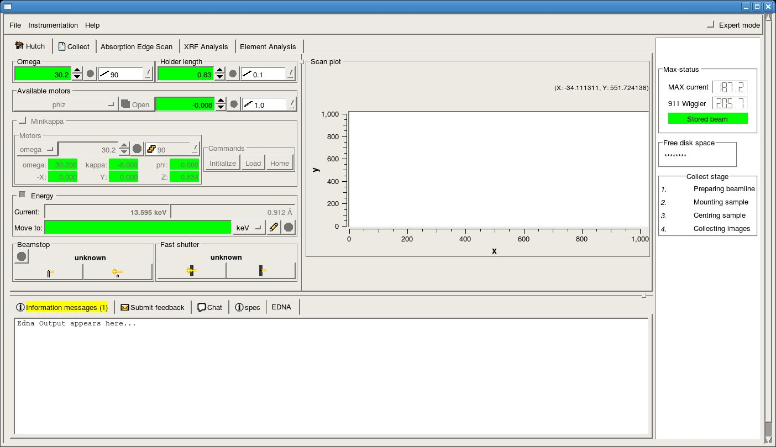
Local MxCuBE
Hutch tab

Slide 6
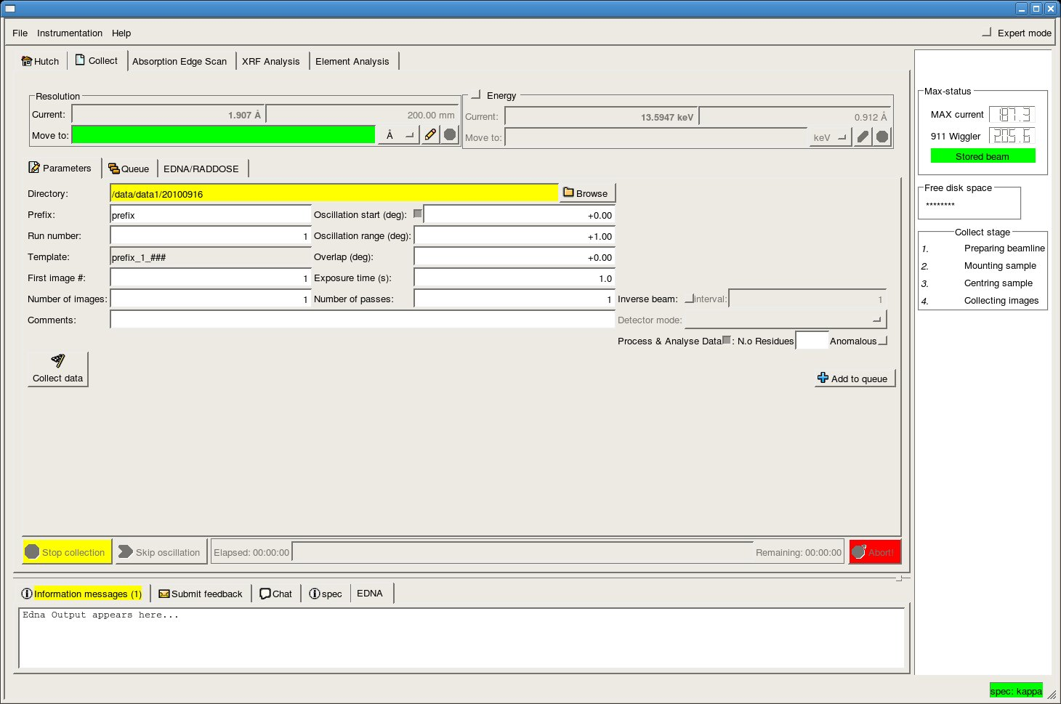
Local MxCuBE
Data collect tab

Slide 7
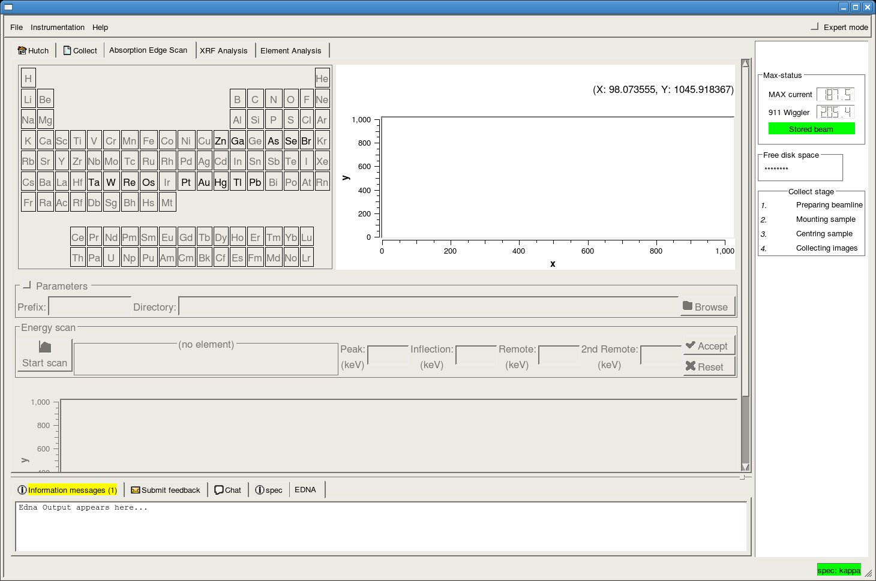
Local MxCuBE
Absorption edge scan tab

Slide 8
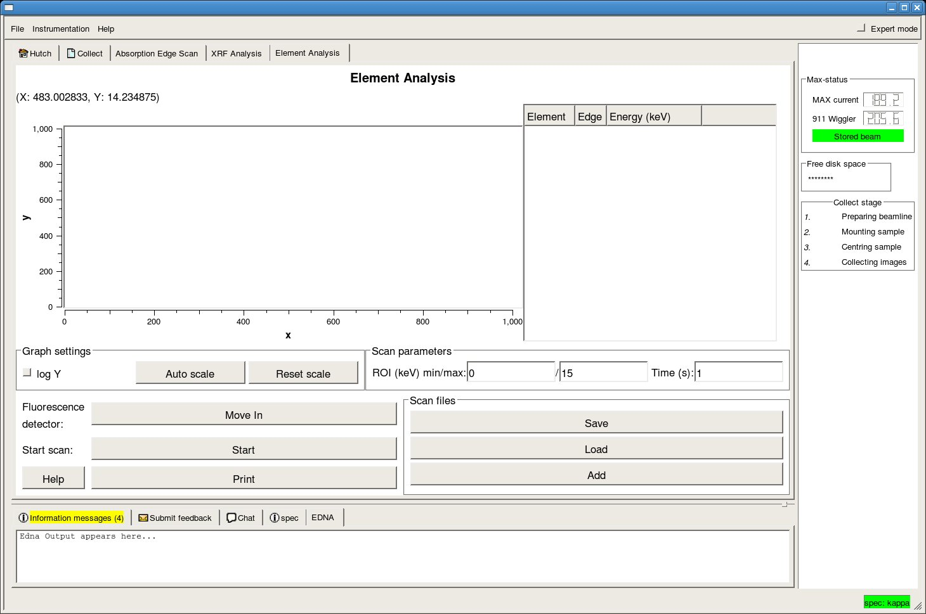
Local MxCuBE
Easier element analysis (fluorescence) tab

Slide 9
Perspectives...
CATS
Current EDNA version
ISPyB
Full Minikappa support
New developments on Kappa strategies
.....

Slide 10
Thoughts...
User are happy with the new version
MxCuBE collaboration:
Documented class style templates for developing colleagues
Documented on the fly class construction
– Thanks for quick email support!

Slide 11
Thoughts...
User are happy with the new version
Suggestion:
Documented class style templates for developing colleagues
Documented on the fly class construction
– Thanks for quick email support!

Slide 12
Thoughts...
Beamline scientists can not make a full day schedule
Time spent: 60% installation issues
38 % code reading
2 % code writing
- many layers of inheritance/interfacing
- hidden classes
- not always strict division HO and Bricks
- style differs between different HO and Bricks
- old local classes (copy and paste:ed) was over complex (bugs in new version)
- limited code documentation

Slide 13
Thoughts...
Suggestion:
Documented class style templates for developing colleagues
Documented on the fly class construction
– Thanks for quick email support!

