Slide 1
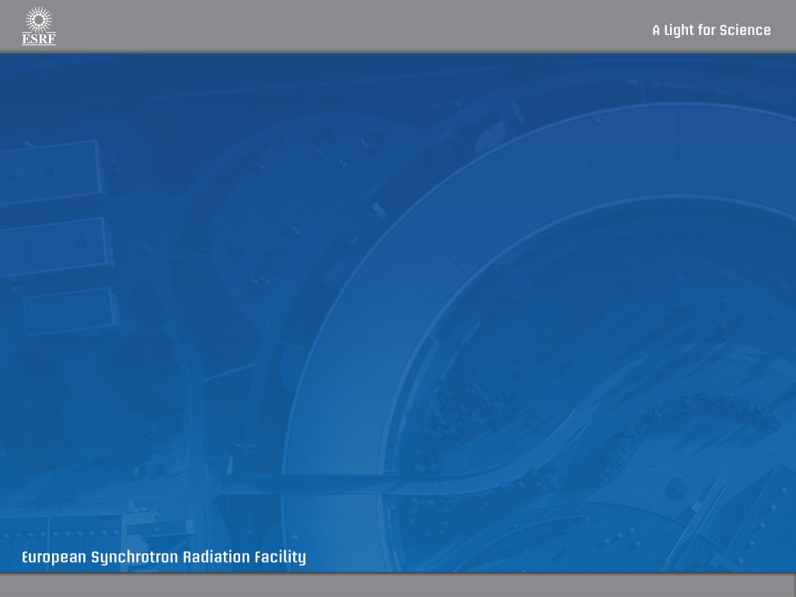

Integrating the MD2 Diffractometer Within mxCuBE
22/09/201
A.Beteva/BCU/ISDD - mxCuBE Workshop

Slide 2

Integrating the MD2 Diffractometer
Within mxCuBE
Bricks
  reuse existing
  create new
Hardware Objects
  reuse existing
  adapt existing
  create new
Other Software – SPEC macros, MD2 Device Server
22/09/2010
A.Beteva/BCU/ISDD - mxCuBE Workshop

Slide 3
Integrating the MD2 Diffractometer
Within mxCuBE
GOLDEN RULE
SEPARATE THE GRAPHICS
FROM THE HARDWARE CONTROL
22/09/2010
A.Beteva/BCU/ISDD - mxCuBE Workshop

Slide 4
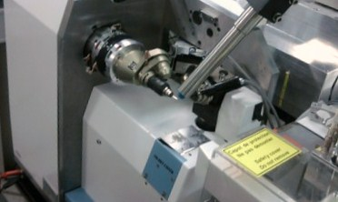
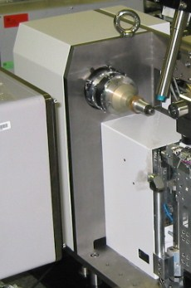
Integrating the MD2 Diffractometer
Within mxCuBE
MD2
Tango
DS
MD2
Hardware
Objects
MD2
Bricks
SPEC
MD2M
Hardware
Objects
Framework
MD2M
22/09/2010
A.Beteva/BCU/ISDD - mxCuBE Workshop

Slide 5
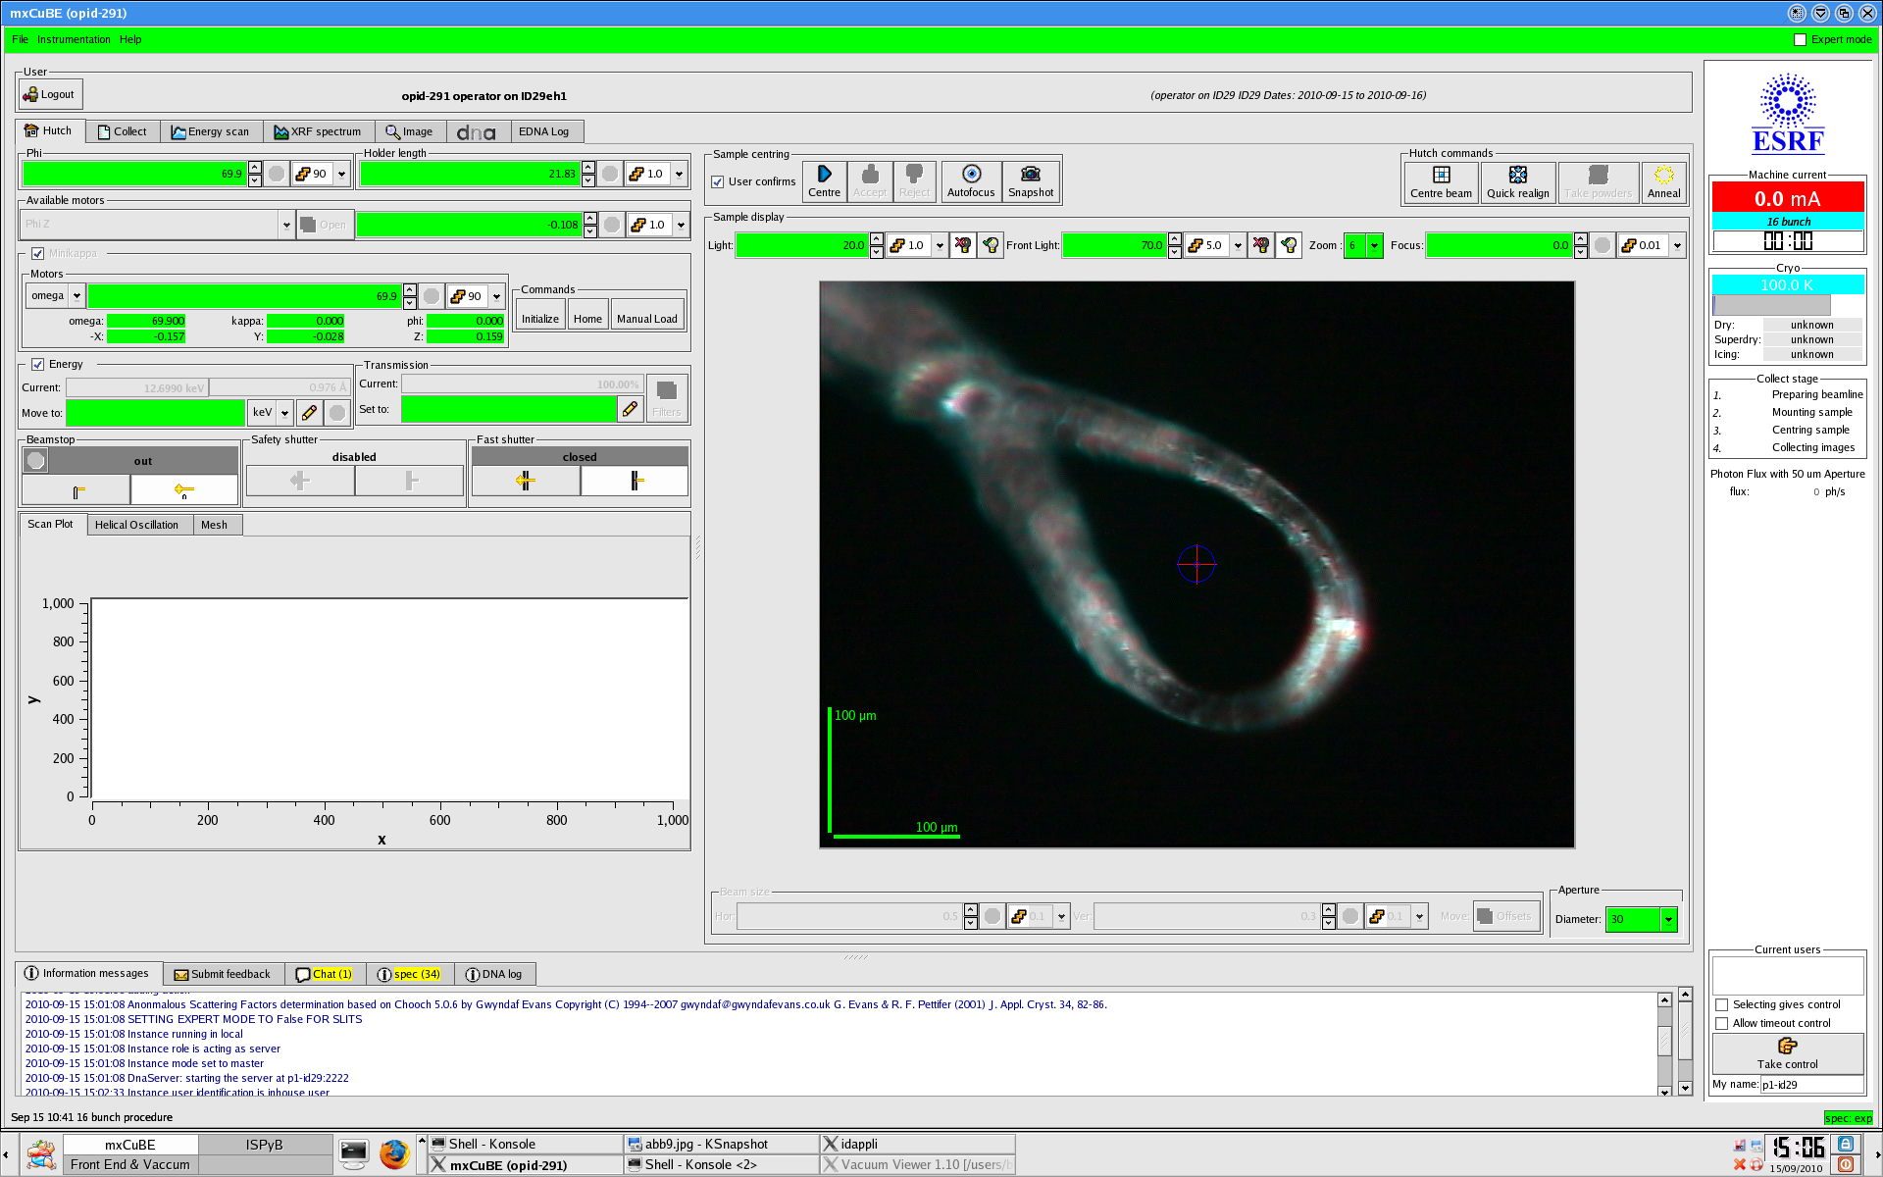
Integrating the MD2 Diffractometer
Within mxCuBE
22/09/2010
A.Beteva/BCU/ISDD - mxCuBE Workshop

Slide 6



BRICKS & HARDWARE OBJECTS
HutchMenuBrick - (MD2M & MD2)
BeamstopBrick (MD2M & MD2)
Minidiff – Microdiff SampleChanger, MultiCollect, DataCollect
MultiplePositions – MicrodiffBeamstop
22/09/2010
A.Beteva/BCU/ISDD - mxCuBE Workshop

Slide 7


BRICKS & HARDWARE OBJECTS
LightControlBrick – backlight (MD2M &MD2), front light (MD2)
MotorPredefPosBrick – zoom (MD2M & MD2)
DuoStateBrick – fast shutter (MD2M & MD2)
SpecMotor/WagoPneu – MicrodiffLight/InOut
SpecMotorWPosition – MicrodiffZoom
InOut (MD2)
22/09/2010
A.Beteva/BCU/ISDD - mxCuBE Workshop

Slide 8


BRICKS & HARDWARE OBJECTS
ApertureBrick
MotorSpinBoxBrick - motors, focus (MD2M & MD2), front light (MD2M)
Aperture
SpecMotor (MD2M) – MicrodiffMotor (MD2)
22/09/2010
A.Beteva/BCU/ISDD - mxCuBE Workshop

Slide 9
xml files - Microdiff Motor / Spec Motor
<device class="MicrodiffMotor">
<username>Omega</username>
<tangoname>id29/microdiff/1</tangoname>
<motor_name>Omega</motor_name>
<unit>1e-3</unit>
</device>
<device class = "SpecMotor">
<username>Phi</username>
<specname>phi</specname>
<specversion>lid232:eh1</specversion>
<GUIstep>90</GUIstep>
</device>
22/09/2010
A.Beteva/BCU/ISDD - mxCuBE Workshop

