Slide 1
Whole life and Universal Life Insurance

Slide 2
WHOLE LIFE INSURANCE
What is Whole Life Insurance?
A type of permanent life insurance that provides lifelong coverage
Includes a guaranteed death benefit
Builds cash value over time
Premium payments remain fixed

Slide 3
WHOLE LIFE INSURANCE
Key Features
Lifetime protection
Predictable premiums
Guaranteed cash value growth
May earn dividends (with some insurers)

Slide 4
WHOLE LIFE INSURANCE
Advantages
Stable and reliable
Forced savings component
Can borrow against cash value

Slide 5
WHOLE LIFE INSURANCE
Disadvantages
Higher premiums than term insurance
Less flexibility in payments and investments

Slide 6
UNIVERSAL LIFE INSURANCE
What is Universal Life Insurance
A type of permanent life insurance with flexible features
Combines life coverage with cash value savings
Allows policyholders to adjust premiums and death benefits

Slide 7
UNIVERSAL LIFE INSURANCE
Key Features
Flexible premium payments
Adjustable death benefit
Cash value earns interest based on market or insurer rates

Slide 8
UNIVERSAL LIFE INSURANCE
Key Features
Flexible premium payments
Adjustable death benefit
Cash value earns interest based on market or insurer rates

Slide 9
UNIVERSAL LIFE INSURANCE
Advantages
Greater flexibility
Potential for higher cash value growth
Can adapt to changing financial needs

Slide 10
UNIVERSAL LIFE INSURANCE
Disadvantages
More complex than whole life
Cash value growth is not guaranteed
Risk of policy lapsing if underfunded

Slide 11
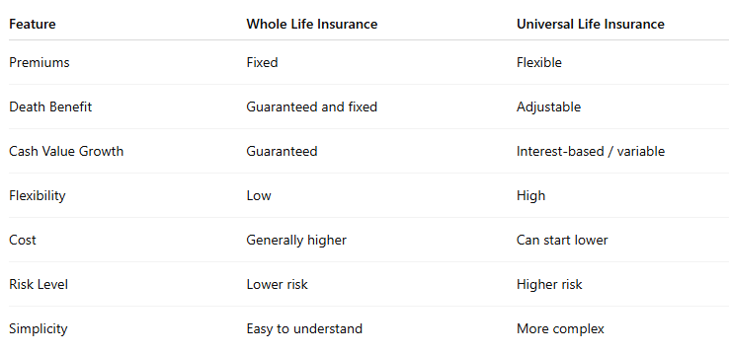
WHOLE LIFE VS UNIVERSAL LIFE

Slide 12
QUESTIONS
Mohammed Farooq
mxfarooq1@gmail.com
248-982-0293

