Slide 1
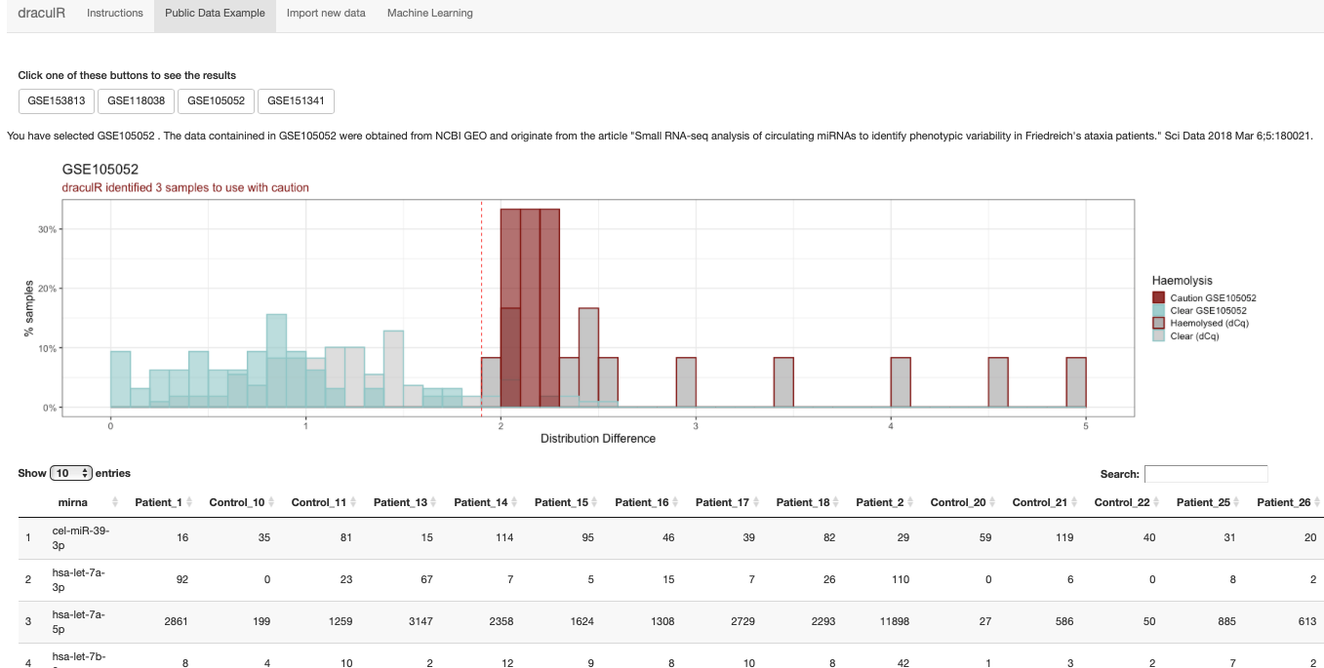
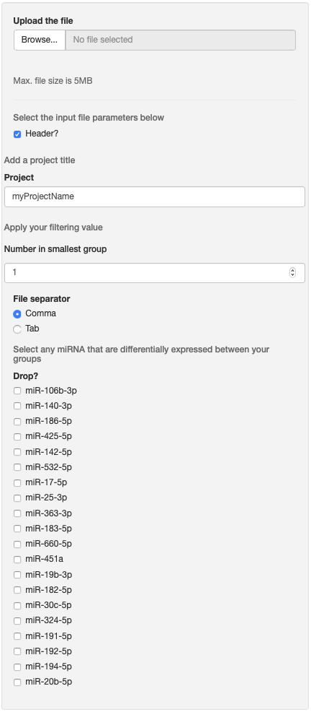
Welcome to draculR, a Shiny App designed to help you detect red blood cell content contamination in miR-Seq data from human plasma. This App uses a new method to allocate individual samples into risk groups for haemolysis.
All code used to calculate data shown here is available at the following git repository.
In case you have questions email me
Getting started
The “Public Data Example” tab allows you to click through the plot output and raw data of four datasets available on NCBI GEO that we have run through our method. Samples we consider “Clear” are seen in light blue, those we consider should be used with ”Caution” are seen in scarlet.
To import new data, move to the “Import new data” tab. From here click Browse to access the require raw counts table from your computer. Importing a new file will populate the main page with a set of tabs that allow you to navigate through the new information. Your count data needs to be either a comma or tab delimited file with samples in the columns and miRNA count observations in the rows. Please ensure your column of miRNA names is titled “mir_name” and that the miRNA names are in a `hsa-miR-123-3p` format. Samplenames need to be in a “sample_condition” format and should not include white space or special characters.
Use the Browse function to import your new count table
Give your analysis a project name for use in tables and plots
Record the number of samples in your smallest group
Select any miRNA that are differentially expressed between your groups of interest. This will remove the selected miRNA from the haemolysis calculation

Slide 2
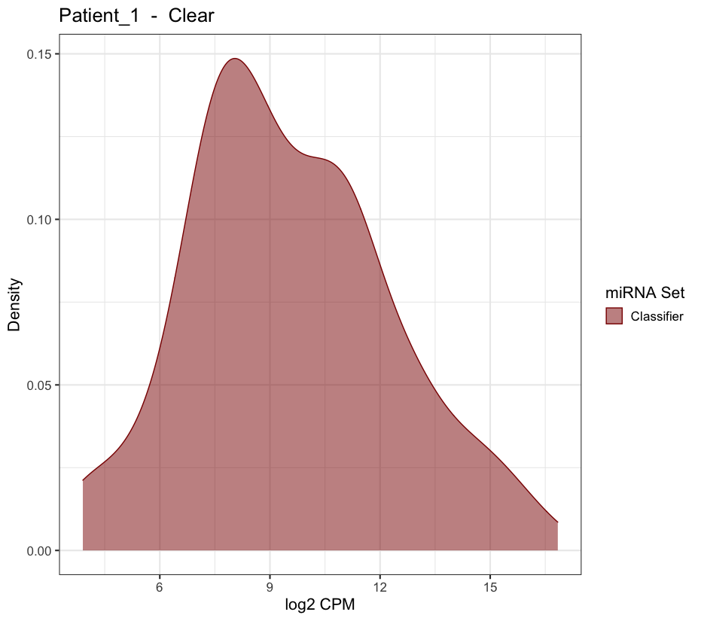
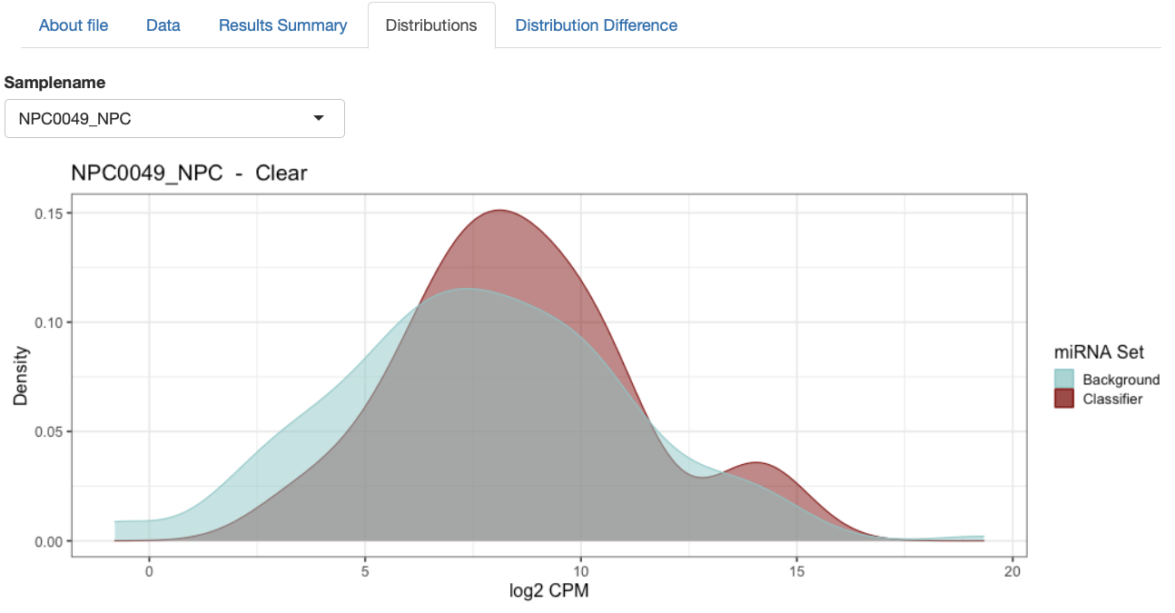
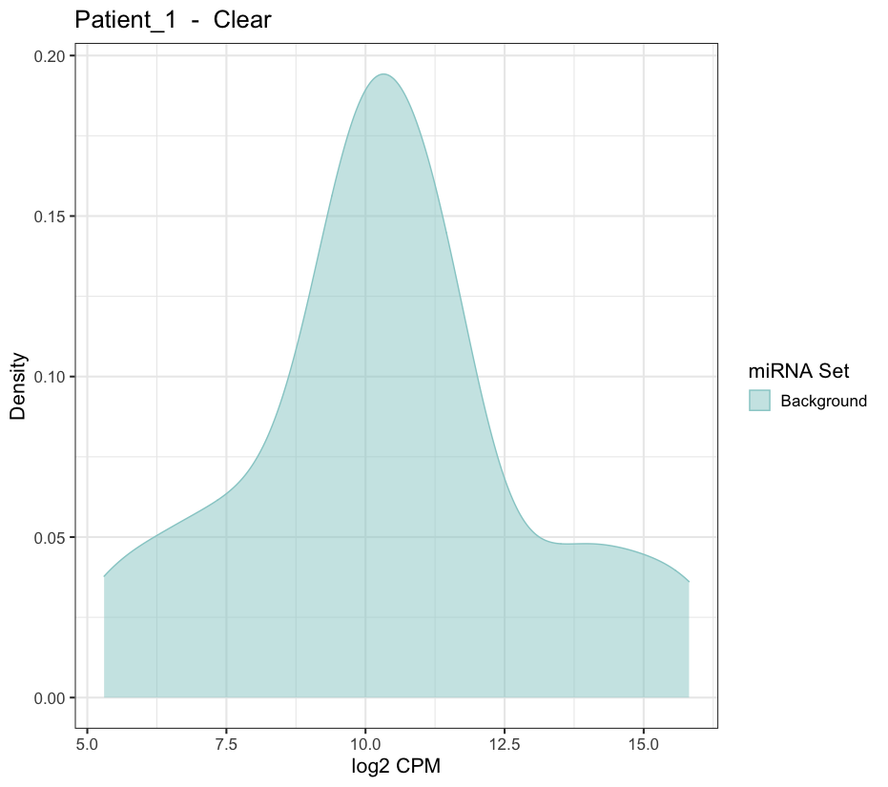
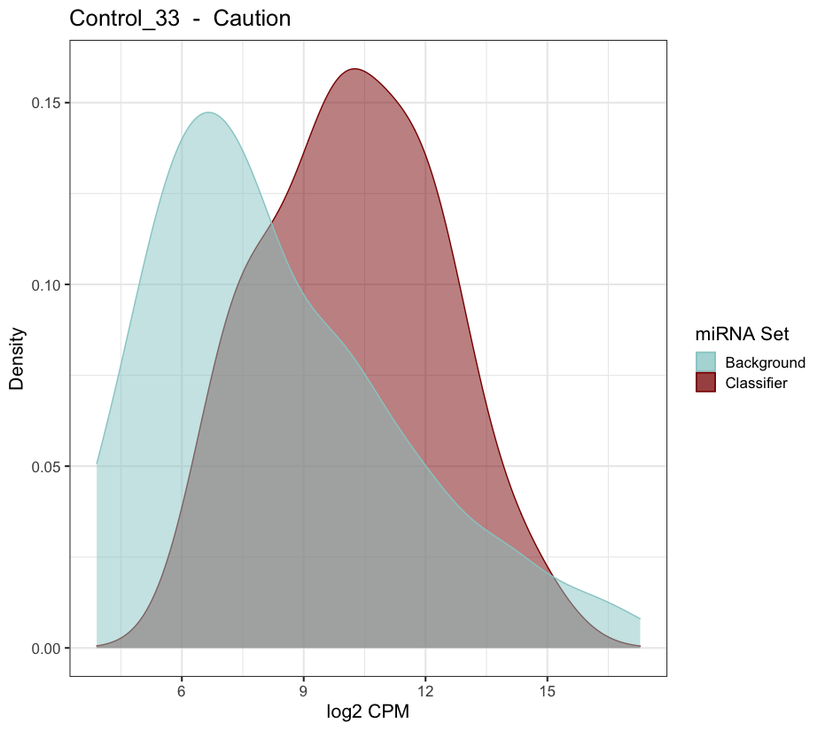
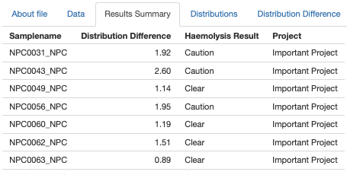
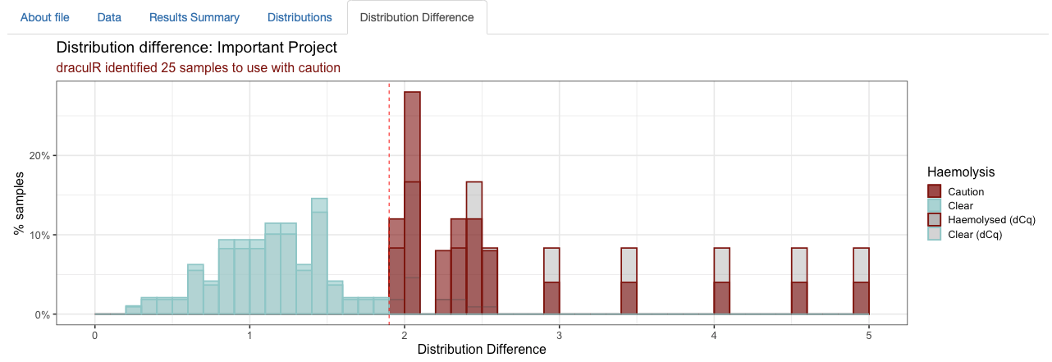
Step 1: Upload, filter and normalise
First filter
Raw counts
<5 ⟹ 0
mirna_name | S1_con | S2_con | S3_dis
hsa-miR-1-5p | 3276 | 1598 | 1752
hsa-miR-2-5p | 1728 | 2532 | 1627
hsa-miR-3-5p | 5228 | 5498 | 6732
hsa-…. | ….. | ….. | …..
Second filter
keep > 40 log₂ CPM ≤ n
Normalise
TMM
Step 2: Calculate distribution difference
Sample Specific Distributions
Signature Set
Discard
Normalised counts
mirna_name | S1_con | S2_con | S3_dis
hsa-miR-1-5p | 3276 | 1598 | 1752
hsa-miR-2-5p | 1728 | 2532 | 1627
hsa-miR-3-5p | 5228 | 5498 | 6732
hsa-…. | ….. | ….. | …..
Reduced
Signature Set
Background
Step 3: Interpret results
Individual results
Combined results
In a “Clear” sample we see a small difference compared to “Caution” where we see a larger, positive, difference between the geometric mean of the distribution between the Classifier and Background miRNA expression.
Combined results in the form of a results table and graphical representation are provided. The histogram (right most) illustrates the results from the user imported counts (coloured) and a baseline demonstrative study (grey).

