Slide 1
Rapidgzip: Parallel Decompression and Seeking in Gzip Files Using Cache Prefetching
Maximilian Knespel, Holger Brunst
Technische Universität Dresden
HPDC’ 23

Slide 2


Motivation
Accessing huge datasets, e.g., from academictorrents.com:
wikidata-20220103-all.json.gz: gzip-compressed JSON, 109 GB, 1.4 TB uncompressed
ImageNet21K: gzip-compressed TAR archive, 1.2 TB, 14 million images averaging 9 KiB.
Solutions:
: Random access TAR mount.
Make (huge) archives’ contents available via FUSE.
, indexed_bzip2: Backends for ratarmount for parallel decompression and fast seeking inside compressed gzip and bzip2 files.
They also offer command line tools for parallelized decompression.

Slide 3

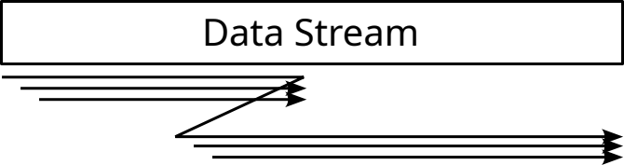

Requirements
Parallelize gzip decompression
  Without additional metadata
  After any seeking
  For concurrent accesses at two offsets
Decompress all kinds of gzip files
Enable fast backward and forward seeking
  After the index has been created
  While the index has only been partially created
Usable as a (Python-)library

Slide 4
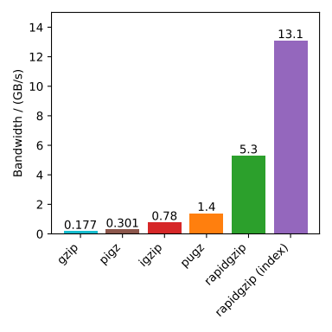
Introducing rapidgzip
: Random access parallel (indexed) decompression for gzip files
Parallel decompression of gzip files
Decompression is faster and less memory intensive with an existing index
The index enables seeking without having to start decompression from the file beginning
Header-only C++ library with Python bindings:
> pip install rapidgzip
Also a has a command line interface that can be used as a drop-in replacement for decompression:
gzip -d → rapidgzip -d
Not for compression
https://github.com/mxmlnkn/rapidgzip
74×
30×
Decompression benchmarks on a 12 GB FASTQ file using 64 cores of an AMD EPYC 7702 @ 2.0 GHz processor.

Slide 5



Tools Overview
1992: gzip by Jean-loup Gailly and Mark Adler
2005: zlib/examples/zran.c example by Mark Adler
  Shows how to resume decompression in the middle of a gzip stream
2007: pigz (parallel implementation of gzip) by Mark Adler
  Compresses in parallel
2008: Blocked GNU Zip Format (BGZF) and the command line tool bgzip, part of HTSlib
  Compresses in parallel to gzip files with additional metadata
  Can decompress files containing such metadata in parallel
  James K. Bonfield and others, "HTSlib: C library for reading/writing high-throughput sequencing data", GigaScience, Volume 10, Issue 2, February 2021
2016: indexed_gzip: Python module for random access based on zran.c
2019: pugz
  Can decompress gzip-compressed files in parallel if it only contains characters 9–126
  Kerbiriou, Maël, and Rayan Chikhi. "Parallel decompression of gzip-compressed files and random access to DNA sequences." 2019 IEEE International Parallel and Distributed Processing Symposium Workshops (IPDPSW). IEEE, 2019.
→ What makes parallel decompression so difficult?

Slide 6
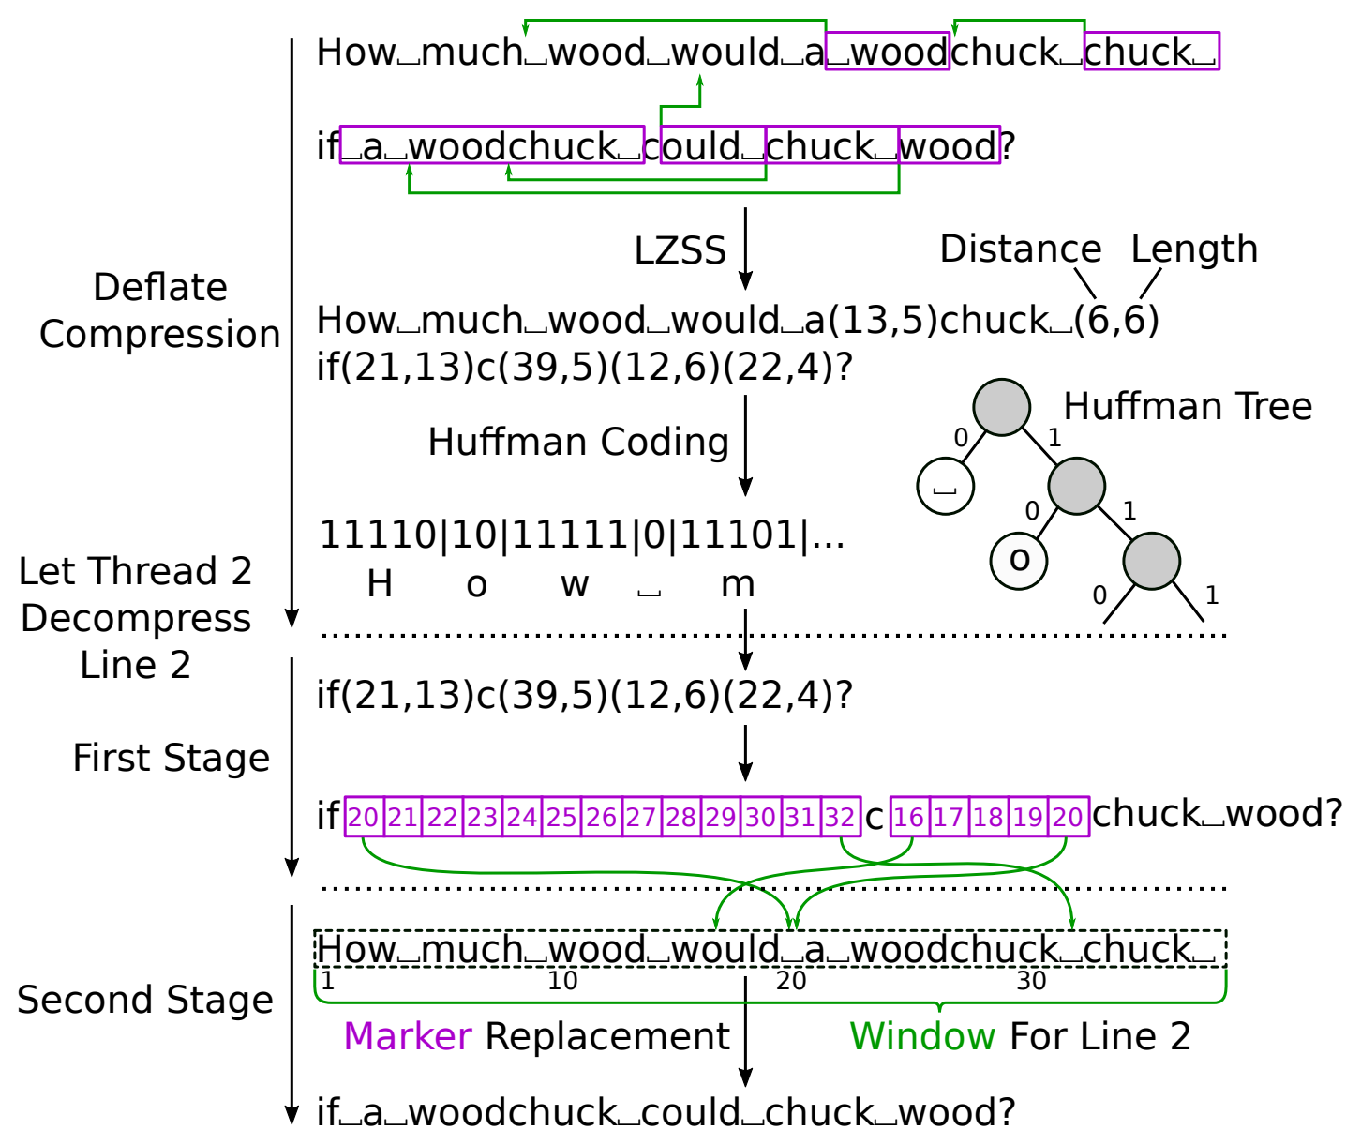
Deflate Compression
Challenges for Parallel Decompression:
Find deflate block start offsets in bit stream
Handling references to unknown data
→ Two-Staged Decompression as introduced by Kerbiriou and Chikhi (2019)
Non-resolvable references result in markers that get resolved in the second stage after the 32 KiB window has become known

Slide 7
Parallelized Deflate Decompression
Challenges for Parallel Decompression:
Find offsets in bit stream to start decompression from
Handling references to unknown data
→ Two-Staged Decompression as introduced by Kerbiriou and Chikhi (2019)
Non-resolvable references result in markers that get resolved in the second stage after the 32 KiB window has become known

Slide 8
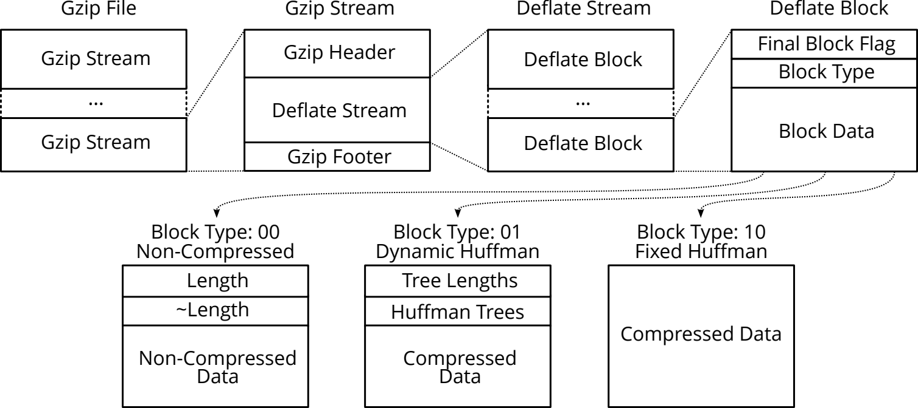
Granularities for Parallelization
Parallelize decompression of Deflate blocks
Often, there is only one Gzip stream per file.

Slide 9

Redundancies that Help in Finding Deflate Blocks
Fixed Huffman Blocks are mostly used for very small files and the tail end of streams.

Slide 10
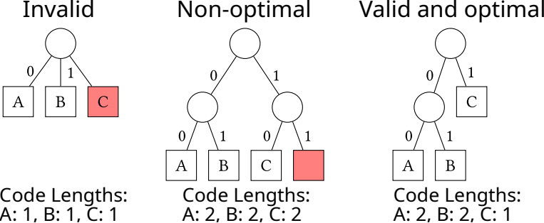
How Often Will Valid-Looking Block Headers be Found in Random Data?
Deflate Blocks with Fixed Huffman codings: Ignore because they are rare
Non-Compressed Deflate blocks: Look for 16-bit lengths and their one’s complement
→ 1 false positive per 525 kB
Deflate Blocks with Dynamic Huffman codings:
Look for valid Deflate block headers and valid and optimal Huffman codings.
~200 offsets pass this test given 1 Tbits of random data → 1 false positive per 625 MB
Pugz reduces false positives further by checking that the decompressed data only contains characters in the range 9-126, an assumption made for FASTQ files

Slide 11
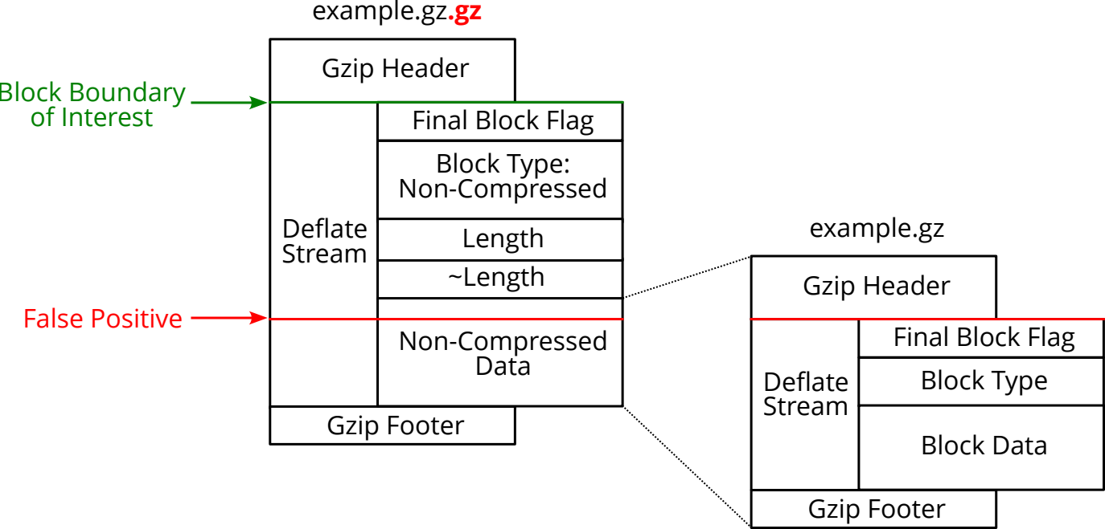
False Positives Can Be Crafted Using Non-Compressed Blocks
Example: Consider a gzip file that is compressed a second time.
Sequences inside the compressed Block Data might be recognized as Deflate block headers
→ These cases need to be detected and handled

Slide 12
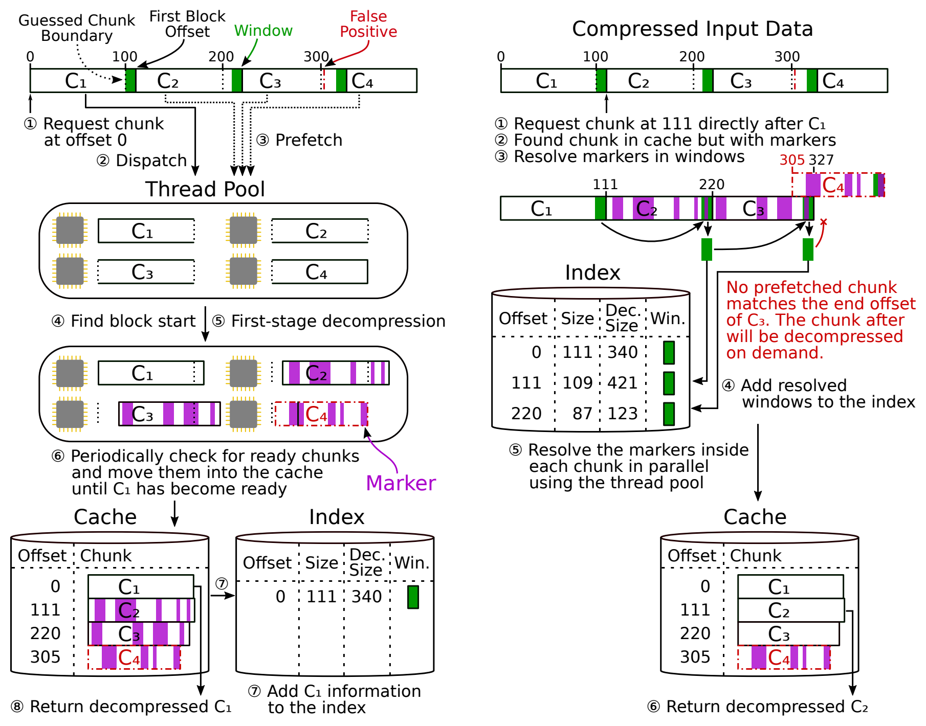
Implementation
Prefetching to generate work that can be processed in parallel
Thread pool for work balancing
Cache to speed up seeking and concurrent decompression
Use block offset as cache key to catch false positives
On-demand cache fill to recover from errors

Slide 13

Implementation
Prefetching to generate work that can be processed in parallel
Thread pool for work balancing
Cache to speed up seeking and concurrent decompression
Use block offset as cache key to catch false positives
On-demand cache fill to recover from errors

Slide 14
Implementation
Prefetching to generate work that can be processed in parallel
Thread pool for work balancing
Cache to speed up seeking and concurrent decompression
Use block offset as cache key to catch false positives
On-demand cache fill to recover from errors

Slide 15
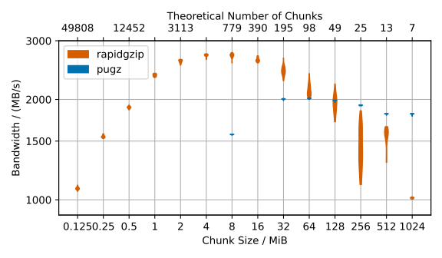
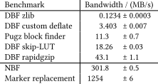
Optimal Chunk Size
For smaller chunk sizes, the block finder overhead leads to worse performance
Larger chunk sizes lead to work balancing issues and also might adversely affect the cache behavior and allocation speed
Optimal chunk sizes: Rapidgzip: 4-8 MiB, Pugz: 32-64 MiB
3.8×
Decompression bandwidth using 16 cores and a 6.08 GiB test file, which decompresses to 8 GiB.
DBF ... Dynamic Block Finder
NBF ... Non-Compressed Block Finder

Slide 16
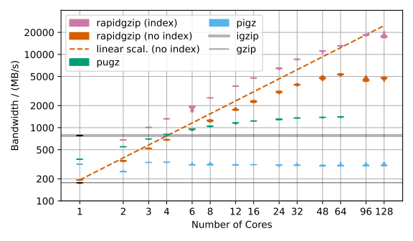
Decompression Benchmark: FASTQ File
Weak-scaling and writing the results to /dev/null
gzip is the slowest, half as slow as zlib-based pigz
rapidgzip with an index scales up to 20 GB/s, without an index up to 5 GB/s
pugz tops out at 1.4 GB/s and crashes for 96+ cores
igzip by Intel shows leading single-core performance
pigz does not parallelize

Slide 17
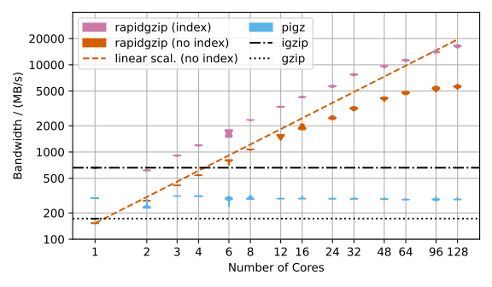
Decompression Benchmark: Silesia File
pugz is limited to files containing only “printable” ASCII characters. It does not work for Silesia.

Slide 18
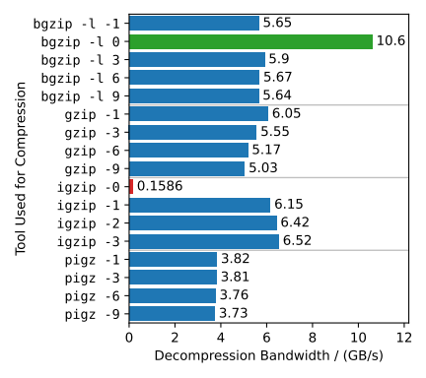
Benchmark: Various Gzip Compressors → Rapidgzip Decompression
rapidgzip can parallelize decompression for gzip files produced with a wide variety of tools and compression levels
Contains only Non-Compressed Deflate blocks so that decompression is reduced to a fast copy and some accounting
Contains only a single Deflate block with Fixed Huffman coding and therefore cannot be parallelized

Slide 19
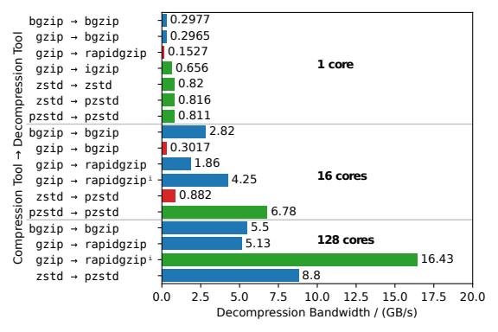
Benchmark: Competing File Formats
igzip is surprisingly competitive to zstd
zstd is the fastest in single-core decompression
bgzip and pzstd can only decompress gzip/zstd files produced by themselves in parallel
zstd-compressed (TAR) files are not eligible for random access and parallel decompression. pzstd is recommended instead to create multi-frame Zstandard files.
Applying the rapidgzip approach to arbitrary Zstandard files might be infeasible because their window size is not limited to 32 KiB.
+25%
3×
ⁱ rapidgzip decompression with an existing index

Slide 20
Limitations
Has some edge cases that are not (yet) parallelized:
  Files with only a single Deflate block
  Files only containing Deflate blocks with Fixed Huffman coding
  → might be possible to look for these blocks
  Files that consist of multiple gzip streams, each containing only one Deflate block
  → add another block finder that looks for gzip headers or do not check the final block flag
The Inflate algorithm was implemented from scratch and is much slower than igzip
High memory usage

Slide 21
Improvements Since Submission
High memory usage has been alleviated by limiting the decompressed chunk size
Worst case (compression ratio ~1000)
was: ~ 9 GB per thread
now: ~ 200 MB per thread (configurable)
The Inflate implementation has been improved for high compression ratios
→ 25 % faster for Silesia by using memcpy/memset for long references
CRC32 computation has been added
→ The slice-by-16 algorithm has been implemented and parallelized using crc32_combine.
Achieves ~ 4 GB/s per core (~ 6 % overhead independent of parallelism)

Slide 22
Summary
We have shown that the specialized approach for parallelized gzip decompression introduced by Kerbiriou and Chikhi (2019) can be generalized without affecting performance and stability.
Our architecture achieves better performance, scales to more cores, adds robustness against false positives, and also increases versatility by adding fast seeking capabilities.
An index is created internally on first time decompression and it can be exported and imported to speed up subsequent decompression and seeking.
Can be used with ratarmount to mount .tar.gz archives.
Available at https://github.com/mxmlnkn/rapidgzip
74×
30×
Decompression benchmarks on a 12 GB FASTQ file using 64 cores of an AMD EPYC 7702 @ 2.0 GHz processor.

