Slide 1
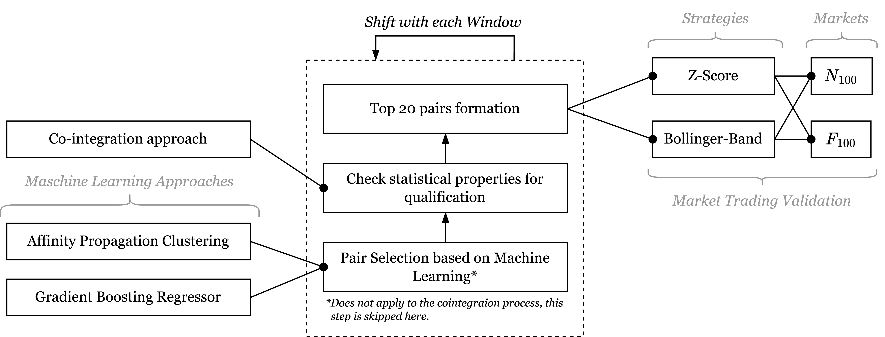
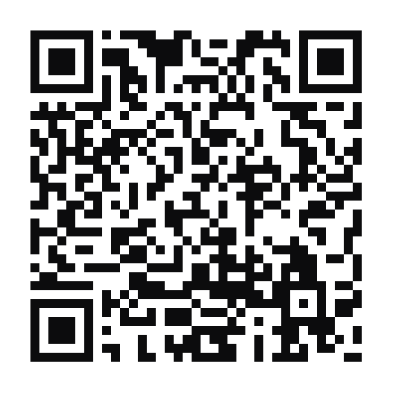
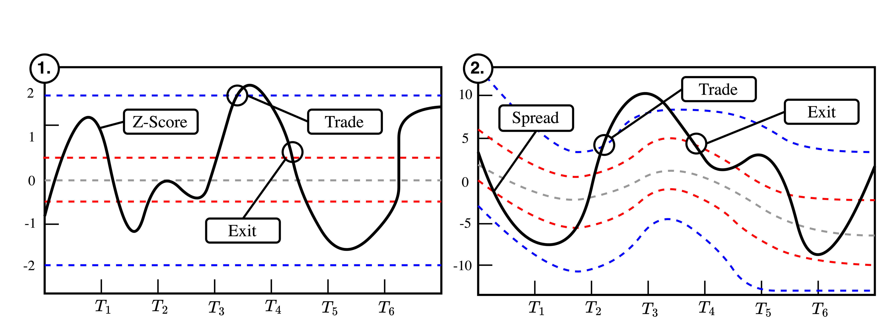





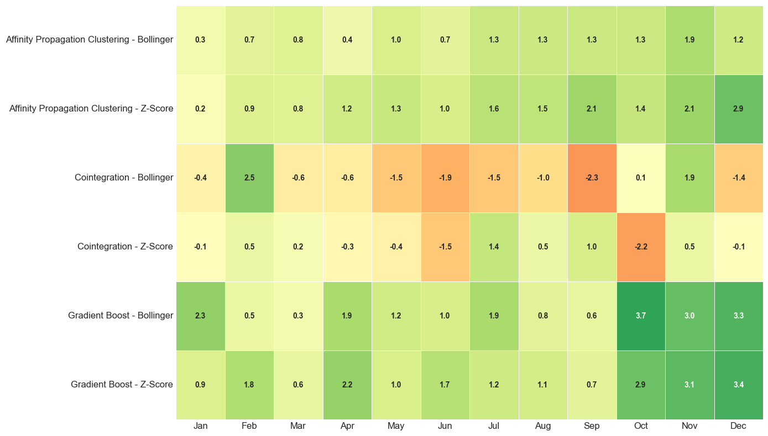
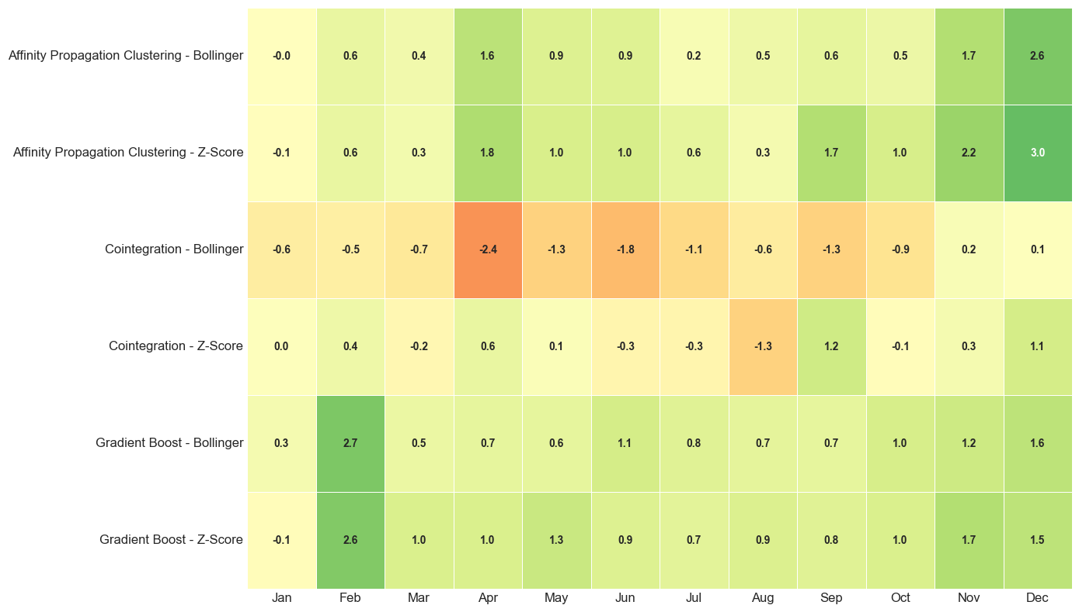
Exploring Machine Learning Optimizatios for Pair Selection in Pairs Trading
Müller, Maximilian TIN22
Approach
Details & Backtester
tinyurl.com/ pairtrade
Strategies
Three pair identification methods (traditional cointegration, Affinity Propagation Clustering, and Gradient Boost Regressor) are compared using Engle-Granger validation and top 20 pair selection. A 12-month sliding window approach tests all methods with Z-Score and Bollinger Bands strategies on NASDAQ-100 and FTSE-100 markets.
Affinity Propagation Clustering:
Gradient Boost Regressor:
The method automatically determines optimal cluster numbers by grouping stocks with similar return and volatility profiles. The economic assumption is that stocks with comparable risk-return characteristics respond similarly to market conditions, creating more stable statistical relationships. Clustering reduces the search space from thousands to a few hundred pair combinations within clusters, with final pair selection based on proximity to cluster centers and profile similarity.
The model combines multiple weak decision trees to predict average spread deviations between stock pairs, essentially forecasting which pairs will have minimal future spread volatility. Instead of trading all cointegrated pairs and waiting for convergence, the model selects only pairs with predicted spread stability. It uses a comprehensive feature set including correlation measures, technical indicators like Williams Oscillators and Bollinger Bands, volume characteristics, and momentum indicators to make these predictions.
Z-Score: Enters at fixed ±2.0 thresholds, exits when spread returns to zero.
Kooperative Partner
Bollinger Bands: Uses adaptive volatility bands with dynamic hedge ratios for entry/exit signals
Results
(NASDAQ100 left, FTSE100 right)
Ansatz | Strategy | Return (%) | Max Drawdown (%)
Affinity Propagation | Z-Score | 14.30 | -0.09
Gradient Boost | Z-Score | 13.75 | -0.09
Gradient Boost | Bollinger | 12.11 | -0.09
Affinity Propagation | Bollinger | 11.18 | -0.07
Kointegration | Z-Score | 0.81 | -0.88
Kointegration | Bollinger | -12.57 | -13.09
Ansatz | Strategy | Return (%) | Max Drawdown (%)
Gradient Boost | Z-Score | 20.90 | -0.11
Gradient Boost | Bollinger | 20.47 | -0.18
Affinity Propagation | Z-Score | 17.98 | -0.09
Affinity Propagation | Bollinger | 13.53 | -0.05
Kointegration | Z-Score | -1.13 | -3.87
Kointegration | Bollinger | -11.21 | -11.99
Musterstraße 1, 89518 Heidenheim
+49 7321 2722-xx, email@dhbw-heidenheim.de
Platz für eine weitere Zeile

