Slide 1

Project Title: Seasonal Agriculture Performance Analysis
Student Name: Manish Kumar Mondal
College Name: Adamas University
AICTE STU ID : STU6a64896a3ff3a1784973674

Slide 2

PROBLEM STATEMENT
Agricultural activities are influenced by seasonal variations in environmental conditions, farming practices, resource availability and market conditions. As a result, agricultural performance may differ from one season to another. However, raw agricultural data does not clearly explain how agricultural performance changes across seasons or what patterns can be observed in different seasonal conditions. The problem is to analyze the given agricultural dataset and investigate seasonal differences in agricultural performance by identifying meaningful patterns, trends, relationships and variations within the available data.

Slide 3
Project Description:
Seasonal Agriculture Performance Analysis is a data analytics project focused on understanding how agricultural performance changes across different seasons. The project uses a dataset containing 4,000 farm-level records and 28 variables, covering information such as crops, locations, weather conditions, soil characteristics, irrigation methods, agricultural inputs, yield, production, water usage and economic outcomes.
The analysis explores seasonal patterns, trends, relationships and variations in agricultural performance. It compares yield, production, profit, resource usage and environmental conditions across seasons, crops, states and irrigation methods. Statistical and visualization techniques are used to identify significant differences, relationships and unusual observations.
The project ultimately aims to generate evidence-based insights and practical recommendations that can help in understanding seasonal agricultural performance and support better agricultural planning and resource management.

Slide 4

WHO ARE THE END USERS?
The main end users of the Seasonal Agriculture Performance Analysis project are:
  👨‍🌾 Farmers – to understand which seasons, crops and farming practices can lead to better yield and resource efficiency.
  🏛️ Agricultural Departments & Government Authorities – to support agricultural planning, seasonal policies and resource management.
  👨‍🔬 Agricultural Researchers – to study relationships between environmental conditions, farming practices and crop performance.
  🌾 Agricultural Consultants – to provide data-driven advice on crop selection, irrigation, fertilizer usage and seasonal planning.
  🏢 Agribusinesses & Agricultural Organizations – to understand production and economic trends across regions and seasons.
  💧 Resource Management Authorities – to analyze water usage and improve agricultural resource efficiency.

Slide 5

Technology Used
The following technologies and tools are used in the Seasonal Agriculture Performance Analysis project:
🐍 Python – Main programming language used for data analysis.
📊 Pandas – Used for data cleaning, manipulation and analysis.
🔢 NumPy – Used for numerical operations and calculations.
📈 Matplotlib – Used to create graphs and visualizations.
🧮 SciPy – Used for statistical analysis, including ANOVA.
📓 Jupyter Notebook – Used to develop, document and present the complete data analysis.
📁 CSV Dataset – Used as the primary source of agricultural data.

Slide 6
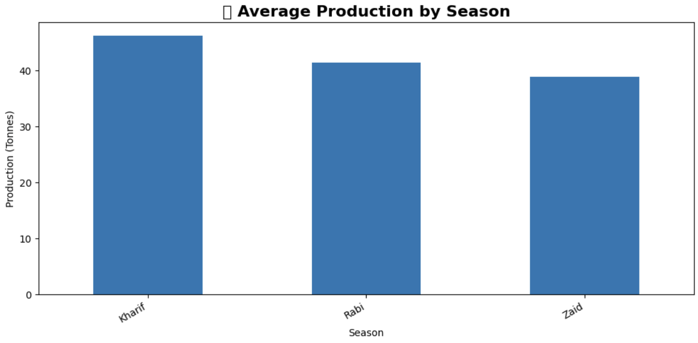
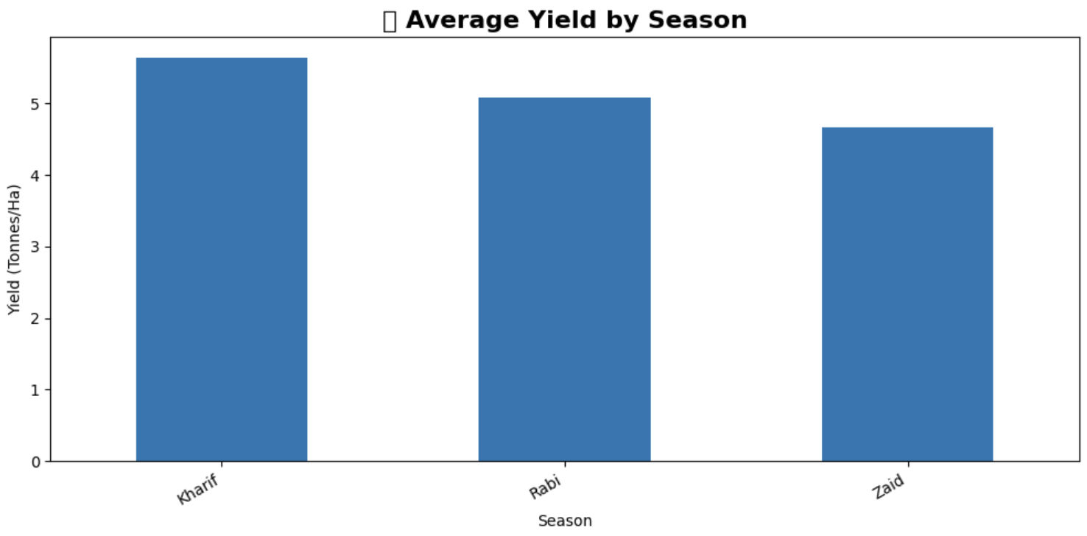
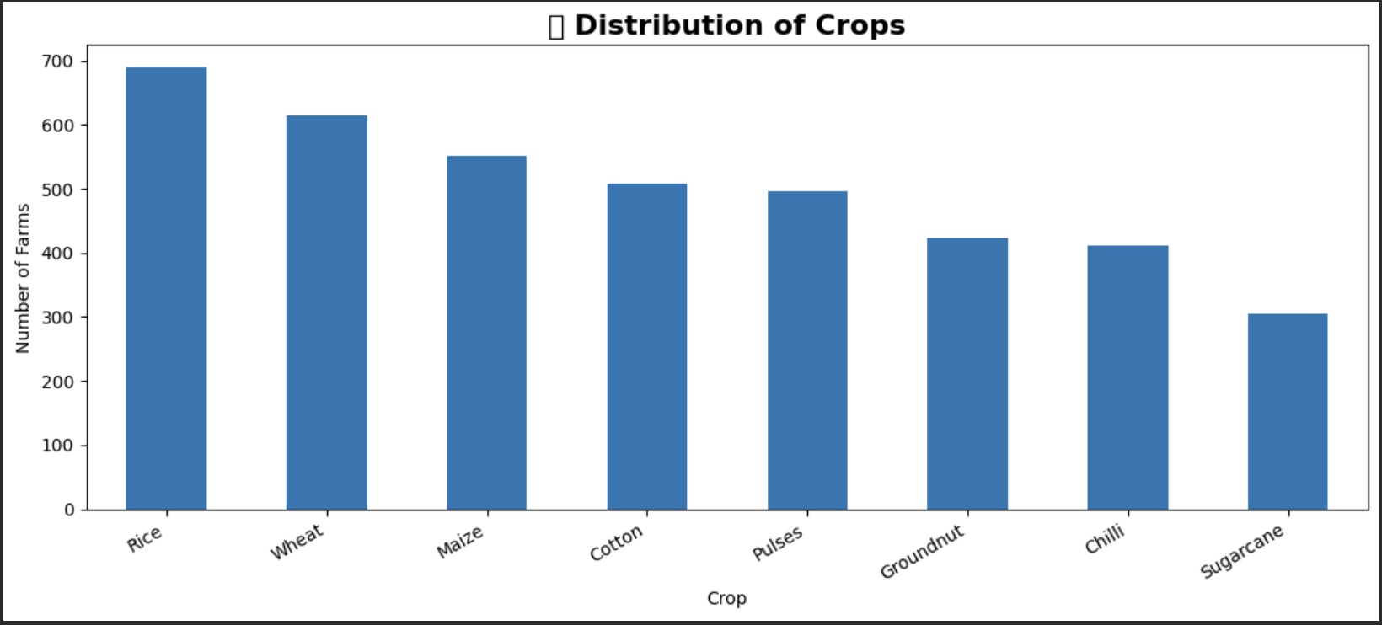
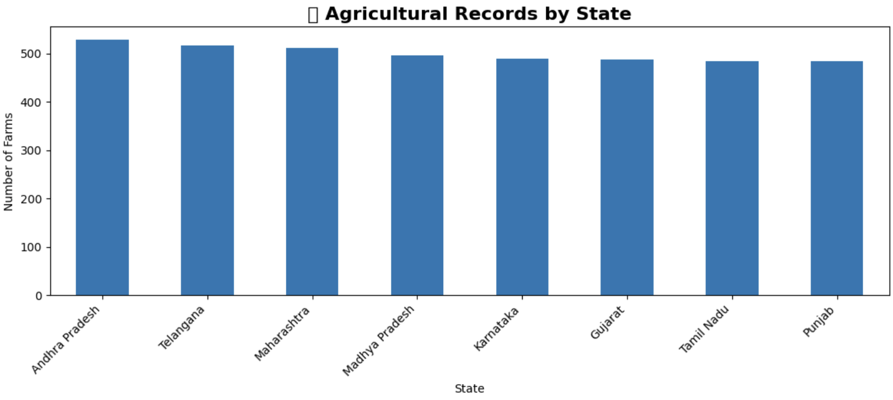
RESULTS

Slide 7
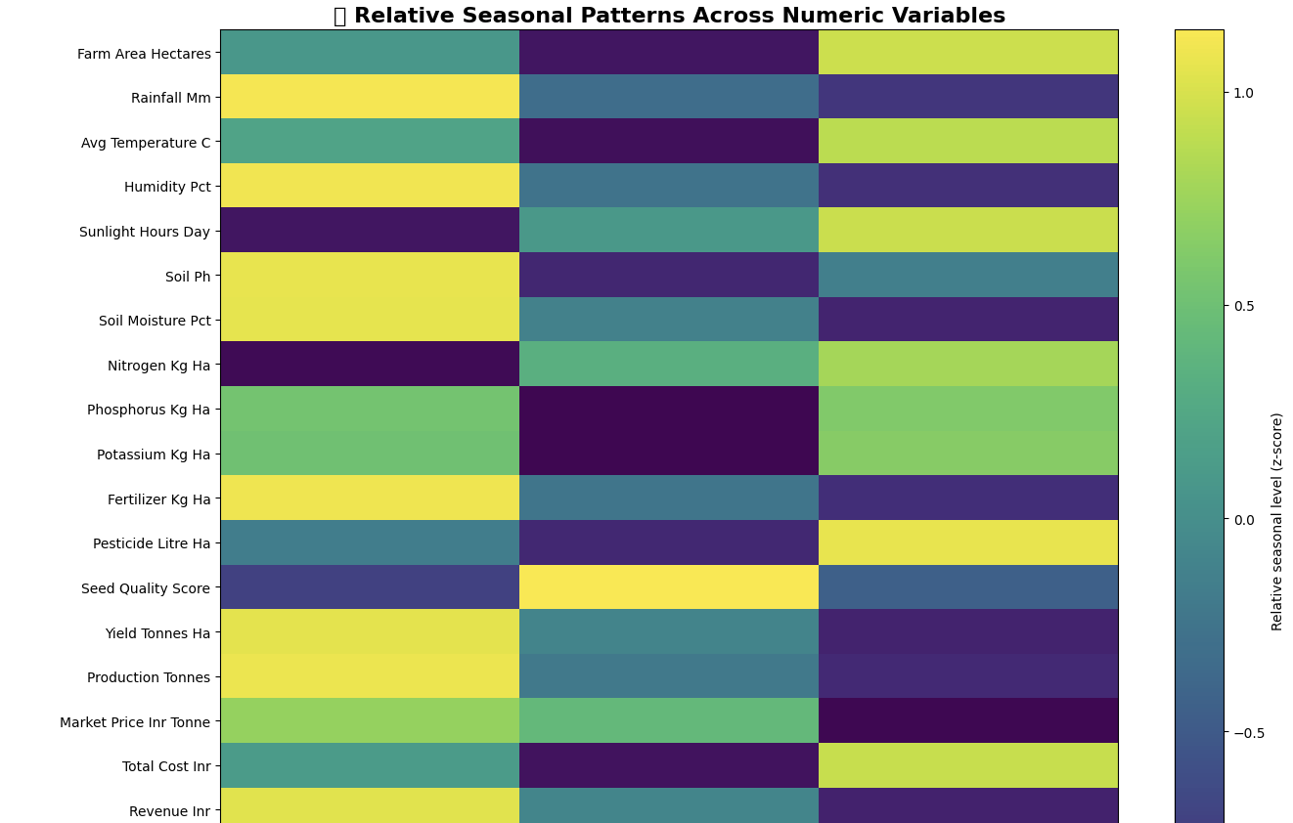
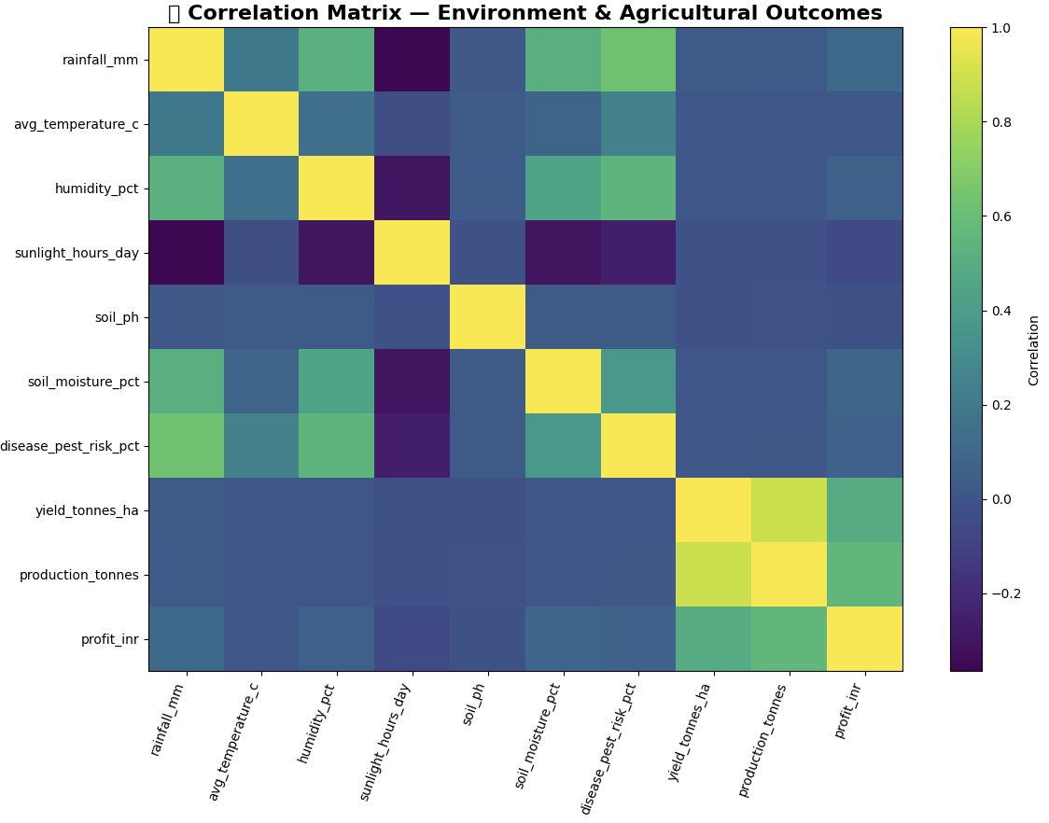
RESULTS

Slide 8
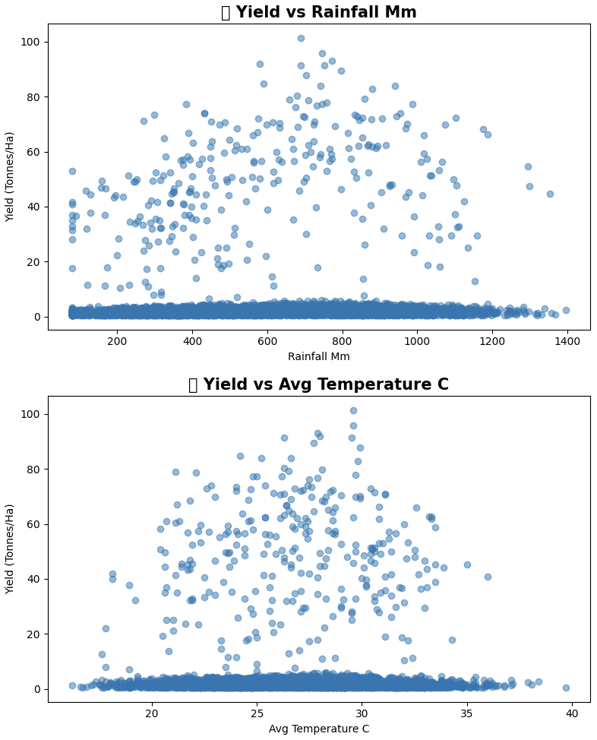
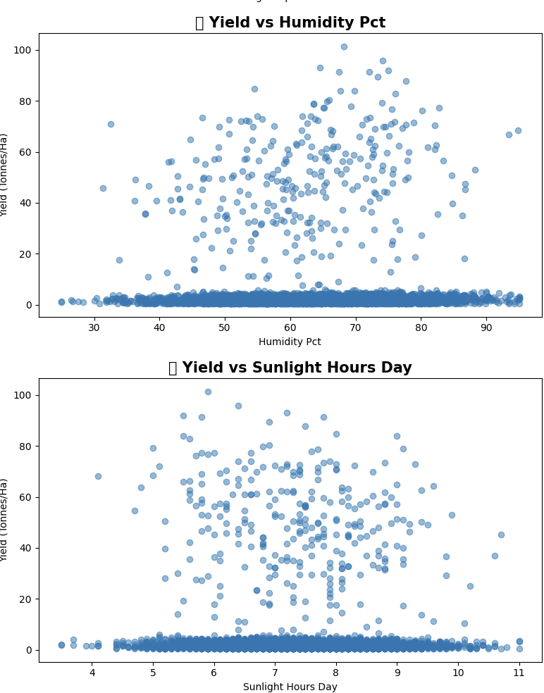
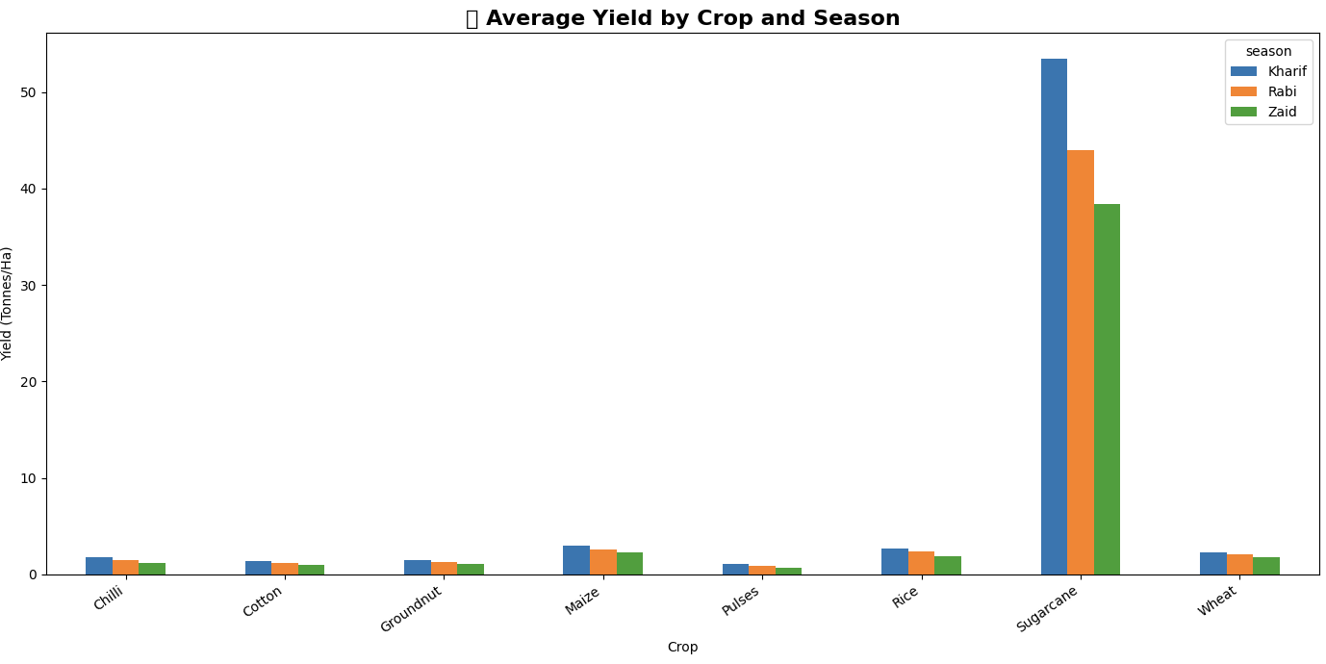
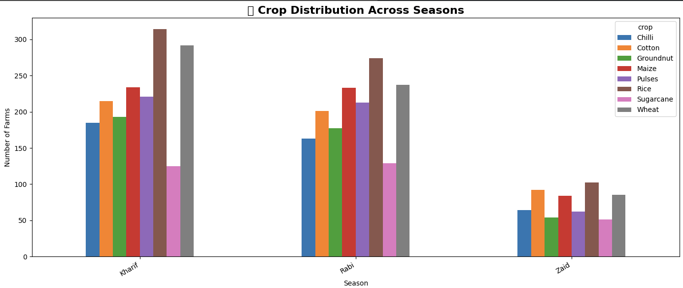
RESULTS

Slide 9
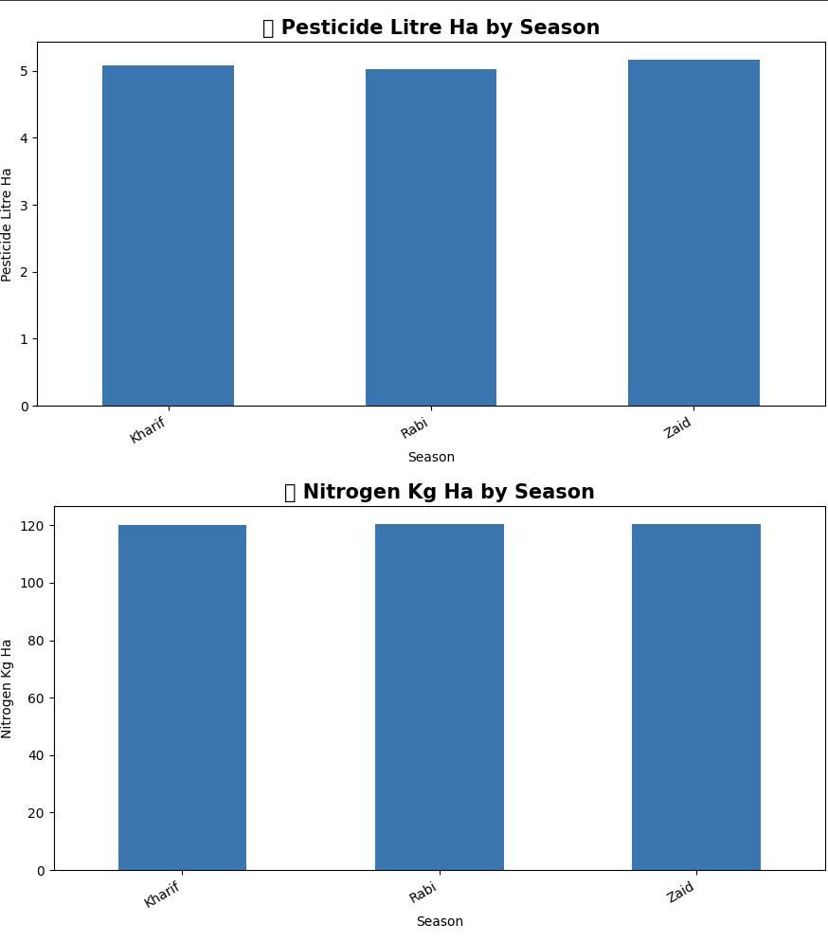
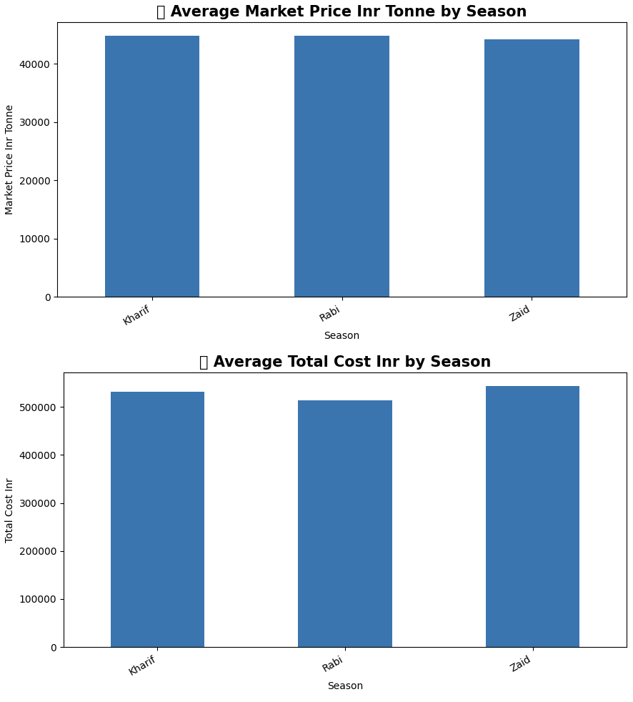
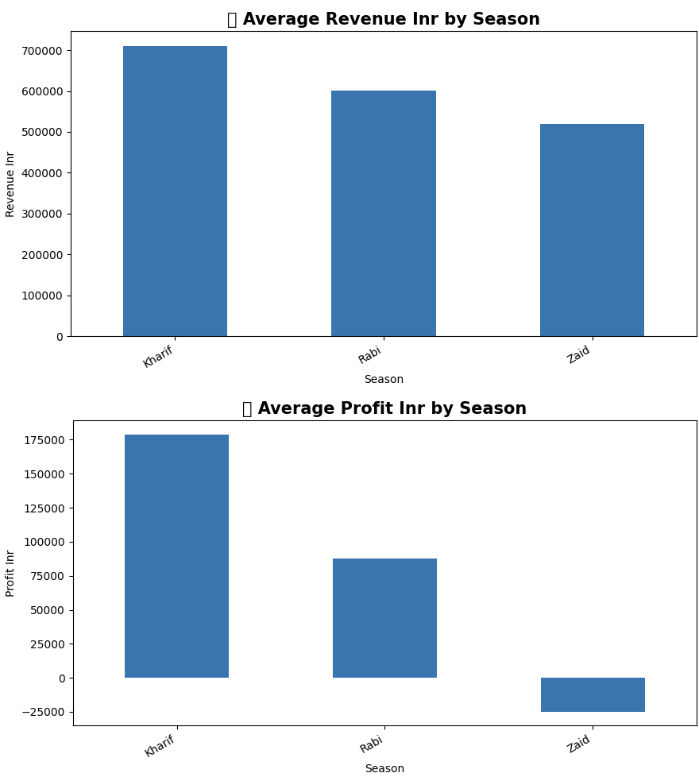
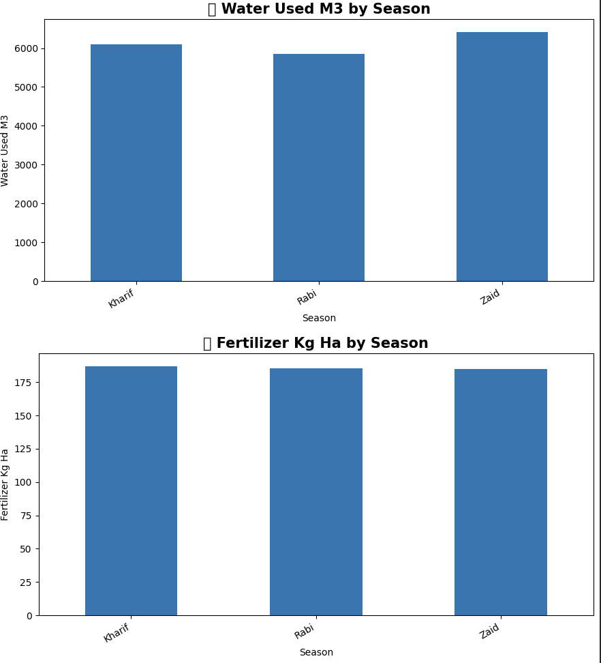
RESULTS

Slide 10
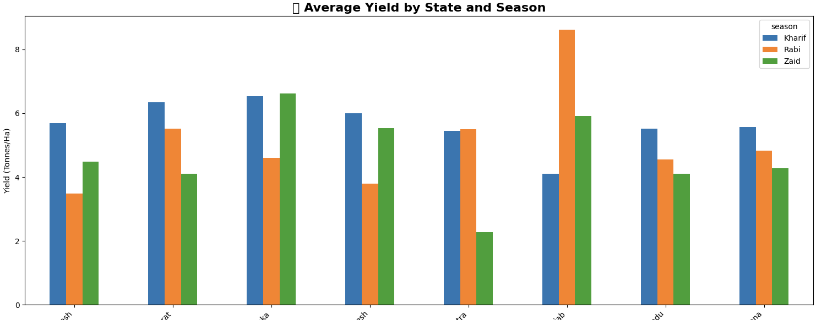
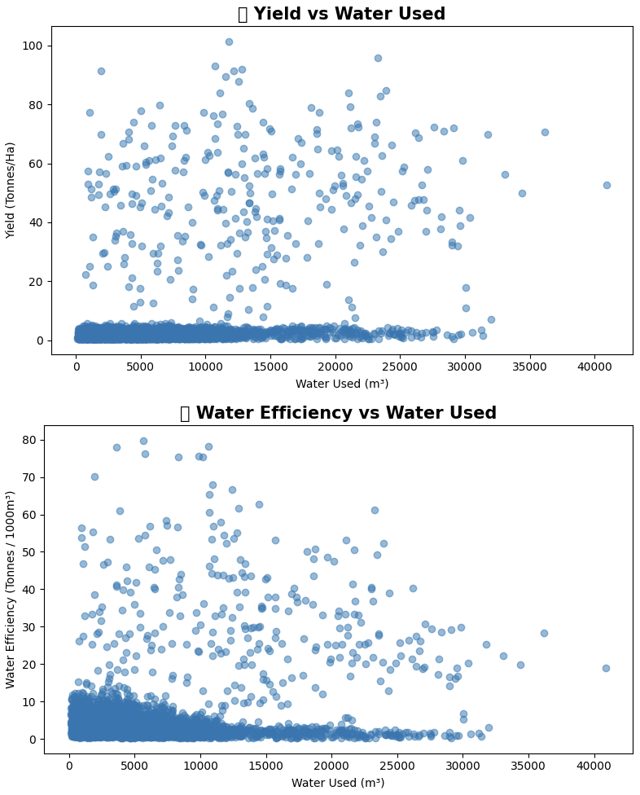
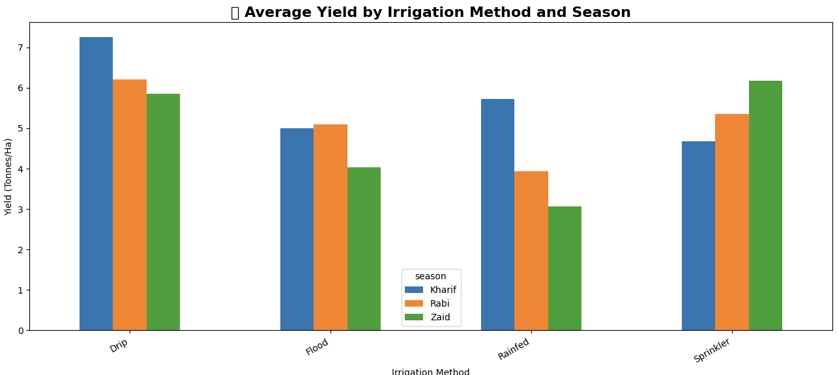
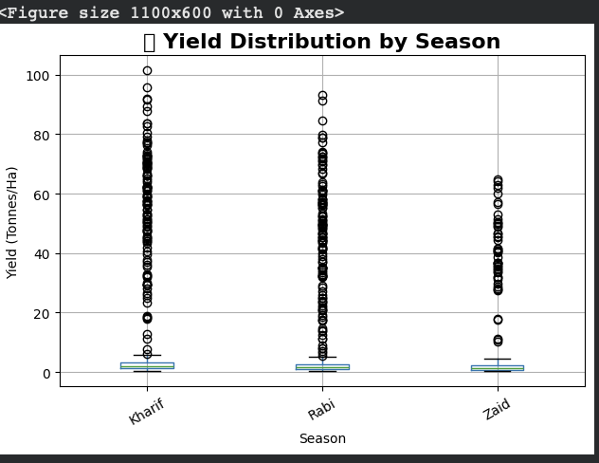
RESULTS

Slide 11
Future scope
The future scope of the Seasonal Agriculture Performance Analysis project includes:
🤖 Predictive Analysis – Machine learning models can be developed to predict crop yield and agricultural performance based on seasonal and environmental conditions.
🌦️ Weather Forecast Integration – Real-time weather and rainfall data can be integrated to provide more accurate seasonal predictions.
📱 Farmer-Friendly Application – The analysis can be converted into a mobile or web application that provides useful insights directly to farmers.
💧 Smart Resource Management – Future systems can recommend optimal water, fertilizer and pesticide usage to improve resource efficiency.
🌾 Crop Recommendation – A recommendation system can suggest suitable crops based on soil, weather, season and regional conditions.
📊 Interactive Dashboard – Tools such as Power BI or Tableau can be used to create interactive dashboards for monitoring agricultural performance.
🗺️ Regional-Level Analysis – More detailed district-level and geographical analysis can be performed to identify region-specific agricultural patterns.
📡 IoT Integration – Sensors can provide real-time information about soil moisture, temperature and other farm conditions.

Slide 12
GitHub Link
https://github.com/mxnishhh/VOIS_Major_Project

Slide 13

VOIS Course completion certificate -
Course name- Data Visualization

Slide 14
Thank you
.
.

