Slide 1

Detecting Causality in Complex Ecosystems
by George Sugihara, Robert May, Hao Ye, Chih-hao Hsieh, Ethan Deyle, Michael Fogarty, and Stephan Munch
Science
Volume 338(6106):496-500
October 26, 2012
Published by AAAS

Slide 2
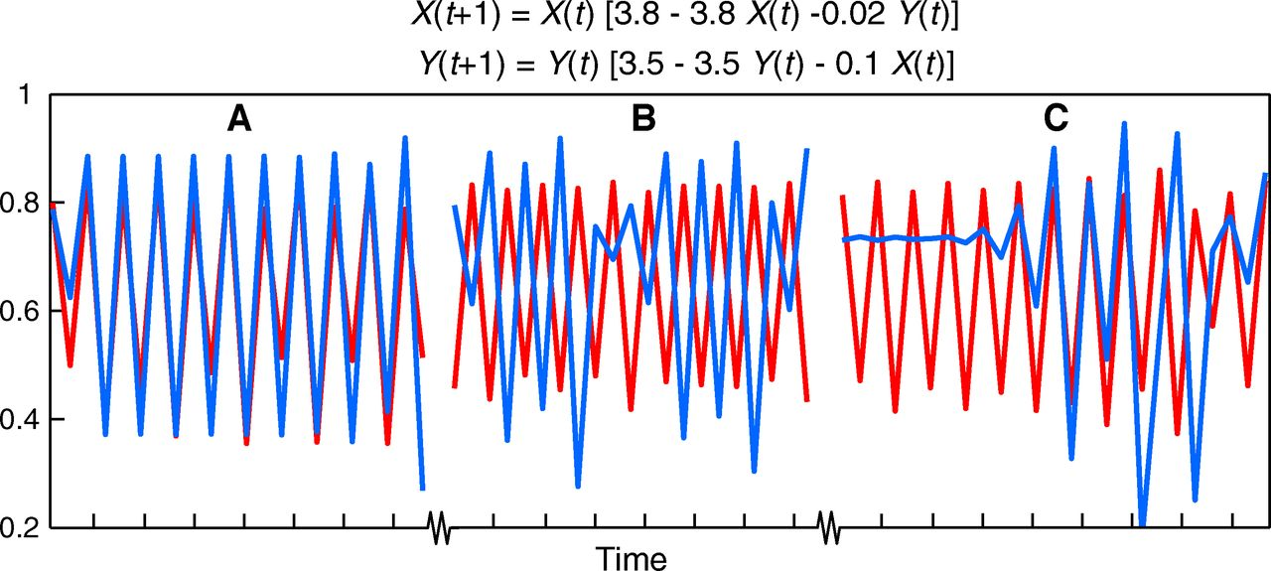
Fig. 1 Mirage correlations.
George Sugihara et al. Science 2012;338:496-500
Published by AAAS
Notes:
Mirage correlations. (A to C) Three samples from a single run of a coupled two-species nonlinear logistic difference system with chaotic dynamics. Variables X (blue) and Y (red) appear correlated in the first time segment (A), anticorrelated in the second time segment (B), and lose all coherence in the third time segment (C) with alternating interspersed periods of positive, negative, and zero correlation. Although the system is deterministic and dynamically coupled, there is no long-term correlation (n = 1000, ρ = 0.0054, P = 0.864).

Slide 3
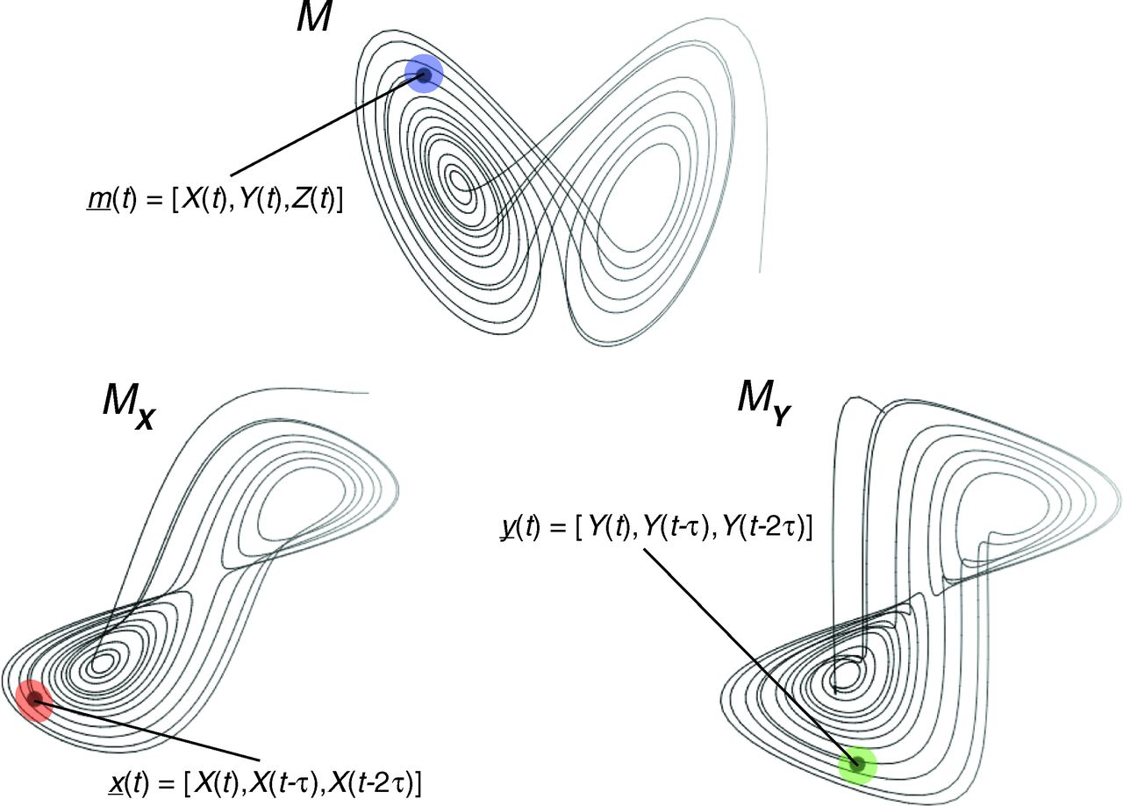
Fig. 2 Convergent cross mapping (CCM) tests for correspondence between shadow manifolds.
George Sugihara et al. Science 2012;338:496-500
Published by AAAS
Notes:
Convergent cross mapping (CCM) tests for correspondence between shadow manifolds. This example based on the canonical Lorenz system (a coupled system in X, Y, and Z; eq. S7 without V) shows the attractor manifold for the original system (M) and two shadow manifolds, M_{X} and M_{Y}, constructed using lagged-coordinate embeddings of X and Y, respectively (lag = τ). Because X and Y are dynamically coupled, points that are nearby on M_{X} (e.g., within the red ellipse) will correspond temporally to points that are nearby on M_{Y} (e.g., within the green circle). That is, the points inside the red ellipse and green circle will have corresponding time indices (values for t). This enables us to estimate states across manifolds using Y to estimate the state of X and vice versa using nearest neighbors (3). With longer time series, the shadow manifolds become denser and the neighborhoods (ellipses of nearest neighbors) shrink, allowing more precise cross-map estimates (see movies S1 to S3).

Slide 4
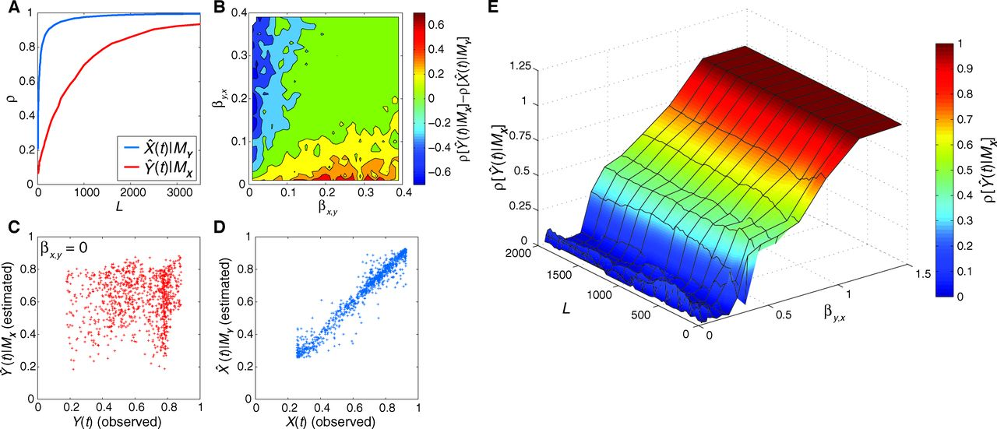
Fig. 3 Detecting causation with CCM. With convergence, the skill of cross-map estimates, indicated by the correlation coefficient (ρ), increases with time-series (library) length L. (A) CCM for Eq. 1, Fig. 1, where the effect of X on Y is stronger than in the reverse: βy,x > βx,y.
George Sugihara et al. Science 2012;338:496-500
Published by AAAS
Notes:
Detecting causation with CCM. With convergence, the skill of cross-map estimates, indicated by the correlation coefficient (ρ), increases with time-series (library) length L. (A) CCM for Eq. 1, Fig. 1, where the effect of X on Y is stronger than in the reverse: β_{y,x} > β_{x,y}. Consequently, cross mapping X using M_{Y} converges faster than cross mapping Y using M_{X}. (B) Summary of this effect for Eq. 1, L = 400. (C to E) When Y (red) has no effect on X (blue) (i.e., β_{x,y} = 0), (C) shows that cross mapping of Y using M_{X} fails; however, the cross map of X succeeds (D) because the time series for Y contains information about the dynamics of X. (E) demonstrates nonconvergence of as a function of forcing strength when β_{x,y} = 0. Convergence only occurs as a special case if strong forcing causes the system to collapse dimensionality (dark red plateau at high β_{y,x}), thus removing the dynamics of Y.

Slide 5
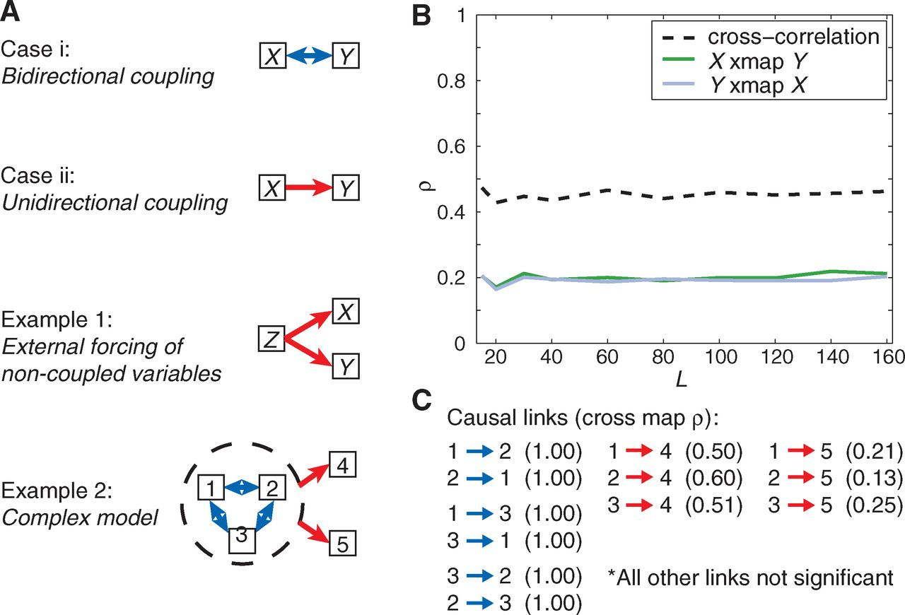
Fig. 4 Model causal networks.
George Sugihara et al. Science 2012;338:496-500
Published by AAAS
Notes:
Model causal networks. (A) Schematics of causal networks: two base cases and two model examples showing external forcing of noncoupled variables. (B) Cross-map results for example 1: external forcing of noncoupled variables. Cross-correlation erroneously suggests that X and Y are interacting, whereas cross mapping correctly shows that there is no interaction. (C) Cross-map results for the complex five-species model example. All significant (P < 0.05) mappings are given and indicate that species 1, 2, and 3 (the subsystem in the circle) all interact mutually (case i), but interact only asymmetrically as external forcing variables with respect to 4 and 5 (case ii), which do not interact directly themselves.

Slide 6
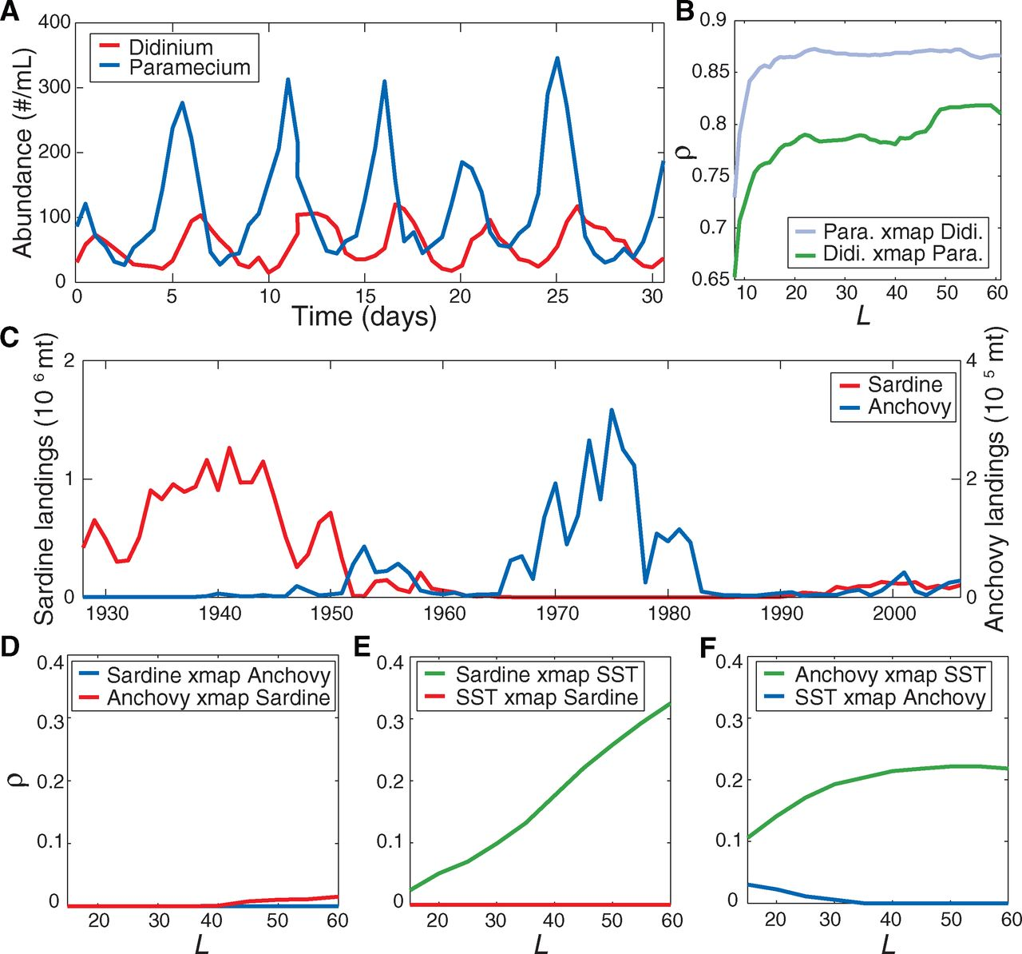
Fig. 5 Detecting causation in real time series.
George Sugihara et al. Science 2012;338:496-500
Published by AAAS
Notes:
Detecting causation in real time series. (A) Abundance time series of Paramecium aurelia and Didinium nasutum as reported in (28). (B) CCM of Paramecium and Didinium with increasing time-series length L. The pattern suggests top-down predator control. (C) California landings of Pacific sardine (Sardinos sagax) and northern anchovy (Engraulis mordax). (D to F) CCM (or lack thereof) of sardine versus anchovy, sardine versus SST (Scripps Pier), and anchovy versus SST (Newport Pier), respectively. This shows that sardines and anchovies do not interact with each other and that both are forced by temperature.

