Slide 1
Working with 3d simulations
Myia powlette 2299223

Slide 2
overview
For my final year project I wanted to experiment with the use of algorithms paired with 3D modelling software

Slide 3
Applications used
Python
Blender

Slide 4


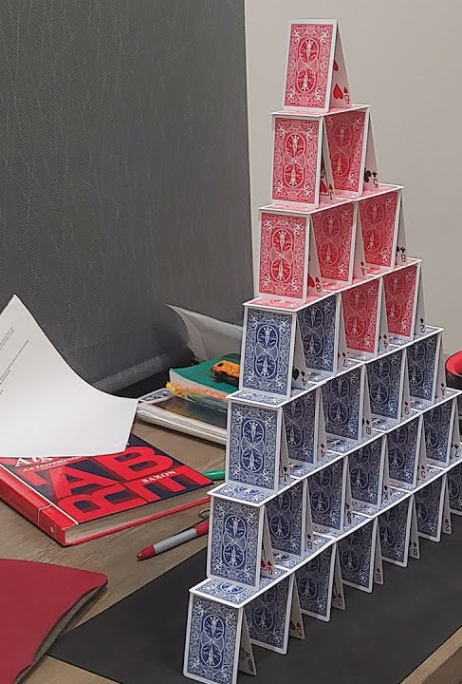
Creating playing cards using blender
For my simulation I decided to stink with something quite simple but mathematically challenging
I decided to create a deck of playing cards in blender and then create a python algorithm using IDLE that has the ability to alter the positioning of each card/object in the simulation

Slide 5
Mathematical equations: trigonometry
The distance from the left is measured using:
Black line:
CAH, Cos(a)=adjacent / hypotenuse
Length_of_card * angle of card (x)
Purple line
SOH, Sin(a)=opposite/hypotenuse
Length of card * angle_of_card(x)

