Slide 1
Deep Learning for Classification and Localization of COVID-19 Markers in Point-of-Care Lung Ultrasound
By Subhankar Roy, Willi Menapace, Sebastiaan Oei, Ben Luijten, Enrico Fini
Published on August 8th, 2020
Presentation Name: Madhu Kumar Sunkaraboina
#700: 700745875

Slide 2
Introduction
Coronavirus Disease 2019 (COVID-19) is a highly contagious respiratory illness caused by the novel coronavirus SARS-CoV-2.
Origin: Identified in Wuhan, China in late 2019, leading to a global pandemic.
Impact on Healthcare Systems: Hospitals faced unprecedented challenges in managing patient surges, allocating resources, and protecting healthcare workers.
Strain on Healthcare Resources: Hospitals and healthcare facilities faced shortages of beds, ventilators, personal protective equipment (PPE), and medical supplies.
Economic Impact: Global economies suffered from disruptions in trade, tourism, and employment due to lockdowns and restrictions.
Public Health Messaging: Communication strategies to educate the public about preventive measures, symptoms, and vaccination.

Slide 3
Objectives
Aim: The primary objective of this study is to develop and evaluate deep learning models for the classification and localization of COVID-19 markers in lung ultrasound images.
Designing and implementing convolutional neural network (CNN) architectures tailored for COVID-19 marker detection in lung ultrasound images.
Curating a comprehensive dataset of lung ultrasound images, including COVID-19 positive and negative cases.
Training deep learning models using the annotated dataset to optimize for accuracy, sensitivity, and specificity in COVID-19 marker classification.
Exploring transfer learning and data augmentation techniques to enhance model performance.
Validating model generalizability across diverse patient demographics and imaging conditions.
Discussing the relevance of deep learning in enhancing diagnostic capabilities, especially in resource-constrained settings and during pandemics.

Slide 4
Critical Technique
In the context of deep learning the generalization capability of a network is of critical importance.
To this end, data segmentation has shown to be very effective in improving the performance of a network. Previous works showed that augmenting a dataset composed of LUS images can drastically improve the ability of the network to discriminate healthy and ill patients.
Another way to achieve robust predictions is to enforce some consistency between two perturbed versions (color jitter, dropout, etc.) of the same image.
This makes the network produce smoothed predictions by attending to the salient features in an image. Inspired by this idea.
we propose to use STN to produce two different crops from a single image and enforce the predictions of the network to be similar. We name our approach Regularized Spatial Transformer Networks (Reg-STN).

Slide 5
Contribution
CNNs are deep neural networks used for processing grid-like structured data like images, learning hierarchical representations and employing convolutional layers for feature extraction.
Deep learning techniques, particularly CNNs, have significantly improved diagnostic capabilities in medical imaging, enabling faster and more accurate detection. Ex: Diagnosis, Segmentation, Prognosis
In traditional methods, such as RT-PCR and CT Scans we going to face challenges like Sensitivity and Specifically, Accessibility and Efficiency.
Deep learning offers potential solutions to these challenges by:
Automating Diagnosis: CNNs can analyze chest X-rays or ultrasound images to detect COVID-19 markers with high accuracy and speed.
Enhancing Sensitivity: Models trained on large datasets can improve sensitivity in detecting subtle COVID-19 signs.
Enabling Point-of-Care Use: Deep learning models can be integrated into portable ultrasound devices, enabling rapid diagnosis at the bedside.

Slide 6
CNN Architecture and Training
Specify the convolutional neural network architecture chosen for the task. Examples include:
ResNet (Residual Networks): Known for its deep architecture with residual connections, which helps alleviate the vanishing gradient problem.
VGG (Visual Geometry Group): Characterized by its simplicity and uniform architecture, consisting of repeated blocks of convolutional layers followed by max-pooling layers.
Training Details
Epochs: Specify the number of training epochs used in the deep learning model. This indicates how many times the entire dataset was processed by the model during training.
Batch Size: Describe the batch size used during training, which refers to the number of samples processed before updating the model's parameters.
Optimizer: Mention the optimizer used to minimize the loss function during training. Examples include Adam, SGD (Stochastic Gradient Descent), RMSprop, etc.

Slide 7
Data Processing
Normalization:
Purpose: Normalize the pixel values of the ultrasound images to a standardized range, typically [0, 1] or [-1, 1].Explain the method used for normalization, such as dividing pixel values by 255 for images with 8-bit depth. Normalize based on statistical properties like mean and standard deviation if using Z-score normalization.
Purpose of Data Splitting:
Training: Train the deep learning model on a subset of data to learn patterns and features.
Validation: Validate the model's performance on another subset of data to monitor for overfitting and optimize hyperparameters.
Train-Validation Split: Divide the dataset into two sets:
Training Set: Used to train the deep learning model. Typically, this comprises 70-80% of the dataset.
Validation Set: Used to evaluate the model's performance during training and adjust hyperparameters. This usually comprises 20-30% of the dataset.

Slide 8
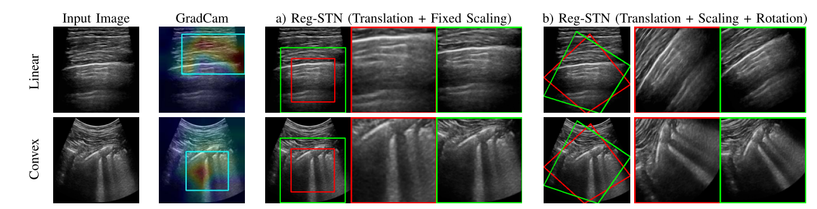
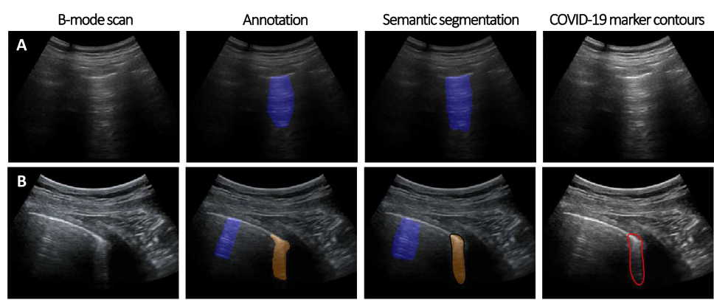
Results - Ultrasound Images
The two rows compare the performance of different STN configurations.
Reg-STN (Translation + Fixed Scaling): This configuration only allows for translation and fixed scaling transformations of the input image.
b) Reg-STN (Translation + Scaling + Rotation): This configuration allows for translation, scaling, and rotation transformations, offering greater flexibility in image alignment.

Slide 9
Discussion
Strengths of the Deep Learning Model:
High Accuracy: Discuss the accuracy achieved in classifying and localizing COVID-19 markers in lung ultrasound images compared to traditional methods.
Efficiency: Highlight the model's ability to automate the detection process, potentially reducing diagnostic time and improving clinical workflow.
Limitations of the Deep Learning Model:
Data Dependency: Discuss any limitations related to the availability or quality of the dataset used for training, and how this might affect generalizability.
Interpretability: Address challenges in interpreting how the model reaches its decisions, which can be crucial for clinical acceptance.

Slide 10
Conclusion
summarize your research's results on the effective application of deep learning to the identification of COVID-19 markers in lung ultrasonography pictures and stress the value of automated instruments
Successful Use of Deep Learning for COVID-19 Marker Detection:
Accuracy and Efficiency: Achieved high accuracy in classifying and localizing COVID-19 markers (e.g., opacities, consolidations) in lung ultrasound images.
Robustness: Demonstrated the robustness of the deep learning model across diverse patient populations and imaging conditions.
Importance of Automated Tools in Point-of-Care Settings:
Accessibility: Facilitates rapid and reliable diagnosis at the bedside or in remote areas, where access to specialized diagnostic facilities may be limited.
Timeliness: Enables early detection and intervention, crucial for managing COVID-19 and improving patient outcomes.

Slide 11
References
[1] WHO. (2020). Laboratory Testing Strategy Recommendations for COVID-19: Interim Guidance. [Online]. Available: https://apps.who.int/iris/bitstream/handle/10665/331509/WHOCOVID-19-lab_testing-2020.1-eng.pdf
[2] R. Niehus, P. M. de Salazar, A. Taylor, and M. Lipsitch, “Quantifying bias of COVID-19 prevalence and severity estimates in Wuhan, China that depend on reported cases in international travelers,” medRxiv 2020.02.13.20022707, Feb. 2020.
[3] Y. Yang et al., “Evaluating the accuracy of different respiratory specimens in the laboratory diagnosis and monitoring the viral shedding of 2019-nCoV infections,” medRxiv 2020.02.11.20021493, Feb. 2020. A
[4] S. Salehi, A. Abedi, S. Balakrishnan, and A. Gholamrezanezhad, “Coronavirus disease 2019 (COVID-19): A systematic review of imaging findings in 919 patients,” Amer. J. Roentgenology, pp. 1–7, Mar. 2020.
[5] A. Bernheim et al., “Chest CT findings in coronavirus disease-19 (COVID-19): Relationship to duration of infection,” Radiology, Feb. 2020, Art. no. 200463.

Slide 12
#Thank You

