Slide 1
AdvPT Project
Group 11
Borst, Michael Jalowski, Felix Scholze, Maximilian
February 3 2016

Slide 2
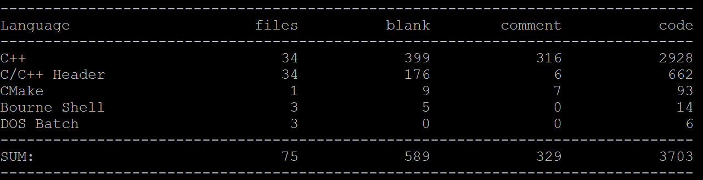
The Final Solution

Slide 3
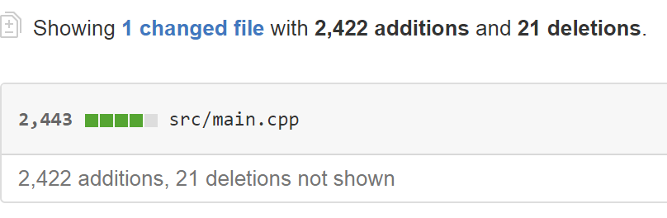
The First Few Days

Slide 4
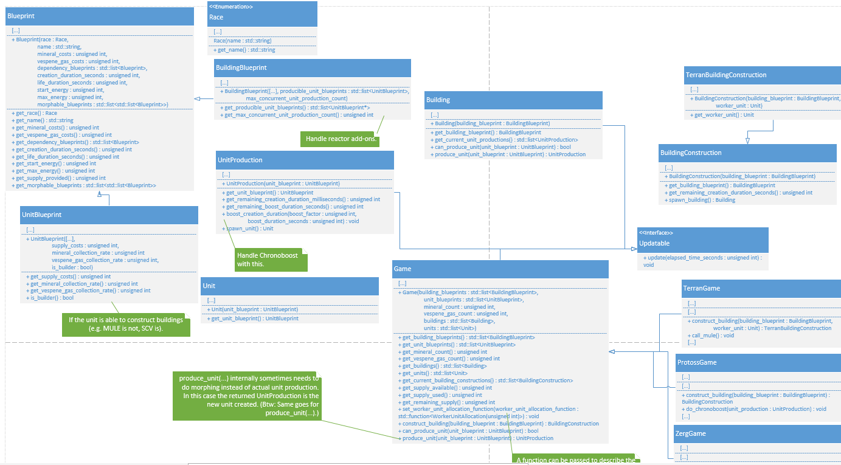
A Better Approach

Slide 5
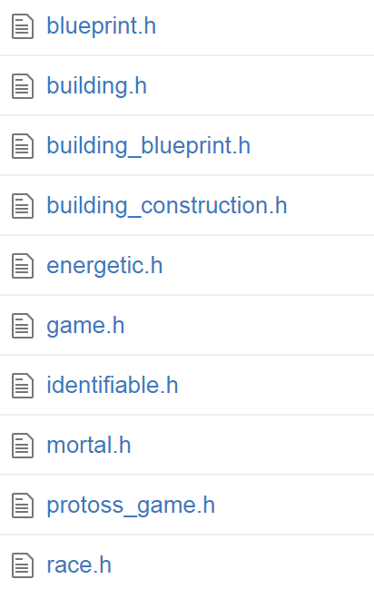
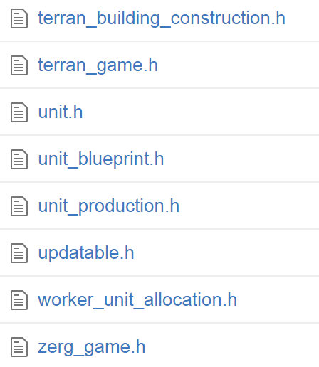
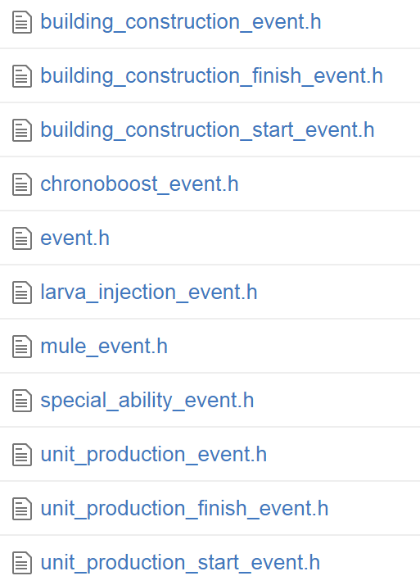
A Better Approach

Slide 6
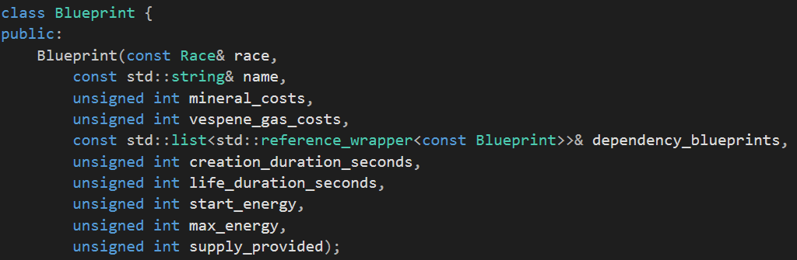
Everything Is Configurable

Slide 7
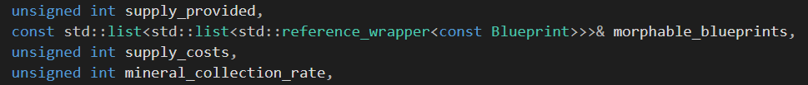
Everything Is Configurable
1 Zergling (+ 0.5 Supply, - 25.0 Minerals)
1 Larva (- 1.0 Supply)
1 Zergling (+ 0.5 Supply, - 25.0 Minerals)

Slide 8
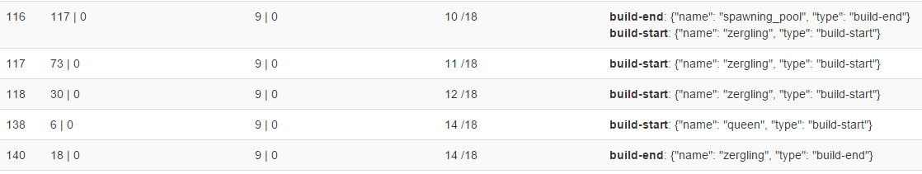

But Does It Work?
1 Zergling -50 Minerals

Slide 9
Overengineering
What we did
Solve the problem
Create a better concept
Solve the problem again
Disagree with the sample solution
What we should have done
Look at the sample solution
Solve the concept
Profit ✓

Slide 10

The End

