Slide 1
BUAN/ITSS 4382 — Applied AI/ML
HEARTHSTONE
Predicting and Reducing Product Returns
Using Machine Learning
[ Group Member Names ]
University of Texas at Dallas | November 17, 2026
Notes:
Welcome. Today we're presenting our BUAN 4382 final project on Hearthstone, an online furniture marketplace. We investigated their product return problem using machine learning and developed specific recommendations to help reduce their return rate.

Slide 2
Company Overview
Who Is Hearthstone?
About Hearthstone
Why Returns Matter
• Online furniture & home décor marketplace
• 18M+ products: sofas, dining, lighting, outdoor
• Serves homeowners, renters, design enthusiasts
• Nationwide delivery + White Glove installation
• Competes with Wayfair, Overstock, West Elm
Sector: Retail & E-Commerce (Home Goods)
Business Model: Online Marketplace
• Returns cost furniture retailers 2–4× more
than other product categories
• Reverse logistics: pickup, inspection, restock
• Each return erodes margin and customer trust
• Hearthstone's 36.7% return rate is ABOVE
the ~20–25% furniture e-commerce average
→ Reducing returns = direct profit improvement
Notes:
Hearthstone sells furniture and home décor online. The company's model is similar to Wayfair. Their business challenge: a 36.7% return rate that is significantly above industry norms. Every return triggers a costly process of pickup, inspection, and restocking — directly hurting margins.

Slide 3
Dataset Overview
R-HEARTHSTONE.csv — 10,000 Orders, 20 Columns
10,000
20
36.7%
0
Total Orders
Variables
Return Rate
Duplicates
Key Variables
Data Quality Notes
order_id, order_date
product_category, product_subcategory
product_price_usd, product_weight_lbs
product_dimensions_cuft
supplier_location, warehouse_location
customer_state, shipping_method
fulfillment_lead_time_days
assembly_required (Yes/No)
product_damaged (Yes/No)
customer_return ← TARGET VARIABLE
return_reason, customer_rating
order_value_usd, shipping_cost_usd
restocking_fee_usd
✓ No duplicate rows or order IDs
✓ No unexpected categorical values
✓ Date range: Jan 2024 – Dec 2024
⚠ return_reason: 6,334 missing (63.3%)
→ Expected: only returned orders have reasons
→ NOT blindly dropped; treated correctly
⚠ restocking_fee_usd = $0 for non-returns
→ Post-return variable; excluded from model
✓ Binary encoding: Yes/No → 1/0
✓ Datetime parsed for order_date
Notes:
Our dataset has 10,000 orders and 20 columns. One important data quality note: return_reason has 6,334 NaN values — but this is expected and correct, because only returned orders have a reason. We confirmed this programmatically and did not blindly drop those records. The restocking fee is zero for all non-returns, so we excluded it from modeling to prevent leakage.

Slide 4
Business Problem Statement
A 36.7% Return Rate Demands Attention
❝ Hearthstone's product return rate of 36.7% significantly exceeds industry norms. The company needs to understand which operational and product factors drive returns, and whether machine learning can identify high-risk orders before they ship. ❞
Research Questions
Key Metrics
1. What % of orders are returned?
2. Which product categories have highest return rates?
3. Are damaged products more likely returned?
4. Do longer fulfillment times increase returns?
Target Variable: customer_return (Yes=1, No=0)
Success Metrics:
• F1-Score > dummy baseline
• ROC-AUC > 0.70
• Business-actionable findings
• Prioritized recommendations
5. Do shipping method & assembly matter?
6. Can ML accurately predict returns?
7. Which factors matter most for prediction?
8. What actions should Hearthstone prioritize?
Notes:
The business problem is clear and measurable: Hearthstone's 36.7% return rate is too high. We structured our investigation around 8 specific business questions. The target variable is customer_return — a binary outcome that makes this a classification problem.

Slide 5
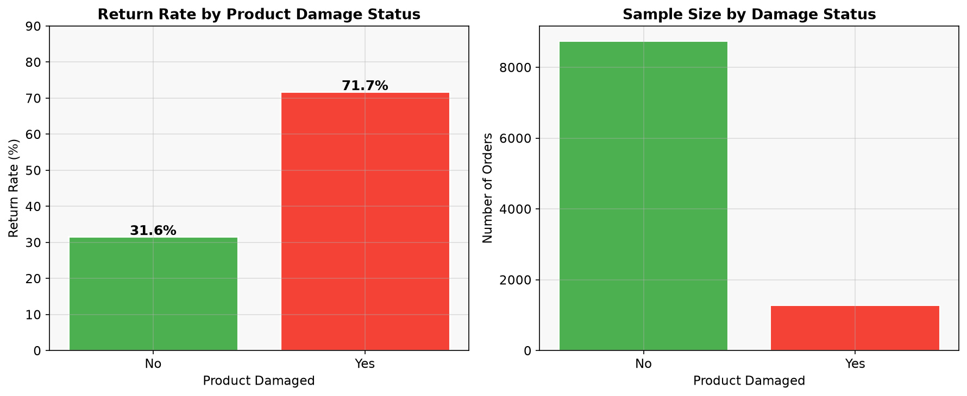
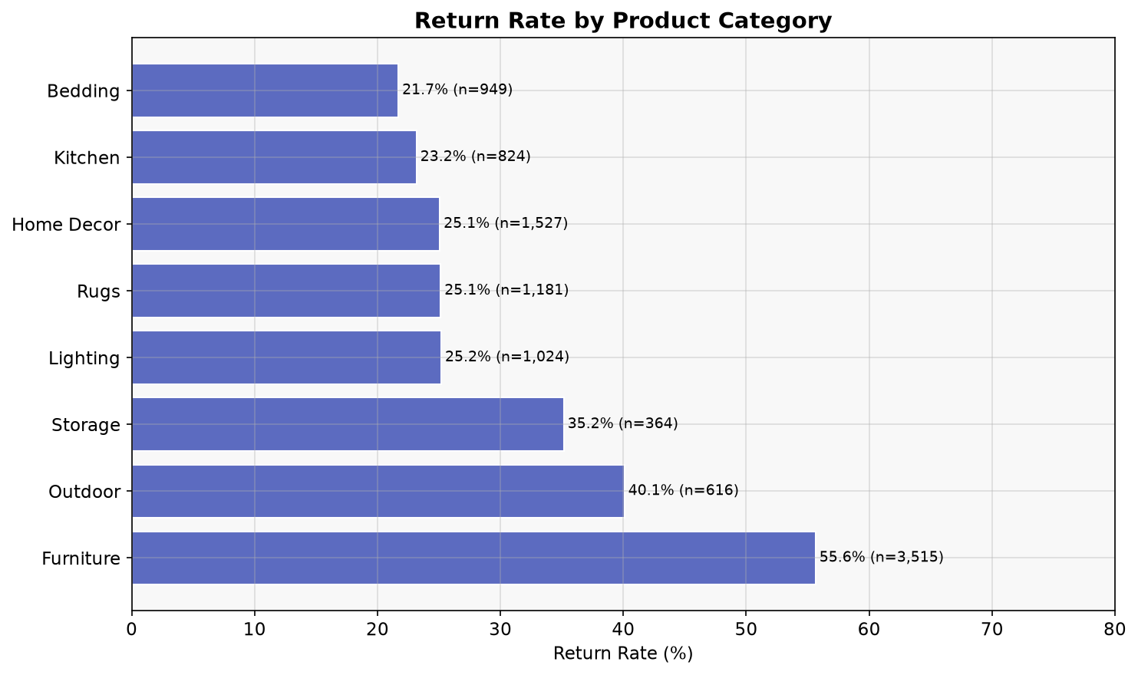
Exploratory Data Analysis
Key Patterns Discovered in the Data
36.7%
55.6%
71.7%
54.6%
Overall Return Rate
Furniture Return Rate
Return Rate — Damaged Products
Return Rate — Assembly Required
■ Damage: 71.7% return rate vs. 31.6% for undamaged (+40 ppts) ■ Fulfillment time: Returned orders avg 23.5 days vs. 18.8 days (non-returned)
■ Assembly Required: 54.6% vs. 28.2% return rate ■ White Glove shipping: 52.1% return rate (vs. 28.7% Expedited)
■ Top return reasons: Changed Mind (21%), Damaged (20%), Assembly Issues (18%), Late Delivery (16%)
Notes:
The EDA revealed several strong patterns. Product damage is the most striking: 71.7% of damaged items are returned — more than double the rate for undamaged items. Furniture has a 55.6% return rate, far above all other categories. Assembly-required products also show significantly higher return rates. And our fulfillment analysis shows returned orders took an average of 4.7 more days to arrive. 'Changed Mind' is the top return reason, followed closely by 'Damaged' and 'Assembly Issues'.

Slide 6
Feature Engineering & Data Preparation
Transforming Raw Data for Machine Learning
Data Preparation Steps
Engineered Features
1. Binary encoding: Yes/No → 1/0
(assembly_required, product_damaged,
customer_return)
2. Datetime parsing: order_date
→ order_month, order_quarter
3. One-Hot Encoding: 6 categorical columns
(category, subcategory, supplier,
warehouse, state, shipping method)
4. Scaling: StandardScaler for Logistic
Regression numeric features
5. Train-Test Split: 80/20, stratified,
random_state=42
• Training: 8,000 rows
• Test: 2,000 rows
price_band: Price tier groups
(<$100 to >$1000)
lead_time_category: 4 speed tiers
(Fast / Standard / Slow / Very Slow)
weight_group: 4 weight classes
(Light / Medium / Heavy / Very Heavy)
shipping_pct_of_order: Shipping cost / order value
⚠ Data Leakage Prevention
EXCLUDED from model features:
✗ return_reason — only known post-return
✗ restocking_fee_usd — only charged
after return is processed
✗ customer_rating — recorded after
customer experience, not before
→ 14 features used; test set held out
until final evaluation only
Notes:
Data preparation was critical for a valid analysis. We encoded Yes/No variables to binary, one-hot encoded categorical features, and scaled numerics for Logistic Regression. We created four engineered features to add business meaning. Most importantly, we excluded three variables to prevent data leakage: return_reason (only known after return), restocking_fee (only charged after return), and customer_rating (may be recorded post-experience). The test set was held out until final evaluation.

Slide 7
Model Selection & Justification
Why Binary Classification? Why These Models?
Binary Classification is the right method: our target is a binary yes/no outcome — did the customer return the product? Classification models predict this directly and produce probability scores for risk stratification.
Model 0
Model 1
Model 2
Model 3
Dummy Classifier
Decision Tree
(max_depth=5)
Random Forest
(200 trees)
Logistic Regression
Strategy: Always predict "No Return"
Sets performance floor
Any real model must beat 63.3% accuracy
Mimics human if-then rules
Highly interpretable
Handles mixed data types
Baseline required by assignment
Ensemble of decision trees
Reduces overfitting via averaging
Provides feature importance scores
Typically outperforms single tree
Linear probabilistic classifier
Outputs calibrated probabilities
Requires feature scaling
Gold standard interpretable benchmark
All models: 80/20 stratified split | random_state=42 | 5-fold CV for validation | Same test set for fair comparison
Notes:
We built four models for this classification problem. We start with a Dummy Classifier as our performance floor — it always predicts 'No Return' and achieves 63.3% accuracy. Any real model must beat this. The Decision Tree is required by the project brief and is highly interpretable. Random Forest is an ensemble method that typically outperforms single trees. Logistic Regression provides a well-calibrated linear benchmark. All models use the same train-test split for a fair comparison.

Slide 8
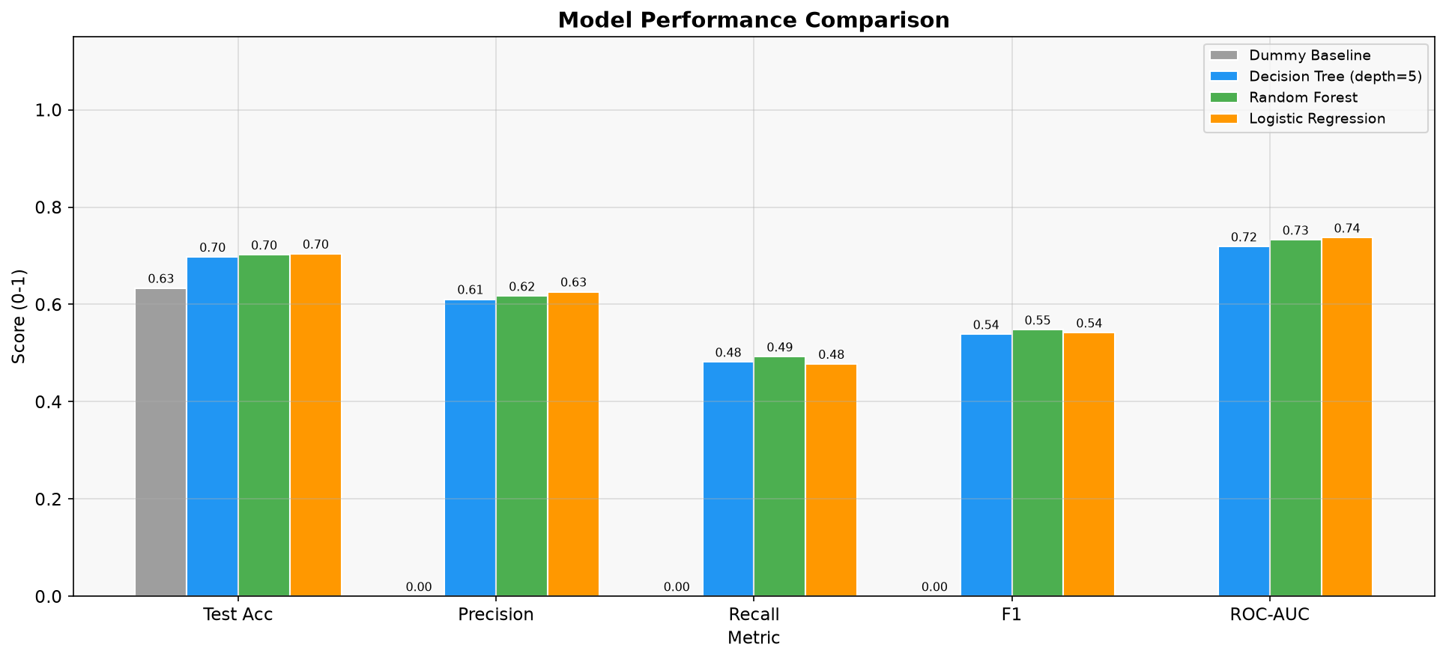
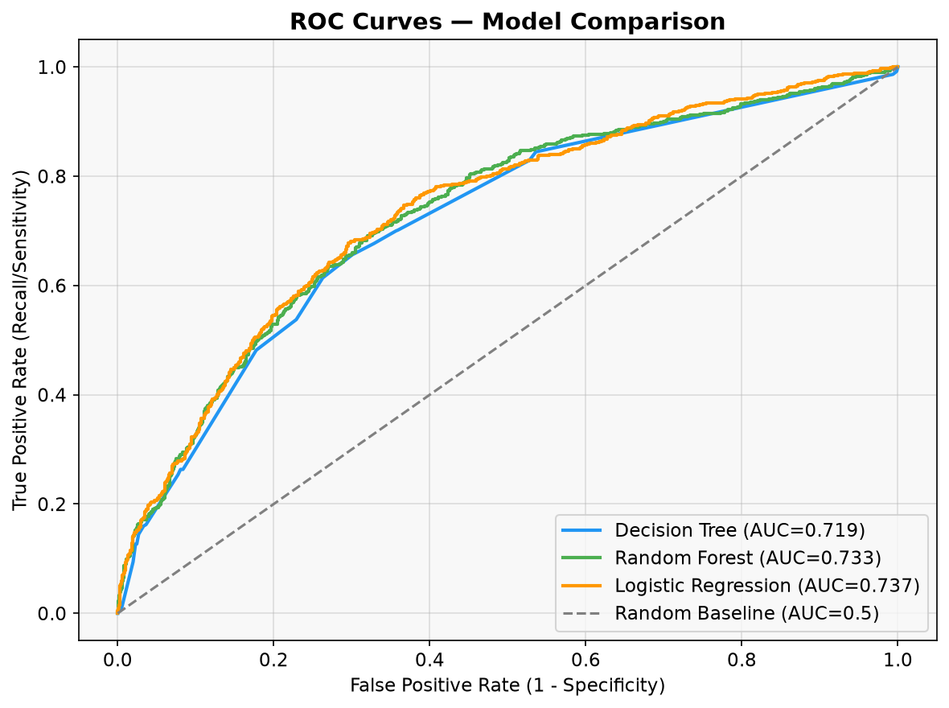
Model Results
Performance on Hold-Out Test Set (2,000 orders)
Key Metrics Summary
Model
Acc
F1
AUC
Dummy
63.3%
0.00
N/A
Decision Tree
69.8%
0.54
0.719
Random Forest
70.2%
0.55
0.733
Log. Regression
70.4%
0.54
0.737
Key Takeaways
✓ All models beat dummy baseline
✓ AUC ~0.73 = moderate predictive power
✓ Logistic Regression: best AUC (0.737)
✓ Random Forest: best for feature importance
⚠ Recall ~49%: catches half of actual returns
⚠ Models help risk-stratify, not replace judgment
Notes:
All three real models significantly outperform the dummy baseline. Logistic Regression achieves the best ROC-AUC at 0.737. This means that given two orders — one returned and one not — the model correctly ranks the returned one as higher risk 73.7% of the time. The recall of about 49% means we catch roughly half of actual returns — good for risk stratification but not for fully automated decisions. The models are most valuable as a prioritization tool, not a replacement for human judgment.

Slide 9
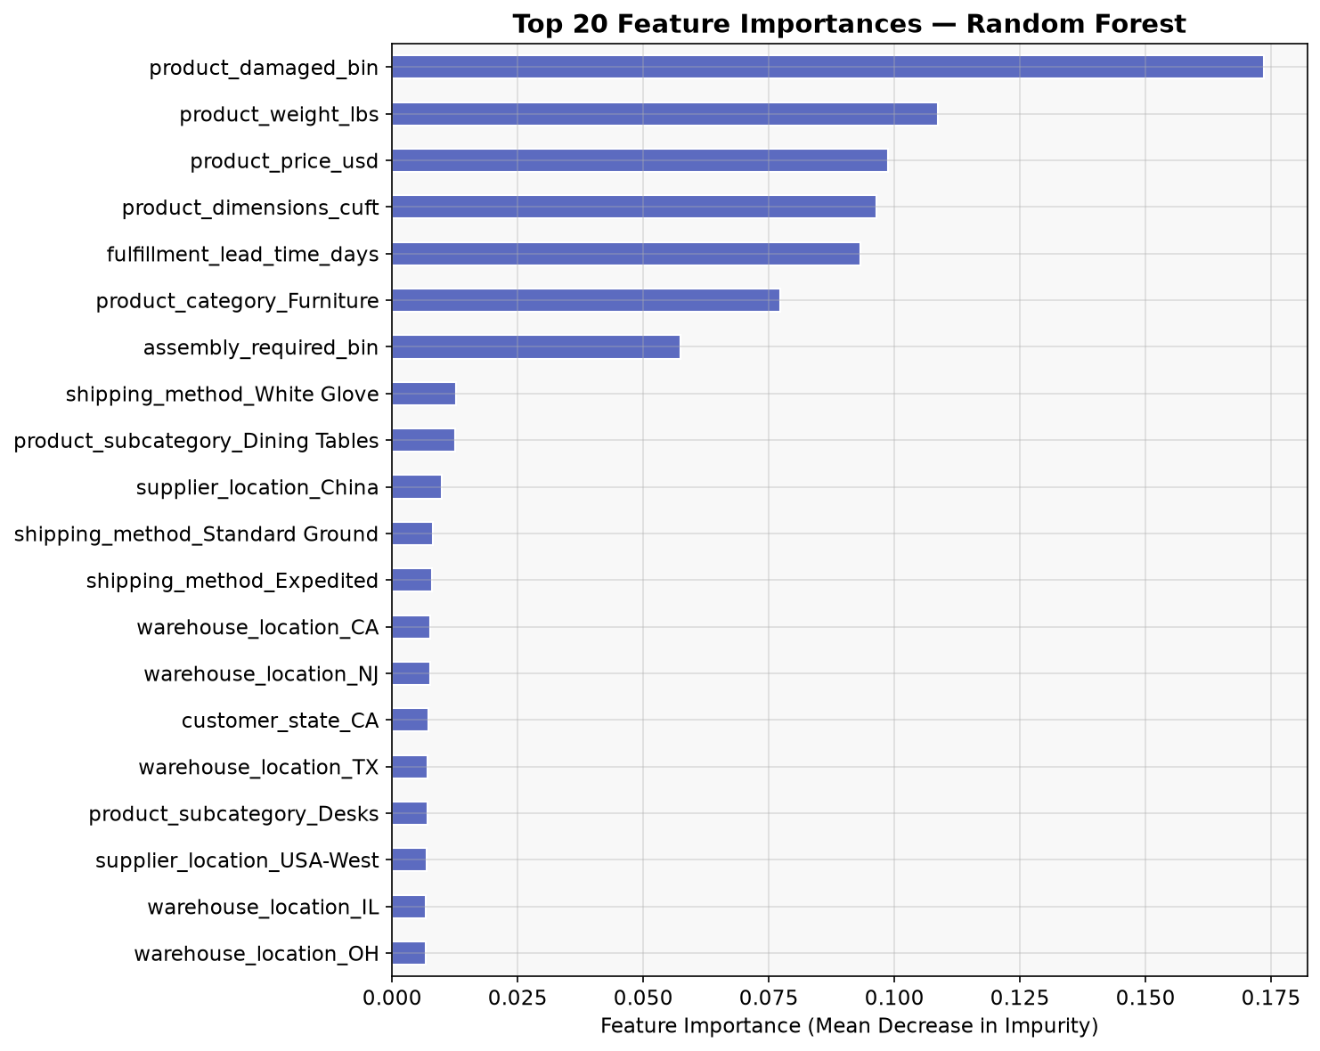
Feature Importance
Which Factors Are Most Predictive of Returns?
Interpretation
① product_damaged (17.3%)
Strongest predictor — damaged items
are returned at 71.7% rate
② product_weight_lbs (10.9%)
Heavier items harder to ship safely
③ product_price_usd (9.9%)
Higher-priced items have higher
customer expectations
④ fulfillment_lead_time (9.3%)
Longer waits → more returns
⑤ Furniture category (7.7%)
Confirms EDA: Furniture is high-risk
⑥ assembly_required (5.7%)
Assembly complexity drives returns
⚠ Importance ≠ Causation
Correlation-based importance only
Notes:
The Random Forest feature importance chart shows which variables are most useful for predicting returns. Product damage status is by far the strongest predictor at 17.3%, consistent with our EDA finding. Product weight and price follow, reflecting that heavier and more expensive items are harder to ship undamaged and have higher customer expectations. Fulfillment lead time and the Furniture category are also strong predictors. Important caveat: feature importance shows correlation, not causation. These features help the model distinguish returns from non-returns — they don't prove that changing them will reduce returns.

Slide 10
Business Recommendations
Five Evidence-Based, Prioritized Actions
1
Improve Packaging & Damage Prevention
IMMEDIATE
71.7% of damaged items are returned. Audit packaging for Furniture & heavy items. Implement pre-shipment quality checks.
2
Address Furniture Category (55.6% Return Rate)
IMMEDIATE
Video assembly guides. Subsidize professional assembly for items >$500. Improve 360° product photos and dimension accuracy.
3
Reduce Fulfillment Lead Times
SHORT-TERM
Flag orders >21 days for proactive customer communication. Expedite high-value orders. "Late Delivery" = 16% of return reasons.
Deploy ML Return-Risk Scoring
SHORT-TERM
4
0.73 AUC sufficient for risk stratification. Score orders at checkout. High-risk orders → quality check before shipment.
Address "Changed Mind" Returns (21%)
MEDIUM-TERM
5
Improve product photography (360° views, AR tools). More detailed descriptions and customer reviews to set accurate expectations.
Notes:
Our five recommendations are prioritized by evidence strength and expected impact. The two immediate priorities — fixing packaging to reduce damage, and addressing the Furniture category — have the strongest data support. The 71.7% return rate for damaged items leaves no doubt. Medium-term, we recommend deploying the ML scoring model to flag high-risk orders, reducing fulfillment times for the longest-wait orders, and improving product page content to reduce 'Changed Mind' returns.

Slide 11
Expected Business Impact
Quantifying the Value of Reducing Returns
⚠ Disclaimer: These are illustrative scenarios using actual dataset values. The $50/return operational cost is a conservative estimate (reverse logistics + labor). Product refund value is NOT counted as a cost — products are restocked, not destroyed.
Baseline: 10,000 orders | 3,666 returns (36.7%) | Avg restocking fee: $59.17 | Avg order value: $692.98
5% Return Reduction
10% Return Reduction
15% Return Reduction
183 fewer returns
Restocking recovered: $10,828
Operational savings: $9,150
TOTAL SAVINGS: $19,978
366 fewer returns
Restocking recovered: $21,656
Operational savings: $18,300
TOTAL SAVINGS: $39,956
549 fewer returns
Restocking recovered: $32,484
Operational savings: $27,450
TOTAL SAVINGS: $59,934
$19,978
$39,956
$59,934
Scale note: These savings assume current order volume. Hearthstone likely processes far more orders annually than our 10K sample represents.
Notes:
These three scenarios show the potential savings from reducing the return rate. Even a conservative 5% relative reduction avoids 183 returns and saves roughly $20,000 in restocking fees and operational costs. A 15% reduction saves nearly $60,000. And this is from our 10,000-order sample — Hearthstone's real order volume would generate proportionally larger savings. We're not claiming the ML model delivers this directly — these are business scenarios that show the value of ANY successful intervention.

Slide 12
Limitations & Ethical Considerations
What We Cannot Prove — What We Must Consider
Analytical Limitations
Ethical & Fairness Considerations
Data Limitations:
• product_damaged timing uncertain —
may only be known post-delivery
• Single year (2024) — may not generalize
• Return processing cost unknown —
limits precise ROI estimation
• No customer ID — cannot assess repeat
returners or customer lifetime value
Model Limitations:
• Moderate accuracy (~70%) — not suitable
for fully automated decisions
• Recall ~49% — misses ~half of returns
• Correlation ≠ Causation — no feature
is proven to cause returns
• Slight overfitting in Random Forest
(Train 81.2% vs Test 70.2%)
Fairness by Geography:
• Model penalizes certain customer states
or supplier locations — could reduce
service quality in those regions
Customer Experience:
• Additional scrutiny for flagged orders
must not create friction for legitimate
customers making valid purchases
Transparency:
• Stakeholders must understand what
drives predictions and be able to
override model recommendations
Feedback Loops:
• Restricting high-risk items could bias
future training data over time
Privacy: Customer state data must comply
with CCPA and applicable regulations
Notes:
Every analysis has limitations. Our biggest concern is that product_damaged timing is unclear — if damage is only detected post-delivery, it cannot be used for pre-shipment predictions. Our models have moderate performance — useful for risk stratification, but not for automated decisions without human oversight. On the ethical side, we must be careful that the model doesn't disadvantage customers in certain states or from certain suppliers in a way that creates unfair service disparities. All recommendations should be implemented with human review and regular bias audits.

Slide 13
CONCLUSION & KEY TAKEAWAYS
Predicting and Reducing Product Returns at Hearthstone
① Return rate of 36.7% is significantly above industry average — a confirmed, measurable problem.
② Furniture (55.6%), assembly-required items (54.6%), and damaged products (71.7%) are highest-risk segments.
③ ML models (ROC-AUC ~0.73) can identify high-risk orders — useful for proactive intervention, not automation.
④ Top return reasons: Changed Mind (21%), Damaged (20%), Assembly Issues (18%), Late Delivery (16%).
⑤ Priority 1: Fix packaging to reduce damage. Priority 2: Address Furniture category operations.
⑥ A 10% return reduction saves an estimated $40,000 in this 10K-order sample — scalable across full operations.
BOTTOM LINE: Hearthstone should immediately focus on reducing product damage and improving the
Furniture purchase experience. These two interventions have the strongest evidence and highest ROI.
Notes:
In summary: Hearthstone has a real and measurable return problem at 36.7%. Our analysis identified the key drivers: product damage, Furniture category complexity, fulfillment delays, and assembly challenges. Machine learning can help identify high-risk orders with about 73% discriminative ability. Our top recommendations are to immediately improve packaging and address the Furniture category experience. We estimate a 10% reduction in returns could save $40,000 from this sample alone — with significantly larger impact at full company scale. Thank you — we're ready for questions.

