Slide 1








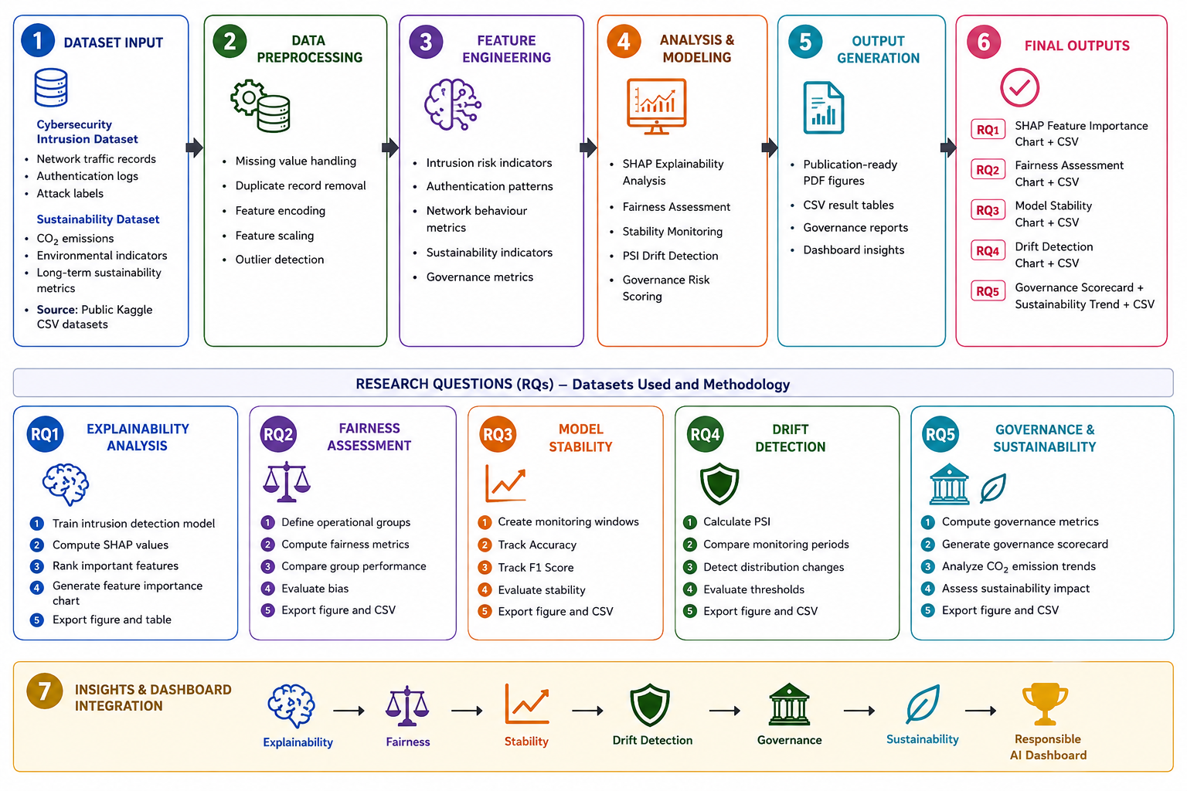













RESPONSIBLE AI DASHBOARD
FOR MODEL RISK ASSESSMENT AND SUSTAINABILITY MONITORING
Transparency
Fairness
Accountability
Governance
AI, Power & Responsibility – Governing Intelligent Systems for Trustworthy AI
Network traffic records
Authentication logs
Attack labels
Sustainability / Environmental Dataset
Sustainability & Environmental Indicators
CO₂ Emissions
Long term sustainability metrics
METHODOLOGY WORKFLOW
01 MOTIVATION
DATASETS
Artificial Intelligence is increasingly deployed in cybersecurity, sustainability, healthcare and financial systems. However, explainability, fairness, model drift and governance challenges reduce trust in AI-driven decisions.
Cybersecurity Intrusion Dataset
1
6
2
7
Goal
Develop a Responsible AI Dashboard integrating explainability, fairness, stability monitoring, drift detection, governance risk assessment and sustainability monitoring.
8
All datasets are publicly available for research purposes.
5
10
? RESEARCH QUESTIONS
SHAP analysis identified the most influential features driving intrusion detection predictions.
Fairness assessment indicated low bias across network activity groups.
The model achieved 88.47% accuracy while maintaining stable prediction performance.
Drift detection reported a minimal drift score of 0.0043, indicating stable operational behavior.
The Responsible AI Dashboard generated an Overall Risk Score of 86/100, supporting governance and compliance decisions.
RQ1
How explainable are AI model predictions?
KEY RESULTS (HIGHLIGHTS)
RQ2
Does Fairness assessment indicated low bias across network activity groups?
RQ3
How can governance and sustainability indicators improve Responsible AI oversight?
RQ4
Can model drift be detected automatically?
RQ5
How can a dashboard improve AI governance and accountability?
RQ1 – Feature Importance (SHAP)
RQ2 – Fairness Assessment
RQ3 – Model Performance Over Time
RQ4 – Drift Detection
SHAP values show the impact of each feature on model predictions.
Fairness scores closer to 1 indicate lower bias across demographic groups.
Slight performance degradation observed over time.
Drift score increases over time indicating distribution changes in the data.
RQ5 – Governance & Sustainability Assessment
Metric | Score
Explainability Score | 99/100
Fairness Score | 89/100
Stability Score | 88/100
Compliance Score | 90/100
Overall Risk Score | 86/100
86
0.00 – 0.05: No Drift
0.05 – 0.15: Minor Drift
Overall Risk Score
(out of 100)
>0.15: Critical Drift
Aggregated risk score to support governance decisions.
CONTRIBUTIONS
RESPONSIBLE DASHBOARD RESULTS
Model Accuracy
Fairness Score
Drift Score
Explainability Score
Compliance Status
Overall Risk Score
Comprehensive Responsible AI Dashboard for model monitoring.
88.47%
89.42%
0.0043
99.14%
PASS
86/100
Integration of Explainability (SHAP) for transparency.
↑ 2% vs last month
↑ 3% vs last month
Stable
↑ 5% vs last month
All checks passed
Low Risk
Bias and Fairness assessment across operational network groups.
Alerts & Insights
Automated Drift Detection for continuous monitoring.
• Drift score remains within acceptable threshold.
• Explainability analysis identified high-impact prediction features.
• Fairness metrics remain within governance limits.
• Continue periodic monitoring and model validation.
Risk Scoring Engine for actionable insights.
Supports Governance, Compliance and Accountability.
08 CONCLUSION
The Responsible AI Dashboard provides a comprehensive framework for monitoring, evaluating, and governing AI systems throughout their lifecycle. By integrating explainability, fairness assessment, performance tracking, drift detection, and compliance monitoring, the dashboard enables organizations to identify risks before they impact decision-making processes.
The results demonstrate that continuous monitoring significantly improves transparency, accountability, and trustworthiness in AI deployments. The unified risk scoring mechanism simplifies complex model evaluation metrics into actionable insights for stakeholders, regulators, and decision-makers.
Overall, this work highlights the importance of Responsible AI practices and demonstrates how governance-driven dashboards can support ethical, fair, and reliable AI systems in real-world applications.
The proposed framework achieved an Explainability Score of 99.14%, Fairness Score of 89.42%, and Overall Risk Score of 86/100 while maintaining a minimal drift score of 0.0043.
These results demonstrate the effectiveness of continuous Responsible AI monitoring and governance.
The framework integrates explainability, fairness assessment, stability monitoring, drift detection, governance scoring and sustainability analysis into a unified Responsible AI governance solution.
Trustworthy AI
Fair & Unbiased
Transparent
Accountable
Interdisciplinary Elective: AI, Power & Responsibility – Governing Intelligent Systems for Sustainability | Author: Miten Mistry | University of Europe for Applied Sciences, Potsdam, Germany

