Slide 1
HT-BDS High Temperature Broadband Dielectric Spectroscopy An Automated High Temperature Capacitor Characterization System
Matthew Wang

Slide 2
Problem & mission
The Problem:
Manual capacitor characterization is time consuming and error prone
Issues:
Commanding 3 different subsystems
Operator dependent and data handling
Limited repeatability, traceability, and scalability
The Mission:
Transform the existing test hardware into a repeatable automated test system that could handle the test workflow end-to-end.

Slide 3
System architecture
Hardware
SunSystems EC1A Temperature Chamber
Keysight E4980A LCR
NI USB-6501
Probe fixture
Operator Input
Temperature profile
Frequencies
Probes
Manual commands
Instrument Interfacing
PyVISA
SCPI
NI-DAQmx
Software Control
Program chamber
Monitor and stabilize DUT temperature
Switch probes
LCR sweep
Log Data
Data Output
Live plots
Temperature log
Probe tagged Cp/Df/ESR
Excel export

Slide 4
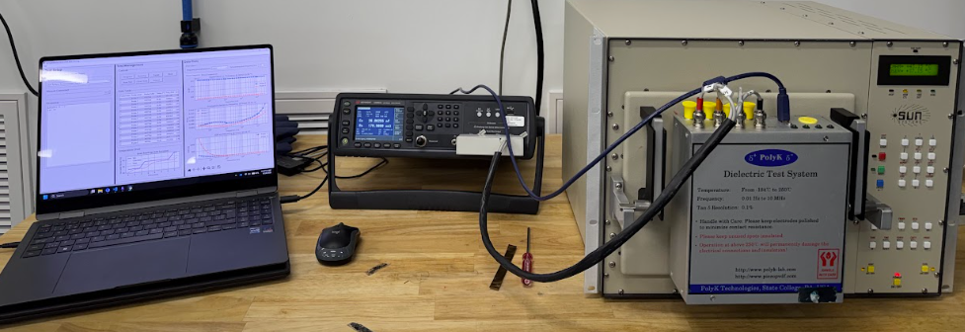
Test bench setup Left to right: HT-BDS GUI, Keysight LCR, SunSystems Oven

Slide 5
Automated Test Workflow
1.
Test Setup
2.
Program Chamber
3.
Oven
Breakpoint
4.
Temperature Stabilization
8.
Export
7.
Log/Plot
6.
LCR Sweep
5.
Probe Switch

Slide 6
Technical challenges
Coordinating 3 Subsystems
The Problem:
Chamber, LCR, and DAQ have independent timing, behavior, and failure modes.
The Solution:
Implement an explicit run state workflow and safety/data integrity measures.
Thermal Lag
The Problem:
Chamber setpoint doesn’t guarantee the DUT is at target temperature.
The Solution:
Use a 2-stage measurement gate to confirm DUT is within tolerated temperature.
Extending to Multi-DUT
The Problem:
Single device testing limits throughput.
The Solution:
DAQ controlled multiprobe selection to allow for multiple DUTs

Slide 7
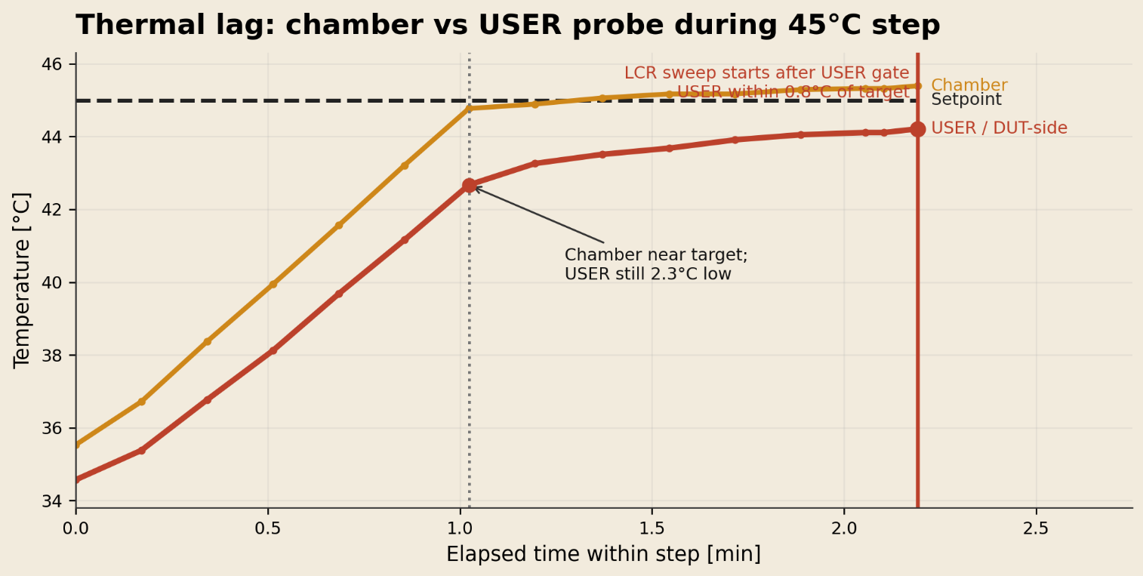
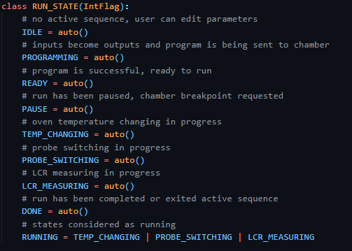
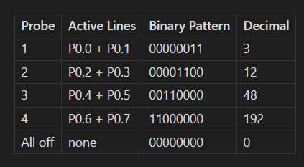
Technical Evidence

Slide 8
Key deliverables
Example Excel Workbook
Primary developer for the end-to-end HT-BDS software/control platform
~75% reduction in time
per-DUT-chamber cycle
Designed for unattended
execution
4x Throughput
Software Control
Run-state workflow
Setup locking
Chamber/LCR sequencing
Multiprobe DAQ
Probe tagged measurements
Switching logic
All-off state
Data
Metadata
Summary metrics
Traceability
Relevance: Hardware automation, instrument control, environmental testing, data acquisition

