Slide 1
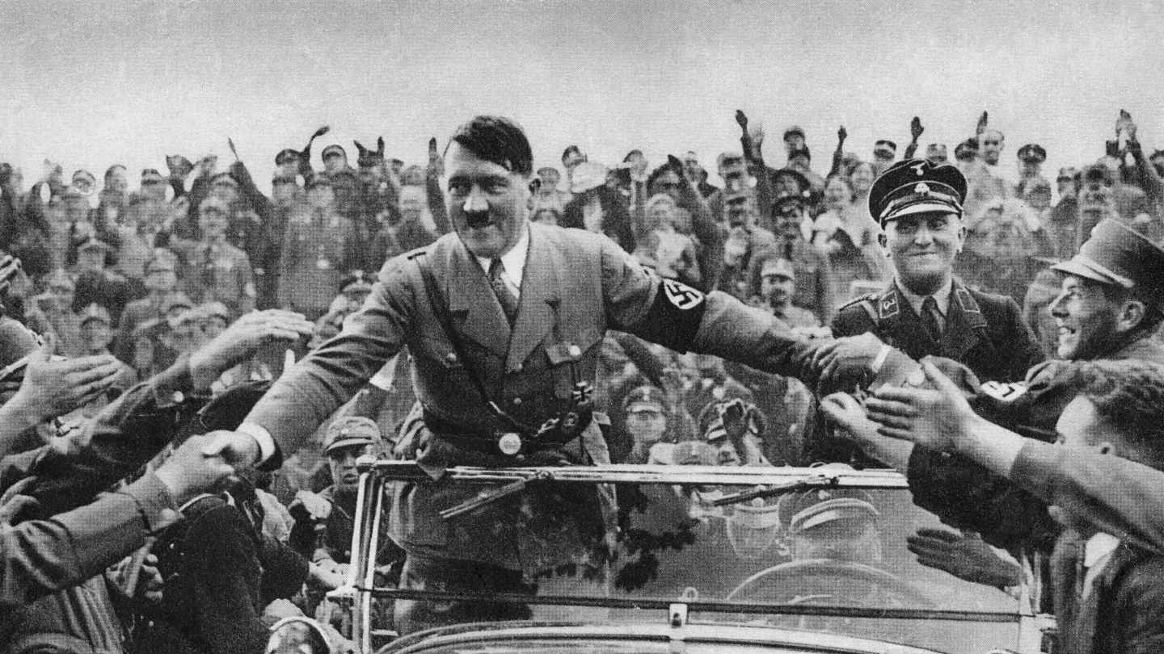
Hitler Propaganda
By Mohammad Wahdan

Slide 2
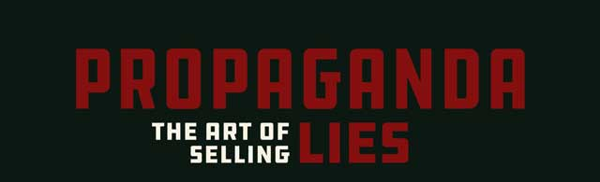
What is propaganda
Propaganda is information, especially of a biased or misleading nature.
Purpose: Propaganda is communication that is primarily used to influence or persuade an audience to further an agenda, which may not be objective
Some methods include name-calling, glittering generalities, transfer, testimonial, plain-folk, card-stacking, and bandwagon

Slide 3
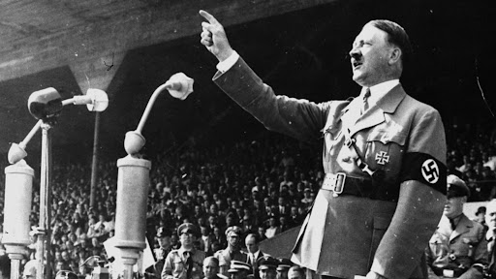
The Role of Propaganda in Nazi Germany
Nazi propaganda was essential in shaping public perception, consolidating power, suppressing dissent, and mobilizing the German population to support the regime's ideological and political goals. Through a comprehensive and relentless propaganda campaign, the Nazis were able to maintain control and push their radical agenda forward.

Slide 4
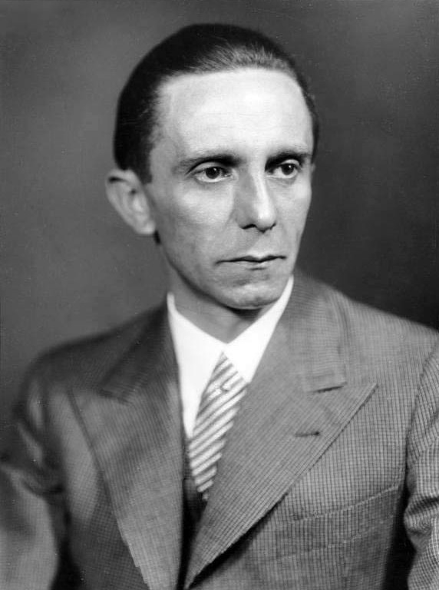
Joseph Goebbels - The Propaganda Mastermind
Joseph Goebbels is remembered as one of the most notorious figures of the Nazi regime. His work as Minister of Propaganda had a profound and devastating impact, contributing significantly to the spread of Nazi ideology and the perpetuation of its crimes. His use of media and communication as tools of manipulation and control remains a critical study in the fields of propaganda and mass communication.

Slide 5
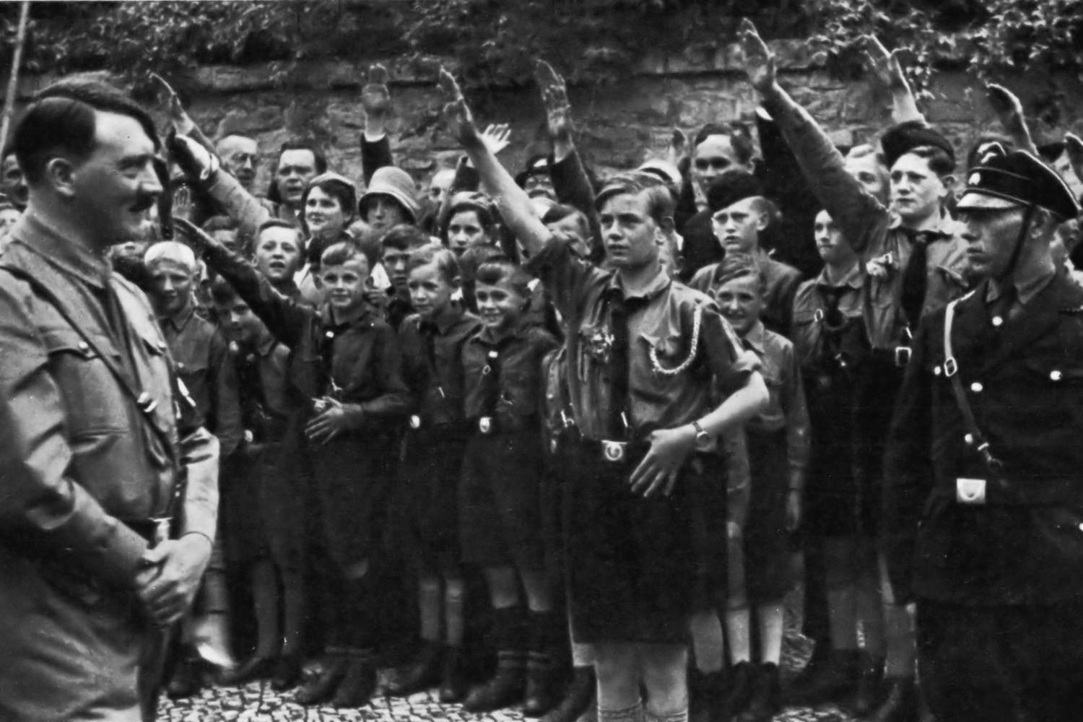
Indoctrination
Education System: Schools were used to teach Nazi ideology to children, ensuring the next generation was loyal to the regime.
Hitler Youth: Youth organizations were instrumental in indoctrinating young Germans, preparing them to be future soldiers and citizens aligned with Nazi ideals.

Slide 6
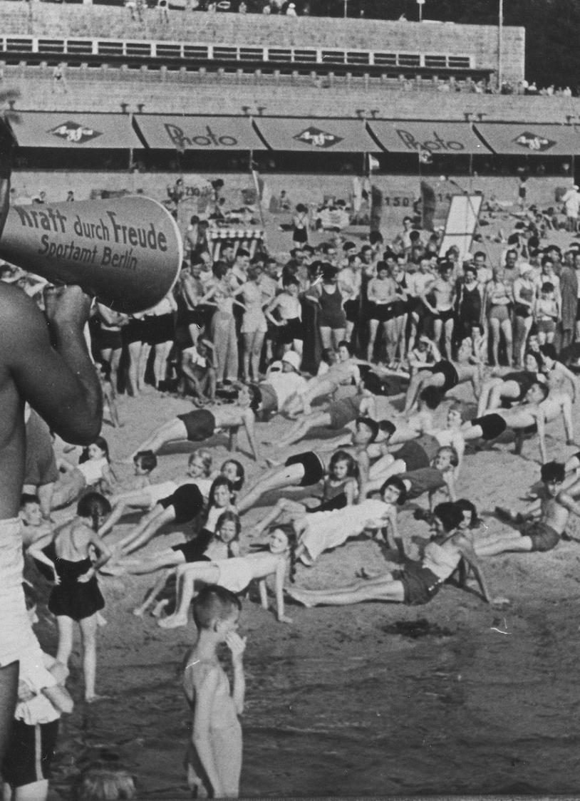

Economic and Social Policy Promotion
Positive Reinforcement: Propaganda highlighted the successes of Nazi policies, such as job creation and autobahn construction, reinforcing the narrative that the regime was beneficial for all.
Community Programs: Initiatives like the Strength Through Joy program were promoted to show the regime's investment in the well-being of ordinary Germans.

Slide 7
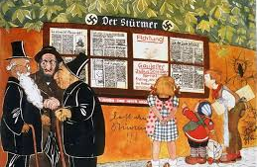
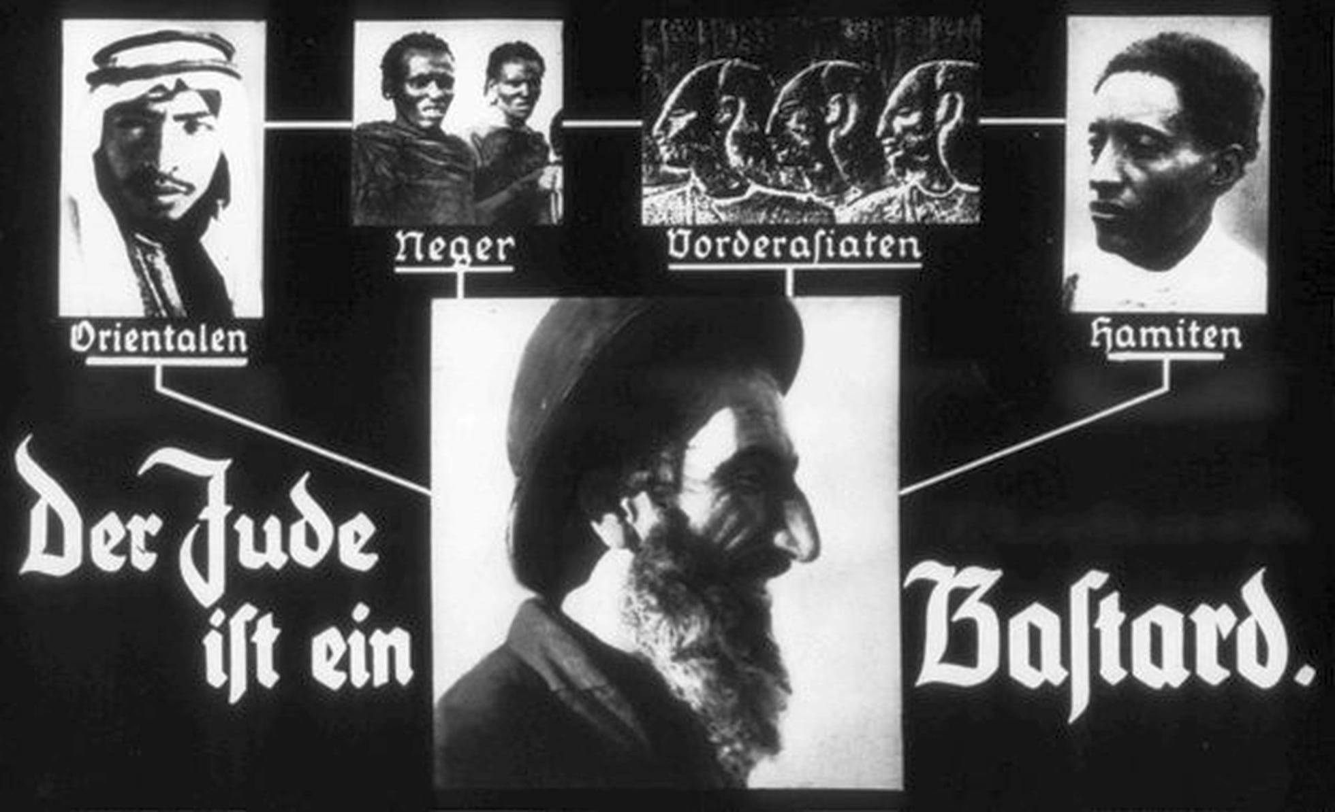

Rationalizing Aggressive Policies
War Justification: Propaganda justified military aggression and expansion by portraying Germany as a victim of international conspiracies and a defender of Western civilization.
Holocaust Justification: Anti-Semitic propaganda dehumanized Jews, making the population more accepting of their persecution and eventual genocide.

Slide 8
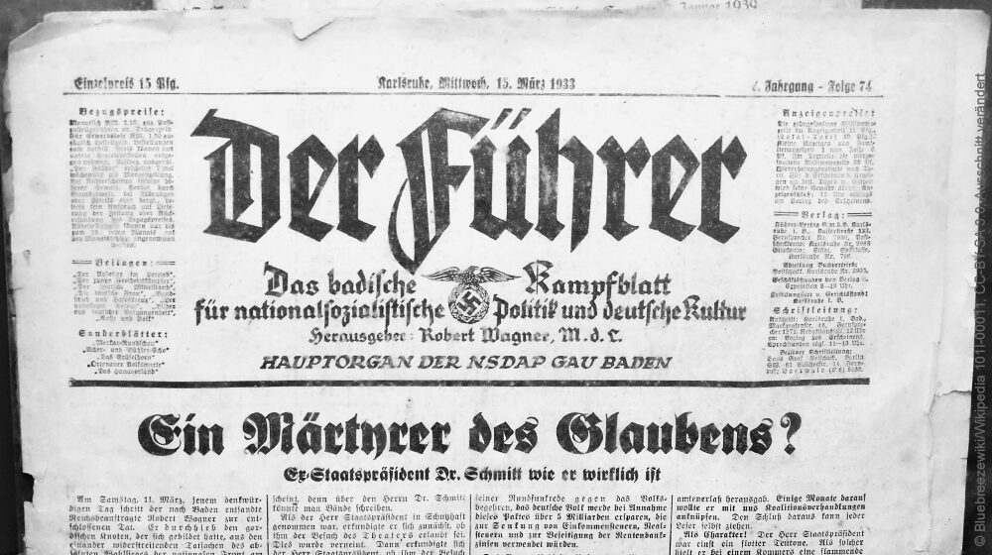
Tools of Nazi Propaganda
Some tools include: Print Media(Newspapers, Books and Pamphlets), radio, film, posters, theaters, and even music

Slide 9
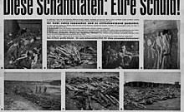
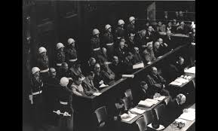
The Impact and Legacy of Nazi Propaganda
Its short-term impacts were seen in the widespread support for Nazi policies and the mobilization for war and genocide. Long-term, it shaped global human rights frameworks, geopolitical realities, and cultural narratives, while also leaving a lingering threat in the form of modern extremist ideologies.

Slide 10

Sources
https://en.wikipedia.org/wiki/Propaganda_in_Nazi_Germany
https://en.wikipedia.org/wiki/Joseph_Goebbels
https://en.wikipedia.org/wiki/The_Holocaust
https://encyclopedia.ushmm.org/content/en/article/the-nuremberg-race-laws
https://en.wikipedia.org/wiki/Nuremberg_Laws
https://encyclopedia.ushmm.org/content/en/article/nazi-propaganda

