Slide 1
Chapter 10 ArrayLists

Slide 2
Collections
collection: an object that stores data; a.k.a. "data structure"
the objects stored are called elements
some collections maintain an ordering; some allow duplicates
typical operations: add, remove, clear, contains (search), size
examples found in the Java class libraries:
ArrayList, LinkedList, HashMap, TreeSet, PriorityQueue
all collections are in the java.util package
import java.util.*;

Slide 3
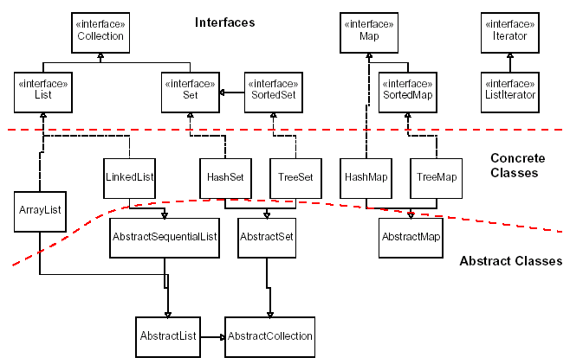
Java collections framework

Slide 4
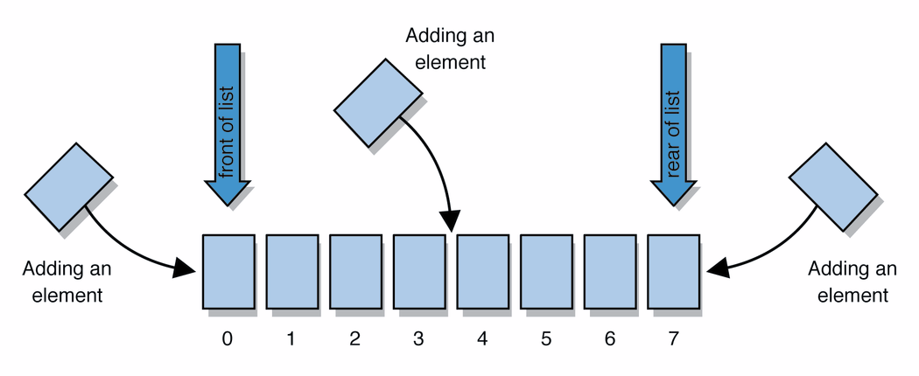
Lists
list: a collection storing an ordered sequence of elements
each element is accessible by a 0-based index
a list has a size (number of elements that have been added)
elements can be added to the front, back, or elsewhere
in Java, a list can be represented as an ArrayList object
Notes:
use jGRASP/DrJava Interactions window to create a list and add some elements, get them, check size

Slide 5
Idea of a list
Rather than creating an array of boxes, create an object that represents a "list" of items. (initially an empty list.)
[]
You can add items to the list.
The default behavior is to add to the end of the list.
[hello, ABC, goodbye, okay]
The list object keeps track of the element values that have been added to it, their order, indexes, and its total size.
Think of an "array list" as an automatically resizing array object.

Slide 6
The ArrayList Class
You can create an array to store objects. But the array’s size is fixed once the array is created. Java provides the ArrayList class that can be used to store an unlimited number of objects.

Slide 7
ArrayList methods
add(value) | appends value at end of list
add(index, value) | inserts given value just before the given index, shifting subsequent values to the right
clear() | removes all elements of the list
indexOf(value) | returns first index where given value is found in list (-1 if not found)
get(index) | returns the value at given index
remove(index) | removes/returns value at given index, shifting subsequent values to the left
set(index, value) | replaces value at given index with given value
size() | returns the number of elements in list
toString() | returns a string representation of the list such as "[3, 42, -7, 15]"

Slide 8
ArrayList methods
addAll(list) addAll(index, list) | adds all elements from the given list to this list (at the end of the list, or inserts them at the given index)
contains(value) | returns true if given value is found somewhere in this list
containsAll(list) | returns true if this list contains every element from given list
equals(list) | returns true if given other list contains the same elements
iterator() listIterator() | returns an object used to examine the contents of the list (seen later)
lastIndexOf(value) | returns last index value is found in list (-1 if not found)
remove(value) | finds and removes the given value from this list
removeAll(list) | removes any elements found in the given list from this list
retainAll(list) | removes any elements not found in given list from this list
subList(from, to) | returns the sub-portion of the list between indexes from (inclusive) and to (exclusive)
toArray() | returns the elements in this list as an array

Slide 9
Generic Type
ArrayList is known as a generic class with a generic type E. You can specify a concrete object type to replace E when creating an ArrayList.
ArrayList<E> name = new ArrayList<E>();
To create an ArrayList and assigns its reference to variable cities. This ArrayList object can be used to store strings.
ArrayList<String> cities = new ArrayList<String>();
ArrayList<String> cities = new ArrayList<>();
Type inference

Slide 10
ArrayList vs. array
construction
String[] names = new String[5];
ArrayList<String> list = new ArrayList<String>();
storing a value
names[0] = "Jessica";
list.add("Jessica");
retrieving a value
String s = names[0];
String s = list.get(0);

Slide 11
ArrayList vs. array 2
doing something to each value that starts with "B"
for (int i = 0; i < names.length; i++) {
if (names[i].startsWith("B")) { ... }
}
for (int i = 0; i < list.size(); i++) {
if (list.get(i).startsWith("B")) { ... }
}
seeing whether the value "Benson" is found
for (int i = 0; i < names.length; i++) {
if (names[i].equals("Benson")) {...}
}
if (list.contains("Benson")) { ... }

Slide 12
import java.util.ArrayList;
public class TestArrayList {
public static void main(String[] args) {
// Create an array list to store cities
ArrayList<String> cityList = new ArrayList<>();
// Add some cities in the list
cityList.add("London");
// cityList now contains [London]
cityList.add("Denver");
// cityList now contains [London, Denver]
cityList.add("Paris");
// cityList now contains [London, Denver, Paris]
cityList.add("Miami");
// cityList now contains [London, Denver, Paris, Miami]
cityList.add("Seoul");
// contains [London, Denver, Paris, Miami, Seoul]
cityList.add("Tokyo");
// contains [London, Denver, Paris, Miami, Seoul, Tokyo]
System.out.println("List size? " + cityList.size());
System.out.println("Is Miami in the list? " + cityList.contains("Miami"));
System.out.println("The location of Denver in the list? " + cityList.indexOf("Denver"));

Slide 13
System.out.println("Is the list empty? " +cityList.isEmpty()); // Print false
// Insert a new city at index 2
cityList.add(2, "Xian");
// contains [London, Denver, Xian, Paris, Miami, Seoul, Tokyo]
// Remove a city from the list
cityList.remove("Miami");
// contains [London, Denver, Xian, Paris, Seoul, Tokyo]
// Remove a city at index 1
cityList.remove(1);
// contains [London, Xian, Paris, Seoul, Tokyo]
// Display the contents in the list
System.out.println(cityList.toString());
// Display the contents in the list in reverse order
for (int i = cityList.size() - 1; i >= 0; i--)
System.out.print(cityList.get(i) + " ");
System.out.println();
// Create a list to store two circles
java.util.ArrayList<Circle> list = new java.util.ArrayList<>();
// Add two circles
list.add(new Circle(2));
list.add(new Circle(3));

Slide 14
// Display the area of the first circle in the list
System.out.println("The area of the circle? " + list.get(0).getArea());
}
}
List size? 6
Is Miami in the list? true
The location of Denver in the list? 1
Is the list empty? false
[London, Xian, Paris, Seoul, Tokyo]
Tokyo Seoul Paris Xian London
The area of the circle? 12.566370614359172

Slide 15
Out-of-bounds
Legal indexes are between 0 and the list's size() - 1.
Reading or writing any index outside this range will cause an IndexOutOfBoundsException.
ArrayList<String> names = new ArrayList<>();
names.add("Marty");
names.add("Kevin");
names.add("Vicki");
names.add("Larry");
System.out.println(names.get(0)); // okay
System.out.println(names.get(3)); // okay
System.out.println(names.get(-1)); // exception
names.add(9, "Aimee"); // exception
index | 0 | 1 | 2 | 3
value | Marty | Kevin | Vicki | Larry

Slide 16
Static method called List.of
//create an ArrayList of names of days of the week
ArrayList<String> dayNames = new ArrayList<>();
dayNames.add("Mon");
dayNames.add(“Tue");
dayNames.add(“Wed");
dayNames.add(“Thu");
dayNames.add(“Fri");
dayNames.add(“Sat");
dayNames.add(“Sun");
List.of static method accepts any number of element values as parameters and returns a list object containing those elements.
ArrayList<String> dayNames = new ArrayList<>(
List.of(“Mon”,“Tue”,”Wed”,”Thu”,”Fri”,”Sat”,
“Sun”));

Slide 17
Differences and Similarities between Arrays and ArrayList

Slide 18
Primitive Data Types
int
double
char
float
byte
long
boolean
short
A primitive-type value can be wrapped in an object using a wrapper class in the Java API.
Not an object
Many Java methods require the use of object as arguments

Slide 19
Wrapper Classes
Wrapper class names are the same as the primitive data type with the 1st letter capitalized.
Exceptions:
Integer for int
Character for char
Boolean
Character
Short
Byte
Integer
Long
Float
Double

Slide 20
Wrapper classes
A wrapper is an object whose sole purpose is to hold a primitive value.
Once you construct the list, use it with primitives as normal:
ArrayList<Double> grades = new ArrayList<Double>();
grades.add(3.2);
grades.add(2.7);
...
double myGrade = grades.get(0);
Primitive Type | Wrapper Type
int | Integer
double | Double
char | Character
boolean | Boolean

Slide 21
Generic Type
ArrayList is known as a generic class with a generic type E. You can specify a concrete object type to replace E when creating an ArrayList.
To create an ArrayList for storing integers
ArrayList<int> listOfIntegers = new ArrayList<>();
//Wrong
ArrayList<Integer> listOfIntegers = new ArrayList<>();
Type inference

Slide 22
Automatic Conversion Between Primitive Types and Wrapper Class Types
Boxing: converting a primitive value to a wrapper object
The reverse conversion is called unboxing
Java allows primitive type and wrapper classes to be converted automatically.
(a) can be simplified as in (b):
Integer[] intArray = {1, 2, 3};
System.out.println(intArray[0] + intArray[1] + intArray[2]);
Unboxing

Slide 23
Exercise using ArrayList class
To prompt the user to enter a sequence of numbers
and displays the distinct numbers in the sequence
Enter 0 to end the input and 0 is not counted as the
Number in the sequence
Create an ArrayList for Integer objects
Use the loop to read user input value
3. If the input value is not in the list, add it to the list

Slide 24
import java.util.ArrayList;
import java.util.Scanner;
public class DistinctNumbers {
public static void main(String[] args) {
ArrayList<Integer> list = new ArrayList<>();
Scanner input = new Scanner(System.in);
System.out.print("Enter integers (input ends with 0): ");
int value;
do {
value = input.nextInt(); // Read a value from the input
if (!list.contains(value) && value != 0) //for each value, if it is not in the list
list.add(value); // Add the value if it is not in the list
} while (value != 0);
// Display the distinct numbers
System.out.print("The distinct numbers are: ");
for (int i = 0; i < list.size(); i++)
System.out.print(list.get(i) + " ");
}
}
Enter integers (input ends with 0): 1 2 3 2 1 6 3 4 5 4 5 1 2 3 0
The distinct numbers are: 1 2 3 6 4 5

Slide 25
Array Lists from Arrays
Creating an ArrayList from an array of objects:
The static method asList in the Array class returns a list that is passed to the ArrayList constructor for creating an ArrayList
String[] array = {"red", "green", "blue"};
ArrayList<String> list = new ArrayList<>(Arrays.asList(array));

Slide 26
Array Lists to Arrays
Creating an array of objects from an ArrayList:
String[] array = {"red", "green", "blue"};
ArrayList<String> list = new ArrayList<>(Arrays.asList(array));
String[] array1 = new String[list.size()];
list.toArray(array1); //copies the contents form list //to array1

Slide 27
The Comparable Interface
The Comparable interface defines the compareTo method for comparing objects in java.lang package.
The Comparable interface is a generic interface.
The generic type E is replaced by a concrete type when implementing this interface
package java.lang;
public interface Comparable<E> {
public int compareTo(E o);
}

Slide 28
The Comparable Interface
All numeric wrapper classes, Character, String and Date class implement the Comparable interface.
Thus the compareTo method is implemented in these classes.

Slide 29
String and Date Classes are defined in Java API

Slide 30
The compareTo method
The standard way for a Java class to define a comparison function for its objects is to define a compareTo method.
Example: in the String class, there is a method:
public int compareTo(String other)
A call of A.compareTo(B) will return:
a value <0 if A comes "before" B in the ordering,
a value >0 if A comes "after" B in the ordering,
or 0 if A and B are considered "equal" in the ordering.

Slide 31
Using compareTo
compareTo can be used as a test in an if statement.
String a = "alice";
String b = "bob";
if (a.compareTo(b) < 0) { // true
...
}
Primitives | Objects
if (a < b) { ... | if (a.compareTo(b) < 0) { ...
if (a <= b) { ... | if (a.compareTo(b) <= 0) { ...
if (a == b) { ... | if (a.compareTo(b) == 0) { ...
if (a != b) { ... | if (a.compareTo(b) != 0) { ...
if (a >= b) { ... | if (a.compareTo(b) >= 0) { ...
if (a > b) { ... | if (a.compareTo(b) > 0) { ...

Slide 32
Exercise
1 System.out.println(new Integer(3).compareTo(new Integer(5)));
2 System.out.println("ABC".compareTo("ABC"));
3 java.util.Date date1 = new java.util.Date(2013, 1, 1);
4 java.util.Date date2 = new java.util.Date(2012, 1, 1);
5 System.out.println(date1.compareTo(date2));
-1
0
1

Slide 33
Sorting an ArrayList
To sort comparable elements in ArrayList using sort method in the java.util.Collections class
Integer[] array = {3, 5, 95, 4, 15, 34, 3, 6, 5};
//create the ArrayList from an array
ArrayList<Integer> list = new ArrayList<>(Arrays.asList(array));
java.util.Collections.sort(list);
System.out.println(list);

Slide 34
Find max and min in an Array List
Use the static max and min methods in the java.util.Collections class to return the maximum and minimal element in a list
Integer[] array = {3, 5, 95, 4, 15, 34, 3, 6, 5};
//create the ArrayList from an array
ArrayList<Integer> list = new ArrayList<>(Arrays.asList(array));
System.out.println(java.util.Collections.max(list));
System.out.println(java.util.Collections.min(list));

Slide 35
Shuffling an ArrayList
Use the static shuffle method in the java.util.Collections class to perform a random shuffle for the elements in a list
Integer[] array = {3, 5, 95, 4, 15, 34, 3, 6, 5};
//create the ArrayList from an array
ArrayList<Integer> list = new ArrayList<>(Arrays.asList(array));
java.util.Collections.shuffle(list);
System.out.println(list);

Slide 36
Exercise
ArrayList<Integer> list = new ArrayList<>();
for (int i = 1; i <= 10; i++) {
list.add(10 * i);
}
What is the output of the following code?
for (int i = 0; i < list.size(); i++) {
list.remove(i);
}
System.out.println(list);
//Answer?
[10, 20, 30, 40, ..., 100]
[10, 20, 30, 40, 50, 60, 70, 80, 90, 100]
i=0 0<10
i=1 1<9
i=2 2<8
i=3 3<7
i=4 4<6
i=5 5<5 false ,exit
Answer:
[20, 40, 60, 80, 100]

Slide 37
Exercise
ArrayList<Integer> list = new ArrayList<>();
for (int i = 1; i <= 5; i++) {
list.add(2 * i);
}
What is the output of the following code?
int size = list.size();
for (int i = 0; i < size; i++) {
list.add(i, 42); // add 42 at index i
}
System.out.println(list);
//Answer?
[2, 4, 6, 8, 10]
Answer:
[42, 42, 42, 42, 42, 2, 4, 6, 8, 10]

