Slide 1
Chapter 11 Java Collections Framework

Slide 2
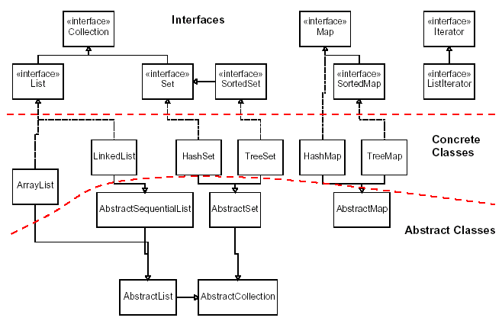
Java collections framework

Slide 3
Java Collection Framework hierarchy
A collection is a container object that holds a group of objects, often referred to as elements.
The Java Collections Framework supports three types of collections, named lists, sets, and maps.
All collections are in the java.util package
import java.util.*;
Set and List are subinterfaces of Collection.

Slide 4
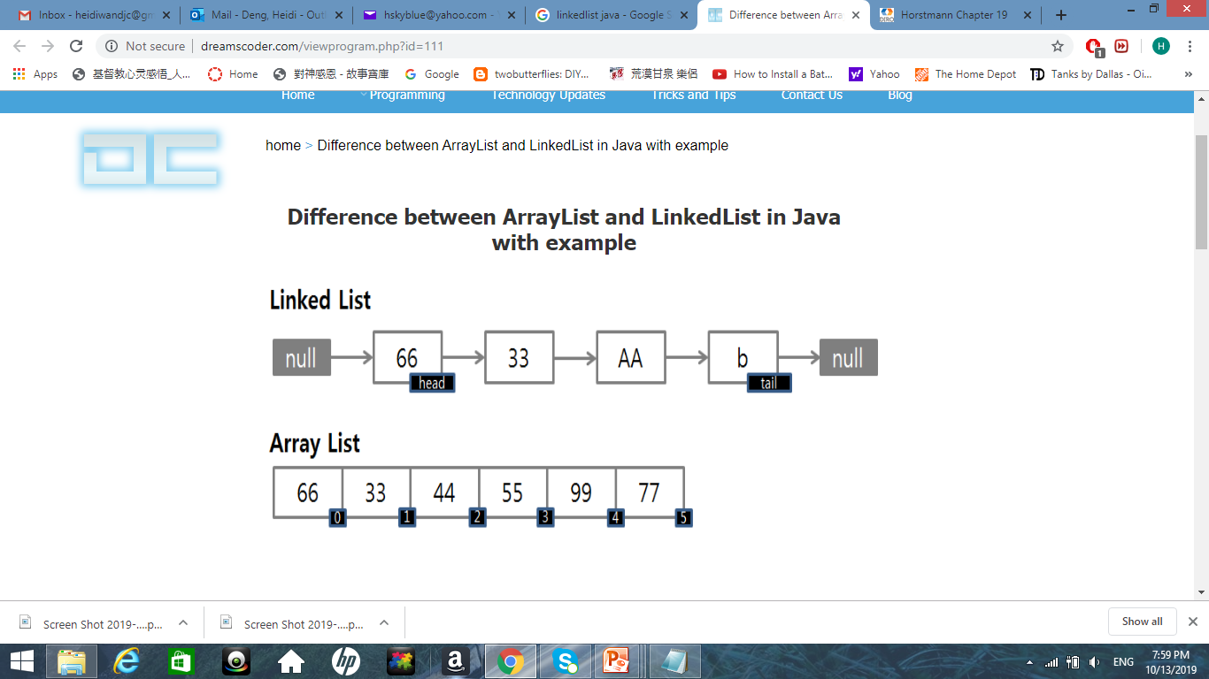
Difference between ArrayList and LinkedList
front
back
Linked List: A collection that stores a list of elements in small object containers called nodes, which are linked together.
Elements can be added at the front of the list quickly

Slide 5
ArrayList and LinkedList
The ArrayList class and the LinkedList class are concrete implementations of the List interface.
To support random access through an index without inserting or removing elements from any place other than the end, ArrayList offers the most efficient collection.
choose LinkedList if it requires the insertion or deletion of elements from any place in the list.
A list can grow or shrink dynamically.
An array is fixed once it is created.
If your application does not require insertion or deletion of elements, the most efficient data structure is the array.

Slide 6
java.util.LinkedList
<? extends E> means "some type that either is E or a subtype of E". The ? is a wildcard.

Slide 7
Iterators
Iterators are used in Collection framework in Java to retrieve elements one by one.
Iterator is a classic design pattern for walking through a data structure without having to expose the details of how data is stored in the data structure
The Collection interface extends the Iterable interface
The Java Iterable interface has only one method named iterator().
This method must return a Java Iterator which can be used to iterate the elements of the object implementing the Iterable interface.

Slide 8
Iterable Interface
The Java Iterable interface (java.lang.Iterable) is one of the root interfaces of the Java Collections API.
A class that implements the Java Iterable interface can be iterated with the Java for-each loop.
The Collection interface extends Iterable, so all subtypes of Collection also implement the Iterable interface.
Both the Java List and Set interfaces extend the Collection interface, and thereby also the Iterable interface.

Slide 10
Iterable Interface
Both Iterable and Iterator are interfaces in Java
The Iterable represents a collection which can be traversed. Implementing the Iterable interface allows an object to make use of for-each loop. It does that by internally calling the iterator() method on the object.
Below code only works as List interface extends the Collection interface and Collection interface extends the Iterable interface
ArrayList<String> persons = new ArrayList<>(Arrays.asList(“A”, “B”, “C”))
for (String person: persons) {
System.out.println(person);
}

Slide 11
Iterator Interface
Iterator interface allows us to iterate over some other objects which is a collection of some kind.
The Iterator interface provides the following methods:
boolean hasNext() - Returns true if the iteration has more elements.
E next() - Returns the next element in the iteration.
void remove() - Removes from the underlying collection the last element returned by the iterator (optional operation).
In order to iterate over an Iterator, we can use hasNext(), next() methods in a while loop

Slide 12
Iterators: to iterate over an Iterator
1)Obtain an iterator to the start of the collection by calling the collection's iterator( ) method.
2)Set up a loop that makes a call to hasNext( ). Have the loop iterate as long as hasNext( ) returns true.
3)Within the loop, obtain each element by calling next( ).
ArrayList<Integer> list= new ArrayList<>(Arrays.asList(1, 2, 3))
Iterator<Integer> iterator =list.iterator();
while (iterator.hasNext()) {
System.out.println(iterator.next());
}
Exercise: Use the iterator to traverse all the elements

Slide 13
Exercise: TestIterator
import java.util.*;
public class TestIterator {
public static void main(String[] args) {
LinkedList<String> llist = new LinkedList<>();
llist.add("New York");
llist.add("Atlanta");
llist.add("Dallas");
llist.add("Madison");
// Iterator to traverse the list
Iterator<String> iterator = llist.iterator();
while (iterator.hasNext()) {
System.out.print(iterator.next().toUpperCase() + " ");
}
System.out.println();
}
}
Output:
NEW YORK ATLANTA DALLAS MADISON

Slide 14
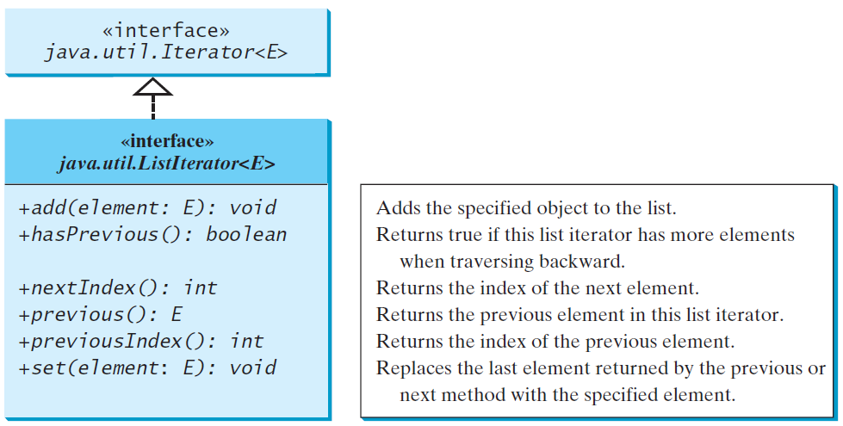
The List Iterator
‘ListIterator’ in Java is an Iterator which allows users to traverse Collection in both direction.

Slide 15
Iterators
1)Obtain an iterator to the start of the collection by calling the List's iterator( ) method.
LinkedList<Integer> list = new LinkedList<Integer>();
ListIterator<Integer> listIterator = list.listIterator();
2)Set up a loop that makes a call to hasNext( ). Have the loop iterate as long as hasNext( ) returns true.
3)Within the loop, obtain each element by calling next( ).
Exercise: Use the listIterator to traverse all the elements

Slide 16
Exercise: TestListIterator
import java.util.*;
public class TestListIterator {
public static void main(String[] args) {
LinkedList<String> list = new LinkedList<String>();
list.add("A");
list.add("B");
list.add("C");
list.add("D");
list.add("E");
// ListIterator to traverse the list
ListIterator<String> iterator = list.listIterator();
// Traversing the list in forward direction
System.out.println("Displaying list elements in forward direction : ");
while (iterator.hasNext())
System.out.print(iterator.next() + " ");
System.out.println();
// Traversing the list in backward direction
System.out.println("Displaying list elements in backward direction : ");
while (iterator.hasPrevious())
System.out.print(iterator.previous() + " ");
System.out.println();
}
}

Slide 17
Sets
set: A collection of unique values (no duplicates allowed) that can perform the following operations efficiently:
add, remove, search (contains)
We don't think of a set as having indexes; we just add things to the set in general and don't worry about order
"the"
"of"
"if"
set.contains("to")
"to"
true
"down"
"from"
set.contains("be")
"by"
"she"
"in"
"you"
false
"why"
"him"
set

Slide 18
Set implementation
in Java, sets are represented by Set interface in java.util
Set is implemented by HashSet and TreeSet classes
HashSet: implemented using a "hash table" array; very fast. elements are stored in unpredictable order
TreeSet: implemented using a "binary search tree"; pretty fast. elements are stored in sorted order

Slide 19
Set methods
can construct an empty set, or one based on a given collection
Set<Integer> set = new TreeSet<Integer>(); // empty set
List<String> list = new ArrayList<String>();
Set<String> set2 = new HashSet<String>(list);
add(value) | adds the given value to the set
contains(value) | returns true if the given value is found in this set
remove(value) | removes the given value from the set
clear() | removes all elements of the set
size() | returns the number of elements in list
isEmpty() | returns true if the set's size is 0
toString() | returns a string such as "[3, 42, -7, 15]"

Slide 20
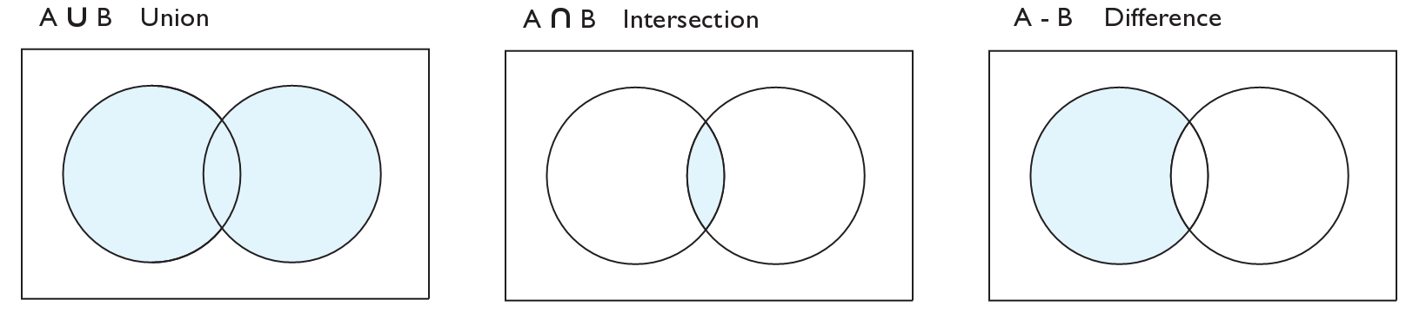
Set operations
addAll
retainAll
removeAll
addAll(collection) | adds all elements from the given collection to this set
containsAll(coll) | returns true if this set contains every element from given set
equals(set) | returns true if given other set contains the same elements
iterator() | returns an object used to examine set's contents
removeAll(coll) | removes all elements in the given collection from this set
retainAll(coll) | removes elements not found in given collection from this set
toArray() | returns an array of the elements in this set

Slide 21
Sets and ordering
HashSet : elements are stored in an unpredictable order
Set<String> names = new HashSet<String>();
names.add("Jake");
names.add("Robert");
names.add("Marisa");
names.add("Kasey");
System.out.println(names);
// [Kasey, Robert, Jake, Marisa]
TreeSet : elements are stored in their "natural" sorted order
Set<String> names = new TreeSet<String>();
names.add("Jake");
names.add("Robert");
names.add("Marisa");
names.add("Kasey");
System.out.println(names);
// [Jake, Kasey, Marisa, Robert]

Slide 22
The "for each" loop
for (type name : collection) {
statements;
}
Provides a clean syntax for looping over the elements of a Set, List, array, or other collection
Set<Double> grades = new HashSet<Double>();
...
for (double grade : grades) {
System.out.println("Student's grade: " + grade);
}
needed because sets have no indexes; can't get element i

Slide 23
Exercise HashSet
import java.util.*;
public class TestHashSet {
public static void main(String[] args) {
// Create a hash set
Set<String> set = new HashSet<>();
// Add strings to the set
set.add("London");
set.add("Paris");
set.add("New York");
set.add("San Francisco");
set.add("Beijing");
set.add("New York");
System.out.println(set);
// Display the elements in the hash set
for (String s: set) {
System.out.print(s.toUpperCase() + " ");
}
System.out.println();
for (String s: set) {
System.out.print(s.toLowerCase() + " ");
}
}
}

Slide 24
Exercise
set1 is [San Francisco, Beijing, New York, London, Paris]
5 elements in set1
set1 is [San Francisco, Beijing, New York, Paris]
4 elements in set1
set2 is [Shanghai, London, Paris]
3 elements in set2
Is Taipei in set2? false
After adding set2 to set1, set1 is [San Francisco, Beijing, New York, Shanghai, London, Paris]
After removing set2 from set1, set1 is [San Francisco, Beijing, New York]
After removing common elements in set2 from set1, set1 is []
import java.util.*;
public class TestMethodsInCollection {
public static void main(String[] args) {
// Create set1
Set<String> set1 = new HashSet<>();
// Add strings to set1
set1.add("London");
set1.add("Paris");
set1.add("New York");
set1.add("San Francisco");
set1.add("Beijing");
System.out.println("set1 is " + set1);
System.out.println(set1.size() + " elements in set1");
// Delete a string from set1
set1.remove("London");
System.out.println("\nset1 is " + set1);
System.out.println(set1.size() + " elements in set1");
// Create set2
Set<String> set2 = new HashSet<>();
// Add strings to set2
set2.add("London");
set2.add("Shanghai");
set2.add("Paris");
System.out.println("\nset2 is " + set2);
System.out.println(set2.size() + " elements in set2");
System.out.println("\nIs Taipei in set2? " + set2.contains("Taipei"));
set1.addAll(set2);
System.out.println("\nAfter adding set2 to set1, set1 is " + set1);
set1.removeAll(set2);
System.out.println("After removing set2 from set1, set1 is " + set1);
set1.retainAll(set2);
System.out.println("After removing common elements in set2 "
+ "from set1, set1 is " + set1);
}
}

Slide 25
Exercise: TestTreeSet
Sorted tree set: [Beijing, London, New York, Paris, San Francisco]
first(): Beijing
last(): San Francisco
pollFirst(): Beijing
pollLast(): San Francisco
New tree set: [London, New York, Paris]
import java.util.*;
public class TestTreeSet {
public static void main(String[] args) {
// Create a hash set
Set<String> set = new HashSet<>();
// Add strings to the set
set.add("London");
set.add("Paris");
set.add("New York");
set.add("San Francisco");
set.add("Beijing");
set.add("New York");
TreeSet<String> treeSet = new TreeSet<>(set);
System.out.println("Sorted tree set: " + treeSet);
// Use the methods in SortedSet interface
System.out.println("first(): " + treeSet.first());
System.out.println("last(): " + treeSet.last());
System.out.println("pollFirst(): " + treeSet.pollFirst());
System.out.println("pollLast(): " + treeSet.pollLast());
System.out.println("New tree set: " + treeSet);
}
}
The pollFirst() method of TreeSet in Java is used to retrieves and removes the first (lowest) element, or returns null if this TreeSet is empty.
The pollLast() method of TreeSet is an in-built function in Java which returns retrieves and removes the last (highest) element, or returns null if this set is empty.

Slide 26
List vs Set
The main difference between List and Set interface in Java is that List allows duplicates while Set doesn't allow duplicates.

Slide 27
Maps vs. sets
Set: Is "Marty" found in the set? (true/false)
Map: What is "Marty" 's phone number?
"Marty"
Set
true
false
"Marty"
Map
"206-685-2181"

Slide 28
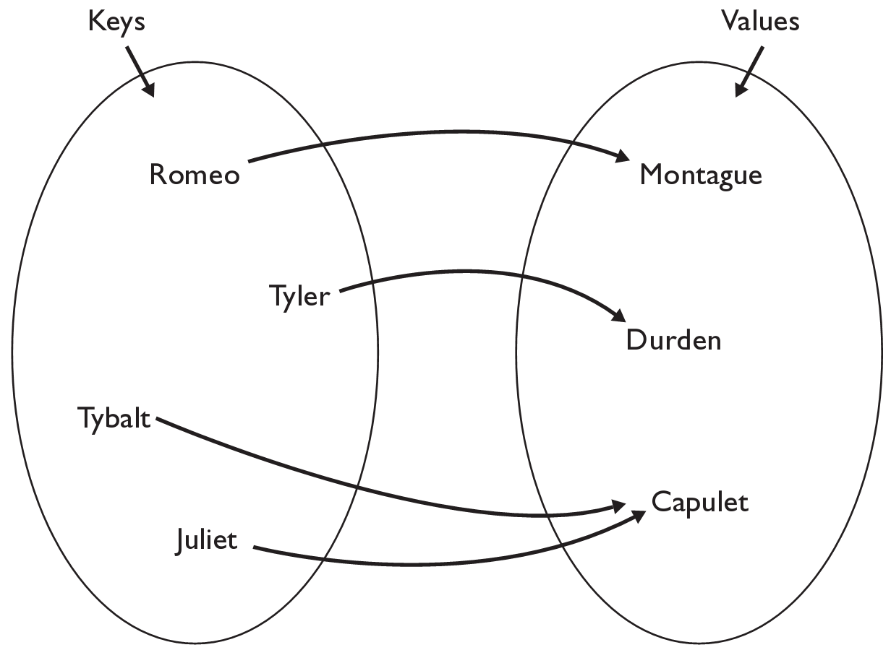
The Map
map: Holds a set of unique keys and a collection of values, where each key is associated with one value.
a.k.a. "dictionary", "associative array", "hash"
basic map operations:
put(key, value ): Adds a mapping from a key to a value.
get(key ): Retrieves the value mapped to the key.
remove(key ): Removes the given key and its mapped value.
Capulet
myMap.get("Juliet") returns "Capulet"

Slide 29
Map implementation
in Java, maps are represented by Map interface in java.util
Map is implemented by the HashMap and TreeMap classes
HashMap: implemented using an array called a "hash table"; extremely fast; keys are stored in unpredictable order
TreeMap: implemented as a linked "binary tree" structure; very fast; keys are stored in sorted order
A map requires 2 type parameters: one for keys, one for values.
// maps from String keys to Integer values
Map<String, Integer> votes = new HashMap<String, Integer>();

Slide 30
Map methods
put(key, value) | adds a mapping from the given key to the given value; if the key already exists, replaces its value with the given one
get(key) | returns the value mapped to the given key (null if not found)
containsKey(key) | returns true if the map contains a mapping for the given key
remove(key) | removes any existing mapping for the given key
clear() | removes all key/value pairs from the map
size() | returns the number of key/value pairs in the map
isEmpty() | returns true if the map's size is 0
toString() | returns a string such as "{a=90, d=60, c=70}"
keySet() | returns a set of all keys in the map
values() | returns a collection of all values in the map
putAll(map) | adds all key/value pairs from the given map to this map
equals(map) | returns true if given map has the same mappings as this one

Slide 31
Using maps
A map allows you to get from one half of a pair to the other.
Remembers one piece of information about every index (key).
Later, we can supply only the key and get back the related value:
Allows us to ask: What is Marty's phone number?
// key value
put("Marty", "206-685-2181")
Map
get("Marty")
Map
"206-685-2181"

Slide 32
keySet and values
keySet method returns a Set of all keys in the map
can loop over the keys in a foreach loop
can get each key's associated value by calling get on the map
Map<String, Integer> ages = new TreeMap<String, Integer>();
ages.put("Marty", 19);
ages.put("Geneva", 2); //ages.keySet() returns Set<String>
ages.put("Vicki", 57);
for (String name : ages.keySet()) { // Geneva -> 2
int age = ages.get(name); // Marty -> 19
System.out.println(name + " -> " + age); // Vicki -> 57
}
values method returns a collection of all values in the map
can loop over the values in a foreach loop
no easy way to get from a value to its associated key(s)

Slide 33
Exercise: TestMap
Display entries in HashMap:
{Lewis=29, Smith=30, Cook=29, Anderson=31}
treeMap:
Display entries in ascending order of key
{Anderson=31, Cook=29, Lewis=29, Smith=30}
import java.util.*;
public class TestMap {
public static void main(String[] args) {
// Create a HashMap
Map<String, Integer> hashMap = new HashMap<>();
hashMap.put("Smith", 30);
hashMap.put("Anderson", 31);
hashMap.put("Lewis", 29);
hashMap.put("Cook", 29);
System.out.println("Display entries in HashMap:");
System.out.println(hashMap + "\n");
// Create a TreeMap from the preceding HashMap
Map<String, Integer> treeMap = new TreeMap<>(hashMap);
System.out.println("treeMap:");
System.out.println("Display entries in ascending order of key");
System.out.println(treeMap);
// Display each entry with name and age
System.out.println("\nNames and ages are: ");
// Way 1: Get keySet() and Iterate using for-each loop
System.out.println("Way 1: Get keySet() and“ + " Iterate using for-each loop\n");
// getting keySet() into Set
Set<String> set1 = treeMap.keySet();
// for-each loop
for(String key : set1) {
System.out.println("Key : " + key + "\t\t“ + "Value : " + treeMap.get(key));
}
// Way 2: Get keySet() and Iterate using Iterator interface
System.out.println("\n\nWay 2: Get keySet() and“ + " Iterate using Iterator interface\n");
// getting keySet() into Set
Set<String> set2 = treeMap.keySet();
// Collection Iterator
Iterator<String> itr1 = set2.iterator();
while(itr1.hasNext()) {
String key = itr1.next();
System.out.println("Key : " + key + "\t\t“ + "Value : " + treeMap.get(key));
}
}
}

Slide 34
Exercise: TestMap
Names and ages are:
Way 1: Get keySet() and Iterate using for-each loop
Key : Anderson Value : 31
Key : Cook Value : 29
Key : Lewis Value : 29
Key : Smith Value : 30
Way 2: Get keySet() and Iterate using Iterator interface
Key : Anderson Value : 31
Key : Cook Value : 29
Key : Lewis Value : 29
Key : Smith Value : 30
import java.util.*;
public class TestMap {
public static void main(String[] args) {
// Create a HashMap
Map<String, Integer> hashMap = new HashMap<>();
hashMap.put("Smith", 30);
hashMap.put("Anderson", 31);
hashMap.put("Lewis", 29);
hashMap.put("Cook", 29);
System.out.println("Display entries in HashMap:");
System.out.println(hashMap + "\n");
// Create a TreeMap from the preceding HashMap
Map<String, Integer> treeMap = new TreeMap<>(hashMap);
System.out.println("treeMap:");
System.out.println("Display entries in ascending order of key");
System.out.println(treeMap);
// Display each entry with name and age
System.out.println("\nNames and ages are: ");
// Way 1: Get keySet() and Iterate using for-each loop
System.out.println("Way 1: Get keySet() and“ + " Iterate using for-each loop\n");
// getting keySet() into Set
Set<String> set1 = treeMap.keySet();
// for-each loop
for(String key : set1) {
System.out.println("Key : " + key + "\t\t“ + "Value : " + treeMap.get(key));
}
// Way 2: Get keySet() and Iterate using Iterator interface
System.out.println("\n\nWay 2: Get keySet() and“ + " Iterate using Iterator interface\n");
// getting keySet() into Set
Set<String> set2 = treeMap.keySet();
// Collection Iterator
Iterator<String> itr1 = set2.iterator();
while(itr1.hasNext()) {
String key = itr1.next();
System.out.println("Key : " + key + "\t\t“ + "Value : " + treeMap.get(key));
}
}
}

