Slide 1
Announcements
Homework-1: out Tuesday, please start early
Please do not copy from anywhere and work on your code yourself. Our detection agents are super smart!
Please don’t post any material from this class in any form, including your homework and related materials, to any public places, such as GitHub or others, on the Internet !

Slide 2
Finding Frequent Itemsets (Chapter 6)
Professor Wei-Min Shen
University of Southern California
Thanks for source slides and material to:
J. Leskovec, A. Rajaraman, J. Ullman: Mining of Massive Datasets
http://www.mmds.org

Slide 3
Frequent Itemsets and Association Rules
Family of techniques for characterizing data: discovery of frequent itemsets
e.g., identify sets of items that are frequently purchased together
Outline:
Introduce market-basket model of data
Define frequent itemsets
Discover association rules
Confidence and interest of rules
A-Priori Algorithm and variations

Slide 4
THE MARKET-BASKET MODEL

Slide 5
Association Rule Discovery
Supermarket shelf management – Market-basket model:
Goal: Identify items that are bought together by sufficiently many customers
Approach: Process the sales data to find dependencies among items
Brick and mortar stores: data collected with barcode scanners
Online retailers: transaction records for sales
A classic rule:
If someone buys diaper and milk, then he/she is likely to buy beer. // really ☺ do you know why?
Don’t be surprised if you find six-packs next to diapers!

Slide 6
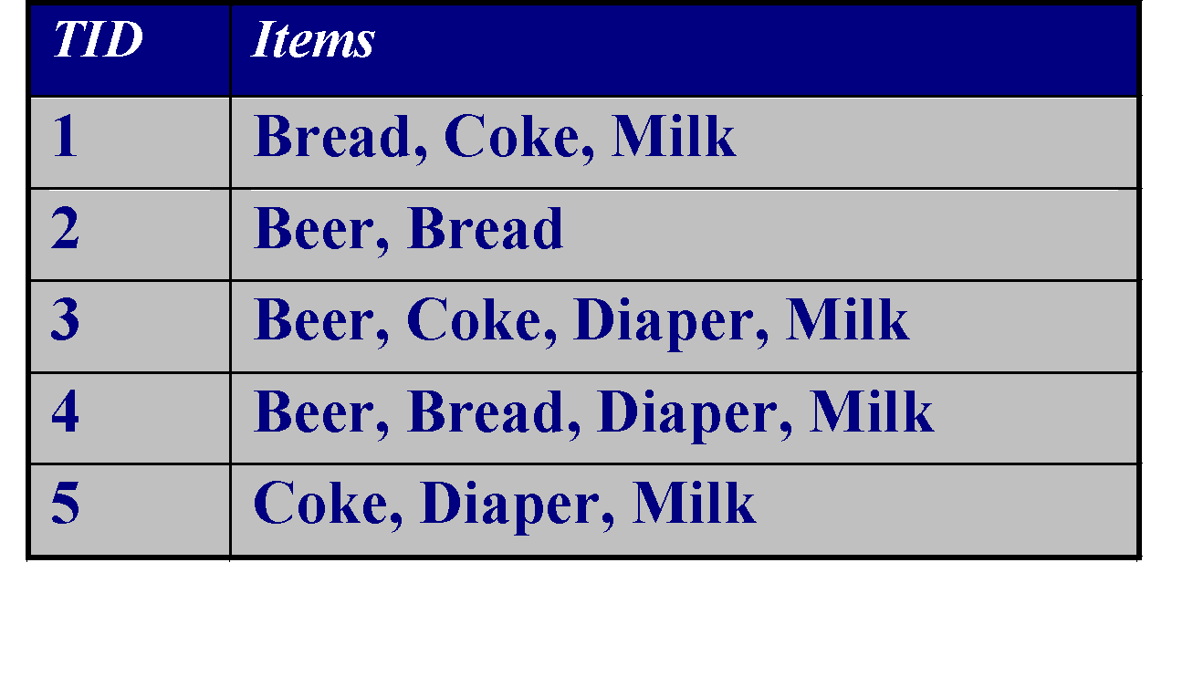
The Market-Basket Model
Input:
A large set of items
e.g., things sold in a supermarket
A large set of baskets
Each basket is a small subset of items
e.g., the things one customer buys on one day
Want to discover Association Rules
People who bought {x,y,z} tend to buy {v,w}
Brick and mortar stores: Influences setting of prices, what to put on sale when, product placement on store shelves
Recommender systems: Amazon, Netflix, etc.
Output:
Rules Discovered:
{Milk} --> {Coke}
{Diaper, Milk} --> {Beer}

Slide 7
Market-Baskets
Really a general many-many mapping (association) between two kinds of things: items and baskets
But we ask about connections among “items,” not “baskets.”
The technology focuses on common events, not rare events
Don’t need to focus on identifying *all* association rules
Want to focus on common events, focus pricing strategies or product recommendations on those items or association rules

Slide 8
Market Basket Applications (1): Identify items bought together
Items = products
Baskets = sets of products someone bought in one trip to the store
Real market baskets: Stores (Walmart, Target, Ralphs, etc.) keep terabytes of data about what items customers buy together
Tells how typical customers navigate stores
Lets them position tempting items
Suggests tie-in “tricks”, e.g., run sale on diapers and raise the price of beer
Need the rule to occur frequently, or no profits!
Amazon’s people who bought X also bought Y
Recommendation Systems

Slide 9
Market Basket Applications (2): Plagiarism detection
Baskets
= Sentences?
= Documents containing those sentences?
Items
= Sentences?
= Documents containing those sentences?
Question: Baskets=?, Items=?

Slide 10
Market Basket Applications (2): Plagiarism detection
Baskets = sentences
Items = documents containing those sentences
Item/document is “in” a basket if sentence is in the document
May seem backward, but relationship between baskets and items is many-to-many
Look for items that appear together in several baskets
Multiple documents share sentence(s)
Items (documents) that appear together too often could represent plagiarism.
Please don’t copy anyone’s code for your homework!
It will be detected easily by our Agent!

Slide 11
Market Basket Applications (3): Identify related “concepts” in web documents
Baskets = words? Web pages?
Items = words? Web pages?

Slide 12
Market Basket Applications (3): Identify related “concepts” in web documents
Baskets = Web pages
Items = words
Baskets/documents contain items/words in the document
Look for sets of words (items) that appear together in many documents (baskets)
Ignore most common words
Unusual words appearing together in a large number of documents, e.g., “World” and “Cup,” may indicate an interesting relationship or joint concept
Can you think of such examples: Word-X, Word-Y ?

Slide 13
Market Basket Applications (4): Drug Interactions
Baskets = patients
Items = drugs and side effects
Has been used to detect combinations of drugs that result in particular side-effects
But requires extension: Absence of an item needs to be observed as well as presence!!
Drinking milk and oil together: BAD
Drinking milk alone: OK
Drinking oil alone: OK

Slide 14
Scale of the Problem
WalMart sells 100,000 items and can store billions of baskets.
The Web has billions of words and many billions of pages.

Slide 15
DEFINE FREQUENT ITEMSETS

Slide 16
“Support” and “Frequent Itemsets”
Simplest question: Find sets of items that appear “frequently” in the baskets
Support for itemset I = the number of baskets containing all items in I
Sometimes given as a percentage
Given a support threshold s, sets of items that appear in at least s baskets are called “Frequent Itemsets”

Slide 17
Example: Frequent Itemsets
Items={milk, coke, pepsi, beer, juice}.
Support = 3 baskets.
B₁ = {m, c, b} B₂ = {m, p, j}
B₃ = {m, b} B₄ = {c, j}
B₅ = {m, p, b} B₆ = {m, c, b, j}
B₇ = {c, b, j} B₈ = {b, c}
Frequent itemsets of size 1: {m}, {c}, {b}, {j}
{m,b}
, {b,c}
, {c,j}.

Slide 18
ASSOCIATION RULES

Slide 19
“Association Rules” and “Confidence”
If-then rules about the contents of baskets
Basket I contains {i₁, i₂,…, i_{k}}
Rule {i₁, i₂,… ,i_{k}} → j means: “if a basket contains all of i₁,…,i_{k} then it is likely to contain j.”
Confidence of this association rule is the probability of j given i₁,…,i_{k}
Ratio of support for I U {j} with support for I
support for I U {j}
support for I
Support for I: number of baskets containing I

Slide 20
Example: Confidence of a Rule
B₁ = {m, c, b} B₂ = {m, p, j}
B₃ = {m, b} B₄ = {c, j}
B₅ = {m, p, b} B₆ = {m, c, b, j}
B₇ = {c, b, j} B₈ = {b, c}
An association rule: {m, b} → c
Confidence: Ratio of support for I U {j} with support for I
Ratio of support for {m,b} U {c} to support for {m,b}
Confidence = 2/4 = 50%
Want to identify association rules with high confidence
Notes:
201601 W1.1

Slide 21
Interesting Association Rules
Not all high-confidence rules are interesting
The rule X → milk may have high confidence for many itemsets X
because milk is just purchased very often (independent of X)
Interest of an association rule I → j: difference between its confidence and the fraction of baskets that contain j
Interesting rules are those with high positive or negative interest values (usually above 0.5)
High positive/negative interest means presence of I encourages or discourages presence of j
Example: {coke} -> pepsi should have high negative interest
Notes:
If confidence is high then interest cannot be negative

Slide 22
Example: Confidence and Interest
B₁ = {m, c, b} B₂ = {m, p, j}
B₃ = {m, b} B₄= {c, j}
B₅ = {m, p, b} B₆ = {m, c, b, j}
B₇ = {c, b, j} B₈ = {b, c}
Association rule: {m, b} →c
Confidence: Ratio of support for I U {j} with support for I
Confidence = 2/4 = 0.5
Interest:
Difference between its confidence and the fraction of baskets that contain j
Interest = |0.5 – 5/8| = 1/8
Item c appears in 5/8 of the baskets
Rule is not very interesting!

Slide 23
Finding Useful Association Rules
Question: “find all association rules with support ≥ s and confidence ≥ c ”
Hard part: finding the frequent itemsets
Note: if {i₁, i₂,…,i_{k}} → j has high support and confidence, then both {i₁, i₂,…,i_{k}} and {i₁, i₂,…,i_{k} ,j } will be “frequent”
Assume: not too many frequent itemsets or candidates for high support, high confidence association rules
Not so many that they can’t be acted upon
Adjust support threshold to avoid too many frequent itemsets

Slide 24
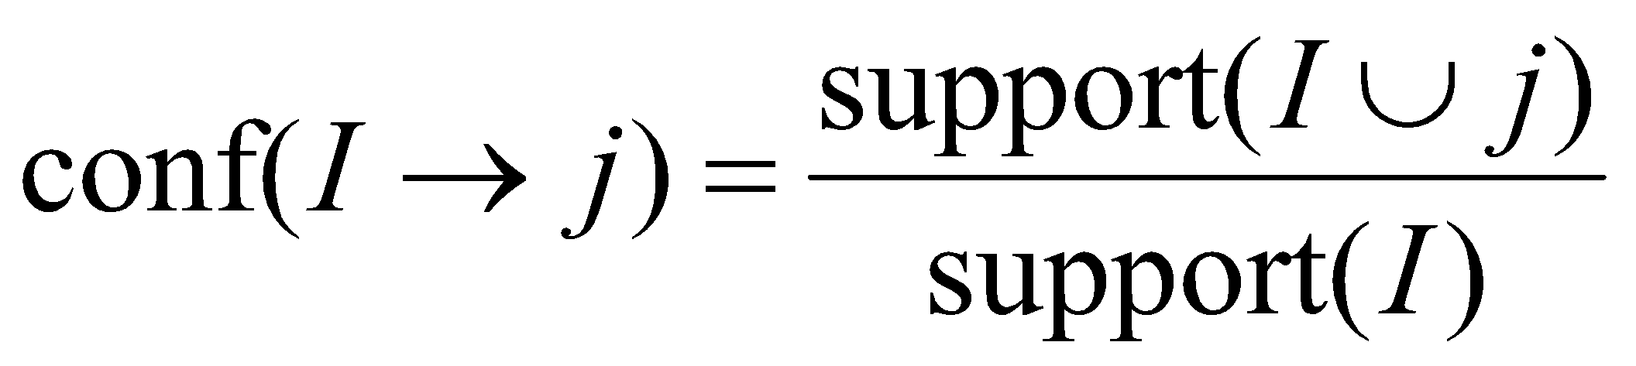
Example: Find Association Rules with support ≥ s and confidence ≥ c
B₁ = {m, c, b} B₂ = {m, p, j}
B₃ = {m, c, b, n} B₄= {c, j}
B₅ = {m, p, b} B₆ = {m, c, b, j}
B₇ = {c, b, j} B₈ = {b, c}
Support threshold s = 3, confidence c = 0.75
1) Frequent itemsets:
{b} {c} {j} {m} {b,m} {b,c} {c,m} {c,j} {m,c,b}
2) Generate rules:
b→m: conf=4/6 b→c: conf=5/6 b,c→m: conf=3/5
m→b: conf=4/5 … b,m→c: conf=3/4
b→c,m: conf=3/6
Difficult part is identifying frequent itemsets: algorithms to find them are the focus of this chapter

Slide 25
FIND FREQUENT ITEMSETS

Slide 26
Computation Model
Typically, market basket data are kept in flat files rather than in a database system
Stored on disk because they are very large files
Stored basket-by-basket
Goal: Expand baskets into pairs, triples, etc. as you read baskets
Use k nested loops to generate all sets of size k

Slide 27
File Organization
Item
Item
Example: items are
positive integers,
and boundaries
between baskets
are –1
Item
Basket 1
Item
Item
Item
Item
Basket 2
Item
Item
Item
Basket 3
Item
Item
Note: We want to find frequent itemsets. To find them, we have to count them. To count them, we have to generate them.
Etc.

Slide 28
Computation Model – (2)
The true cost of mining disk-resident data is usually the number of disk I/O’s
In practice, association-rule algorithms read the data in passes – all baskets read in turn
Thus, we measure the cost by the number of passes an algorithm takes
Notes:
W1.1

Slide 29
Main-Memory Bottleneck
For many frequent-itemset algorithms, main memory is the critical resource
As we read baskets, we need to count something, e.g., occurrences of pairs
The number of different things we can count is limited by main memory
Swapping counts in/out is a disaster
Algorithms are designed so that counts can fit into main memory

Slide 30
Finding Frequent Pairs
The hardest problem often turns out to be finding the frequent pairs
Why? Often frequent pairs are common, frequent triples are rare
Why? Probability of being frequent drops exponentially with size; number of sets grows more slowly with size
We’ll concentrate on pairs, then extend to larger itemsets

Slide 31
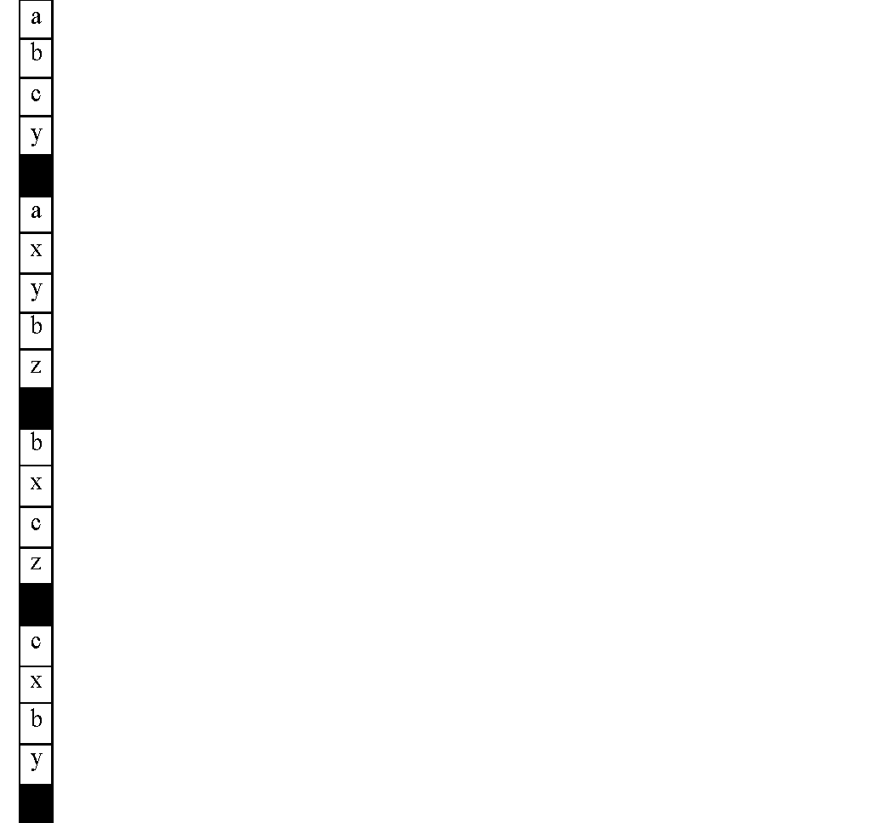


Naïve Algorithm
Baskets
Read file once, counting in main memory the occurrences of each pair
Number of pairs in a basket of n items: n choose 2
From each basket of n items, generate its n*(n -1)/2 pairs using two nested loops, add to the count for each pair
First basket: (a,b), (a,c), (a,y), (b,c), (b,y), (c,y)
Second basket: (a,b), (a,x), (a,y), (a,z), (b,x), (b,y), (b,z), ...
Total possible number of pairs in all baskets:
(#items)(#items -1)/2
Fails if (#items)² exceeds main memory
Remember: #items can be 100K (Wal-Mart) or 10B (Web pages)

Slide 32
Example: Counting Pairs
Suppose 10⁵ items
Suppose counts are 4-byte integers
Number of pairs of items: 10⁵(10⁵-1)/2 = 5*10⁹ (approximately)
Therefore, 2*10¹⁰ (20 gigabytes) of main memory needed

Slide 33
Details of Main-Memory Counting
Two approaches:
Count all pairs, using a triangular matrix
Keep a table of triples [i, j, c] = “the count of the pair of items {i, j } is c”
(1) requires only 4 bytes/pair, but requires a count for each pair
Note: assume integers are 4 bytes
(2) requires 12 bytes, but only for those pairs with count > 0
Plus some additional overhead for a hashtable
Notes:
20170101

Slide 34
4 per pair
12 per
occurring pair
Method (1):
It is a long list of “c”
Method (2)
It is a long list of
= (i,j,c)

Slide 35
Triangular Matrix: (i,j) is index, c is count
i
a11 a12 a13 a14 a15 …
a21 a22 a23 a24 a25 …
a31 a32 a33 a34 a35 …
a41 a42 a43 a44 a45 …
…
j
Where is (1,5)? (4, 7)?

Slide 36
Triangular-Matrix Approach – (1)
n
i-1
n = total number of items
Order each pair of items {i, j} so that i<j
Keep pair counts in lexicographic order:
{1,2}, {1,3},…, {1,n}, {2,3}, {2,4},…,{2,n}, {3,4},…
Pair {i, j} is at position (i –1)(n– i/2) + j – i
Every time you see a pair {i,j} from a basket, increment the count at the corresponding position in triangular matrix
Total number of pairs n(n –1)/2; total bytes= 2n²
Triangular Matrix requires 4 bytes (1 integer) per pair
i

Slide 37
Comparing the two approaches
Approach 1: Triangular Matrix
n = total number items
Count pair of items {i, j} only if i<j
Keep pair counts in lexicographic order:
{1,2}, {1,3},…, {1,n}, {2,3}, {2,4},…,{2,n}, {3,4},…
Pair {i, j} is at position (i –1)(n– i/2) + j –i
Total number of pairs n(n –1)/2; total bytes= 2n²
Triangular Matrix requires 4 bytes (1 integer for c) per pair
Approach 2: uses 12 bytes (i, j, c) per occurring pair (but only for pairs with count > 0)
Beats Approach 1 if fewer than 1/3 of possible pairs actually occur in the market basket data

Slide 38
Comparing the two approaches
Approach 1: Triangular Matrix
n = total number items
Count pair of items {i, j} only if i<j
Keep pair counts in lexicographic order:
{1,2}, {1,3},…, {1,n}, {2,3}, {2,4},…,{2,n}, {3,4},…
Pair {i, j} is at position (i –1)(n– i/2) + j –1
Total number of pairs n(n –1)/2; total bytes= 2n²
Triangular Matrix requires 4 bytes per pair
Approach 2 uses 12 bytes per pair (but only for pairs with count > 0)
Beats Approach 1 if less than 1/3 of possible pairs actually occur
Problem is if we have too many items so the pairs do not fit into memory.
Can we do better?

Slide 39
A-Priori Algorithm

Slide 40
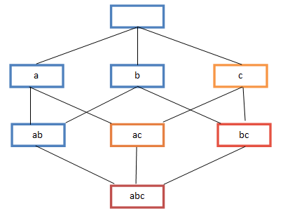
A-Priori Algorithm – (1)
A two-pass approach called A-Priori limits the need for main memory
Key idea: monotonicity
If a set of items I appears at least s times, so does every subset J of I
Contrapositive for pairs: If item i does not appear in s baskets, then no pair including i can appear in s baskets
So, how does A-Priori find freq. pairs?
Notes:
201603 w1.1

Slide 41
A-Priori Algorithm
Pass 1: Read baskets and count in main memory the occurrences of each single item
Requires only memory proportional to #items
Items that appear at least s times are the frequent items
At the end of pass 1, after the complete input file has been processed, check the count for each item
If count > s, then that item is frequent: saved for the next pass
Pass 1 identifies frequent itemsets (support>s) of size 1

Slide 42
A-Priori Algorithm
Pass 2: Read baskets again and count in main memory only those pairs of items where both were found in Pass 1 to be frequent
Requires:
Memory proportional to square of frequent items only (to hold counts of pairs)
List of the frequent items from the first pass (so you know what must be counted)
Pairs of items that appear at least s times are the frequent pairs of size 2
At the end of pass 2, check the count for each pair
If count > s, then that pair is frequent
Pass 2 identifies frequent pairs: itemsets of size 2

Slide 43
Main-Memory: Picture of A-Priori
Item counts
Frequent items
Counts of pairs of frequent items (candidate pairs)
Main memory
Pass 1
Pass 2

Slide 44
Detail for A-Priori
You can use the triangular matrix method with n = number of frequent items
May save space compared with storing triples
Trick: re-number frequent items 1,2,… and keep a table relating new numbers to original item numbers
Item counts
Frequent items
Old item #s
Counts of pairs of frequent items
Counts of pairs of frequent items
Main memory
Pass 1
Pass 2

Slide 45
What About Larger Frequent Itemsets? Frequent Triples, Etc.
For each k, we construct two sets of k-tuples (sets of size k):
C_{k} = candidate k-tuples = those that might be frequent sets (support > s) based on information from the pass for k–1
L_{k} = the set of truly frequent k-tuples
Count
the items
All pairs
of items
from L₁
Count
the pairs
All
items
To be
explained
Filter
Filter
Construct
Construct
C₁
L₁
C₂
L₂
C₃

Slide 46
Recall: Example
B₁ = {m, c, b} B₂ = {m, p, j}
B₃ = {m, c, b, n} B₄= {c, j}
B₅ = {m, p, b} B₆ = {m, c, b, j}
B₇ = {c, b, j} B₈ = {b, c}
Frequent itemsets (s=3):
{b}, {c}, {j}, {m}
{b,m} {b,c} {c,m} {c,j}
{m,c,b}

Slide 47
Example
Hypothetical steps of the A-Priori algorithm
C₁ = { {b} {c} {j} {m} {n} {p} }: all candidate items
Count the support of itemsets in C₁
Prune non-frequent: L₁ = { b, c, j, m }
Generate C₂ = { {b,c} {b,j} {b,m} {c,j} {c,m} {j,m} }
Count the support of itemsets in C₂
Prune non-frequent: L₂ = { {b,m} {b,c} {c,m} {c,j} }
Generate C₃ = { {b,c,m} }
Count the support of itemsets in C₃
Prune non-frequent: L₃ = { {b,c,m} }
Filter
Filter
Construct
Construct
C₁
L₁
C₂
L₂
C₃
Notes:
** Note here we generate new candidates by generating C_{k} from L_{k-1} and L₁. But that one can be more careful with candidate generation. For example, in C₃ we know {b,m,j} cannot be frequent since {m,j} is not frequent
201601 W1.2

Slide 48
A-Priori for All Frequent Itemsets
One pass for each k (itemset size)
Needs room in main memory to count each candidate k–tuple
For typical market-basket data and reasonable support (e.g., 1%), k = 2 requires the most memory

