Slide 1
Hybrid Recommendation Systems
Professor Wei-Min Shen
University of Southern California
Thanks for source slides and material to:
J. Leskovec, A. Rajaraman, J. Ullman: Mining of Massive Datasets
http://www.mmds.org

Slide 2
Three Approaches to Recommendation Systems
1) Content-based
Use characteristics of an item
Recommend items that have similar content to items user liked in the past
Or items that match pre-defined attributes of the user
2) Collaborative filtering
Build a model from a user's past behavior (items previously purchased or rated) and similar decisions made by other users
Use the model to predict items that the user may like
Read https://spark.apache.org/docs/2.1.0/ml-collaborative-filtering.html
Collaborative: suggestions made to a user utilize information across the entire user base
3) Hybrid approaches

Slide 3
HYBRID RECOMMENDER SYSTEMS

Slide 4
Hybrid Recommender Systems
Implement two or more different recommenders and combine predictions
Perhaps using a linear model
Example: Add content-based methods to collaborative filtering
Item profiles for new item problem
Demographics to deal with new user problem
Additional reading: “Hybrid Web Recommender Systems” by Robin Burke
Burke, R. (2007). Hybrid web recommender systems. In The adaptive web (pp. 377-408). Springer Berlin Heidelberg.
Some slides adapted from PPT by Jae-wook Ahn

Slide 5
Hybrid Recommender Systems
Mix of recommender systems
Recommender system classification based on its knowledge source
Collaborative Filtering (CF)
User ratings only
Content-based (CN)
Product features, user ratings
Classifications of users’ likes/dislikes
Demographic
User ratings, user demographics
Knowledge-based (KB)
Domain knowledge, product features, user’s need/query
Inferences about a user’s needs and preferences

Slide 6
Netflix Example
Urban legend
Before green-lighting House of Cards, Netflix knew:
A lot of users watched the David Fincher directed movie The Social Network from beginning to end
The British version of “House of Cards” has been well watched
Those who watched the British version “House of Cards” also watched ☹Kevin Spacey☹ films and/or films directed by David Fincher
Read: https://blog.kissmetrics.com/how-netflix-uses-analytics/

Slide 7
Strategies for Hybrid Recommendation
Combination of multiple recommendation techniques together for producing output
Different techniques of different types
Most common implementations
Most promise to resolve cold-start problem
Different techniques of the same type
Example: NewsDude – naïve Bayes + k-nearest neighbor

Slide 8
Seven Types of Hybrid Recommender Systems (Taxonomy by Burke, 2002)
Weighted: The score of different recommendation components are combined numerically
Switching: The system chooses among recommendation components and applies the selected one.
Mixed: Recommendations from different recommenders are presented together.
Feature Combination: Features derived from different knowledge sources are combined together and given to a single recommendation algorithm.
Feature Augmentation: One recommendation technique is used to compute a feature or set of features, which is then part of the input to the next technique.
Cascade: Recommenders are given strict priority, with the lower priority ones breaking ties in the scoring of the higher ones.
Meta-level: One recommendation technique is applied and produces some sort of model, which is then the input used by the next technique.

Slide 9
1. WEIGHTED HYBRID

Slide 10
1. Weighted Hybrid
Each component of the hybrid scores a given item and the scores are combined using a linear formula
Combines evidence from both recommenders in a static manner (weighting doesn’t change)
Appropriate when component recommenders have consistent relative accuracy across the product space
The movie recommender system in [32] has two components: one, using collaborative techniques, identifies similarities between rating profiles and makes predictions based on this information. The second component uses simple semantic knowledge about the features of movies, compressed dimensionally via latent semantic analysis, and recommends movies that are semantically similar to those the user likes. The output of the two components is combined using a linear weighting scheme.

Slide 11
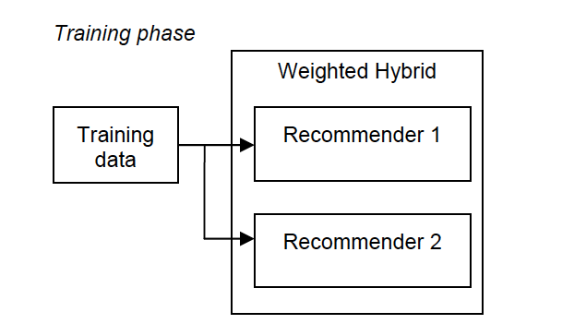
1. Weighted Hybrid
Training phase: each individual recommender processes the training data
Note: all hybrid algorithms include training phase

Slide 12
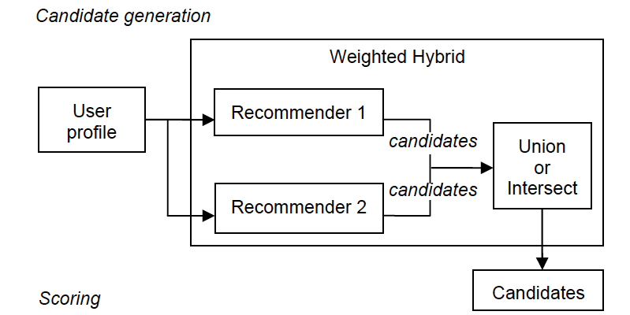
1. Weighted Hybrid
Candidate generation: When a prediction is being generated for a test user, the recommenders jointly propose candidates
Some recommendation techniques (e.g., content-based algorithms) make predictions on any item
Others are limited
e.g., collaborative filtering can’t make predictions if there are no peer users who have rated the item
Candidate generation necessary to identify items that will be considered

Slide 13
1. Weighted Hybrid
The sets of candidates must then be rated jointly
Two approaches:
Intersection of candidate sets: possible only a small number of candidates shared between candidate sets
Union of candidate sets: must decide how to handle cases in which it is not possible for a recommender to rate a given candidate
May give such a candidate a neutral (neither liked nor disliked) score

Slide 14
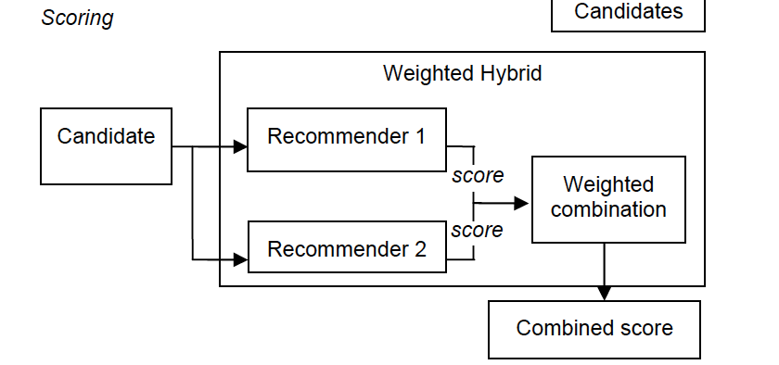
1. Weighted Hybrid
Scoring:
Each candidate is then rated by the two recommenders
A linear combination of the two scores computed, which becomes the item's predicted rating

Slide 15
1. Weighted Hybrid
Weighted hybrid recommender:
Burke classification discusses static, linear combination of weights
More generally: Weights can be linear combination, use weighted majority voting or weighted average voting
Example: P-Tango system
Initially: CF and content-based recommenders have equal weight
Gradually adjusts weighting as predictions are confirmed or found incorrect

Slide 16
2. MIXED HYBRID

Slide 17
2. Mixed Hybrid
A mixed hybrid presents recommendations of its different components side-by-side in a combined list
There is no attempt to combine evidence between recommenders
PTV recommends television shows [48]. It has both content-based and collaborative components, but because of the sparsity of the ratings and the content space, it is difficult to get both recommenders to produce a rating for any given show. Instead the components each produce their own set of recommendations that are combined before being shown to the user.

Slide 18
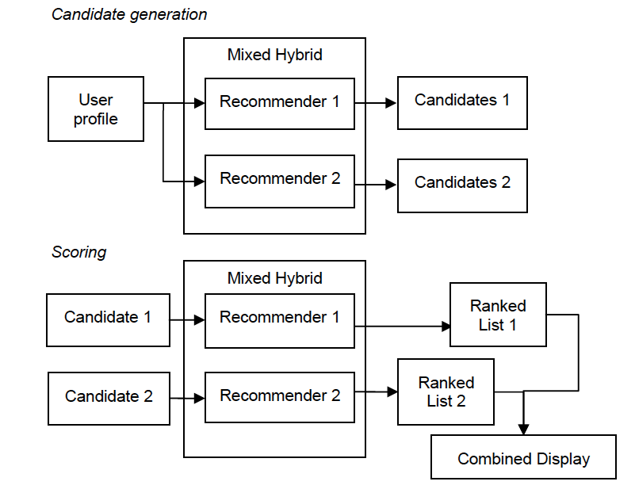
2. Mixed Hybrid

Slide 19
3. SWITCHING HYBRID

Slide 20
3. Switching Hybrid
Selects a single recommender from among its constituents based on the recommendation situation
For a different profile, a different recommender might be chosen
Takes into account that components may not have consistent performance for all types of users
Assumes that some reliable criterion is available on which to base the switching decision
E.g., Confidence values inherent in the recommendation components

Slide 21
3. Switching Hybrid
NewsDude [4] recommends news stories. It has three recommendation components: a content-based nearest-neighbor recommender, a collaborative recommender and a second content-based algorithm using a naive Bayes classifier. The recommenders are ordered. The nearest neighbor technique is used first. If it cannot produce a recommendation with high confidence, then the collaborative recommender is tried, and so on, with the naive Bayes recommender at the end of line.

Slide 22
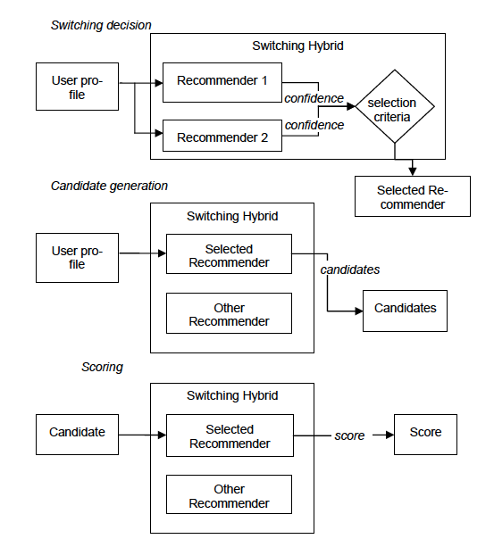
3. Switching Hybrid

Slide 23
4. FEATURE COMBINATION

Slide 24
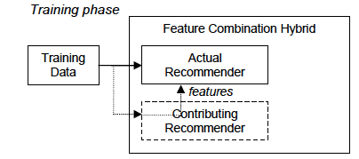
4. Feature Combination
Inject features of one source (such as collaborative recommendation) into an algorithm designed to process data with a different source (such a content-based recommendation)
A virtual "contributing recommender”
Features would ordinarily be processed by one recommender are instead used as part of the input to the actual recommender
Hybrid is the knowledge sources involved
Borrows the recommendation logic from another technique rather than employing a separate component that implements it

Slide 25
4. Feature Combination
Basu, Hirsh and Cohen [3] used the inductive rule learner Ripper [16] to learn content-based rules about user's likes and dislikes. They were able to improve the system's performance by adding collaborative features, thereby treating a fact like "User1 and User2 liked Movie X" in the same way that the algorithm treated features like "Actor1 and Actor2 starred in Movie X".
Content-based recommender works in the typical way
Builds a learned model for each user (a user profile)
But user rating data is combined with the product features
Content-based recommender draws from a knowledge source associated with collaborative filtering recommandation

Slide 26
5. FEATURE AUGMENTATION

Slide 27
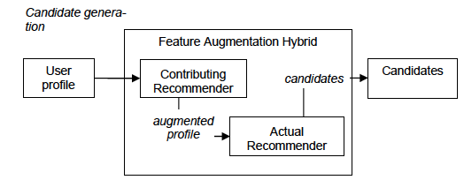
5. Feature Augmentation
Feature augmentation hybrid generates a new feature for each item by using the recommendation logic of the contributing domain
E.g. use association rule mining over the collaborative data to derive new content features for content-based recommendation
At each step, the contributing recommender intercepts the data headed for the actual recommender and augments it with its own contribution
not raw features as in feature combination, but the result of some computation

Slide 28
5. Feature Augmentation
Melville, Mooney and Nagarajan [30] coin the term "content-boosted collaborative filtering." This algorithm learns a content-based model over the training data and then uses this model to generate ratings for unrated items. This makes for a set of profiles that is denser and more useful to the collaborative stage of recommendation that does the actual recommending.
Employed when there is:
a well-developed strong primary recommendation component
desire to add additional knowledge sources
Augmentation can usually be done offline

Slide 29
Content-Boosted CF Example
Uses naïve Bayes as the content classifier
Fills in missing values of rating matrix with predictions of the content predictor
Form a pseudo rating matrix: observed ratings unchanged, missing ratings replaced by predictions of content predictor
Then make predictions over the pseudo ratings matrix using weighted Pearson correlation based CF
Give higher weight for item that more users rated
Gives higher weight for active user

Slide 30
6. CASCADE HYBRID

Slide 31
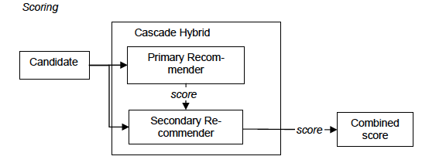
6. Cascade Hybrid
Create a strictly hierarchical hybrid
A weak recommender cannot overturn decisions made by a stronger one, but can merely refine them
Order-dependence
A cascade recommender uses a secondary recommender only to break ties in the scoring of the primary one

Slide 32
6. Cascade Hybrid
The knowledge-based Entree restaurant recommender [10] was found to return too many equally-scored items, which could not be ranked relative to each other. Rather than additional labor-intensive knowledge engineering (to produce finer discriminations), the hybrid EntreeC was created by adding a collaborative re-ranking of only those items with equal scores.
This taxonomy is very strict
Real-world systems might have other refinements that are not exclusive (e.g., only breaking ties)

Slide 33
7. META-LEVEL HYBRID

Slide 34
7. Meta-Level Hybrid
Uses a model learned by one recommender as input for another
Similar to the feature augmentation hybrid in that the contributing recommender is providing input to the actual recommender
Difference: in meta-level hybrid, contributing recommender completely replaces the original knowledge source with a learned model that the actual recommender uses
Actual recommender does not work with any raw profile data
Pazzani [36] used the term "collaboration through content" to refer to his restaurant recommender that used the naive Bayes technique to build models of user preferences in a content-based way. With each user so represented, a collaborative step was then be performed in which the vectors were compared and peer users identified.

Slide 35
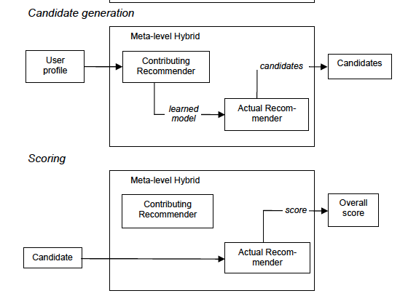
7. Meta-level Hybrid

Slide 36
Hybrid Recommendation Systems
Personality diagnosis
Combines memory-based and model-based CF
Active user generated by choosing one of the other users uniformly at random, adding Gaussian noise to their ratings
Given active user’s known ratings, can calculate probability active user is same “personality type” as other users
Predict probability they will like new items
Can be regarded as a clustering method with one user per cluster
Makes better predictions than:
Pearson correlation-based and vector similarity-based CF algorithms
Bayesian clustering and Bayesian networks

Slide 37
HW3/Competition & More Readings
SparkML:
https://spark.apache.org/docs/2.2.0/mllib-collaborative-filtering.html
How to evaluate recommendation systems:
https://www.microsoft.com/en-us/research/wp-content/uploads/2016/02/EvaluationMetrics.TR_.pdf
HW3: You will have 3 weeks to complete
Don’t panic!
Hint: first debug your code on small and known examples from the lecture notes, before you run on the big data set

