Slide 1

Clustering Professor Wei-Min Shen University of Southern California
Note to other teachers and users of these slides: We would be delighted if you found this our material useful in giving your own lectures. Feel free to use these slides verbatim, or to modify them to fit your own needs. If you make use of a significant portion of these slides in your own lecture, please include this message, or a link to our web site: http://www.mmds.org
Mining of Massive Datasets
Jure Leskovec, Anand Rajaraman, Jeff Ullman Stanford University
http://www.mmds.org

Slide 2
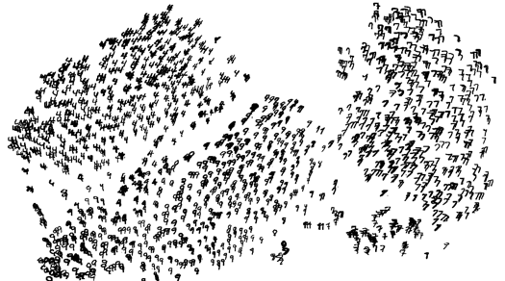
High Dimensional Data
Given a cloud of data points we want to understand its structure

Slide 3
The Problem of Clustering
Given a set of points, with a notion of distance between points, group the points into some number of clusters, so that
Members of a cluster are close/similar to each other
Members of different clusters are dissimilar
Usually:
Points are in a high-dimensional space
Similarity is defined using a distance measure
Euclidean, Cosine, Jaccard, edit distance, …

Slide 4
Example: Clusters & Outliers
x
xx x
x x
x x x
x
x x x
x
x
xx x
x x
x x x
x
x x x
x
x
x x
x x x x
x x x x
x x x
x x
x x
x x x x
x x x x
x x x
x x
x x
x x x x
x x x
x
x x
x x x x
x x x
x
x
Outlier
Cluster

Slide 5
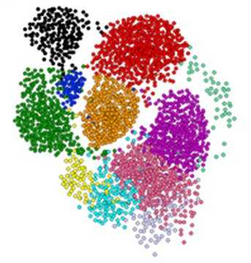
Clustering is a hard problem!

Slide 6
Why is it hard?
Clustering in two dimensions looks easy
Clustering small amounts of data looks easy
Many applications involve not 2, but 10 or 10,000 dimensions
High-dimensional spaces look different: Almost all pairs of points are at about the same distance

Slide 7
High Dimension: Euclidean
Consider a set of data points on a line
dist(a, b) < dist(a, c)
Consider increasing the dimension by 1
dist(a, b) ~ dist(a, c)
a
b
c
b
a
c

Slide 8
High Dimension: Cosine
Cosine(a, b) > Cosine(a, c)
Increase d to 3
Cosine(a, b) ~ Cosine(a, c)
Higher d
Angle -> 90º
Cosine -> 0
b
a
c
a
b
c

Slide 9
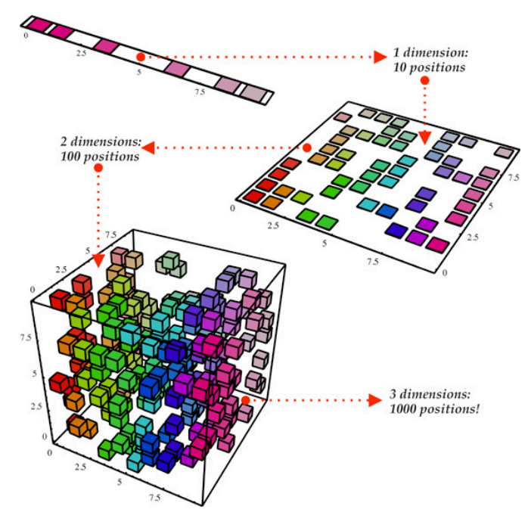
Curse of Dimensionality
Data points have similar distance btw each other
Euclidean distance breaks
almost all pairs of points are equally far away from one another
Data vectors become orthogonal
Cosine function breaks
almost any two vectors are orthogonal
https://bigsnarf.wordpress.com/2013/06/14/curse-of-dimensionality/

Slide 10
Clustering Problem: Music CDs
Intuitively: Music divides into categories, and customers prefer a few categories
But what are categories really?
Represent a CD by a set of customers who bought it
Similar CDs have similar sets of customers, and vice-versa

Slide 11
Clustering Problem: Music CDs
Space of all CDs:
Think of a space with one dim. for each customer (there are many customers!)
Values in a dimension may be 0 or 1 only
A CD is a point in this space (x₁, x₂,…, x_{k}), where x_{i} = 1 iff the i ^{th} customer bought the CD
For Amazon, the dimension is tens of millions
Task: Find clusters of similar CDs

Slide 12
Cosine, Jaccard, and Euclidean
As with CDs we have a choice when we think of documents as sets of words or shingles:
Sets as vectors: Measure similarity by the cosine distance
Sets as sets: Measure similarity by the Jaccard distance
Sets as points: Measure similarity by Euclidean distance

Slide 13
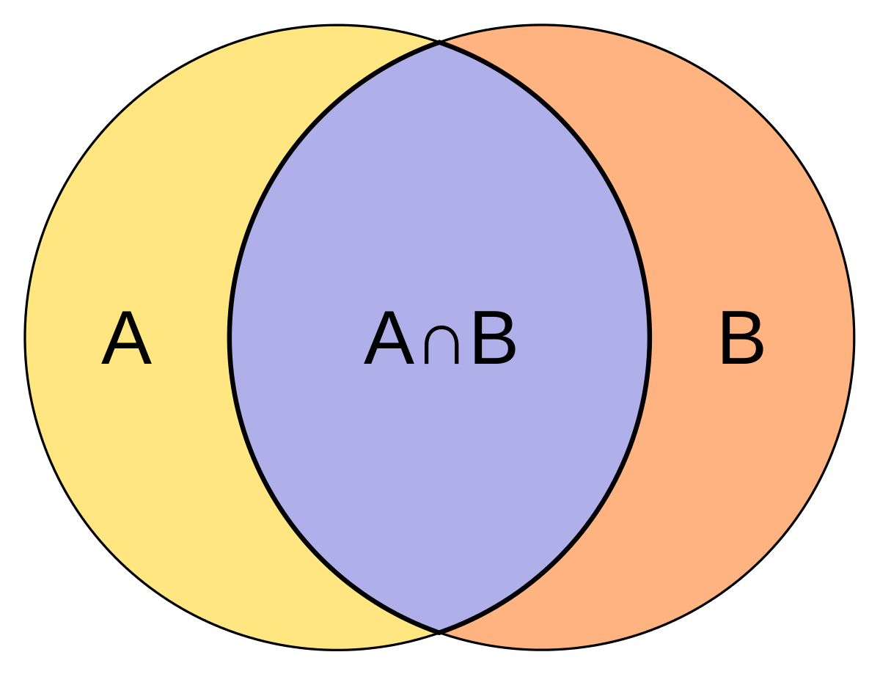
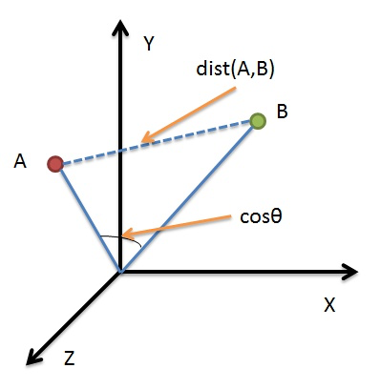
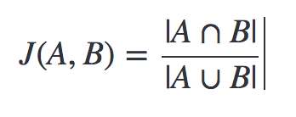
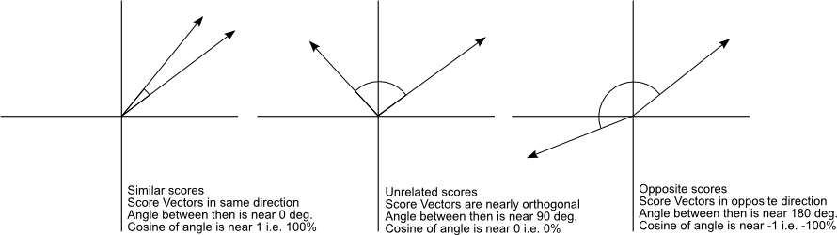
Measure similarity
Euclidean distance
cosine distance
Jaccard distance
cosine distance

Slide 14
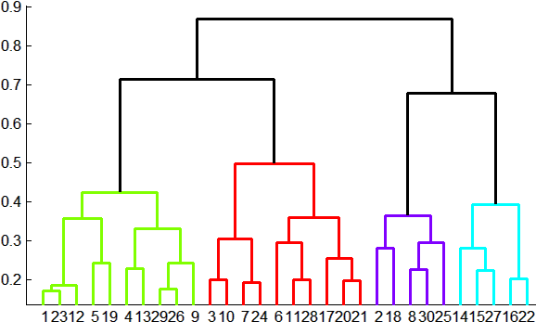
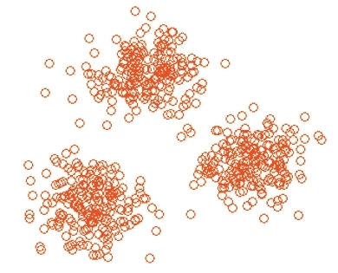
Overview: Methods of Clustering
Hierarchical
Agglomerative (bottom up)
Initially, each point is a cluster
Repeatedly combine the two “nearest” clusters into one
Divisive (top down)
Start with one cluster and recursively split it
Point Assignment
Maintain a set of clusters
Points belong to “nearest” cluster

Slide 15
Hierarchical Clustering
Key operation: Repeatedly combine two nearest clusters
Three important questions:
1) How do you represent a cluster of more than one point?
2) How do you determine the “nearness” of clusters?
3) When to stop combining clusters?

Slide 16
Hierarchical Clustering
Key operation: Repeatedly combine two nearest clusters
(1) How to represent a cluster of many points?
Euclidean case: each cluster has a centroid = average of its (data)points
(2) How to determine “nearness” of clusters?
Measure cluster distances by distances of centroids

Slide 17
Example: Hierarchical clustering
(5,3)
o
(1,2)
o
o (2,1) o (4,1)
o (0,0) o (5,0)
x (1.5,1.5)
x (4.7,1.3)
x (1,1)
x (4.5,0.5)
Data:
o … data point
x … centroid
Dendrogram

Slide 18
And in the Non-Euclidean Case?
What about the Non-Euclidean case?
The only “locations” we can talk about are the points themselves
i.e., there is no “average” of two points (e.g., students)
Approach 1:
(1) How to represent a cluster of many points? clustroid = (data)point “closest” to other points
(2) How do you determine the “nearness” of clusters? Treat clustroid as if it were centroid, when computing inter-cluster distances

Slide 19
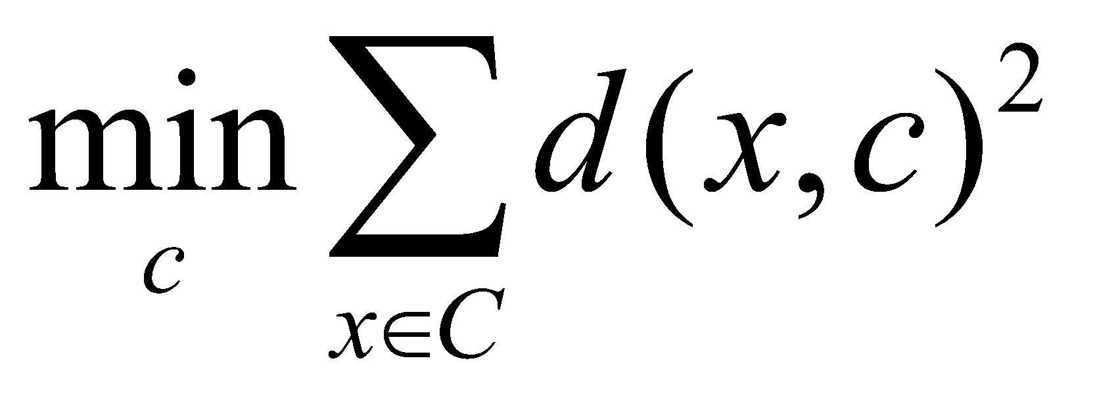
“Closest” Point?
(1) How to represent a cluster of many points? clustroid = point “closest” to other points
Possible meanings of “closest”:
Smallest maximum distance to other points
Smallest average distance to other points
Smallest sum of squares of distances to other points
For distance metric d clustroid c of cluster C is:
Datapoint
Centroid
Centroid is the avg. of all (data)points in the cluster. This means centroid is an “artificial” point.
Clustroid is an existing (data)point that is “closest” to all other points in the cluster.
X
Clustroid
Cluster on 3 datapoints

Slide 20
Defining “Nearness” of Clusters
(2) How do you determine the “nearness” of clusters?
Approach 2: Intercluster distance = minimum of the distances between any two points, one from each cluster
Approach 3: Pick a notion of “cohesion” of clusters, e.g., maximum distance from the clustroid
Merge clusters whose union is most cohesive

Slide 21
Cohesion
Approach 3.1: Use the diameter of the merged cluster = maximum distance between points in the cluster
Approach 3.2: Use the average distance between points in the cluster
Approach 3.3: Use a density-based approach
Take the diameter or avg. distance, e.g., and divide by the number of points in the cluster

Slide 22
Example
Consider a cluster of 4 points:
abcd, aecdb, abecb, ecdab
Their edit distances:
 | aecdb | abecb | ecdab
abcd | 3 | 3 | 5
aecdb |  | 2 | 2
abecb |  |  | 4
Notes:
Insertion of a single symbol. If a = uv, then inserting the symbol x produces uxv. This can also be denoted ε→x, using ε to denote the empty string.Deletion of a single symbol changes uxv to uv (x→ε).Substitution of a single symbol x for a symbol y ≠ x changes uxv to uyv (x→y).

Slide 23
Determine Clusteroid
“aecdb” will be chosen as clusteroid
Located in “center” judged by all 3 measures
Point | Sum | Sum-sq | Max
abcd | 11 | 43 | 5
aecdb | 7 | 17 | 3
abecb | 9 | 29 | 4
ecdab | 11 | 45 | 5
 | aecdb | abecb | ecdab
abcd | 3 | 3 | 5
aecdb |  | 2 | 2
abecb |  |  | 4

Slide 24
Complexity of Hierarchical Clustering
n data points
At most n – 1 step of merging
Naive implementation, e.g., storing pairwise cluster distances in a matrix
 | C1 | C2 | C3 | C4
C1 | 0 | 2 | 3 | 2
C2 |  | 0 | 4 | 5
C3 |  |  | 0 | 3
C4 |  |  |  | 0

Slide 25
Complexity of Naive Implementation
Initially, O(n²) for creating matrix and finding pair with minimum distance
Subsequent merge, assuming matrix: k x k
Delete columns for old clusters: O(k)
Add new column for new cluster C’: O(k)
Compute dist. of C’ with other clusters: O(k)
Find new pair of clusters with min. dist: O(k²)
=> Overall complexity: O(n³)
Notes:
N, n-1, n-2,…k,…1 so n*k^2 = n^3

Slide 26
Implementation Summary
Naïve implementation of hierarchical clustering:
At each step, compute pairwise distances between all pairs of clusters, then merge
O(N³)
Careful implementation using priority queue can reduce time to O(N² log N) (read textbook)
Still too expensive for really big datasets that do not fit in memory

Slide 27
Sum Squared Error (SSE)
SSE (sum squared error) is a common measure of the quality of a cluster.
It is the sum of the squares of the distances between each of the points of the cluster and the centroid.
Sometimes, we decide to split a cluster in order to reduce the SSE.
Calculate the SSE before split
Decide the split (you can choose)
Calculate the sum of SSE(s) for the clusters after split
If SSE_after < SSE_before, then split
Example: before split: (9,5), (2,2), and (4,8)
how to split?
should it be split?

Slide 28
k-means clustering

Slide 29
k–means Algorithm(s)
Assumes Euclidean space/distance
Start by picking k, the number of clusters
Initialize clusters by picking one point per cluster
Example: Pick one point at random, then k-1 other points, each as far away as possible from the previous points

Slide 30
Example: Assigning Clusters
x
x
x
x
x
x
x
x
x
x
x
x … data point
… centroid
Clusters after round 1

Slide 31
Example: Assigning Clusters
x
x
x
x
x
x
x
x
x
x
x
x … data point
… centroid
Clusters after round 2

Slide 32
Example: Assigning Clusters
x
x
x
x
x
x
x
x
x
x
x
x … data point
… centroid
Clusters at the end

Slide 33
Populating Clusters
1) For each point, place it in the cluster whose current centroid it is nearest
2) After all points are assigned, update the locations of centroids of the k clusters
3) Reassign all points to their closest centroid
Sometimes moves points between clusters
Repeat 2 and 3 until convergence
Convergence: Points don’t move between clusters and centroids stabilize

Slide 34
Getting the k right
How to select k?
Try different k, looking at the change in the average distance to centroid as k increases
Average falls rapidly until right k, then changes little
Best value
of k
Average
distance to
centroid
k

Slide 35
Example: Picking k
x
xx x
x x
x x x
x
x x x
x
Too few;
many long
distances
to centroid.
x
x x
x x x x
x x x x
x x x
x x
x x
x x x x
x x x
x
x

Slide 36
Example: Picking k
x
xx x
x x
x x x
x
x x x
x
x
Just right;
distances
rather short.
x x
x x x x
x x x x
x x x
x x
x x
x x x x
x x x
x
x

Slide 37
Example: Picking k
Too many;
little improvement
in average
distance.
x
xx x
x x
x x x
x
x x x
x
x
x x
x x x x
x x x x
x x x
x x
x x
x x x x
x x x
x
x

Slide 38
Two Scalable Algorithms
BFR: Bradley-Fayyad-Reina
- for uniform-distributed axis-aligned shapes
CURE: Clustering Using REpresentitives
- for arbitrary shapes

Slide 39
The BFR Algorithm
Extension of k-means to large data

Slide 40
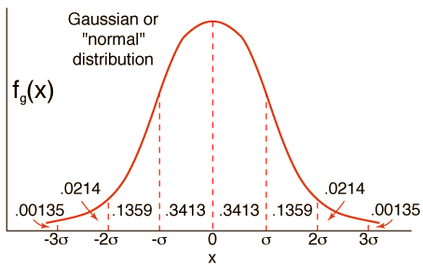
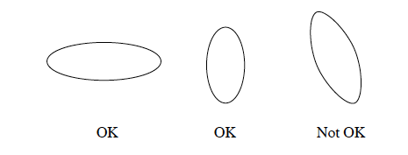
BFR Algorithm
BFR [Bradley-Fayyad-Reina] is a variant of k-means designed to handle very large (disk-resident) data sets
Assumes that clusters are normally distributed around a centroid in a Euclidean space
About 68% of values are within σ away from the mean; about 95% 2σ away; and about 99.7% 3σ away.
Standard deviations in different dimensions may vary
Clusters are axis-aligned ellipses
Efficient way to summarize clusters (want memory required O(clusters) and not O(data))

Slide 41
BFR Algorithm
Points are read from disk one ”main-memory-full” or “memory-load” at a time
Most points from previous memory loads are summarized by simple statistics
To begin, from the initial load we select the initial k centroids by some sensible approach:
Take k random points
Take a small random sample and cluster optimally
Take a sample; pick a random point, and then k–1 more points, each as far from the previously selected points as possible

Slide 42
Three Classes of Points
3 sets of points which we keep track of:
Discard set (DS):
Points close enough to a centroid to be summarized
Compression set (CS):
Groups of points that are close together but not close to any existing centroid
These points are summarized, but not assigned to a cluster
Retained set (RS):
Isolated points waiting to be assigned to a compression set

Slide 43
BFR: “Galaxies” Picture
Points in
the RS
Compressed sets.
Their points are in
the CS.
A cluster. Its points
are in the DS.
The centroid
Discard set (DS): Close enough to a centroid to be summarized
Compression set (CS): Summarized, but not assigned to a cluster
Retained set (RS): Isolated points
Notes:
20170101

Slide 44
Summarizing Sets of Points
For each cluster, the discard set (DS) is summarized by:
The number of points, N
The vector SUM, whose i^{th} component is the sum of the coordinates of the points in the i^{th} dimension
The vector SUMSQ: i^{th} component = sum of squares of coordinates in i^{th} dimension
A cluster. All its points are in the DS.
The centroid

Slide 45
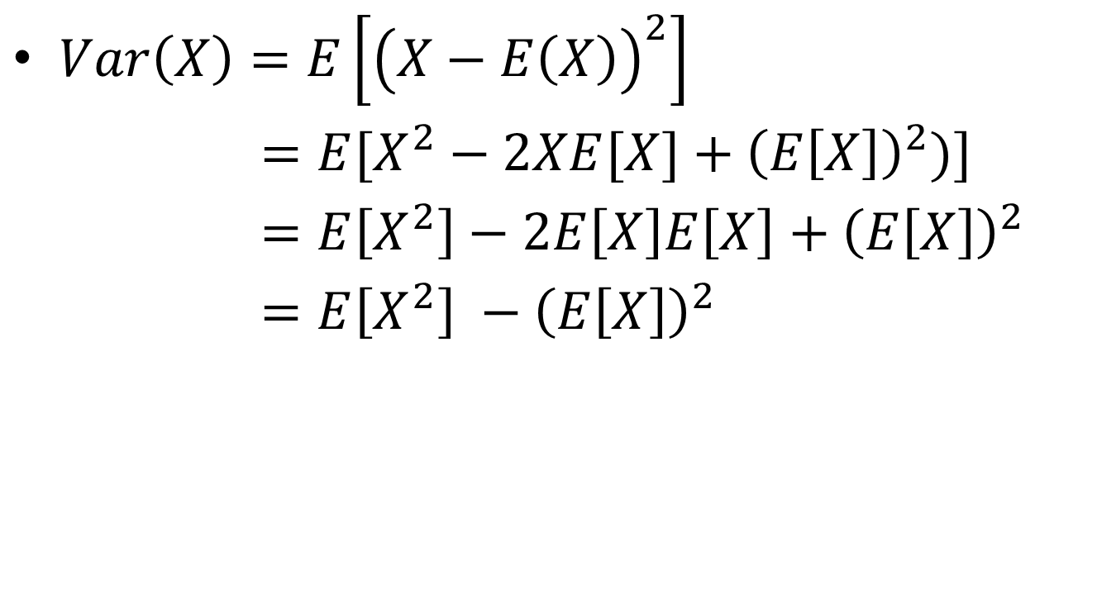
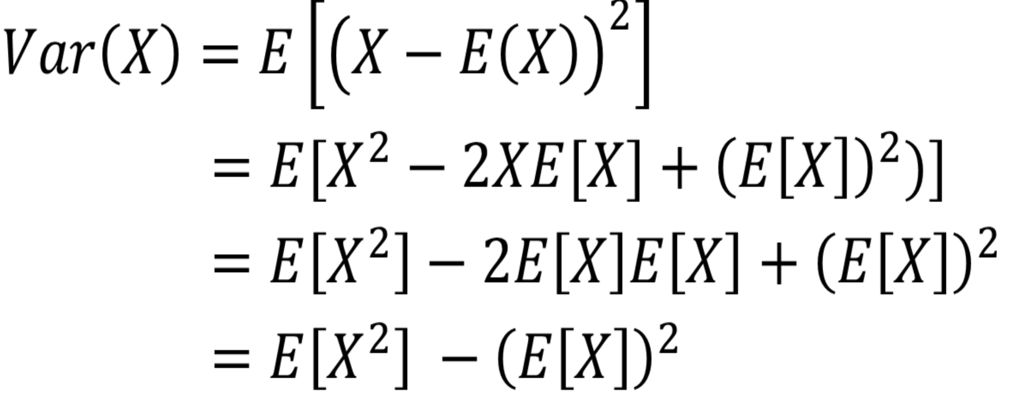
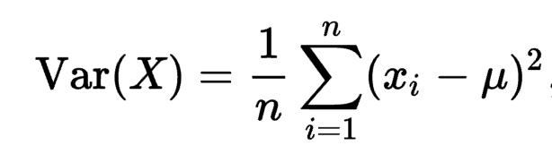
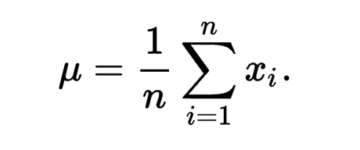
Variance

Slide 46

Summarizing Points: Comments
2d + 1 values represent any size cluster
d = number of dimensions
Average in each dimension (the centroid) can be calculated as SUM_{i} / N
SUM_{i} = i^{th} component of SUM
Variance of a cluster’s discard set in dimension i is: (SUMSQ_{i} / N) – (SUM_{i} / N)²
And standard deviation is the square root of that
Next step: Actual clustering
Note: Dropping the “axis-aligned” clusters assumption would require storing full covariance matrix to summarize the cluster. So, instead of SUMSQ being a d-dim vector, it would be a d x d matrix, which is too big!

Slide 47
The “Memory-Load” of Points
Processing the “Memory-Load” of points (1):
1) Find those points that are “sufficiently close” to a cluster centroid and add those points to that cluster and the DS
These points are so close to the centroid that they can be summarized and then discarded
2) Use any main-memory clustering algorithm to cluster the remaining points and the old RS
Clusters go to the CS; outlying points to the RS
Discard set (DS): Close enough to a centroid to be summarized.
Compression set (CS): Summarized, but not assigned to a cluster
Retained set (RS): Isolated points

Slide 48
The “Memory-Load” of Points
Processing the “Memory-Load” of points (2):
3) DS set: Adjust statistics of the clusters to account for the new points
Add Ns, SUMs, SUMSQs
4) Consider merging compressed sets in the CS
5) If this is the last round, merge all compressed sets in the CS and all RS points into their nearest cluster
Discard set (DS): Close enough to a centroid to be summarized.
Compression set (CS): Summarized, but not assigned to a cluster
Retained set (RS): Isolated points

Slide 49
BFR: “Galaxies” Picture
Points in
the RS
Compressed sets.
Their points are in
the CS.
A cluster. Its points
are in the DS.
The centroid
Discard set (DS): Close enough to a centroid to be summarized
Compression set (CS): Summarized, but not assigned to a cluster
Retained set (RS): Isolated points

Slide 50
A Few Details…
Q1) How do we decide if a point is “close enough” to a cluster that we will add the point to that cluster?
Q2) How do we decide whether two compressed sets (CS) deserve to be combined into one?

Slide 51
Define “Sufficiently Close”
~68% of points: 1 σ away from mean
~95% of points: 2 σ away
~99% of points: 3 σ away

Slide 52
How Close is Close Enough?
Q1) We need a way to decide whether to put a new point into a cluster (and discard)
BFR suggests two ways:
The Mahalanobis distance is less than a threshold
High likelihood of the point belonging to currently nearest centroid

Slide 53
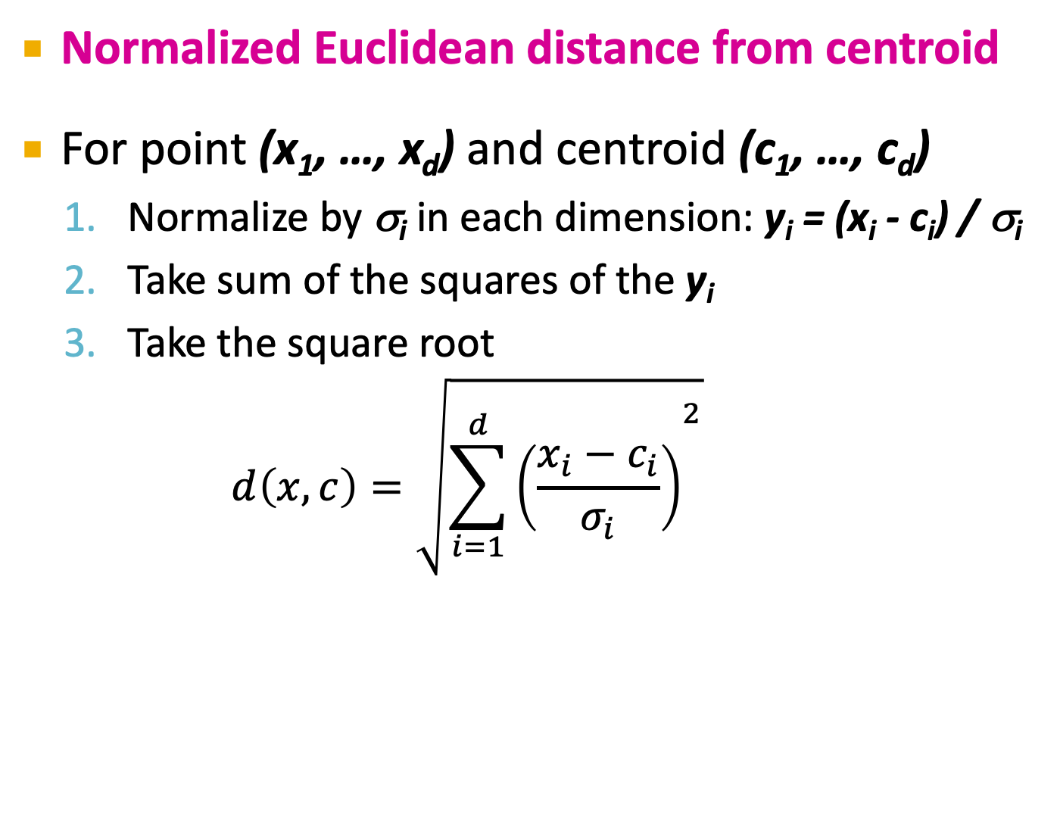
Mahalanobis Distance
σ_{i} … standard deviation of points in the cluster in the i^{th} dimension

Slide 54
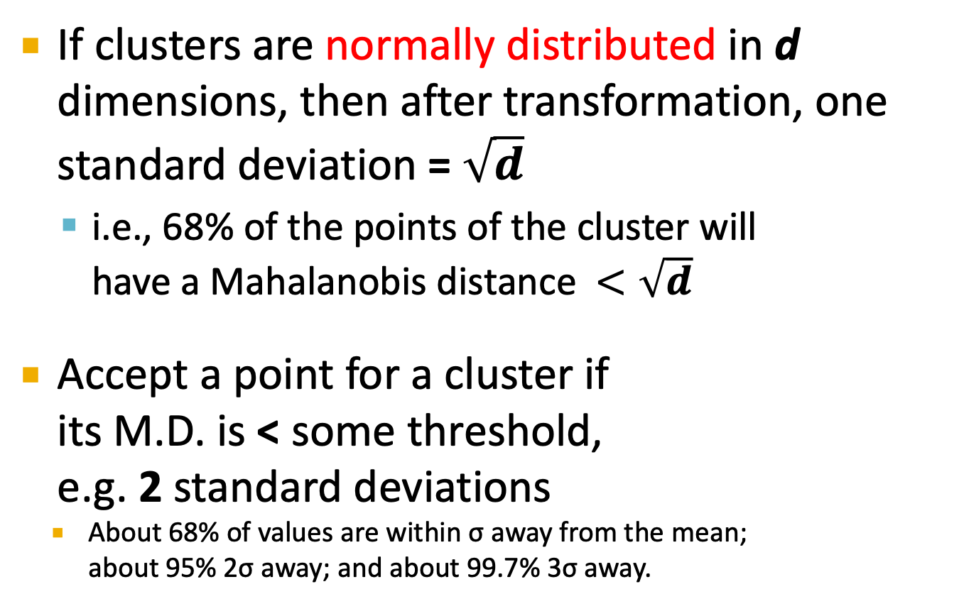
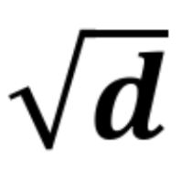
Mahalanobis Distance

Slide 55
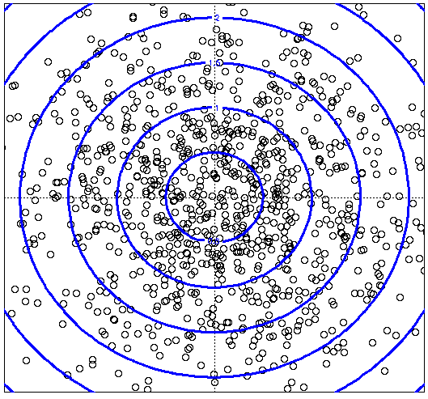
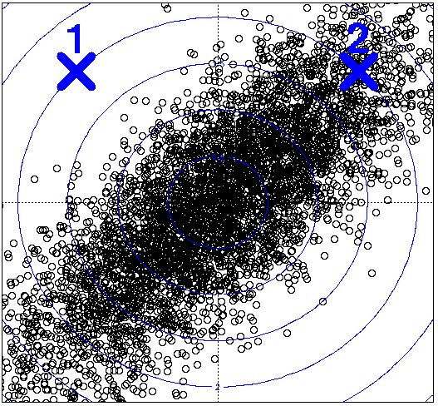
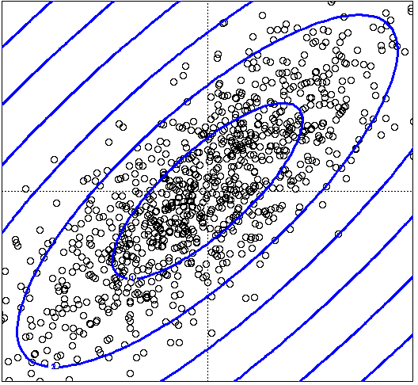
Picture: Equal M.D. Regions
Euclidean vs. Mahalanobis distance
Contours of equidistant points from the origin
Uniformly distributed points, Euclidean distance
Normally distributed points, Euclidean distance
Normally distributed points, Mahalanobis distance

Slide 56
Should two CS clusters be combined?
Q2) Should two CS subclusters be combined?
Compute the variance of the combined subclusters
N, SUM, and SUMSQ allow us to make that calculation quickly
Combine if the combined variance is below some threshold
Many alternatives: Treat dimensions differently, consider density

Slide 57
The CURE Algorithm
Extension of k-means to clusters of arbitrary shapes

Slide 58
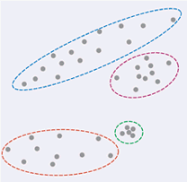
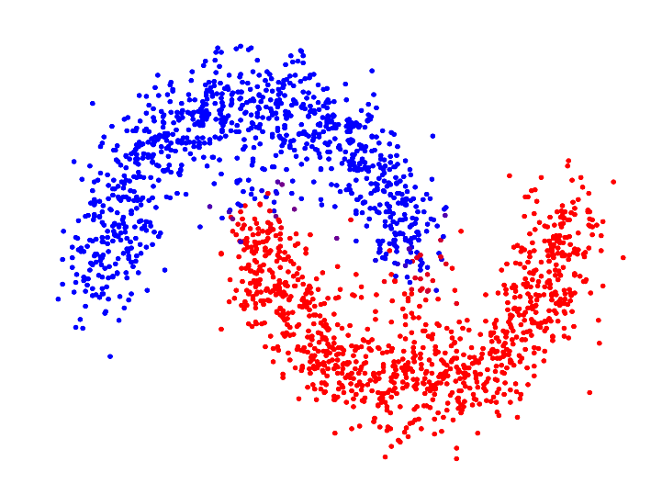
The CURE Algorithm
Vs.
Problem with BFR/k-means:
Assumes clusters are normally distributed in each dimension
And axes are fixed – ellipses at an angle are not OK
CURE (Clustering Using REpresentatives):
Assumes a Euclidean distance
Allows clusters to assume any shape
Uses a collection of representative points to represent clusters

Slide 59
Example: Stanford Salaries
h
h
h
e
e
e
h
e
e
e
h
e
e
e
e
salary
h
e
h
h
h
h
h
h
h
age

Slide 60
Starting CURE
Two-Pass Algorithm: Pass 1
0) Pick a random sample of points that fit in main memory
1) Initial clusters:
Cluster these points hierarchically – group nearest points/clusters
2) Pick representative points:
For each cluster, pick a sample of points, as dispersed as possible
From the sample, pick representatives by moving them (say) 20% toward the centroid of the cluster

Slide 61
Example: Initial Clusters
h
h
h
e
e
e
h
e
e
e
h
e
e
e
e
h
salary
e
h
h
h
h
h
h
h
age

Slide 62
Example: Pick Dispersed Points
h
h
h
e
e
e
h
e
e
e
h
e
e
e
e
h
salary
e
Pick (say) 4
remote points
for each
cluster.
h
h
h
h
h
h
h
age

Slide 63
Example: Pick Dispersed Points
h
h
h
e
e
e
h
e
e
e
h
e
e
e
e
h
salary
e
Move points
(say) 20%
toward the
centroid.
h
h
h
h
h
h
h
age

Slide 64
Finishing CURE
Pass 2:
Now, rescan the whole dataset and visit each point p in the data set
Place it in the “closest cluster”
Normal definition of “closest”: Find the closest representative to p and assign it to representative’s cluster
p

Slide 65
Compare CURE with BFR
Distribution of data
CURE: do not assume any particular distribution
BFR: data should be normally distributed
Representation of cluster
CURE: a set of representatives
BFR: centroid
Common: both assume data in Euclidean space

Slide 66
Summary
Clustering: Given a set of points, with a notion of distance between points, group the points into some number of clusters
Algorithms:
Agglomerative hierarchical clustering:
Centroid and clustroid
k-means:
Initialization, picking k
BFR
CURE

Slide 67
Standardization vs. Normalization
Standardization vs. Normalization
Incomparable units
“Age” vs. “GPA”
Same units, irrelevant features
commuting miles vs. maximum jogging miles
Same units, similar features
air quality values today vs. air quality tomorrow
length of right vs. left arms
Others

