Slide 1
Parallel Computing
Guoliang Chen
E-mail : glchen@ustc.edu.cn

Slide 2
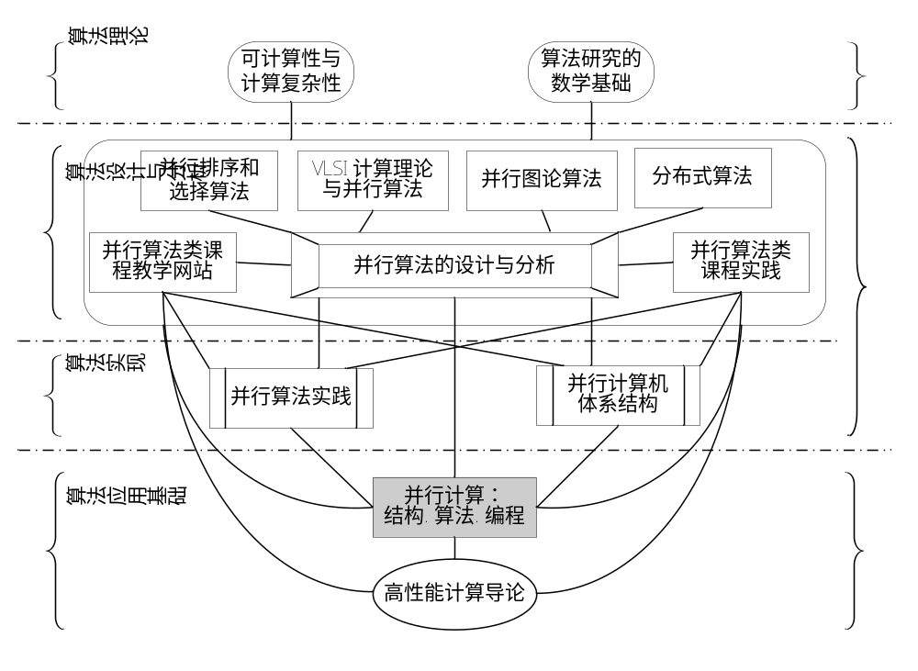

Slide 3
Parallel Computing
Parallel Architectures
Parallel Algorithms
Parallel Programming

Slide 4
Abstract
Generally speaking, parallel computing deals with the parallel computer architectures, parallel algorithms and parallel programming. In this lecture we will discuss briefly them separately. In part I, we will discuss the contemporary parallel computer system architectures and memory access models, parallel system interconnections and parallel system performance evaluation. In part II, we will discuss the parallel computational models, the design methods, techniques and methodology of parallel algorithms, as well as some parallel numerical algorithms. In part III, we will discuss the parallel programming models,shared-memory, message-passing and dataparallel programming, as well as parallel programming environment and tools.

Slide 5
Part I : Parallel Computer Systems
Hardware Platform for Parallel Computing:
System Architectures and Models
System Interconnections
Performance Evaluation

Slide 6
System Architectures and Models
Parallel Computer System Architectures
  PVP : Parallel Vector Processors
  SMP : Symmetric Multiprocessors
  MPP : Massively Parallel Processors
  DSM : Distributed Shared Memory
  COW : Cluster Of Workstations
Parallel Computer Memory Access Models
  UMA : Uniform Memory Access
  NUMA : Non-Uniform Memory Access
  COMA : Cache-Only Memory Access
  NORMA : NO-Remote Memory Access

Slide 7
System Interconnections
Network Environments
  Intra-node Interconnections( Buses , Switches )
  Inter-node Interconnections( SAN )
  Inter-system Interconnections( LAN , MAN , WAN )
Interconnection Topologies
  Static-Connection Networks( LA,RC,MC,TC,HC,CCC)
  Dynamic-Connection Networks (Buses, Crossbar, MIN)
Wide-Band Networks
  FDDI( Fiber Distributed Data Interface )
  FE/GE( Fast Ethernet / Gigabit Ethernet )
  ATM( Asynchronous Transfer Mode )
  SCI( Scalable Coherence Interface )

Slide 8
Performance Evaluation
Speed up of Systems
  Amdahl’s Law
  Gustafson’s Law
  Sun and Ni’s Law
Scalability of Systems
  Iso-efficiency
  Iso-speed
  Average Latency
Performance of Systems : Benchmarks
  LINPACK
  SPEC
  PARKBENCH
  NAS etc

Slide 9
Part II : Parallel Algorithms
Theoretical Base for Parallel Computing:
Computational Models
Design Policy
Design Techniques
Design Methodology
Parallel Numerical Algorithms

Slide 10
Computational Models
PRAM : Parallel Random Access Machines
APRAM : Asynchronous PRAM
BSP : Bulk Synchronous Parallel
LogP : Latency , Overhead , Gap , Processors

Slide 11
Design Policy
Parallelizing a Sequential Algorithm
Designing a new Parallel Algorithm
Borrowing Other Well-known Algorithm

Slide 12
Design Techniques
Balanced Trees
Doubling Technique
Partitioning Strategy
Divide and Conquer
Pipelining

Slide 13
Design Methodology
PCAM : Partitioning
PCAM : Communication
PCAM : Agglomeration
PCAM : Mapping

Slide 14
Parallel Numerical Algorithms
Dense Matrix Algorithms
Solving Systems of Linear Equations
Fast Fourier Transform

Slide 15
Part III : Parallel Programming
Software Support for Parallel Computing:
Programming Models
Shared-Memory Programming
Message-Passing Programming
Data-Parallel Programming
Programming Environment and Tools

Slide 16
Programming Models
Implicit Model
Data-Parallel Model
Shared-Memory Model
Message-Passing Model

Slide 17
Shared-Memory Programming
ANSI X3H5
POSIX Threads( Pthreads )
OpenMP
Shared-Variable Parallel Code to Compute Pi

Slide 18
Message-Passing Programming
MPI : Message-Passing Interface
MPI Basics
Message-Passing Code to Compute Pi
PVM : Parallel Virtual Machine
PVM Program to Compute Pi

Slide 19
Data-Parallel Programming
HPF : High-Performance Fortran
Gaussian Elimination in HPF

Slide 20
Programming Environment and Tools
Parallelizing Compiler
  Two Ways to Parallelize Compiler
  SIMDizing : Vectoring
  MIMDizing : Parallelizing
  Dependency Analysis
Performance Analysis
  Performace Prediction
  Performace Monitoring
  Performace Visualization

Slide 21
Programming Environment and Tools
Parallel Program Debugging
  Correct Debugging
  Performance Debugging
Graphical Development Environment for Parallel Programming
  Graphical Editor and Language
  Pre-Compilation
  Mapping
  Debugging and Monitoring

Slide 22


Thank you for
your listening !

