Slide 1
第十三章 共享存储系统编程

Slide 2
共享存储系统编程
13.1 ANSI X3H5共享存储模型
13.2 POSIX 线程模型
13.3 OpenMP模型

Slide 3
编程标准的作用
规定程序的执行模型
  SPMD, SMP 等
如何表达并行性
  DOACROSS, FORALL, PARALLEL,INDEPENDENT
如何表达同步
  Lock, Barrier, Semaphore, Condition Variables
如何获得运行时的环境变量
  threadid, num of processes

Slide 4
ANSI X3H5共享存储器模型
Started in the mid-80’s with the emergence of shared memory parallel computers with proprietary directive driven programming environments
更早的标准化结果—PCF共享存储器并行Fortran
1993年制定的概念性编程模型
Language Binding
  C
  Fortran 77
  Fortran 90

Slide 5
并行块（工作共享构造）
  并行块(psections ... end psections)
  并行循环(pdo ... Endo pdo)
  单进程(psingle ... End psingle)
  可嵌套
非共享块重复执行
隐式路障(nowait)，显式路障和阻挡操作
共享/私有变量
线程同步
  门插销(latch)：临界区
  锁：test,lock,unlock
  事件:wait,post,clear
  序数(ordinal):顺序

Slide 6
X3H5:并行性构造
Program main !程序以顺序模式开始,此时只有一个
A !A只由基本线程执行，称为主线程
parallel !转换为并行模式，派生出多个子线程（一个组）
B !B为每个组员所复制
psections !并行块开始
section
C !一个组员执行C
section
D !一个组员执行D
end psections !等待C和D都结束
psingle !暂时转换成顺序模式
E !已由一个组员执行
end psingle !转回并行模式
pdo i=1,6 !pdo构造开始
F(i) !组员共享F的六次迭代
end pdo no wait !无隐式路障同步
G !更多的复制代码
end parallel !转为顺序模式
H !初始化进程单独执行H
... !可能有更多的并行构造
End

Slide 7
P
Q
R
线程
A
隐式路障同步
B
B
B
C
D
隐式路障同步
E
隐式路障同步
F(1:2)
F(3:4)
F(5:6)
无隐式路障同步
G
G
G
隐式路障同步
H

Slide 8
共享存储系统编程
13.1 ANSI X3H5共享存储模型
13.2 POSIX 线程模型
13.3 OpenMP模型

Slide 9
POSIX线程模型
IEEE/ANSI标准—IEEE POSIX 1003.1c-1995线程标准—Unix/NT操作系统层上的，SMP
Chorus, Topaz, Mach Cthreads
Win32 Thread
  GetThreadHandle,SetThreadPriority,SuspendThread,ResumeThread
  TLS(线程局部存储)—TlsAlloc, TlsSetValue
LinuxThreads:__clone and sys_clone
用户线程和内核线程(LWP)(一到一，一到多，多到多)

Slide 10
What Are Threads?
Shared state
(memory, files, etc.)
Threads
General-purpose solution for managing concurrency.
Multiple independent execution streams.
Shared state.
Preemptive scheduling.
Synchronization (e.g. locks, conditions).

Slide 11
线程共享相同的内存空间。
与标准 fork() 相比，线程带来的开销很小。内核无需单独复制进程的内存空间或文件描述符等等。这就节省了大量的 CPU 时间。
和进程一样，线程将利用多 CPU。如果软件是针对多处理器系统设计的，计算密集型应用。
支持内存共享无需使用繁琐的 IPC 和其它复杂的通信机制。
Linux __clone不可移植，Pthread可移植。
POSIX 线程标准不记录任何“家族”信息。无父无子。如果要等待一个线程终止，就必须将线程的 tid 传递给 pthread_join()。线程库无法为您断定 tid。

Slide 12
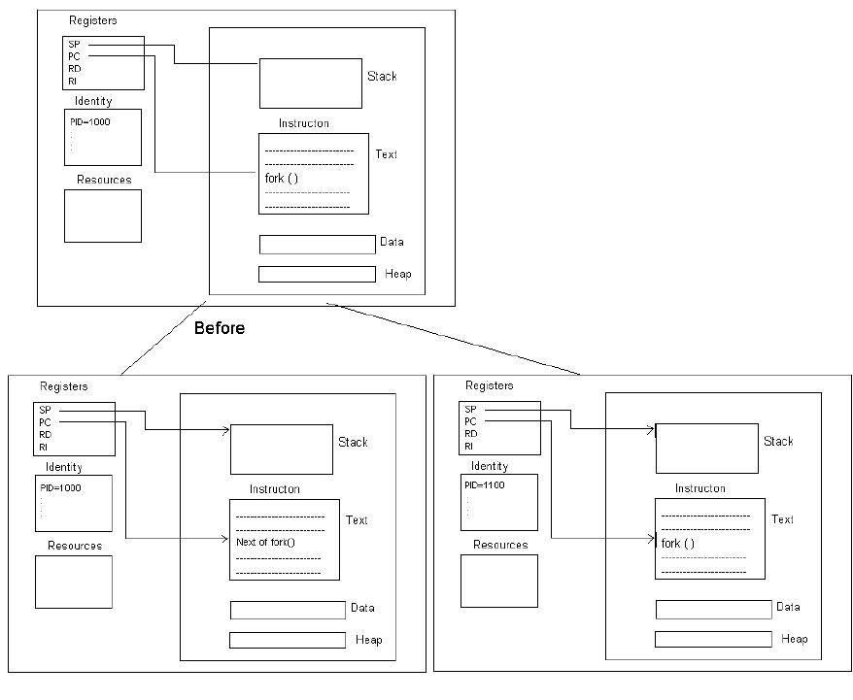
POSIX Threads: Basics and Examples by Uday Kamath
http://www.coe.uncc.edu/~abw/parallel/pthreads/pthreads.html
POSIX 线程详解: 一种支持内存共享的简单和快捷的工具
by Daniel Robbins
http://www.cn.ibm.com/developerWorks/linux/thread/posix_thread1/index.shtml

Slide 13
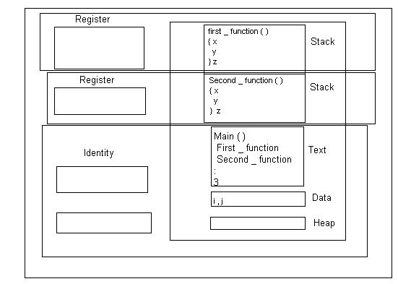

Slide 14
线程调用—线程管理
POSIX Solaris 2
pthread_create thr_create
pthread_exit thr_exit
pthread_kill thr_kill
pthread_join thr_join
pthread_self thr_self

Slide 15
线程调用—线程同步和互斥
POSIX Solaris 2
pthread_mutex_init mutex_init
pthread_ mutex_destroy mutex_destroy
pthread_ mutex_lock mutex_lock
pthread_ mutex_trylock mutex_trylock
pthread_ mutex_unlock mutex_unlock
pthread_cond_init
pthread_cond_destroy
pthread_cond_wait
pthread_cond_timedwait
pthread_cond_signal
pthread_cond_broadcast

Slide 16
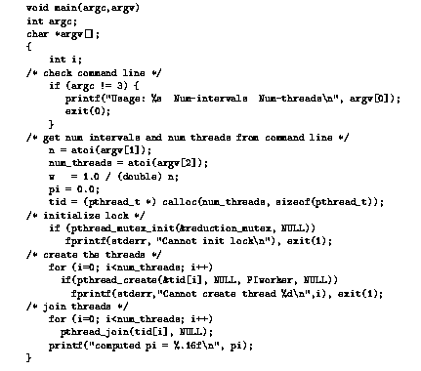
Pthreads实现计算π的实例 1

Slide 17
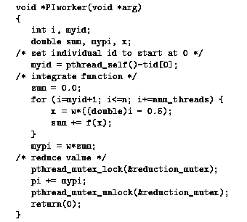
Pthreads实现计算π的实例 2

Slide 18
对生产者驱动的有界缓冲区问题的Pthread条件变量解
void *producer(void *arg1){
int i;
for (i=1;i<=SUMSIZE;i++){
pthread_mutex_lock(&slot_lock);
while(nslots<=0)
pthread_cond_wait(&slots,&slot_lock);
nslots--;
pthread_mutex_unlock(&slot_lock);
put_item(i*i);
pthread_mutex_lock(&item_lock);
nitems++;
pthread_cond_signal(&items);
pthread_mutex_unlock(&item_lock);
}
pthread_mutex_lock(&item_lock);
producer_done=1;
pthread_cond_broadcast(&items); pthread_mutex_unlock(&item_lock);
return NULL;}
void *consumer(void *arg2){
int i,myitem;
for (;;){
pthread_mutex_lock(&item_lock);
while ((nitems<=0)&&!producer_done)
pthread_cond_wait(&items,&item_lock);
if ((nitems<=0)&&producer_done){
ptherad_mutex_unlock(&item_lock);
break;
}
nitems--;
pthread_mutex_unlock(&item_lock);
get_item(&myitem);
sum+=myitem;
pthread_mutex_lock(&slot_lock
nslots++;
cond_signal(&slots);
pthread_mutex_unlock(&slot_lock);
}
return NULL; }

Slide 19
共享存储系统编程
13.1 ANSI X3H5共享存储模型
13.2 POSIX 线程模型
13.3 OpenMP模型

Slide 20
OpenMP标准
The History of OpenMP
  What is directive/pragma?
    Directive-based general purpose parallel programming API with emphasis on the ability to parallelize existing serial programs
  Why a new standard?
  Who’s Involved?
Parallelism model and basic directives
  Fortran77, Fortran90
  C, C++

Slide 21
The History of OpenMP
A key intermediate step was X3H5 in the late 80’s.
  An official standards effort to agree on a parallel dialect of Fortran for shared memory computers.
  The X3H5 effort failed. It was too big and too late.
OpenMP is born:
  In 1996 a group formed to create an industry standard set of directives for SMP programming
  This group called itself the OpenMP Architecture Review Board(the ARB) who takes care of OpenMP

Slide 22
The History of OpenMP(cont.)
The ARB has released the following specifications:
  OpenMP 1.0 for Fortran, Nov. 1997
  OpenMP 1.0 for C/C++, Nov. 1998
  OpenMP Fortran Interpretations, Spring 1999
  OpenMP 2.0(soon)
OpenMP is an evolving standard. Send comments over the feedback link on the OpenMP web site(http://www.openmp.org)

Slide 23
为什么要建立新标准?
ANSI X3H5, 1994
  时机不好, 分布式机器流行
  只支持循环级并行性，粒度太细
Pthreads(IEEE Posix 1003.4a )
  是为低端(low end)的共享机器(如SMP)的标准
  对FORTRAN的支持不够
  适合任务并行, 而不适合数据并行
MPI 消息传递的编程标准, 对程序员要求高
HPF 主要用于分布式存储机器
大量已有的科学应用程序需要很好地被继承和移植

Slide 24

In a Nutshell
A set of directives(library routines, and environment variables) used to annotate a sequential program to indicate how it should be executed in parallel—继承X3H5的许多概念
Portable, Simple and Scalable Shared Memory Multiprocessing API
  not a new language
  not automatic parallelization
  extend base languages: Fortran77, Fortran90, C and C++
  Multi-vendor Support, for both UNIX and NT
Standardizes Fine Grained(Loop) Parallelism, also Supports Coarse Grained Algorithms

Slide 25
OpenMP是什么？
一组编译制导语句和可调用的运行(run-time)库函数, 扩充到基本语言中用来表达程序中的并行性
编译制导语句包括: 在串行程序中加入下列结构
  SPMD(Single Program Multiple Data) constructs
  work-sharing constructs
  synchronization constructs
  data environment constructs
运行库函数包括:
  execution environment routines
  lock routines
另外, 在FORTRAN标准中, 还包括对环境变量的描述

Slide 26
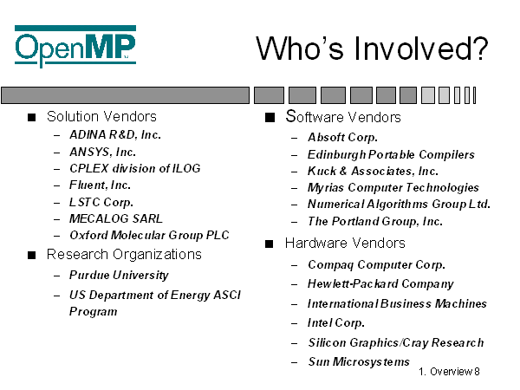

Slide 27
OpenMP当前的状况
1997年10月28日, DEC, IBM, Intel, SGI, 和 Kuch & Associates 等公司的代表们决定制定一种适用于多种硬件平台的共享存储编程的新的工业应用标准
接着, 全球很多的组织和ISV决定支持这一标准, 如DOE/ASCI, Livermore Software Technology Corp., Fluent Inc., Absoft Corp. , Ansys Inc. Etc.
目前支持FORTRAN语言, C 和C, 并建有专门的网址 http://www.openmp.org
在科研机构中, 也引起了足够的重视, 被认为是21世纪最受欢迎的并行编程标准
OpenMP on NOWs (SC98, Nov. 1998)
Integrated OpenMP and MPI on Clusters

Slide 28
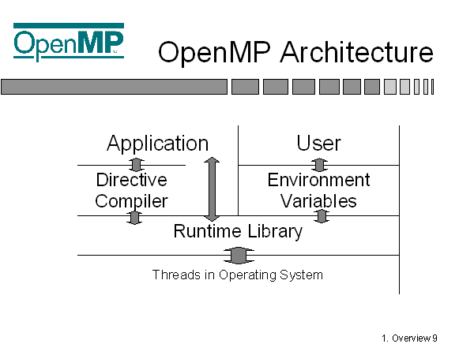

Slide 29
SPMD的程序执行模型
P0
P1 P2 . . .
Pn

Slide 30
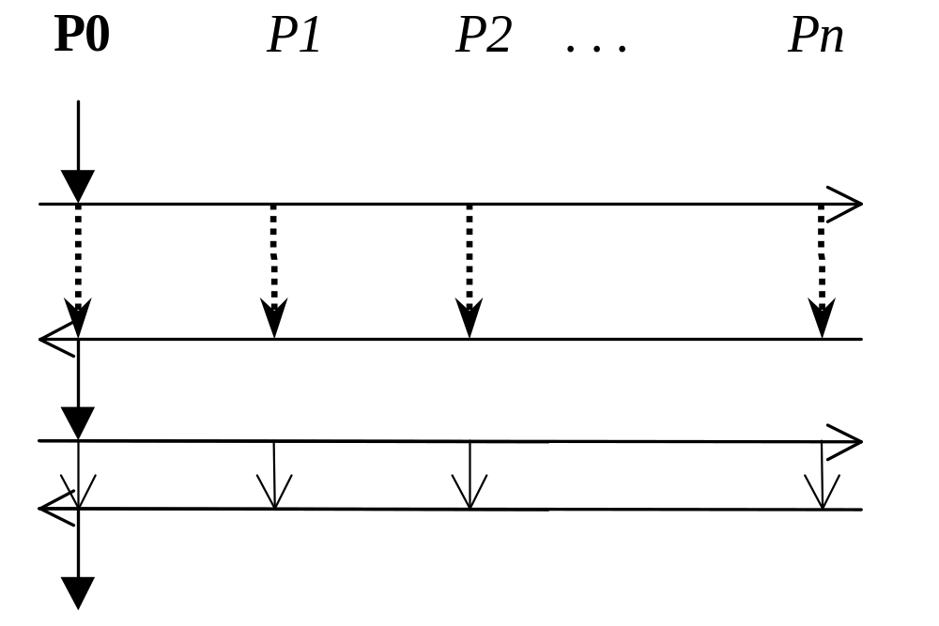
SMP的程序执行模型

Slide 31
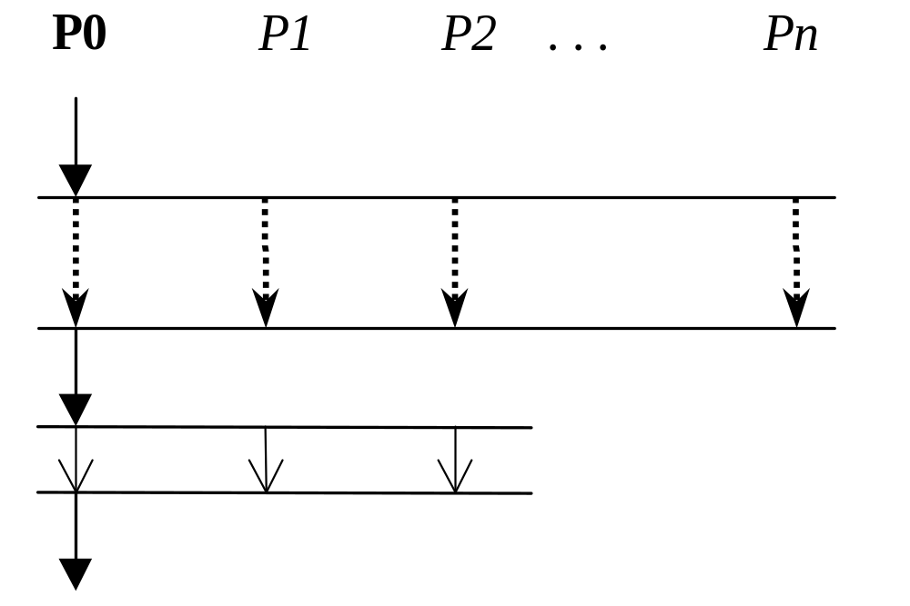
OpenMP的程序执行模型

Slide 32
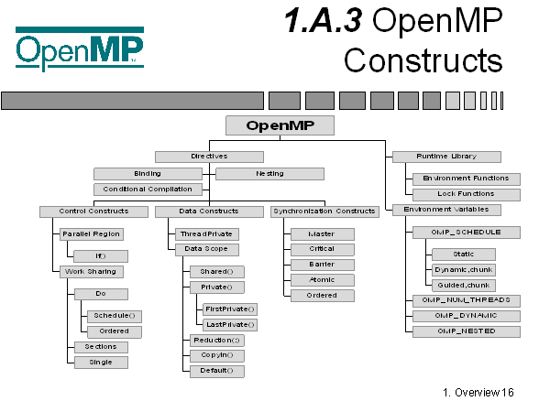
Parallel and work sharing directives
data environment directives
synchronization directives

Slide 33
编译制导语句(1)
Work-sharing constructs
将结构内的任务分配到处理机中, 必须动态地放在Parallel region construct 中, 进入这种结构之前并不隐含BARRIER操作
  DO(最常用)
    有SCHEDULE选项, 可以指定采用什么调度算法
  SECTIONS(可以流水线执行之)
  SINGLE(只有一个处理机执行之)

Slide 34
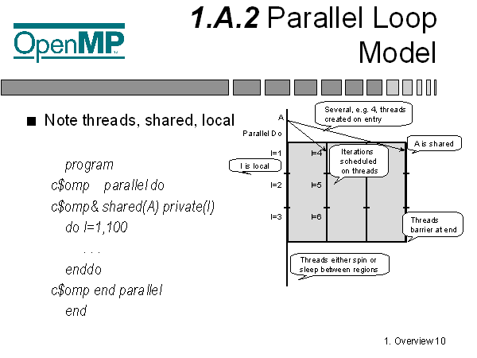
Parallel Region and Work Sharing Directives
Parallel Region: parallel, end parallel
Work Sharing: do, sections, single(parallel do, nowait)
Fork-Join model of parallel execution(static,dynamic,orphaned)

Slide 35
编译制导语句(2)
指令格式
  固定形式 !$OMP
  自由形式 !$OMP, *$OMP, C$OMP
Parallel Region Construct
!$OMP Parallel [clause[[,] clause] . . .]
Do I = 1, 20
A(I) = A(I) + B(I)
!$OMP End Parallel (隐含BARRIER操作)
其中Clause可以为:PRIVATE(list), SHARED(list),COPYIN(list), FIRSTPRIVATE(list), DEFAULT(PRIVATE|SHARED|NONE),
REDUCTION({operation|intrinsic}:list), IF(logical_expression)

Slide 36
DO编译制导语句
!$OMP DO [clause[[,] clause] . . .]
do_loop
[!$OMP END DO [NOWAIT]]
例子:
!$OMP PARALLEL DO
DO I = 2, N
B(I) = ( A(I) + A(I-1)) /2.0
ENDDO
!$OMP END DO NOWAIT
!$OMP END PARALLEL

Slide 37
SECTIONS 编译制导语句
!$OMP SECTIONS
!$OMP SECTION
block1
!$OMP SECTION
block2
!$OMP SECTION
block3
!$OMP END SECTIONS

Slide 38
编译制导语句(3)
Data environment constructs
  THREADPRIVATE
Data scope attribute clauses
  PRIVATE
  SHARED
  DEFAULT
  FIRSTPRIVATE
  LASTPRIVATE
  REDUCTION
  COPYIN

Slide 39
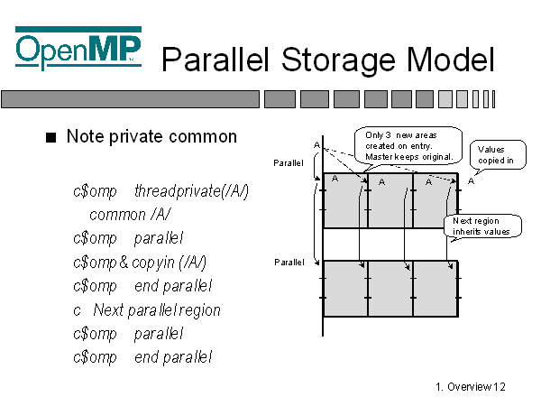
Data Environment Directives
Data Scope attribute clauses: Private, Shared, Default, Firstprivate, Lastprivate, Reduction and Copyin/Copyout(value undefined entering/exiting parallel region)
Threadprivate directives:Private to a thread but global within the thread(SMP) Fortran:COMMON blocks / C:file scope and static variables

Slide 40
编译制导语句(4)
Synchronization constructs
  MASTER
  CRITICAL
  BARRIER
  ATOMIC
  FLUSH
  ORDERED

Slide 41
例子(ORDERED)
规定了各个线程执行的顺序
!$OMP PARALLEL
!$OMP DO ORDERED SCHEDULE(DYNAMIC)
DO I = LowBound, UpBound, Step
CALL WORK(I)
END DO
!$OMP END PARALLEL
SUBROUTINE WORK(K)
!$OMP ORDERED
WRITE(*,*) K
!$OMP END ORDERED
END

Slide 42
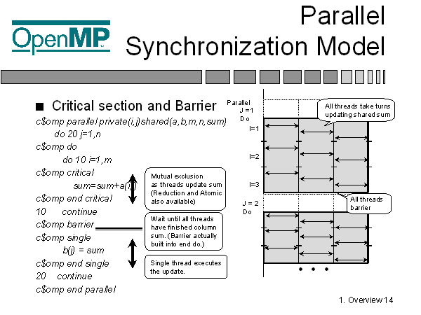
Synchronization Directives
master, barrier, critical, atomic, flush, ordered

Slide 43
OpenMP的Orphan新特性 1
为了便于支持粗粒度的任务级并行, OpenMP 提供了Orphan制导语句
Orphan制导语句是指那些在并行区域(Parallel Region, 如PARALLEL)之外的制导语句
在OpenMP中提供了一种绑定规则使得这些Orphan制导语句与调用它们的并行区域产生联系, 这样大大地增加了程序的模块性。X3H5 中不支持这一特点, 所有的同步和控制语句都必须依次出现在并行区域内,无模块性。

Slide 44
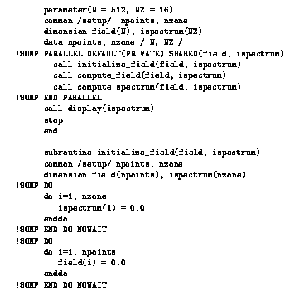
OpenMP的Orphan特性 2

Slide 45
运行库函数(1)
Execution Environment Routines
  OMP_SET_NUM_THREADS
  OMP_GET_NUM_THREADS
  OMP_GET_MAX_THREADS
  OMP_GET_THREAD_NUM
  OMP_GET_NUM_PROCS
  OMP_IN_PARALLEL
  OMP_SET_DYNAMIC
  OMP_GET_DYNAMIC
  OMP_SET _NESTED
  OMP_GET_NESTED

Slide 46
运行库函数(2)
Lock Routines
  OMP_INIT_LOCK
  OMP_DESTROY_LOCK
  OMP_SET_LOCK
  OMP_UNSET_LOCK
  OMP_TEST_LOCK

Slide 47
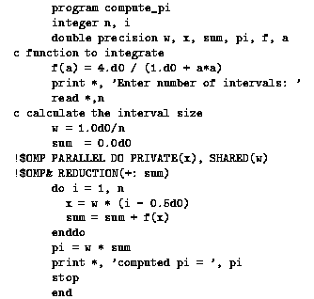
OpenMP计算π的实例

Slide 48
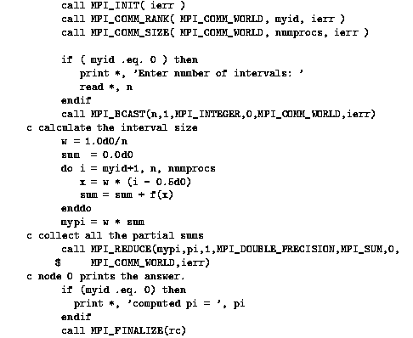
MPI计算π的实例

Slide 49
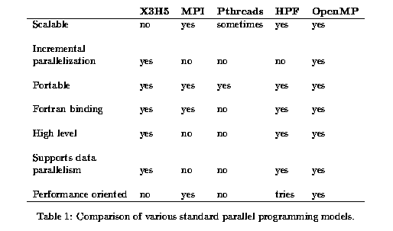
OpenMP与其他标准的比较

Slide 50
OpenMP的优点与缺点
优点
  提供了一个可用的编程标准
  可移植性, 简单, 可扩展性
  灵活支持多线程, 具有负载平衡的潜在能力
  支持Orphan Scope, 使程序更具有模块化
缺点
  只适用于硬件共享存储型的机器
  动态可变的线程数使得支持起来困难

