Slide 1
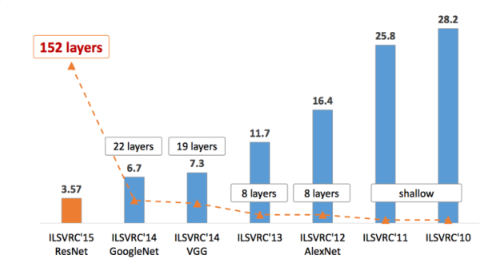
ImageNet Challenge
ILSVRC Top-5 Error Rate with Diffent CNN Models from 2010 to 2015

Slide 2
CNN Model Comparison
Model | LeNet4 | AlexNet | VGG-16 | GoogLeNet | ResNet
Time | 1998 | 2012 | 2014 | 2014 | 2015
Top-5 Error Rate | >25% | 16.4% | 7.3% | 6.7% | 3.57%
Layer | 4 | 8 | 19 | 22 | 152
Data Augmentation | - | + | + | + | +
Inception(NIN) | - | - | - | + | -
Conv Layer | 2 | 5 | 16 | 21 | 151
Conv Kernel Size | 5 | 11,5,3 | 3 | 7,1,3,5 | 7,1,3,5
Fully-Connected Layer | 2 | 3 | 3 | 1 | 1
Fully-Connected Size | 1024,1000 | 4096,4096,1000 | 4096,4096,1000 | 1000 | 1000
Dropout | + | + | + | + | +
Local Response Norm | + | + | - | + | -
Batch Normalization | - | - | - | - | +

Slide 3
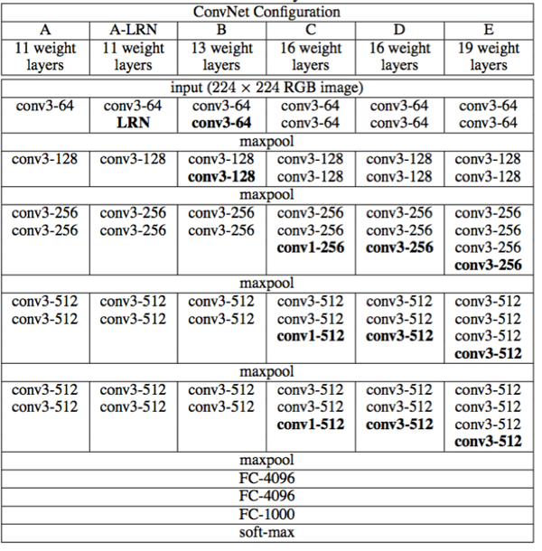
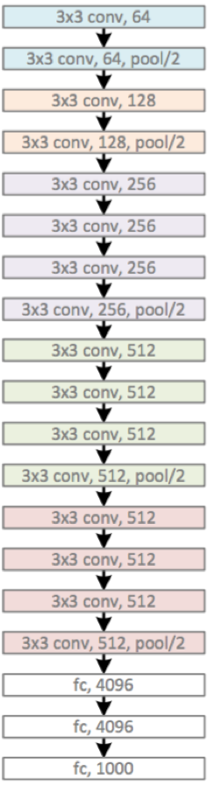
VGG
Left: Network
Configuration
Right: VGG-19

Slide 4
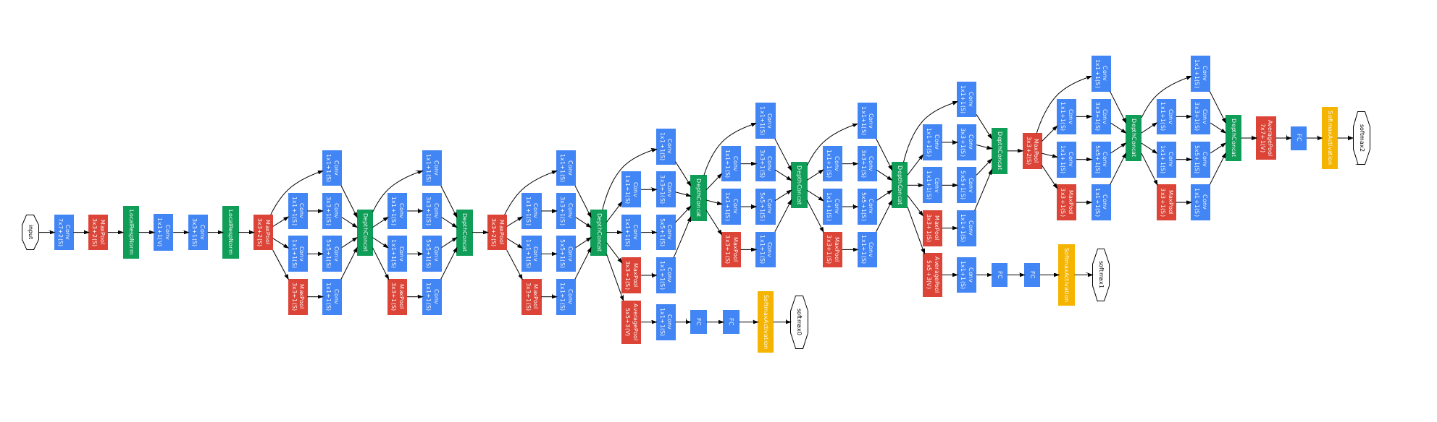
GoogLeNet
Network Configuration

Slide 5
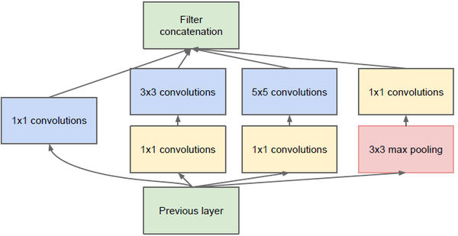
GoogLeNet
Inception Structure
(Network In Network)

Slide 6
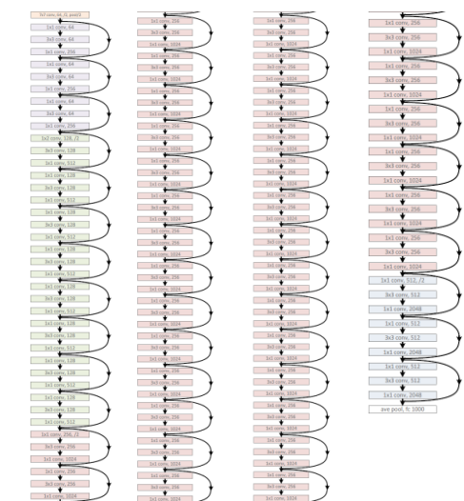
ResNet
Model Structure
152 layers

Slide 7
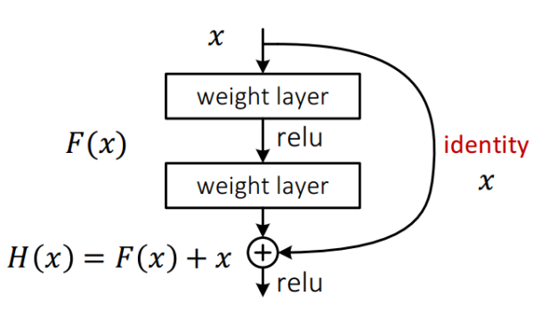
ResNet
Network Configuration

Slide 8
VGG, GoogLeNet, ResNet
Code Implementation
VGG Train and Test: vgg16.py
GoogLeNet Train and Test: googlenet.py
Resnet Train and Test: residual_net.py
Inception_ResNet Train and Test: inception_resnet_v2.py

