Slide 1
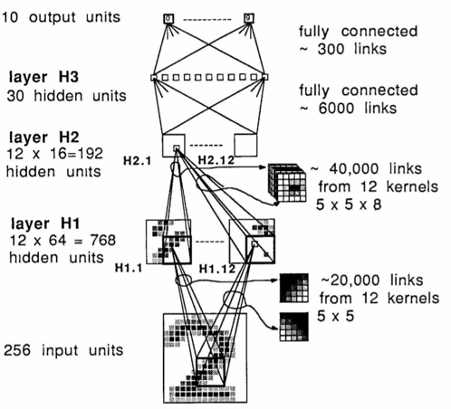
CNN
Model Structure

Slide 2
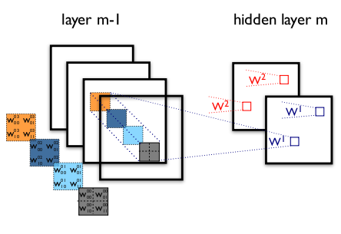
CNN
Two Layers of A CNN
K-th feature map at a given layer as h^{k},
whose filters are determined by the weights
W^{k} and bias b_{k}
Layer m-1 contains four feature maps.
Hidden layer m contains two feature maps (h⁰ and h¹).

Slide 3
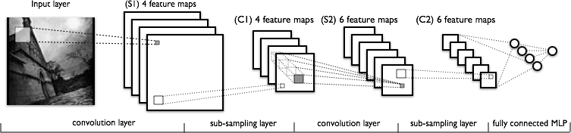
LeNet
Model Structure

Slide 4
LeNet
Code Implementation
Dataset: 2-class images (bird, fish)
train (1,000 * 2)
test (200 * 2)
Data Preprocessing: resize the image (256 ppi * 256 ppi, RGB)
convert images to binary files
(tfrecord_write.py)

Slide 5
LeNet
Code Implementation
Data Presentation: show the sample of labeled images
(tfrecord_read.py)
LeNet Train and Test: lenet.py
Accuracy: 50.8% (120 epochs)

Slide 6
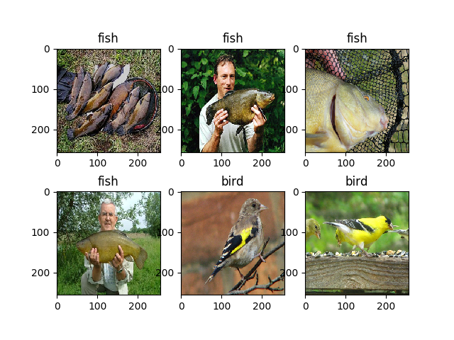
LeNet
Labeled Images

Slide 7
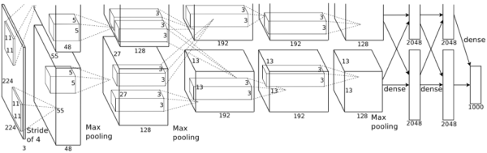
AlexNet
Structure Diagram

Slide 8
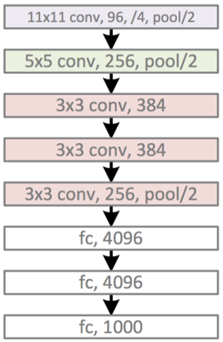
AlexNet
Network Configuration

Slide 9
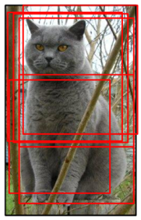
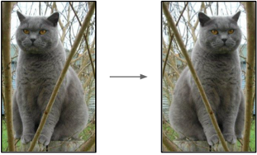
Data Augmentation
Flip Horizontal
Random Cropping

Slide 10
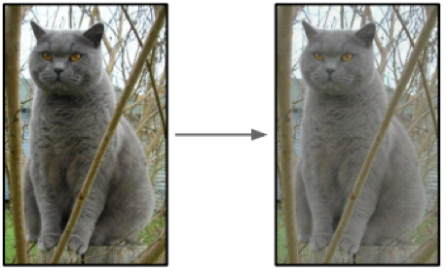
Data Augmentation
Light Transform

Slide 11
AlexNet
Code Implementation
Data Presentation: show the sample of labeled images
(tfrecord_read.py)
AlexNet Train and Test: alexnet.py
Accuracy: 99.8% (80 epochs)

