Slide 1
Konveyor Demo - Cloud Native Kubernetes Meetup
Mezba Rahman, Platform Engineer, CIS Capgemini

Slide 2
Visual Konveyor Demo - Cloud Native Kubernetes Meetup

Slide 3
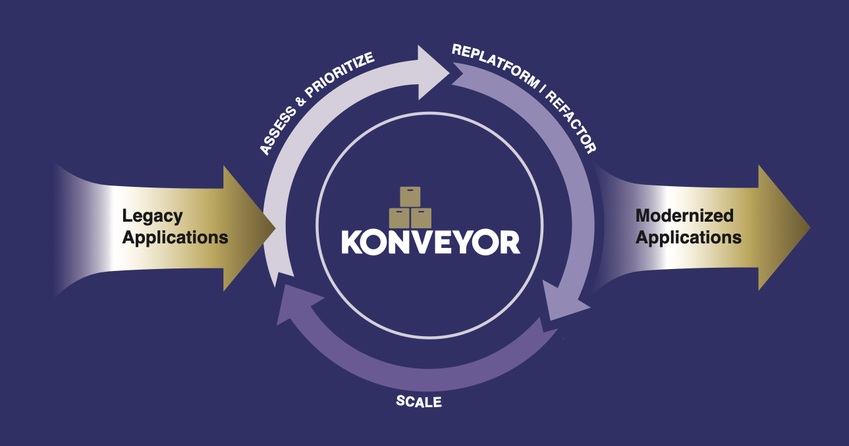
Slide 1: Title
Konveyor Logo

Slide 4
Legacy to Kubernetes Made Simple

Slide 5

┌─────────────────────────────────────┐ │ 🏢 Legacy Apps ──► 🏗️ Kubernetes │ │ │ │ Automated • AI-Powered │ │ Assessment & Migration │ └─────────────────────────────────────┘
Mezba Rahman Platform Engineer | CIS Capgemini
Cloud Native Kubernetes Virtual Meetup October 10th, 2025
CNCF Sandbox

Slide 6
Slide 2: The Challenge
graph TD A[🏢 Legacy Applications] --> B{Manual Assessment} B --> C[📋 Weeks of Analysis] B --> D[❓ Hidden Dependencies] B --> E[⚠️ Migration Risks] C --> F[😫 Delayed Projects] D --> F E --> F
The Reality
70% of enterprise workloads are legacy
Manual assessment takes 3-6 weeks per app
40% of migrations fail due to unknowns

Slide 7

Slide 3: Meet Konveyor
graph LR A[📦 Legacy App] --> B[🔍 Konveyor] B --> C[📊 Analysis] C --> D[🎯 Recommendations] D --> E[🚀 Migration Plan] subgraph "AI-Powered Assessment" B end
What is Konveyor?
🎯 Open-source toolkit 🤖 AI-powered analysis 📈 Red Hat backed CNCF Sandbox CNCF Sandbox Project
Konveyor Avatar

Slide 8
Slide 4: Architecture Overview
graph TB subgraph "Your Environment" A[Legacy Applications] end subgraph "Konveyor Platform" B[Tackle Hub] C[Analysis Engine] D[AI Rules Engine] end subgraph "Output" E[Assessment Reports] F[Migration Recommendations] G[Containerization Plans] end A --> B B --> C C --> D D --> E D --> F D --> G

Slide 9
Slide 5: Demo Environment
┌─────────────────────────────────────────┐ │ 🖥️ Local Setup │ ├─────────────────────────────────────────┤ │ │ │ 📦 Minikube Cluster │ │ ├── 🛠️ Konveyor Operator │ │ ├── 🎯 Tackle Hub │ │ └── 🔍 Analysis Tools │ │ │ │ 📂 Sample Applications │ │ ├── ☕ Java Legacy App │ │ ├── 🌐 Web Components │ │ └── 🗄️ Database Dependencies │ │ │ └─────────────────────────────────────────┘
Ready for live analysis!

Slide 10
Slide 6: Live Demo - Application Upload
What We’ll See:
sequenceDiagram participant U as 👨‍💻 User participant K as 🎯 Konveyor participant A as 🔍 Analysis Engine U->>K: Upload Application K->>A: Start Assessment A->>A: Code Analysis A->>A: Dependency Mapping A->>K: Generate Report K->>U: Display Results
Application: Sample Java Web App Size: ~50MB, 15,000 lines of code

Slide 11
Slide 7: Assessment in Progress
🔍 Analyzing Application... ▓▓▓▓▓▓▓▓░░ 80% Current Phase: Dependency Analysis ✅ Source Code Scan (Complete) ✅ Framework Detection (Complete) ✅ Library Analysis (Complete) 🔄 Security Scan (In Progress) ⏳ Container Readiness (Pending) ⏳ Cloud Suitability (Pending)
Real-time analysis in action

Slide 12
Slide 8: Results Dashboard
Assessment Score: 85/100 🎯
pie title Migration Readiness "Ready" : 60 "Minor Changes" : 25 "Major Refactor" : 15
Key Findings
🟢 No blocking issues 🟡 3 minor configuration changes 🟠 1 deprecated library to update

Slide 13
Slide 9: Detailed Analysis
graph TD A[Application Components] A --> B[🌐 Web Layer] A --> C[🏗️ Business Logic] A --> D[🗄️ Data Layer] B --> B1[✅ Spring MVC - Compatible] C --> C1[✅ Core Services - Ready] C --> C2[⚠️ Legacy Utils - Needs Update] D --> D1[✅ JPA - Container Ready] style B1 fill:#90EE90 style C1 fill:#90EE90 style C2 fill:#FFE4B5 style D1 fill:#90EE90

Slide 14
Slide 10: Migration Recommendations
Suggested Path: Lift & Shift → Optimize
graph LR A[Current State] --> B[Containerize] B --> C[Kubernetes Deploy] C --> D[Cloud Optimize] A1[Monolith<br/>VM-based] --> B1[Docker Container<br/>Same Architecture] B1 --> C1[K8s Deployment<br/>Basic Config] C1 --> D1[Cloud-Native<br/>Microservices Ready]
Timeline: 2-3 weeks

Slide 15
Slide 11: Dependencies Map
graph TD A[Sample App] --> B[Spring Framework 5.x] A --> C[PostgreSQL Driver] A --> D[Apache Commons] B --> B1[✅ K8s Compatible] C --> C1[✅ Cloud Ready] D --> D2[⚠️ Version Update Needed] E[External APIs] --> E1[Payment Service] E --> E2[User Management] E1 --> E11[🔄 Requires Config] E2 --> E21[✅ Ready] style B1 fill:#90EE90 style C1 fill:#90EE90 style D2 fill:#FFE4B5 style E21 fill:#90EE90 style E11 fill:#ADD8E6

Slide 16
Slide 12: Container Strategy
Recommended Approach
# Generated Dockerfile Preview FROM openjdk:11-jre-slim COPY app.jar /app/ EXPOSE 8080 # Optimizations suggested: # - Multi-stage build # - Security scanning # - Resource limits
Benefits
🐳 Consistent environments 📈 Scalable deployment 🔒 Enhanced security

Slide 17
Slide 13: Kubernetes Deployment
# Generated K8s Resources apiVersion: apps/v1 kind: Deployment metadata: name: legacy-app spec: replicas: 3 selector: matchLabels: app: legacy-app template: spec: containers: - name: app image: legacy-app:1.0 ports: - containerPort: 8080 resources: requests: memory: "256Mi" cpu: "250m"
Auto-generated from analysis

Slide 18
Slide 14: Risk Assessment
graph LR A[Risk Factors] A --> B[🟢 Low Risk] A --> C[🟡 Medium Risk] A --> D[🔴 High Risk] B --> B1[Standard Framework] B --> B2[Common Patterns] C --> C1[Version Updates Needed] C --> C2[Config Changes Required] D --> D1[None Identified! 🎉] style B fill:#90EE90 style C fill:#FFE4B5 style D fill:#FFB6C1
Migration Confidence: High 🎯

Slide 19
Slide 15: Before vs After
Current Architecture
┌─────────────────────┐ │ 🖥️ Physical Server │ │ │ │ 🏢 Legacy App │ │ 🗄️ Local DB │ │ 📁 File Storage │ └─────────────────────┘
Target Architecture
┌─────────────────────────────────────┐ │ ☁️ Kubernetes Cluster │ ├─────────────────────────────────────┤ │ 🐳 App Pods │ 🗄️ DB Service │ │ 📊 Monitoring │ 📁 Persistent Vol │ │ 🔒 Security │ 🌐 Ingress │ └─────────────────────────────────────┘

Slide 20
Slide 16: Implementation Timeline
gantt title Migration Timeline dateFormat YYYY-MM-DD section Assessment Konveyor Analysis :done, assess, 2025-10-10, 1d section Development Containerization :active, dev1, 2025-10-11, 3d K8s Configuration :dev2, after dev1, 2d section Testing Integration Tests :test1, after dev2, 2d Performance Tests :test2, after test1, 1d section Deployment Production Deploy :deploy, after test2, 1d
Total: 2 weeks ⚡

Slide 21
Slide 17: Key Benefits
Why Choose Konveyor?
mindmap root((🚀 Konveyor)) (⏰ Speed) Minutes vs Weeks Automated Analysis (🎯 Accuracy) AI-Powered Rules Proven Patterns (💰 Cost) Reduce Assessment Time Minimize Risks (🔧 Integration) Existing Workflows Open Source

Slide 22
Slide 18: Integration Options
Fits Your Workflow
graph TD A[Development Team] --> B[Konveyor Assessment] C[DevOps Pipeline] --> B D[Architecture Review] --> B B --> E[Migration Planning] B --> F[Container Strategy] B --> G[K8s Deployment] E --> H[🚀 Production] F --> H G --> H
Supports
✅ CI/CD Integration ✅ GitOps Workflows ✅ Enterprise Standards

Slide 23
Slide 19: Getting Started
Three Simple Steps
graph LR A[1️⃣ Install] --> B[2️⃣ Upload] --> C[3️⃣ Analyze] A1[kubectl apply -f konveyor] --> B1[Upload your app] --> C1[Get recommendations]
Resources
📚 Documentation: konveyor.io 🐙 Source Code: github.com/konveyor 💬 Community: #konveyor on CNCF Slack

Slide 24
Slide 20: Demo Results Summary
What We Discovered
📊 Assessment Results ├── ✅ 85% Migration Ready ├── ⚡ 2-week timeline ├── 🐳 Container strategy defined ├── 🎯 Zero blocking issues └── 📈 Risk: Low 🎉 Ready for Kubernetes!
Next Step: Start containerization

Slide 25
Slide 21: Q&A

Slide 26
🤔 Questions & Discussion

Slide 27
Popular Topics
Konveyor vs manual assessment
Integration with existing tools
Enterprise deployment patterns
Custom rule development
Let’s discuss your use cases!

Slide 28
Slide 22: Thank You & Resources
Konveyor Logo

Slide 29
🙏 Thank You!

Slide 30
Connect & Learn More
📧 Mezba Rahman - mezba.rahman@capgemini.com 🏢 Platform Engineering, CIS Capgemini
Resources
🌐 Konveyor Project: https://konveyor.io 📖 Documentation: https://konveyor.io/docs 💻 Demo Repository: github.com/my-janala/app-modernisation-demo 🎥 This Presentation: [Link to slides]
Community
💬 Slack: #konveyor (CNCF Slack) 🐦 Twitter: @KonveyorIO 📺 YouTube: Konveyor Community

Slide 31
Backup Slide 23: Technical Deep Dive
Analysis Engine Details
graph TB A[Source Code] --> B[AST Parser] B --> C[Pattern Matching] C --> D[Rule Engine] D --> E[Scoring Algorithm] F[Dependencies] --> G[Version Analysis] G --> H[Compatibility Check] H --> D I[Configuration] --> J[Environment Scan] J --> K[Security Analysis] K --> D

Slide 32
Backup Slide 24: Enterprise Features
Advanced Capabilities
🏢 Multi-Application Assessment 📊 Portfolio Analytics 🔐 Enterprise Security 📈 Custom Reporting 🔄 CI/CD Integration 👥 Team Collaboration
Pricing Model
🆓 Open Source Core 💼 Enterprise Support Available

Slide 33
Backup Slide 25: Comparison Matrix
Feature | Manual Assessment | Konveyor
⏱️ Time | 3-6 weeks | Minutes
🎯 Accuracy | Variable | Consistent
📊 Coverage | Limited | Comprehensive
🔄 Repeatability | Low | High
💰 Cost | High | Low
📈 Scalability | Poor | Excellent

