Slide 1
Application Modernisation Journey - From Legacy to Cloud Native

Slide 2
Using Konveyor to Accelerate Transformation

Slide 3
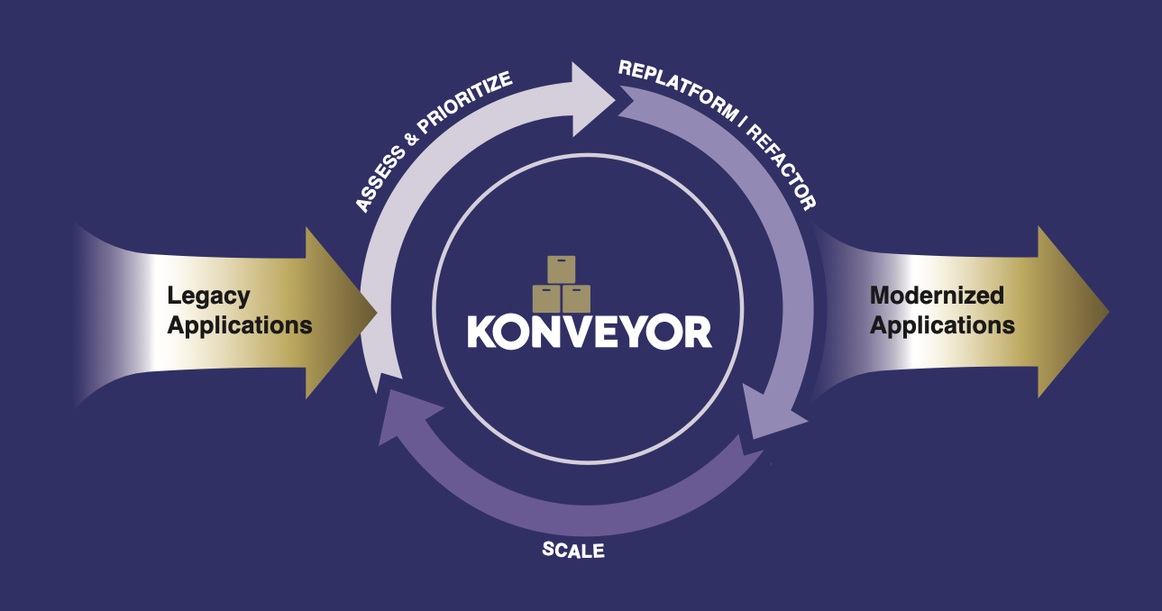
Slide 1: Title
Konveyor Logo

Slide 4
Application Modernisation

Slide 5
From Monolith to Microservices
Mezba Rahman Platform Engineer | CIS Capgemini
Cloud Native Kubernetes Virtual Meetup October 10th, 2025

Slide 6
Slide 2: The Digital Transformation Challenge
graph TB A[Business Demands] --> B[Faster Time to Market] A --> C[Cloud Scalability] A --> D[Cost Optimisation] E[Legacy Reality] --> F[Monolithic Apps] E --> G[Slow Releases] E --> H[High Maintenance] I[The Gap] --> J[Technical Debt] I --> K[Skills Shortage] I --> L[Risk & Complexity]
The Business Reality
Companies need to move fast, but legacy systems hold them back

Slide 7
Slide 3: Legacy Application Landscape
TYPICAL ENTERPRISE (Fortune 500) APPLICATION PORTFOLIO: ├── 2,000+ Applications ├── 70% Built 10+ Years Ago ├── Multiple Technologies └── Critical Business Logic CURRENT CHALLENGES: ├── $2M Annual Maintenance ├── 6-Month Release Cycles ├── Security Vulnerabilities └── Talent Retention Issues
Sound familiar?

Slide 8
Slide 4: Modernisation Business Drivers
Why Modernise Now?
mindmap root((Business Value)) (Cost Reduction) 60% Lower Infrastructure 40% Faster Development (Speed to Market) Weekly vs Monthly Releases Continuous Deployment (Scalability) Auto-scaling Global Distribution (Security) Modern Security Practices Compliance Ready

Slide 9
Slide 5: The Modernisation Spectrum
graph LR A[Rehost<br/>Lift & Shift] --> B[Replatform<br/>Lift & Reshape] B --> C[Refactor<br/>Re-architect] C --> D[Rebuild<br/>Cloud Native] A1[Same Code<br/>New Infrastructure] --> B1[Minor Changes<br/>Cloud Services] B1 --> C1[Major Changes<br/>Microservices] C1 --> D1[Complete Rewrite<br/>Serverless] style A fill:#FFE4B5 style B fill:#ADD8E6 style C fill:#98FB98 style D fill:#FFA07A
Which Path for Your Applications?

Slide 10
Slide 6: The Assessment Problem
Traditional Approach: Manual Analysis
MANUAL ASSESSMENT APPROACH: - Team of 5 Architects - 6 weeks per application - 200+ page documents - $50,000+ per assessment PROBLEMS: ├── Inconsistent Results ├── Human Error Prone ├── Doesn't Scale └── Misses Hidden Dependencies
There has to be a better way…

Slide 11
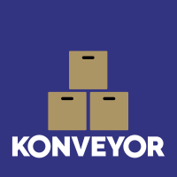
Slide 7: Enter AI-Powered Assessment
Meet Your Modernisation Assistant
graph LR A[Upload Application] --> B[AI Analysis] B --> C[Smart Recommendations] C --> D[Action Plan] B --> B1[Code Scanning] B --> B2[Dependency Analysis] B --> B3[Pattern Recognition] B --> B4[Risk Assessment]
Konveyor: Open-source modernisation platform
Konveyor Avatar

Slide 12
Slide 8: Real-World Modernization Example
Case Study: E-commerce Platform
Before Modernization
MONOLITHIC ARCHITECTURE: ├── Single Java WAR (50GB) ├── Oracle Database ├── Physical Servers └── 6-month Release Cycle BUSINESS IMPACT: ├── $500K/month Infrastructure ├── 2-day Deployment Process ├── Cannot Handle Black Friday └── 5 Critical Outages/Year

Slide 13
Slide 9: Transformation Journey
Step 1: Assessment & Discovery
graph TD A[E-commerce App] --> B[Konveyor Analysis] B --> C[Assessment Report] C --> D[PASS: Suitable for Containers] C --> E[WARN: Database Dependencies] C --> F[INFO: 3rd Party Integrations] C --> G[RESULT: Migration Complexity - Medium]
Result: Clear path forward in 2 hours vs 6 weeks

Slide 14
Slide 10: Architecture Evolution
Before: Monolithic Deployment
┌─────────────────────────────────────┐ │ Physical Server │ ├─────────────────────────────────────┤ │ [APP] E-commerce App (50GB WAR) │ │ ├── User Management │ │ ├── Product Catalog │ │ ├── Shopping Cart │ │ ├── Payment Processing │ │ └── Order Management │ │ │ │ [DB] Oracle Database (On-premise) │ └─────────────────────────────────────┘

Slide 15
Slide 11: Target Architecture
After: Cloud-Native Microservices
┌─────────────────────────────────────────────┐ │ Kubernetes Cluster │ ├─────────────────────────────────────────────┤ │ [SVC] Users [SVC] Products [SVC] Cart │ │ Service Service Service │ │ │ │ [SVC] Payment [SVC] Orders [SVC] Gateway │ │ Service Service Service │ │ │ │ [DB] Managed Database [MON] Monitoring │ │ [SEC] Security │ └─────────────────────────────────────────────┘

Slide 16
Slide 12: Migration Strategy
Incremental Modernization Plan
gantt title E-commerce Modernization Timeline dateFormat YYYY-MM-DD section Phase 1 Assessment & Planning :done, phase1, 2024-01-01, 2w section Phase 2 Containerization :done, phase2, after phase1, 4w section Phase 3 Service Extraction :active, phase3, after phase2, 8w section Phase 4 Cloud Migration :phase4, after phase3, 6w section Phase 5 Optimization :phase5, after phase4, 4w
Total: 6 months (vs 2 years traditional)

Slide 17
Slide 13: Business Impact - Before vs After
Metric | Before | After | Improvement
Deployment | 2 days | 5 minutes | 99.8% faster
Infrastructure | $500K/month | $150K/month | 70% reduction
Scalability | Fixed capacity | Auto-scale | 10x peak handling
Releases | 2 per year | 50+ per year | 25x frequency
Downtime | 5 incidents/year | 0.1 incidents/year | 98% reliability
Transformation Results

Slide 18
Slide 14: Live Demo Preview
What We’ll See Today
graph LR A[Legacy App<br/>Upload] --> B[AI Analysis<br/>2 minutes] B --> C[Modernization<br/>Plan] C --> D[Business<br/>Value]
Demo Application
Type: Java Spring Boot Monolith
Complexity: Medium (typical enterprise app)
Goal: Kubernetes readiness assessment
Let’s see AI-powered modernisation in action!

Slide 19
Slide 15: Demo Results Overview
Assessment Complete
MODERNIZATION READINESS SCORE: 85/100 RECOMMENDED PATH: Containerization → Kubernetes ESTIMATED TIMELINE: 3-4 weeks EXPECTED ROI: 300% in 12 months MIGRATION CONFIDENCE: High RESULT: Ready for Cloud Native Transformation
From assessment to deployment plan in minutes

Slide 20
Slide 16: Key Modernization Patterns
What Makes Applications Cloud-Ready?
graph TD A[Cloud-Ready App] --> B[Stateless Design] A --> C[External Configuration] A --> D[Health Endpoints] A --> E[Observability] B --> B1[No Local Storage] C --> C1[Environment Variables] D --> D1[Liveness/Readiness] E --> E1[Metrics & Logging] style A fill:#90EE90
Modern patterns for resilient applications

Slide 21
Slide 17: Modernization ROI Calculator
Business Value Metrics
graph LR A[Investment] --> B[$200K Modernization] C[Returns Year 1] --> D[$300K Infrastructure Savings] C --> E[$400K Developer Productivity] C --> F[$200K Reduced Downtime] G[Total ROI] --> H[350% Return]
Typical modernisation pays for itself in 6-8 months

Slide 22
Slide 18: Getting Started Journey
Your Modernization Roadmap
graph TD A[Assess Portfolio] --> B[Prioritize Applications] B --> C[Start with Quick Wins] C --> D[Scale Success Patterns] A --> A1[Use AI Assessment Tools] B --> B1[Focus on Business Value] C --> C1[Prove ROI Early] D --> D1[Establish CoE]

Slide 23
Slide 19: Success Factors
What Makes Modernization Successful?
EXECUTIVE SPONSORSHIP └── Clear business objectives CROSS-FUNCTIONAL TEAMS └── DevOps culture adoption RIGHT TOOLS & PLATFORMS └── AI-powered assessment MEASURE EVERYTHING └── ROI tracking & optimisation SKILLS DEVELOPMENT └── Cloud-native expertise

Slide 24
Slide 20: Common Pitfalls to Avoid
Modernization Anti-Patterns
AVOID: Big Bang Approach Solution: Incremental migration
AVOID: Lift & Shift Everything Solution: Assess first, then choose path
AVOID: Ignoring Data Strategy Solution: Database modernisation plan
AVOID: Skipping Observability Solution: Monitoring from day one
AVOID: Forgetting Security Solution: Security by design

Slide 25
Slide 21: Industry Trends & Future
The Modernization Wave
graph TB A[2025 Trends] --> B[AI-Driven Automation] A --> C[Serverless Adoption] A --> D[Edge Computing] A --> E[Green Computing] F[Future State] --> G[Self-Healing Systems] F --> H[Zero-Touch Operations] F --> I[Autonomous Scaling]
Organizations that modernize today lead tomorrow

Slide 26
Slide 22: Your Next Steps
Ready to Start Your Modernization Journey?
Immediate Actions:
Inventory Your Applications - What do you have?
Assess Modernization Readiness - What’s possible?
Prioritize by Business Value - What matters most?
Start Small & Learn - Quick wins build momentum
Tools to Help:
Konveyor for AI-powered assessment
Business case templates
Community best practices

Slide 27
Slide 23: Q&A & Discussion

Slide 28
Q&A - Your Modernization Challenges

Slide 29
Common Questions:
How to build the business case?
Which applications to modernize first?
How to handle legacy dependencies?
What about data migration strategies?
Share your modernisation experiences!

Slide 30
Slide 24: Thank You & Connect
Konveyor Logo

Slide 31
Start Your Modernization Journey Today

Slide 32

Connect & Learn More
Mezba Rahman Platform Engineer | CIS Capgemini 📧 mezba.rahman@capgemini.com
Connect & Follow
🔗 LinkedIn: linkedin.com/in/mezba 📝 Technical Blog: medium.com/@mezba 💼 Expertise: Platform Engineering, App Modernisation, Cloud-Native Architecture
Resources
Konveyor Project: https://konveyor.io Modernisation Guides: https://konveyor.io/docs This Demo: github.com/my-janala/app-modernisation-demo
CNCF Sandbox

Slide 33
CNCF Sandbox Project

Slide 34
Backup Slide 25: Technology Deep Dive
How AI Assessment Works
graph TB A[Application Code] --> B[Static Analysis] B --> C[Pattern Recognition] C --> D[ML Models] D --> E[Recommendations] F[Knowledge Base] --> G[Best Practices] G --> D H[Industry Data] --> I[Benchmarks] I --> D

Slide 35
Backup Slide 26: Modernization Checklist
Pre-Migration Assessment
COMPLETE: Application Inventory Complete COMPLETE: Dependencies Mapped COMPLETE: Business Value Prioritized COMPLETE: Team Skills Assessed COMPLETE: Target Architecture Defined COMPLETE: Success Metrics Established COMPLETE: Risk Mitigation Planned

Slide 36
Backup Slide 27: ROI Model Details
Detailed Cost-Benefit Analysis
Investment:
Assessment & Planning: $50K
Development & Migration: $200K
Training & Change Management: $75K
Total: $325K
Annual Benefits:
Infrastructure Cost Reduction: $400K
Development Productivity: $300K
Operational Efficiency: $200K
Total Annual: $900K
Payback Period: 4.3 months

